Slide 1
Making Maintenance Safer, Smarter, and More Productive

Slide 2

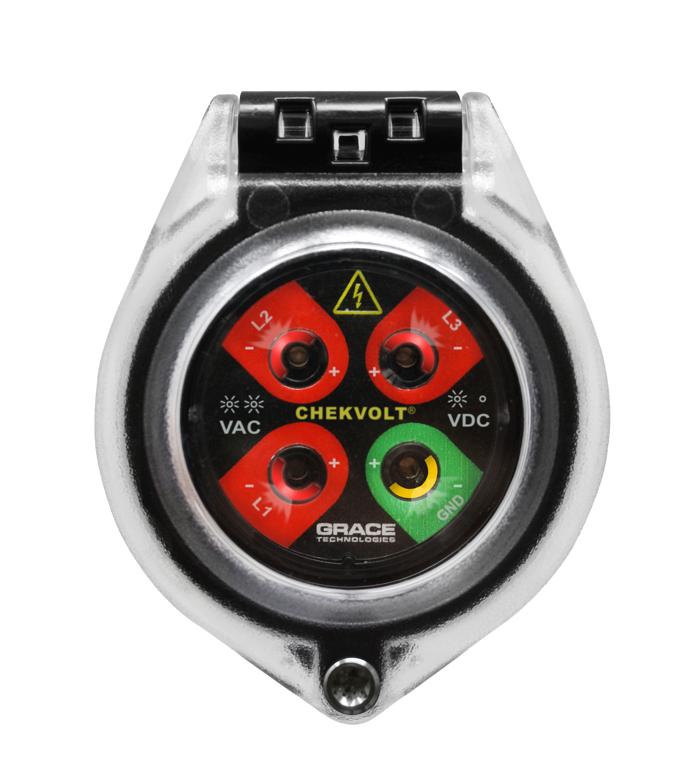
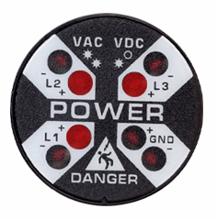
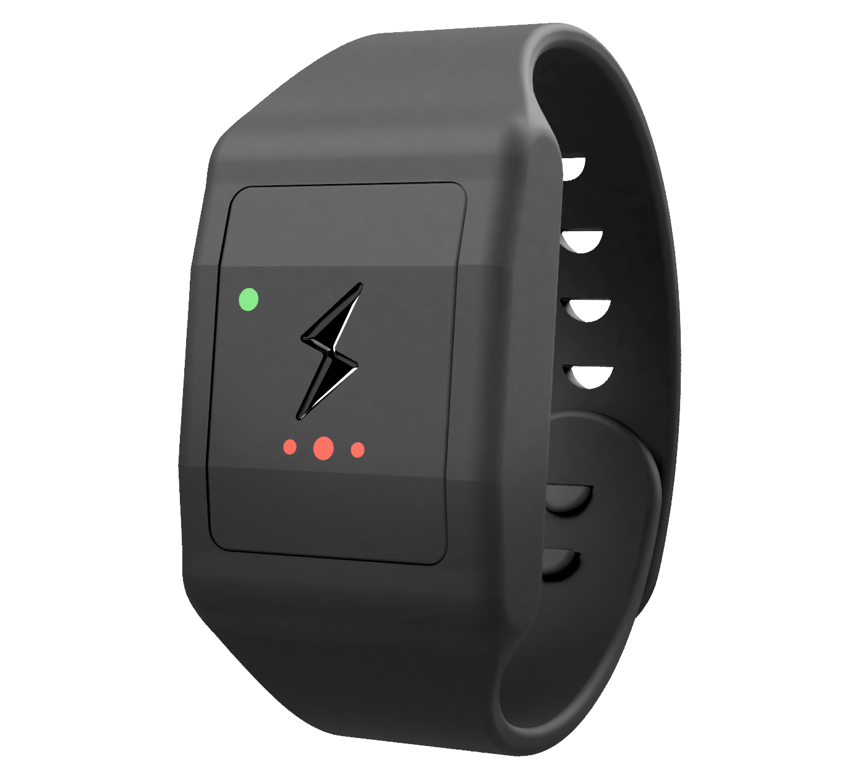
What Are Workers
Saying About Risk?
Elimination
Lack of confidence in the electrical diagrams provided
Lack of confidence in those performing LOTO
Previous experience with mistakes made by themselves or others
Substitution
ChekVolt
Engineering Controls
Voltage Indicator
Awareness
Grace realizes PESDs can’t be in every location, although we wish they could.
Proxxi Band adds an extra layer of protection when the unexpected happens
Administrative
Controls
PPE
Proxxi Band

Slide 3
Synergy of LOTO, PESDs, and Proxxi Band
Enhance LOTO procedures by verifying voltage absence with PESDs and monitoring voltage presence with the Proxxi Band.
Isolate:
LOTO
Enhanced Verification: PESDs
Enhanced Monitoring:
Proxxi Band
Purpose: Physically isolate energy sources to prevent accidental energization.
Purpose: Verify absence of voltage using PESDs at the point of work.
Purpose: Provide real-time alerts if energized equipment is approached or unexpected voltage is detected.
Benefit: Ensures equipment remains de-energized during maintenance and repair
Benefit: Safely verify de-energization without exposure to live parts.
Benefit: Continuous monitoring for unforeseen electrical hazards during work activities.
Integrating these three steps creates a layered safety protocol that enhances worker protection and compliance with OSHA, NFPA 70E, and CSA Z462 safety standards.

Slide 4
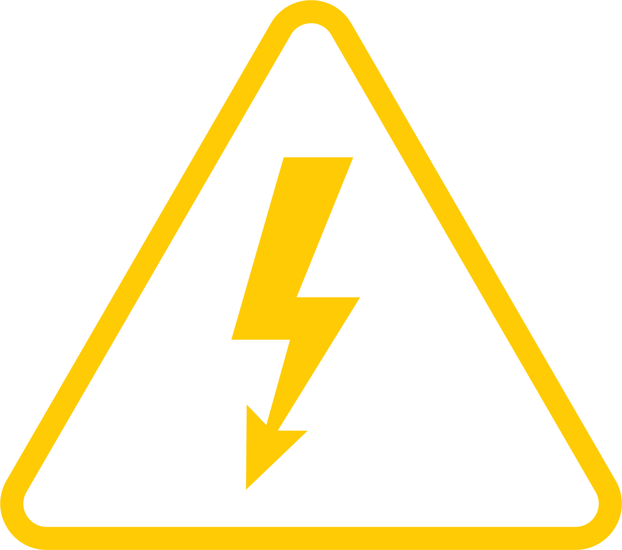
Human Error
is the
#3
Cause of
Workplace Death
95%
Of near misses are unreported
Over 80%
Of workers confirmed that they had been shocked on the job
The cost of these preventable incidents can cost
^{$50,000 - $10 Million+}

Slide 5
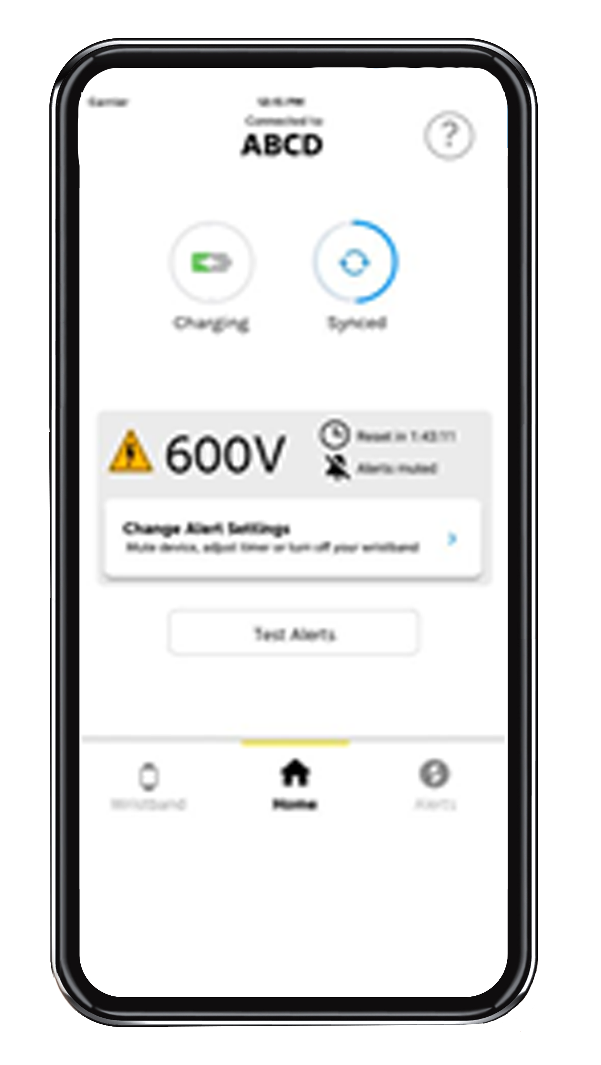

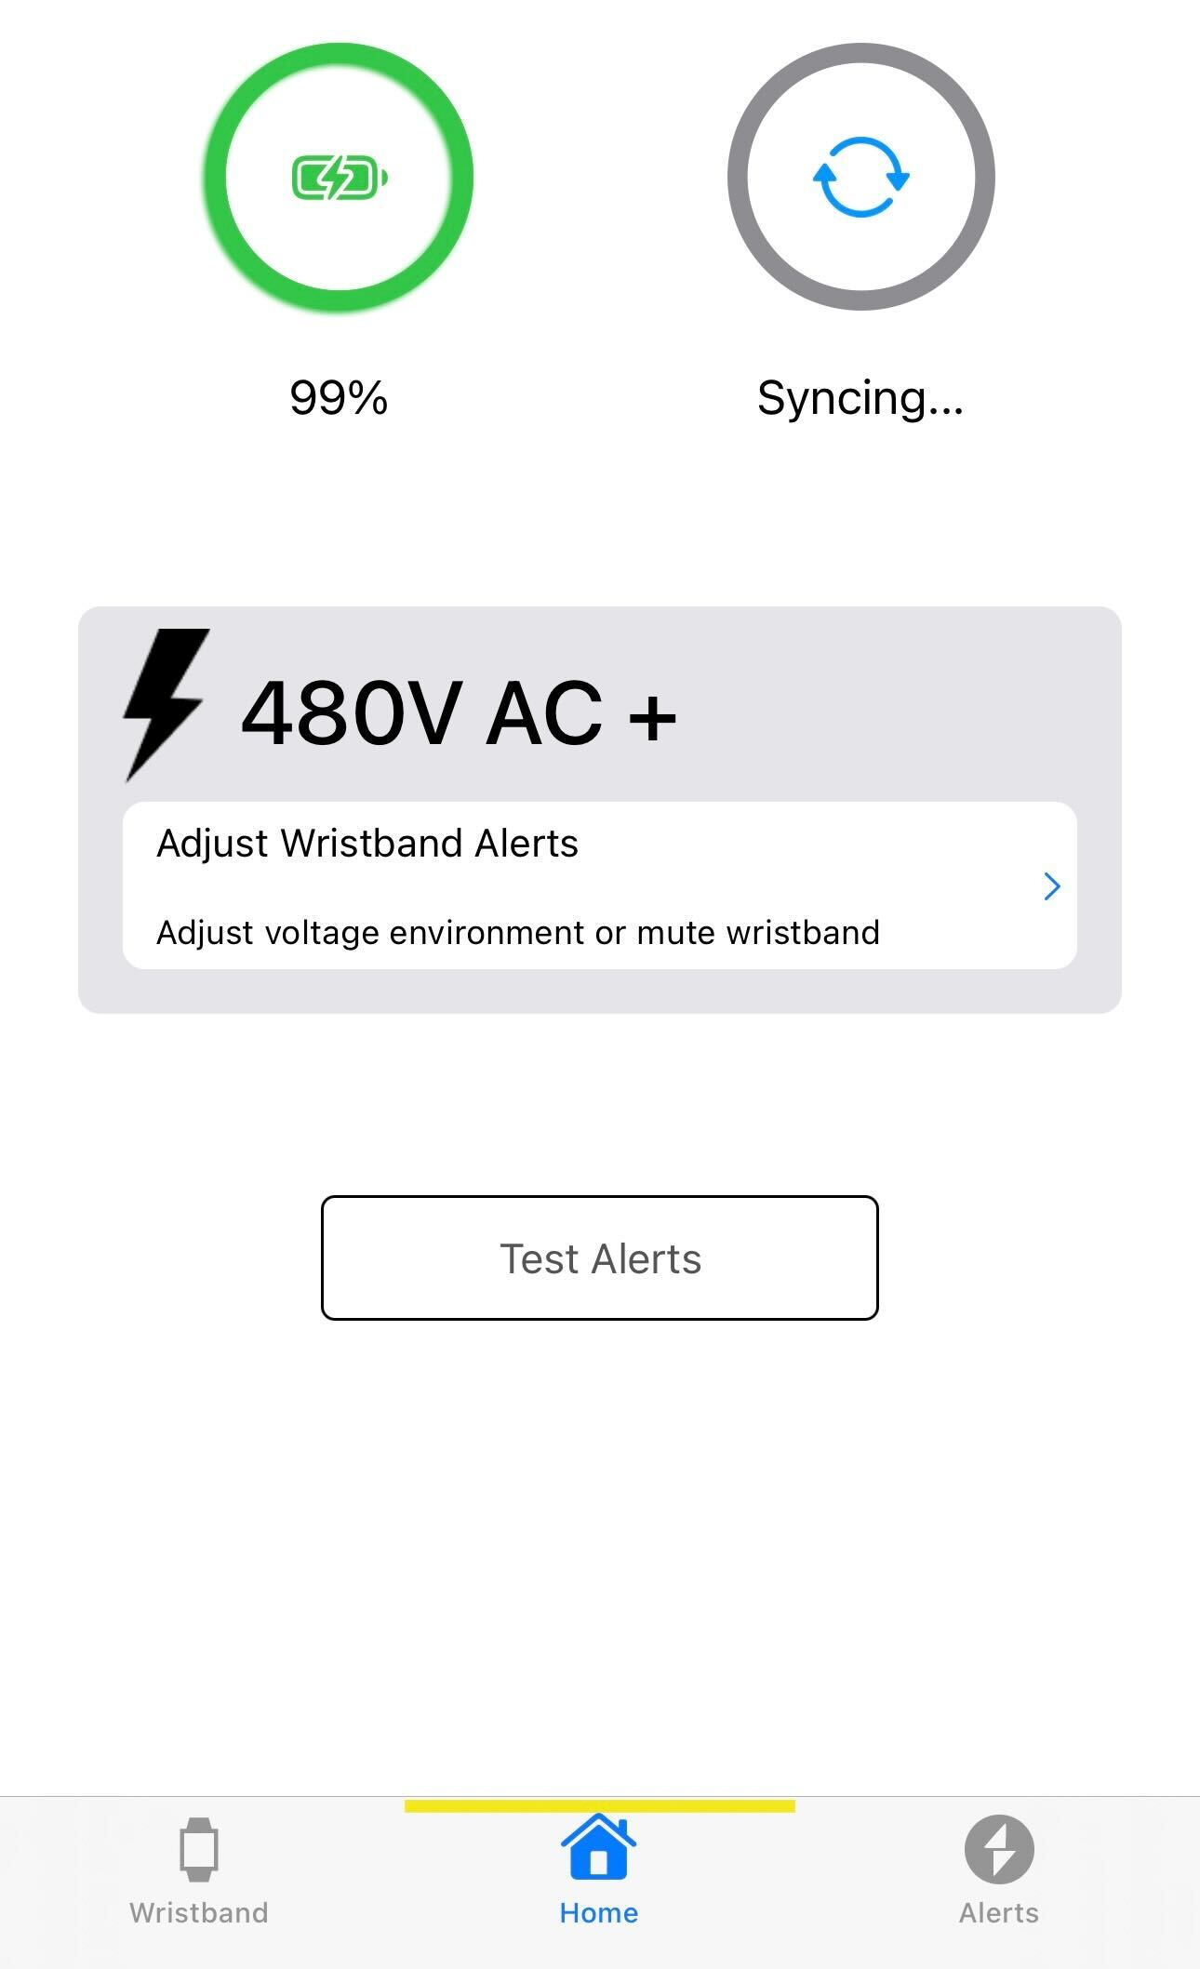

Proxxi by Grace - An Added Layer of Safety
Multi-Voltage: Enable users to calibrate warnings on the fly from 480V – 500kV
Non-Conductive Material
Mute: Silence alarms when workers acknowledge they are working energized
Compatibility:
iOS & Android Capable

Slide 6
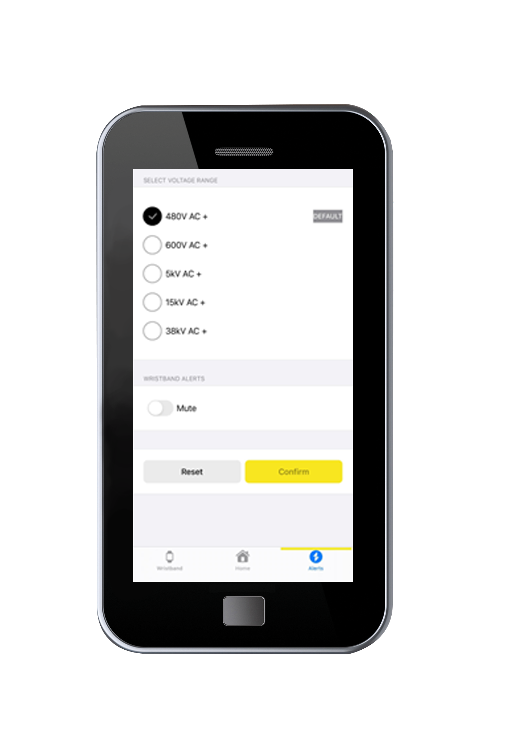
Proxxi by Grace - How it Works
How Alerts Work: The band senses electric field strength—not actual voltage or distance. Settings adjust the field strength needed to trigger an alert. Higher voltages alert from farther away; lower voltages require closer proximity.
Default Setting: By default, the band’s 480V setting triggers alerts at distances equivalent to 480V field strength—18 in for the initial alert, 12 in for the high alert.
    Adjustable Sensitivity: Voltage sensitivity can be changed in the app. Each setting adjusts the alert threshold to match the voltage level of the equipment being worked on.

Slide 7
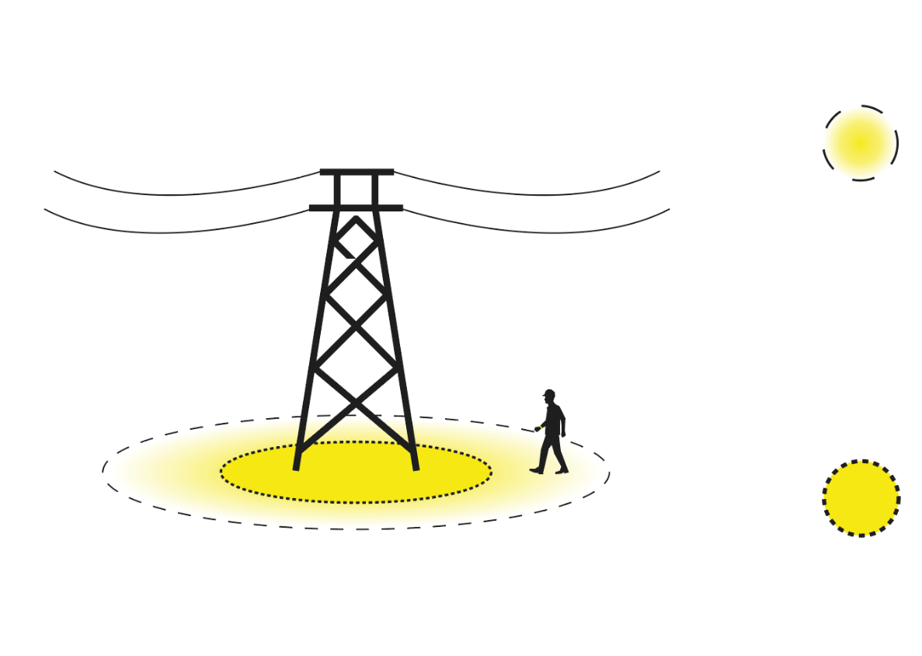
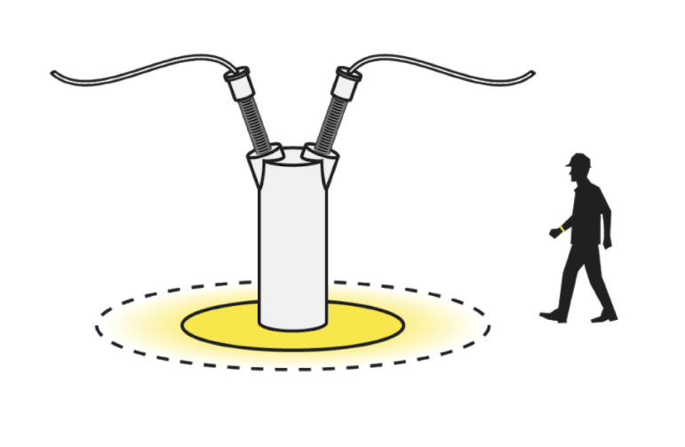

Proxxi by Grace - How it Works
Initial Alert: Voltage will alert as you enter the initial alert zone.
The alert consists of haptic feedback (vibrations) well as audible and visual alerts.
These alerts increase in frequency as you near the limits of approach
High Alert: Once the limit of approach has been breached, the alert because persistent, indicating a potential near miss.

Slide 8
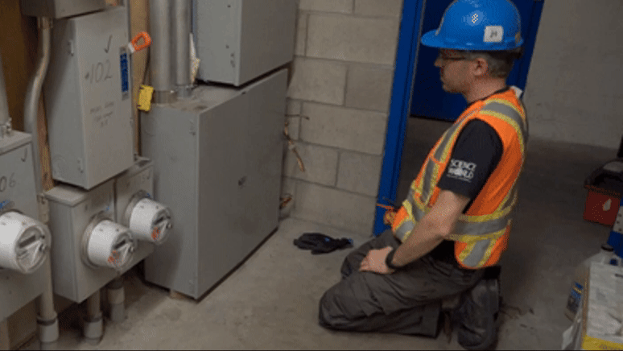

Slide 9
Proxxi by Grace - Use Cases
Recommended Use:
Use the wristband on the default or other environment setting for:
Any environment where the equipment should be de-energized, or is presumed to be electrically safe
When intending to stay outside of the restricted approach boundary of live equipment
Non-Recommended Use:
Mute, power down, put on charge, or do not wear the wristband for:
Live work and Live testing
DC equipment
When not performing work (home, office, breaks, commuting)
Notes:
This was true both when they LOTO themselves and when it was performed by someone else
When they have seen mistakes made, the causes have been:
Network modification (22%)
Human error (22%)
Electrical diagram error (22%)
Identification error (33%)

Slide 10
Tailor Settings to Customer Usage
We can customize the following with the customer:
Create custom voltage sensitivity settings for different use cases
Rename the voltage sensitivity settings on the app
Adjust default settings
Add/Remove settings entirely

Slide 11

Proxxi Dashboard - Data Analytics & Insights
Identify precursor incidents
Track usage and drive compliance
See interactions with energized equipment

Slide 12
Proxxi Dashboard - What Does the Wristband Record?
What is recorded:
Assignment status and assignee
Sync status
Firmware version
Charge and use information
Setting and mute information
Alert and voltage sensing information
What is not recorded:
GPS/location data
Health metrics (ex. heart rate)
Step count
Context (ex: whether an alert was a near miss or a known source)

Slide 13
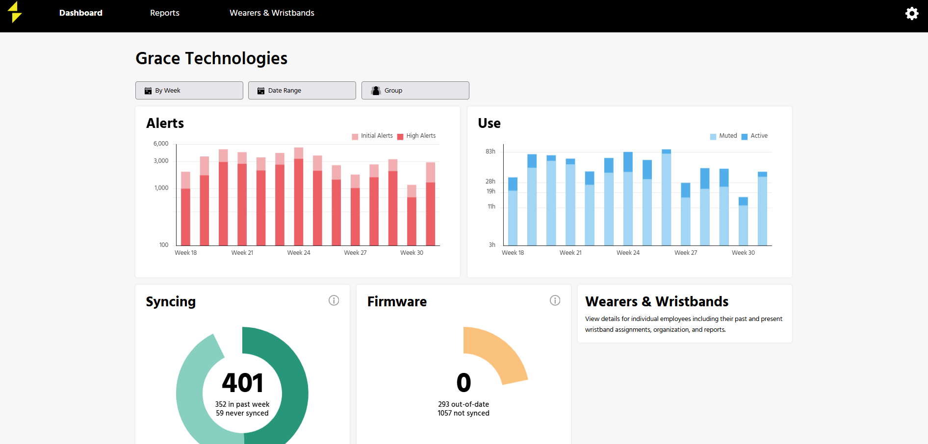
Notes:
This was true both when they LOTO themselves and when it was performed by someone else
When they have seen mistakes made, the causes have been:
Network modification (22%)
Human error (22%)
Electrical diagram error (22%)
Identification error (33%)

Slide 14




Proxxi Dashboard - Key Benefits
Uncover Hidden
Near Misses
Alert data captures instances where workers come dangerously close to energized equipment—providing critical insights into near misses that often go unnoticed. Use this to proactively mitigate risks and refine safety training.
Identify High-Risk Environments
and Behaviors
Analyze patterns in alerts to uncover high-risk locations, tasks, or individuals. This enables you to take focused, data-driven steps to reduce exposure and improve procedures.
Drive Safety Compliance and Accountability
Usage reports offer visibility into how the bands are configured and used—including voltage settings and mute status—supporting regulatory compliance, identifying training gaps, and reinforcing accountability.
Customize
Your Insights
Tailor notifications to your specific safety priorities. Whether tracking frequent alerts, monitoring usage behavior, or focusing on critical voltage thresholds, the platform delivers insights aligned to your goals.
Notes:
Have Brooke

Slide 15
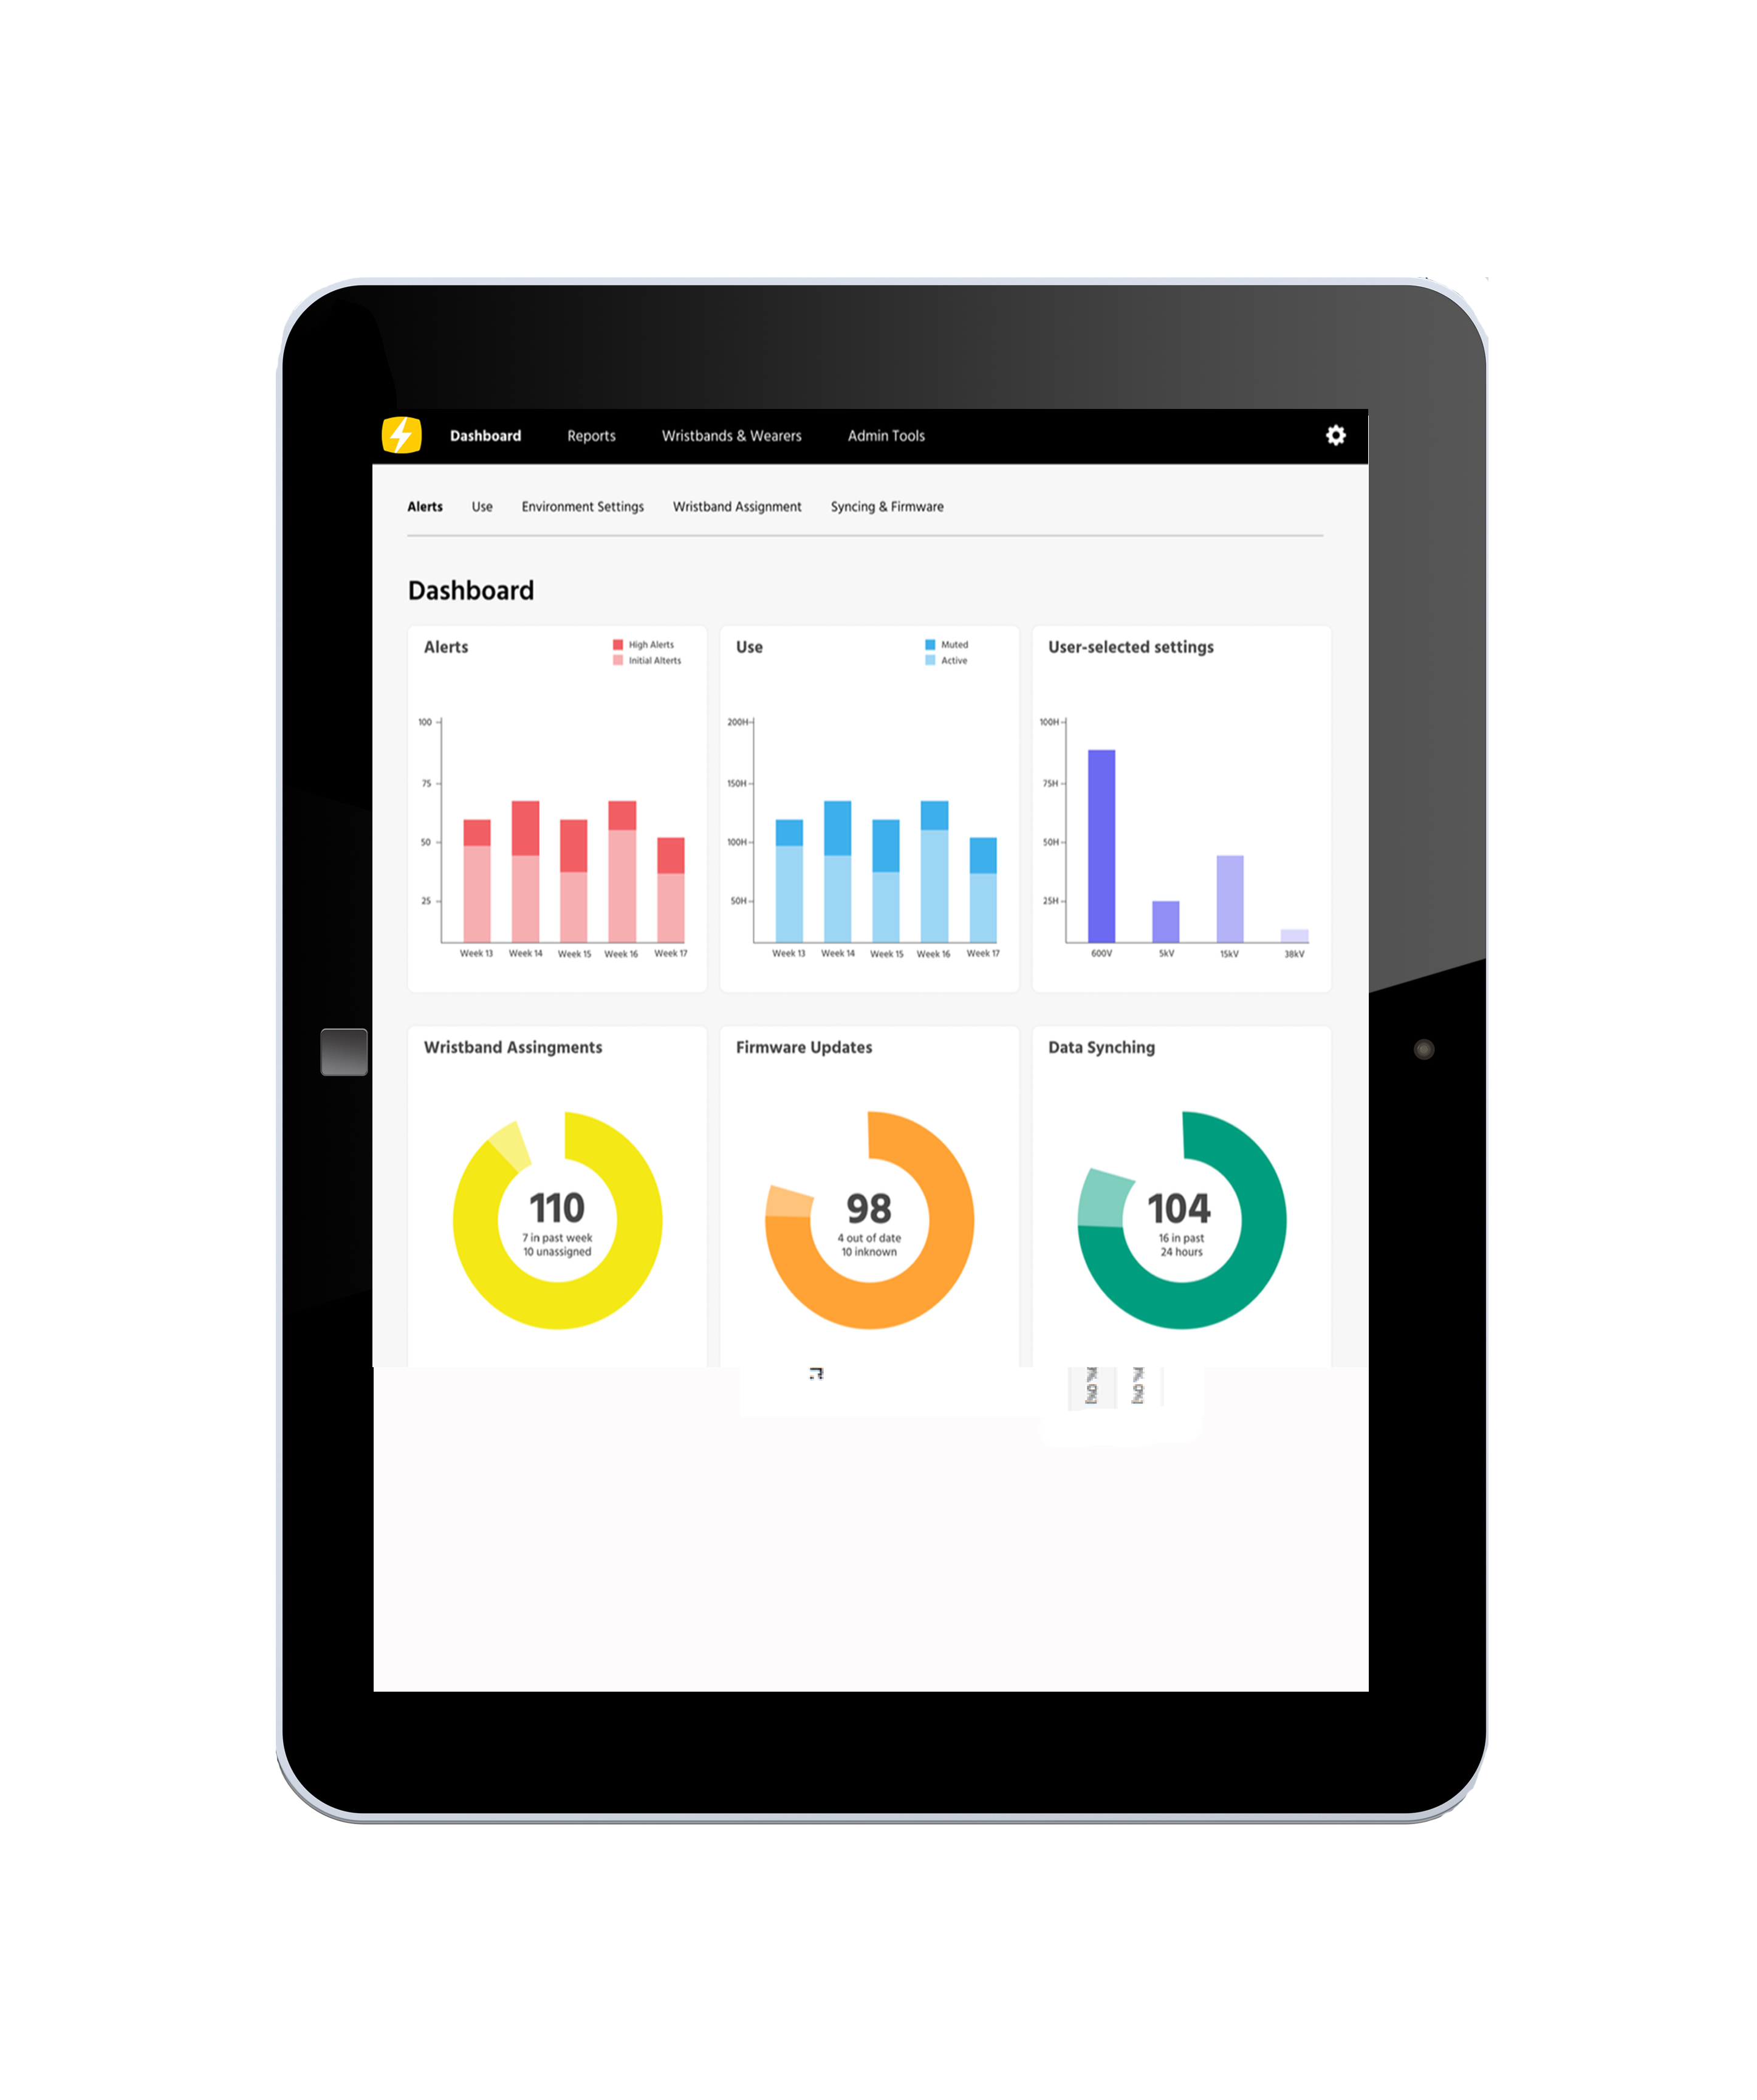
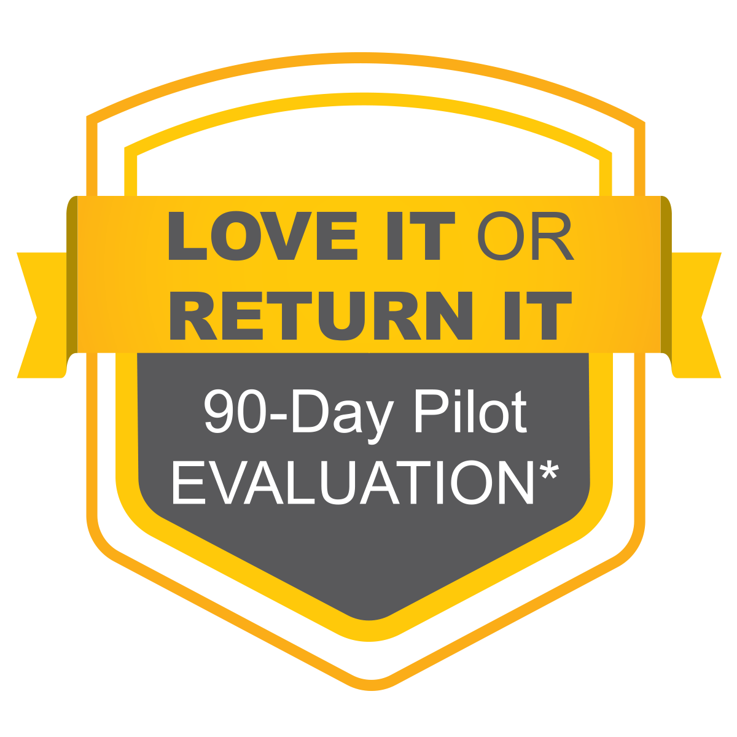
Proxxi by Grace Pilot Program
What’s Included in the Pilot? (Part No. W-PRX-PLT6)
6 Proxxi Wristbands
White Glove Onboarding
Dashboard Access
Try It On Your Terms: Test Proxxi in your environment before a full rollout.
Spot Safety Gaps Sooner: Use dashboard insights to flag exposure trends and training needs.
Easy, Expert Onboarding: Setup and training with four weeks of included support.
Add a Smart Layer of Protection: Real-time alerts add a critical layer to your safety program.
^{*Return for full hardware}
refund ($2,500); does not include setup and service fees.

Slide 16
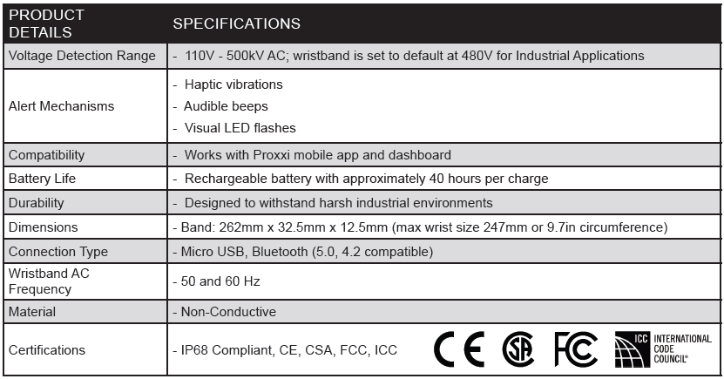
Proxxi by Grace - Specifications

Slide 17





Trusted By:
Notes:
Add Shermco to this slide

Slide 18

Making Maintenance Safer, Smarter, and More Productive

