Slide 1
Distributor Advisory Council Members

Slide 2
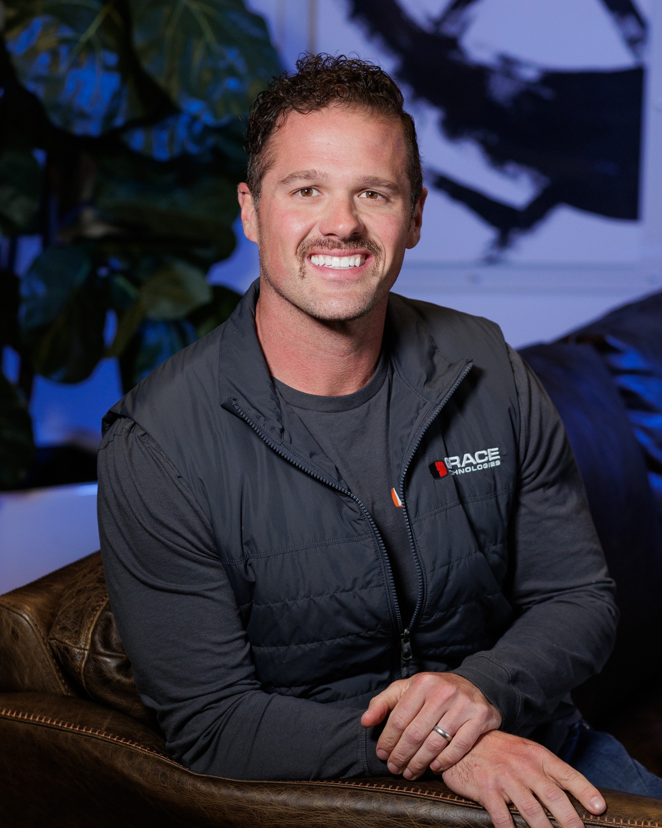
Grace Technologies’ Representatives
Drew Allen, CEO
Contact Info:
Email: drewa@gracetechnologies.com
Phone: 563.650.4051
LinkedIn

Slide 3
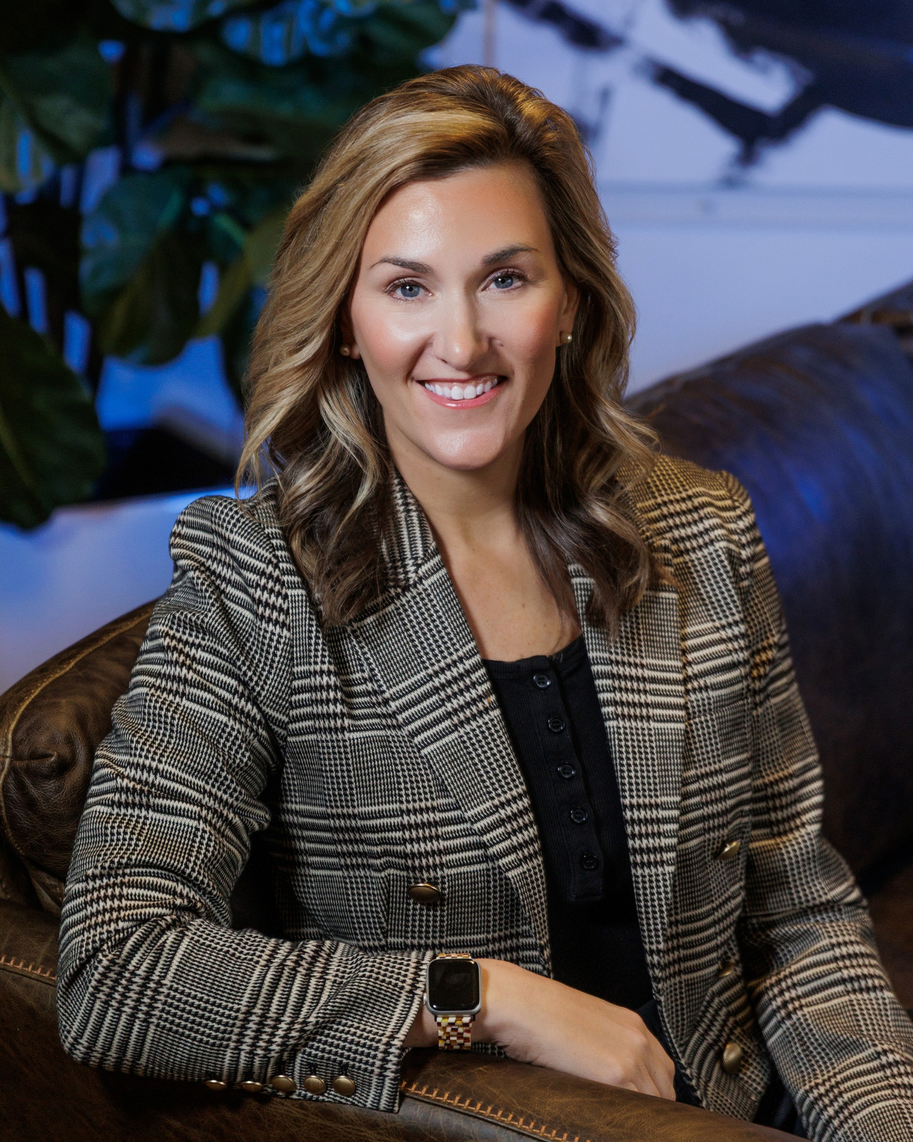
Grace Technologies’ Representatives
Shannon Whiting, Senior Channel Manager
Contact Info:
Email: ShannonE@gracetechnologies.com
Phone: 563.210.2705
LinkedIn

Slide 4
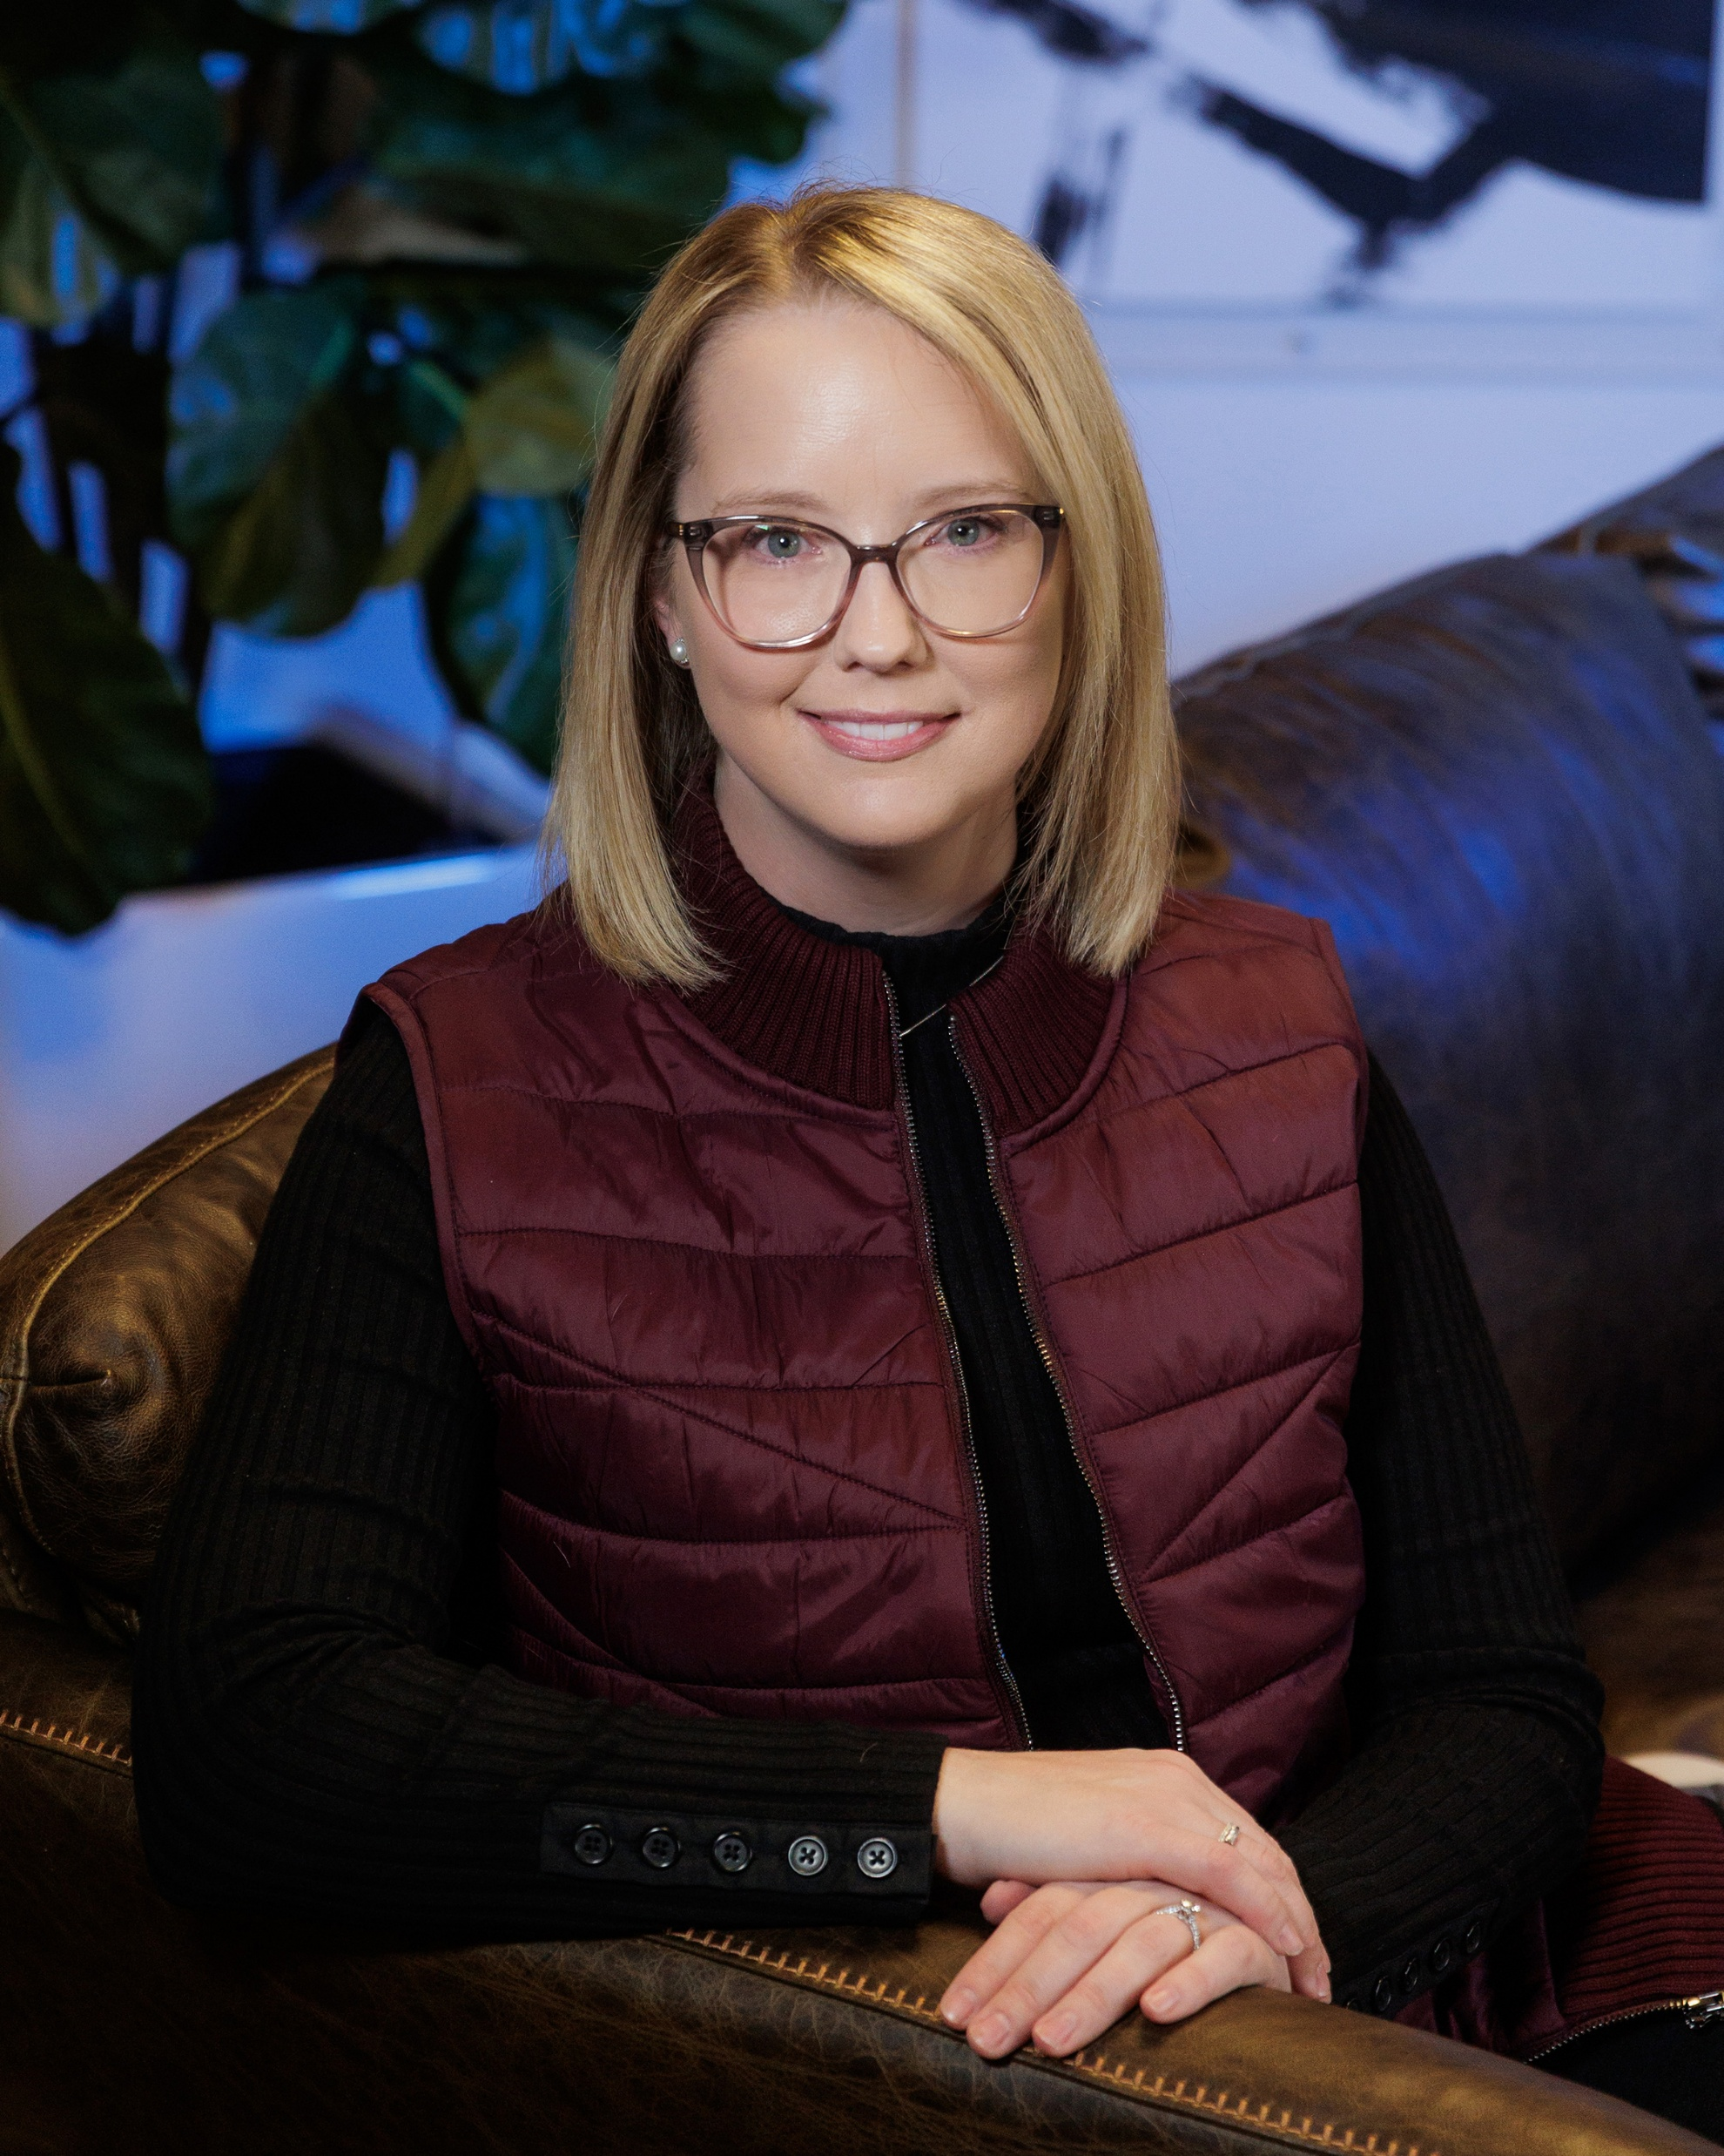
Grace Technologies’ Representatives
Emma Wentzel, Channel Marketing Coordinator
Contact Info:
Email: Emma@gracetechnologies.com
Phone: 563.844.8310
LinkedIn

Slide 5
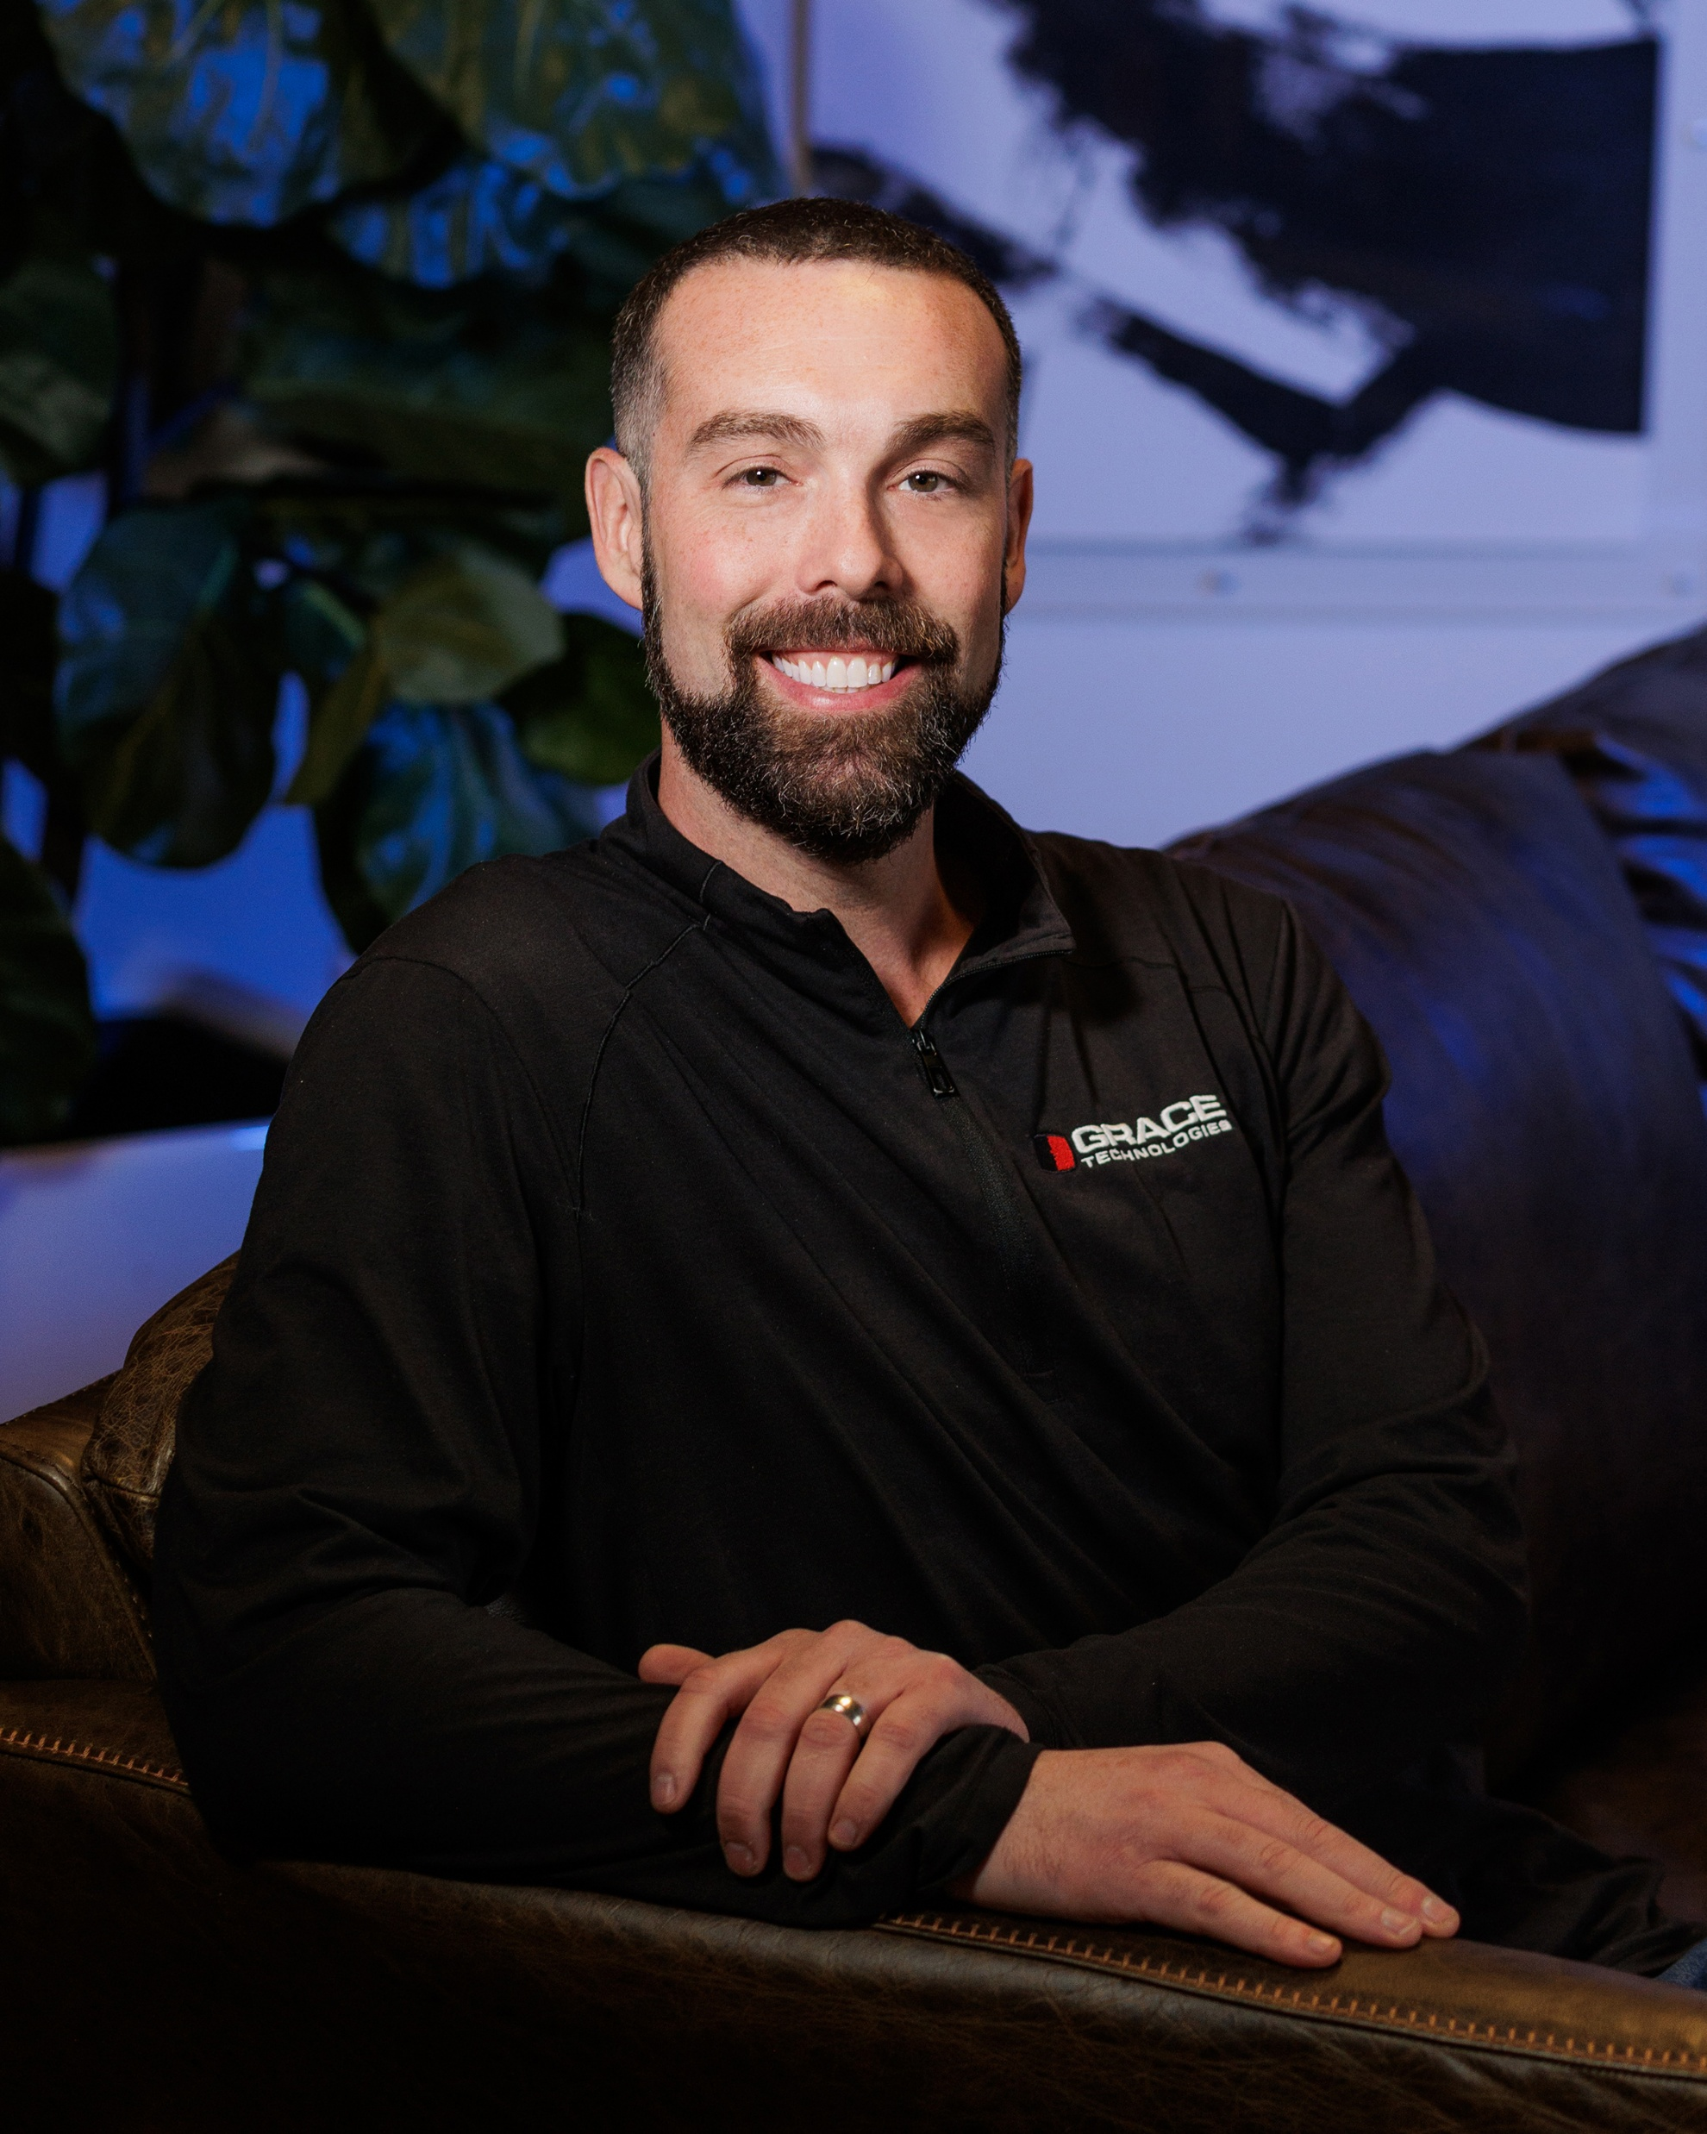
Grace Technologies’ Representatives
Chris Schneck, Director of Sales
Contact Info:
Email: ChrisS@gracetecnologies.com
Phone: 563.823.5534
LinkedIn

Slide 6
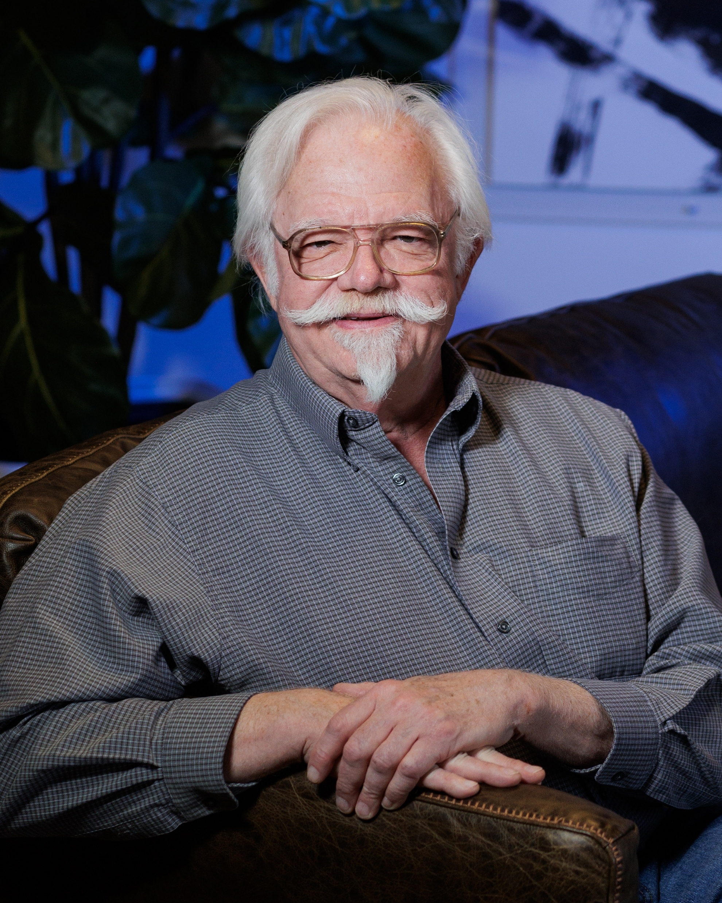
Grace Technologies’ Representatives
Frank Hurtte, Consultant
Contact Info:
Email: frank@riverheightsconsulting.com
LinkedIn

Slide 7
Rockwell Council Members
Chris Gerber, Smart Devices Manager, Van Meter
Robert Werkman, Industrial Solutions and Service Manager, Rexel
Jeff Jones, Automation Group Manager, McNaughton-McKay Electric Company
Tony Monday, Product Manager – Enclosures, Werner
Ahmad Khosti, Sales & Account Management Director, Border States
Dan Goulet, Director of Marketing, Rexel
Dean Bickerton, Account Manager, Reynolds Company
Ray Archer, VP Industrial Sales & Solutions, Crawford Electric Supply

Slide 8
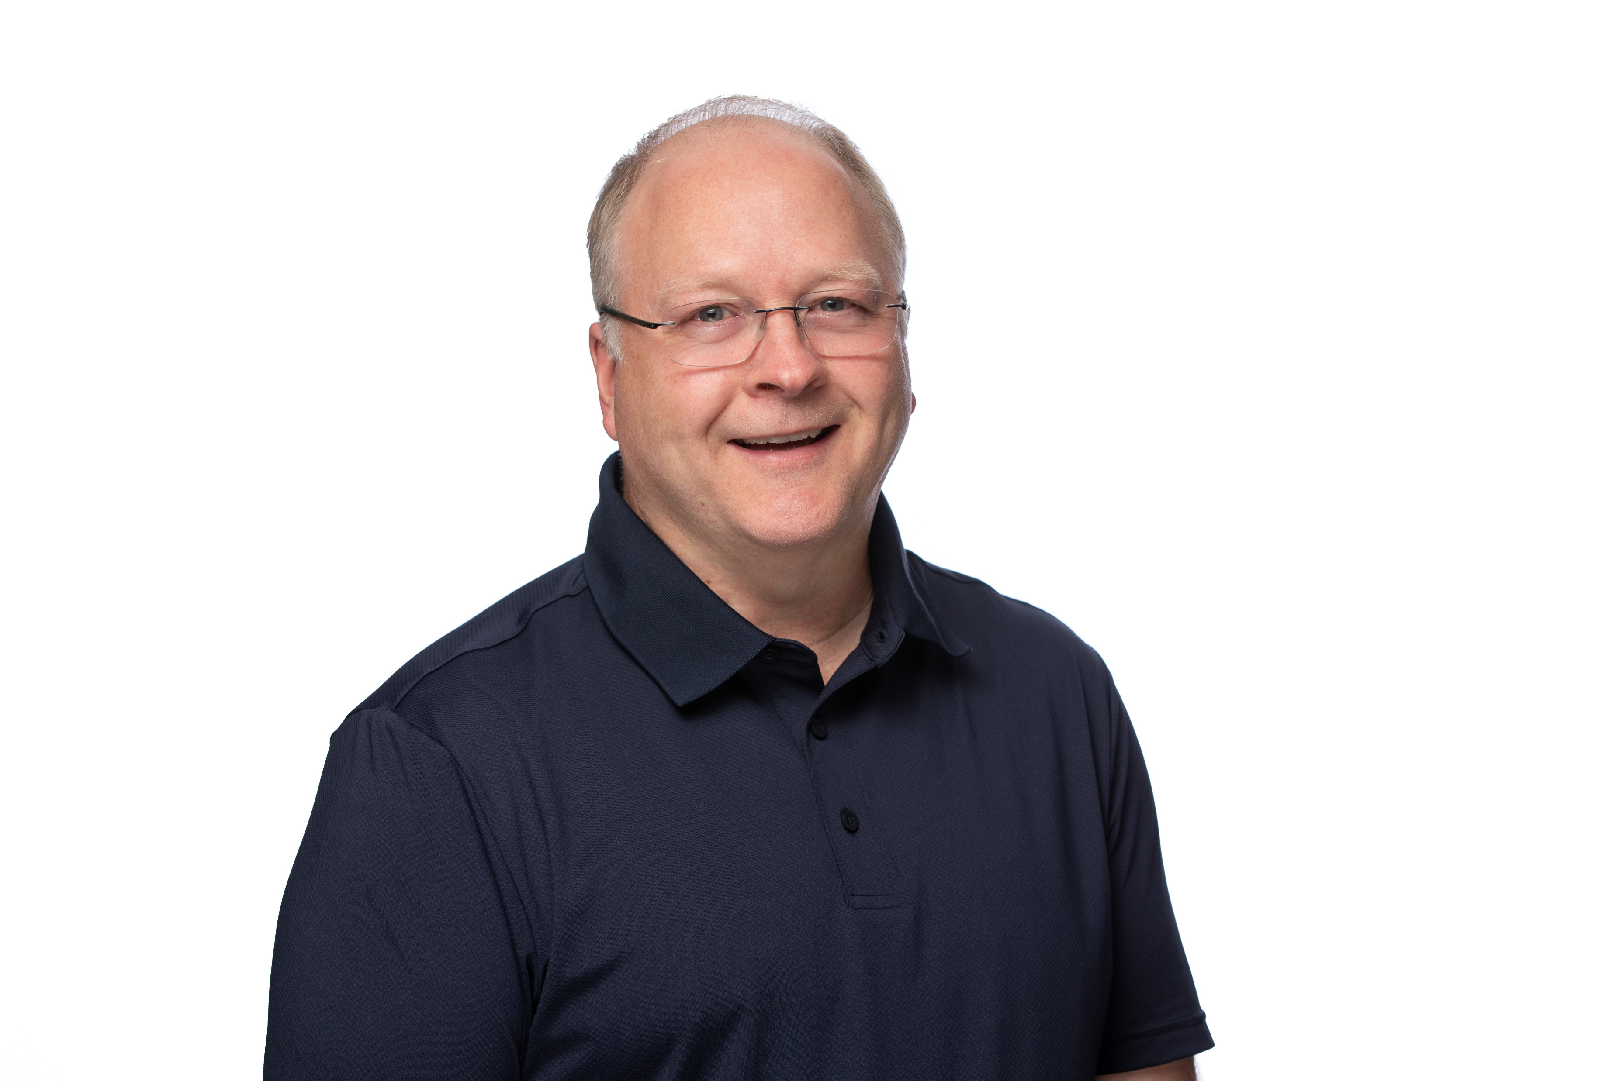
Chris Gerber, Smart Devices Manager, Van Meter
Rockwell Council Member
Contact Info:
Email: cgerber@vanmeterinc.com
Phone: 507.273.8171
LinkedIn
Personal Intro:
Over 41 years in Industry. 23 years in Automation at several large corporations, supported automated production lines worldwide. 18 years in distribution at Van Meter.
Married to my high-school sweetheart for over 40 years. 3 children (Kayla, Fisheries Biologist for the State of Kentucky; Kristine, Biology/Medical Device Testing; Mitchell, Software Engineer). Each married, 5 grandchildren and counting.
Just completed building out a campervan, hitting the backroads of America
I lead the Smart Devices team covering Iowa, Minnesota, and western Wisconsin. We support and grow the Industrial Controls business at Van Meter.
As part of the council, I hope to build relationships with the Grace team, connect with fellow leaders in the industry, and provide input to help learn and grow in our markets.

Slide 9
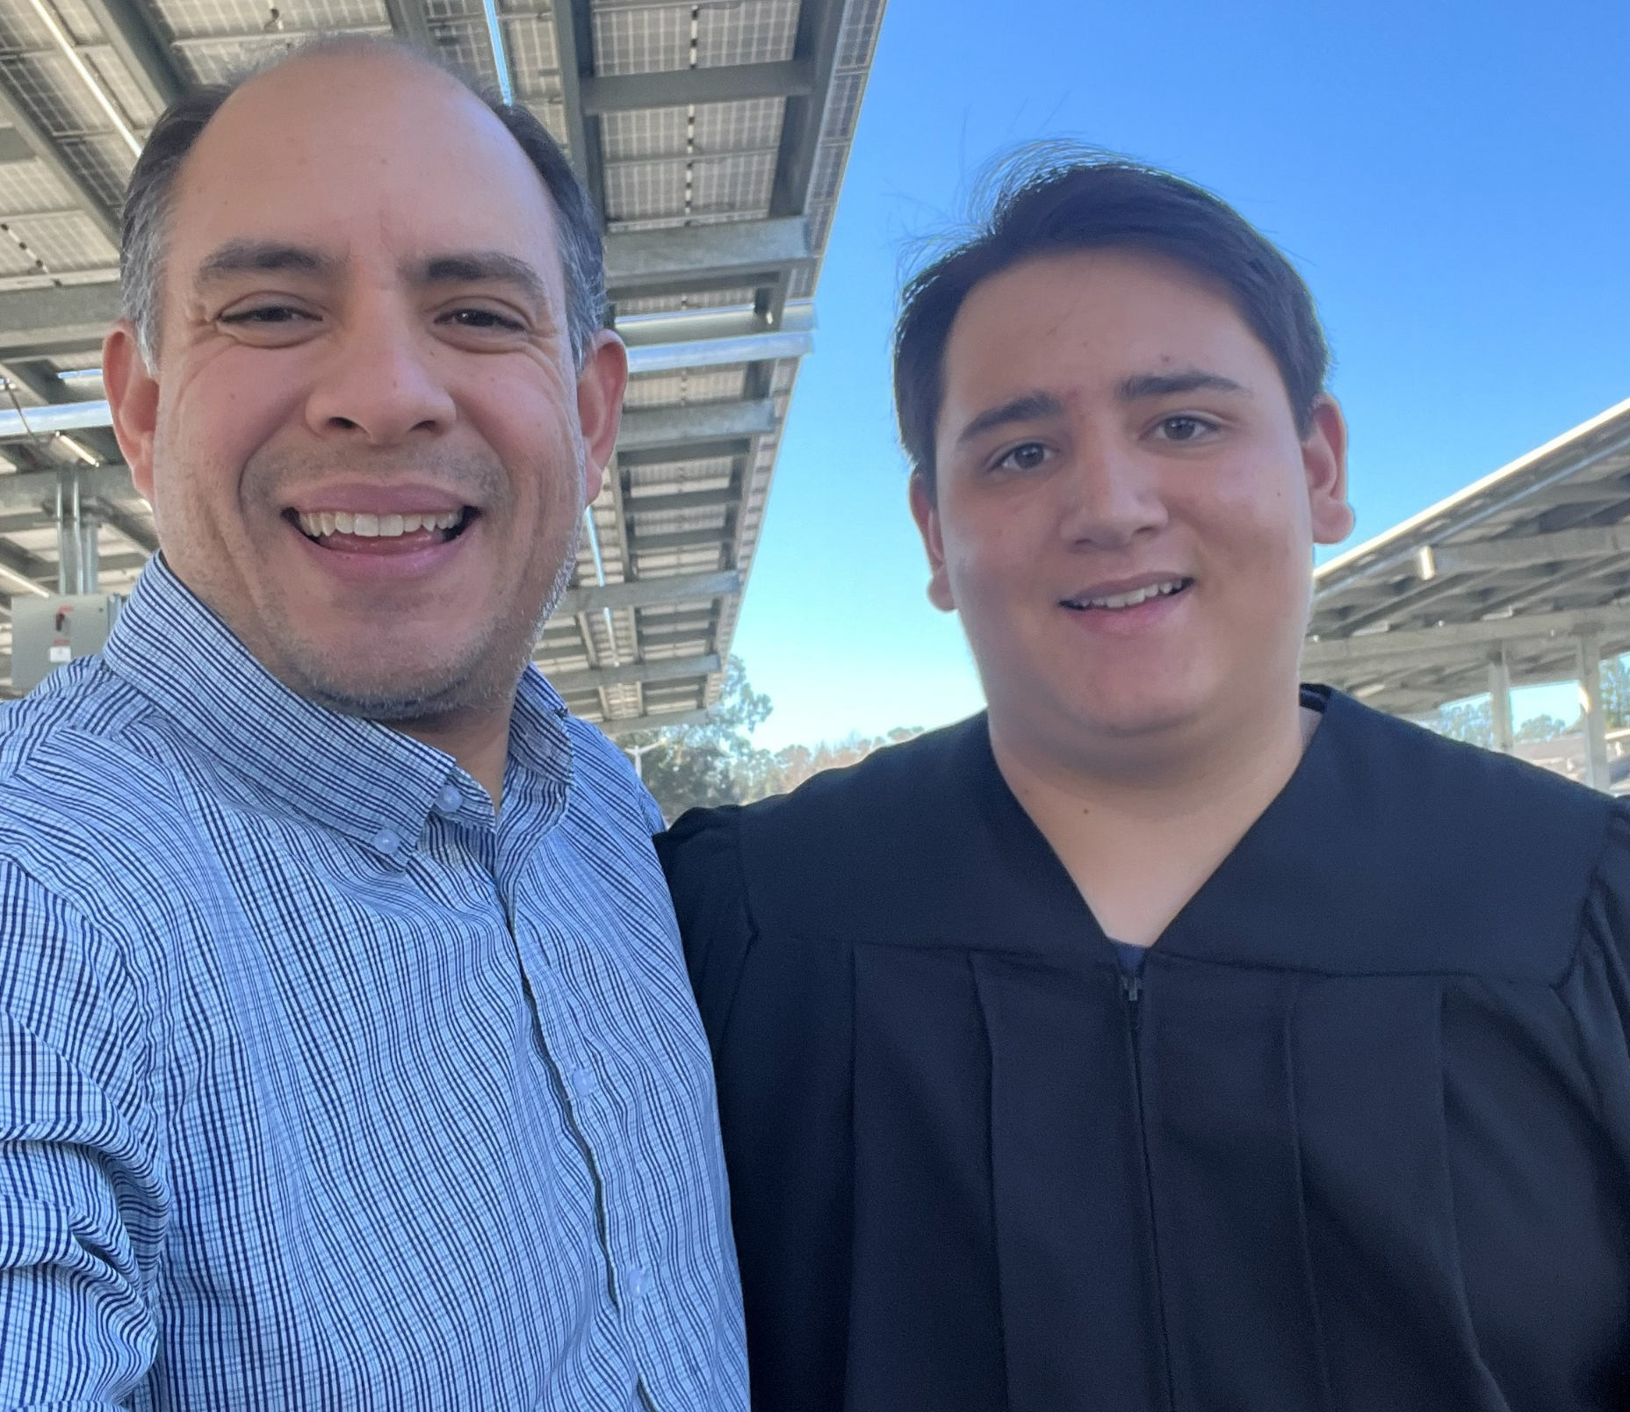

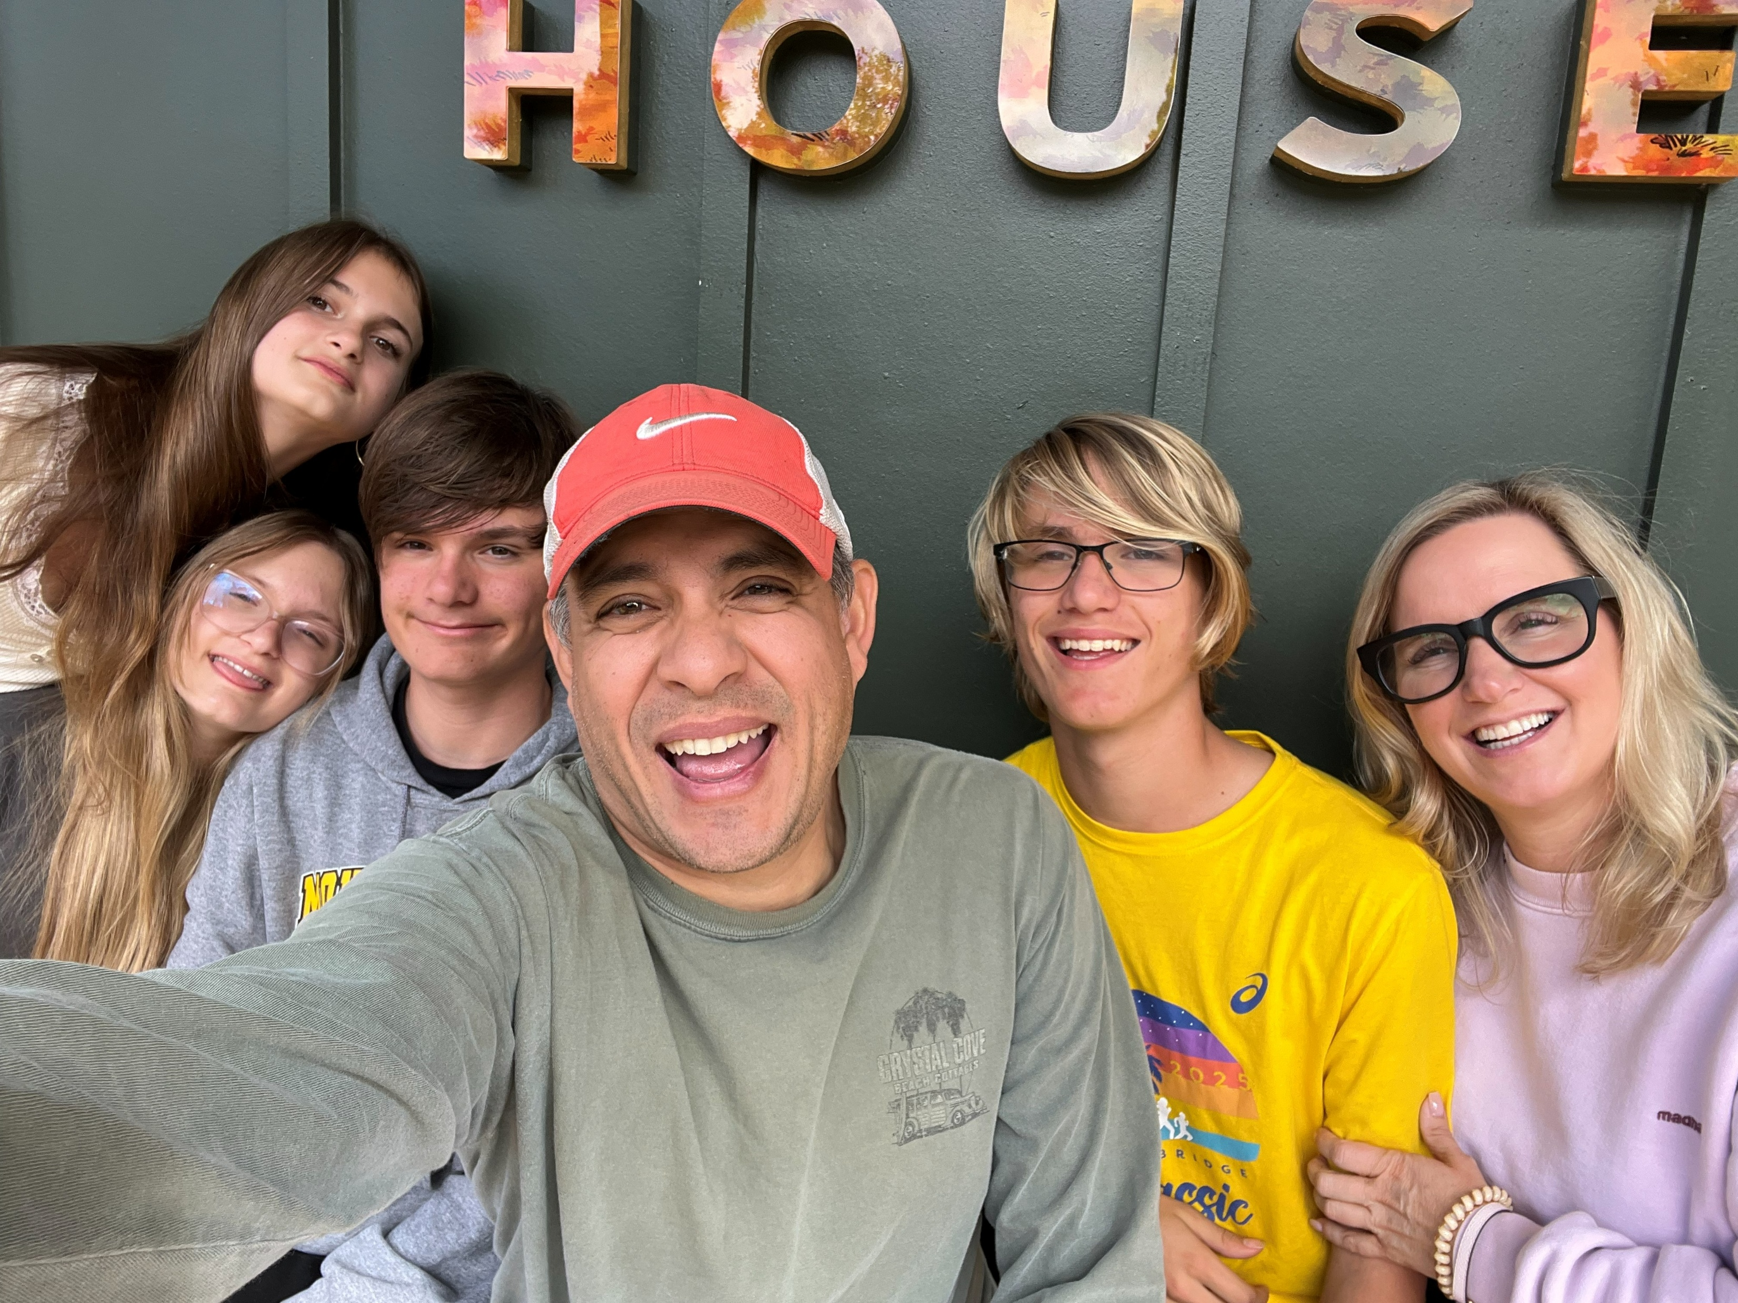
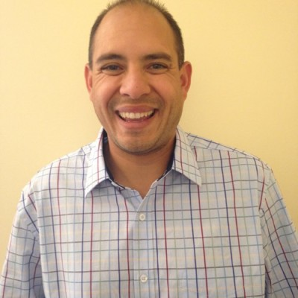

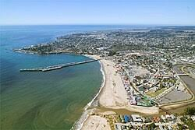


Robert Werkman
Industrial Solutions and Service Manager-Northern CA
Email: robert.werkman@rexelusa.com
Phone: 408.690.8658
LinkedIn
Personal and Fun Stuff
One son, 17 years old
Girlfriend with 4 kids (triplets at 16, one at 14)
Love to travel
Adult Cub/Boy Scout leader since my son was 5
Love the LA Dodgers, Sacramento Kings and Cincinnati Bengals (I know, really strange mix of teams)
Fun fact: Have summited continental US’s highest summit, Mt. Whitney, in a day (up and down)
Live in Santa Cruz, CA (fun beach town)
What I’d like to get out of the council
Continue to build network with the Grace team and DAC
Help Grace build mindshare through unique solutions
Identify where adjacent Services’ opportunities can be paired with Grace products
Career and Boring Stuff
25+ Years in Industrial Automation Sales
  Current Role with Rexel to promote and manage Services’ sales and the Services’ delivery team (2023-)
  Current Role as Lecturer in Industrial Automation, San Jose St University, College of Engineering (2015-)
  Buckles-Smith Electric (VP of Automation, Industrial Sales Manager, Motion Control Business Development) (2000-2023)
  MBA, San Jose St
  BS, Mechanical Engineering, Cal Poly, San Luis Obispo
9

Slide 10
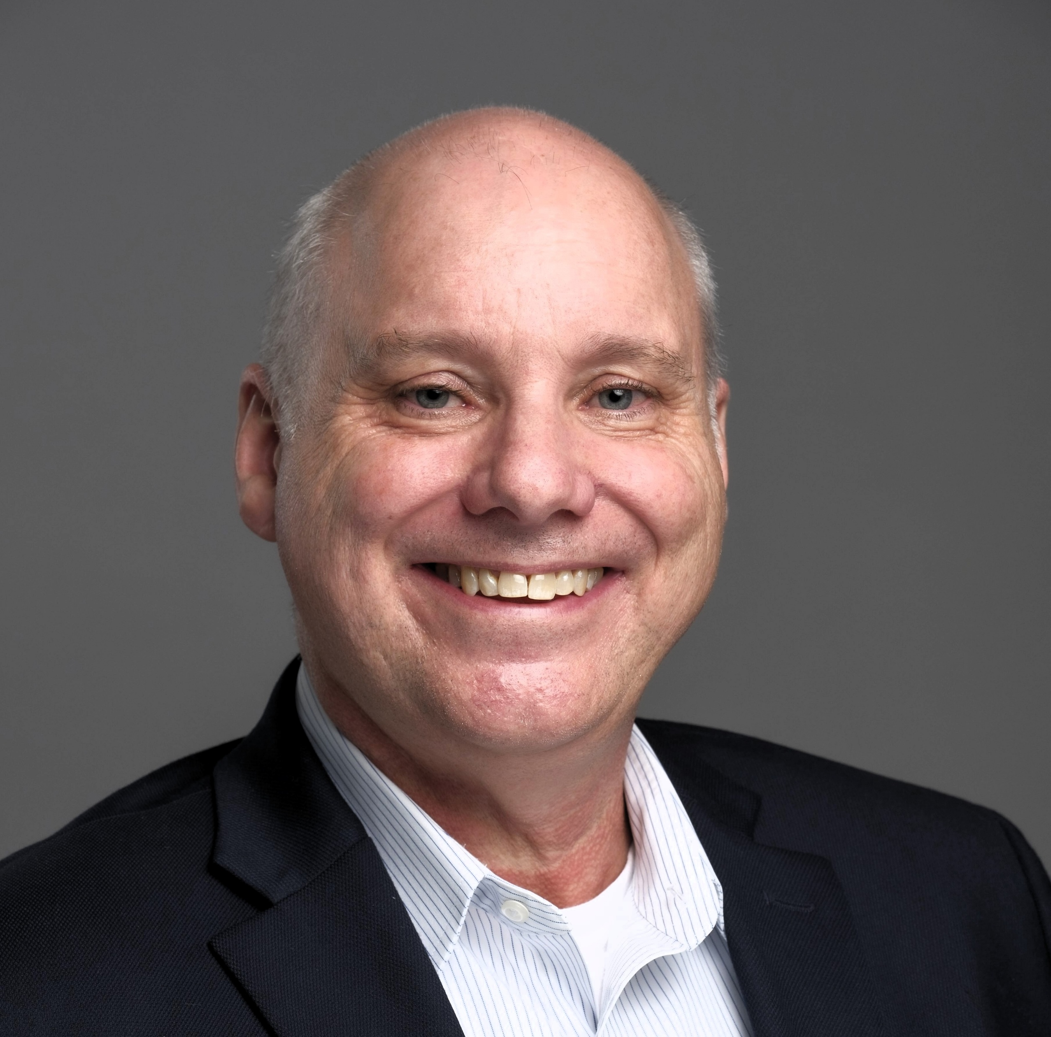
Dean Bickerton, Account Manager, The Reynolds Company
Rockwell Council Member
Contact Info:
Email: dabickerton@reynco.com
Phone: 504.717.0718
LinkedIn
Personal Intro:
I am Dean Bickerton with The Reynolds Company, part of the McNaughton-McKay Group. I have been involved in Industrial Automation since 1992, my entire career. I am an Electrical Engineer from Auburn University and have worked in distribution, systems integration, and for a manufacturer. I worked directly with Rockwell Automation for 11 years managing their Architecture and Software business for Texas, Louisiana, Oklahoma, and Arkansas. My current role with TRC is as an account manager. I am a direct customer facing resource focused on End User, OEM, Systems Integrator, Panel Shop, and EPC accounts in various industries.
I have been married to my lovely wife, Charlotte, for 28 years. We have three girls, Caroline (26), Catherine (24), and Janie (22). I am interested in racing of all forms (F1, IndyCar, NASCAR, boats, or anything that goes fast). I’ve done some performance driving a few times.
I have always viewed Grace as forward thinking and a company we can partner with to promote existing solutions and develop and grown new solutions. I hope to bring the voice of the customer and application needs to the council.

Slide 11
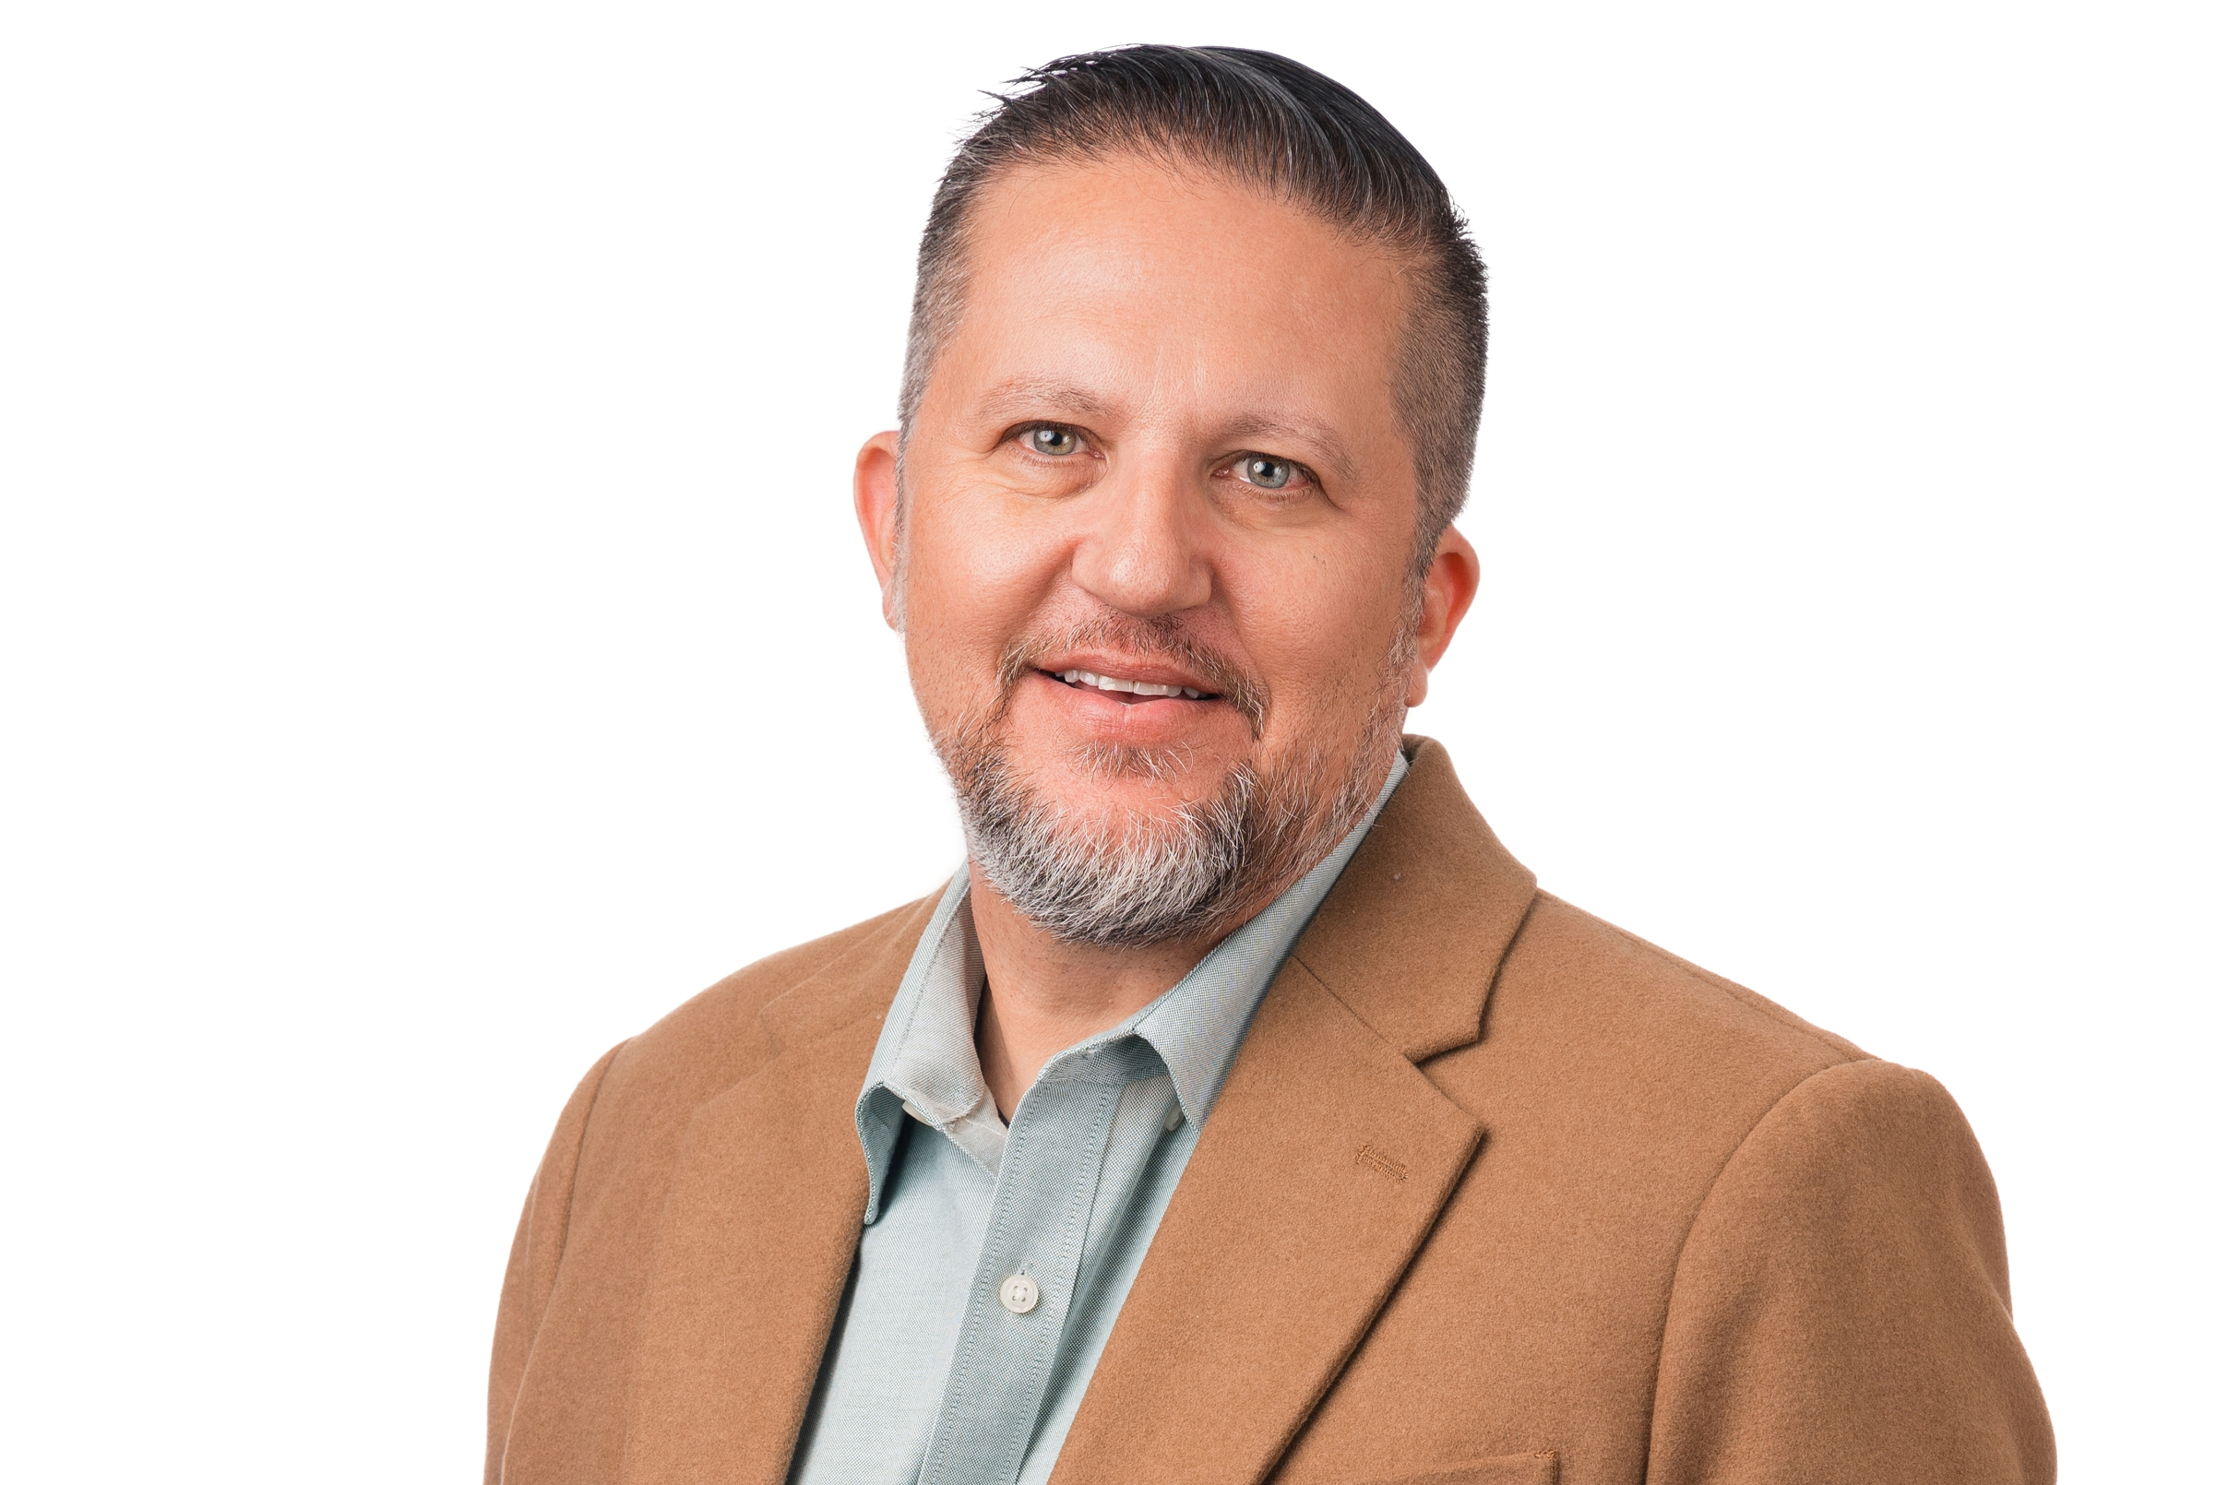
Ahmad Khosti, Sales & Acct Management Director, Border States
Rockwell Council Member
Contact Info:
Email: akhosti@borderstates.com
Phone: 602.721.1638
LinkedIn
Personal Intro:
Years at Border States – 13 Years
Family: Joelle (Wife) Madelaine, Raleigh and Landon (Kids) Tucker and Pearl (Dogs)
Education: BS in Communications from Arizona State
Career Experience: Started in Finance and shifted to Industrial Automation as an integrator in 1996 as a system integrator.
Hobbies: I enjoy traveling with the family and doing Scuba, snorkeling, hiking, boating and wake boarding.
Originally from Ohio, lived in Northern Minnesota for 12 year in Cloquet. Have lived in Phoenix Arizona for 43 years.
Favorite quote: “The most dangerous phrase in our language is ‘we’ve always done it this way.’” – Rear Admiral Grace Hopper
Hope to be able to understand direction that Grace is heading and hope to be able to help guide the direction with feedback and experience

Slide 12
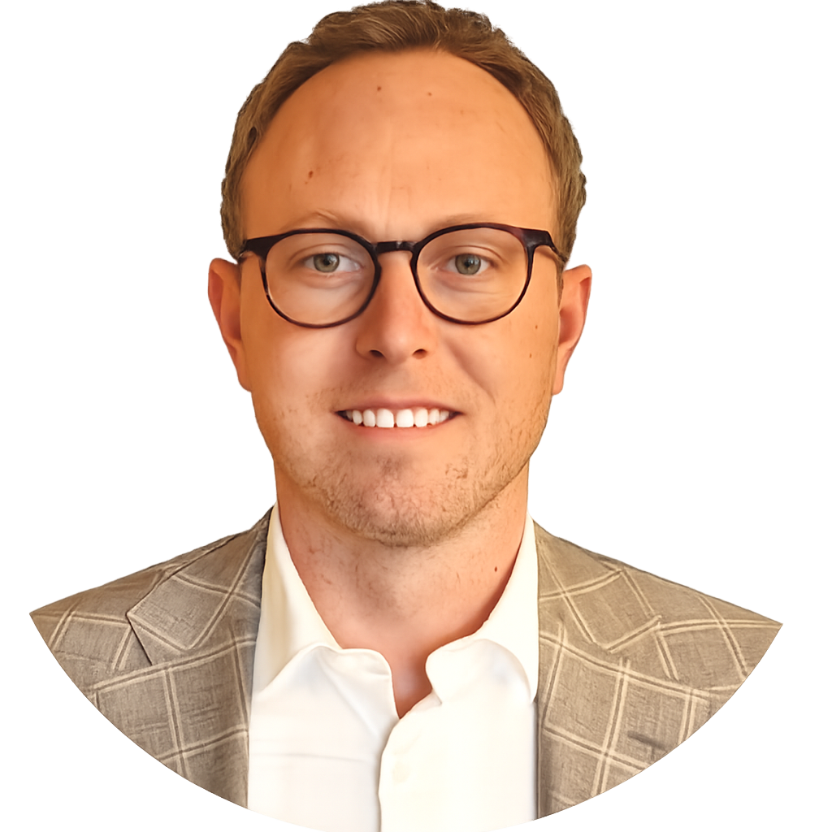
Dan Goulet, Director of Automation Marketing, Rexel
Rockwell Council Member
Contact Info:
Email: Daniel.Goulet@rexel.com
Phone: 720.281.2044
LinkedIn
Personal Intro:
Originally from Michigan (go green)! BSBA majored in Marketing. Moved to Denver in 2013 (sorry guys, I gotta see about a girl), started working for Rexel. Customer Experience Manager > Customer Solutions Team Leader > Marketing Manager > Marketing Director. Have 3 mostly wonderful children, Livi (5), Asher (3), Andi (1).
Grew up playing sports and still enjoy recreational play. Pickleball is my weekly escape these days since I can squeeze it in between work/family life balance. Love outdoor activities; hiking, biking, snowboarding, fishing etc. and teaching the kids when they have appetite for it. Played cello growing up, mostly play guitar now. Have an affinity for local craft beer. Can’t wait to get back into traveling, with & without kids.
Director of Automation Marketing – I’m responsible for executing the marketing strategy for all of Rexel’s Rockwell authorized geographies. I work closely with the industrial automation sales leadership and Rockwell partner network to drive growth.
As part of the council, I hope to provide insights into both the opportunities and challenges related to a distributorship, in efforts to create actional plans that help us achieve mutual growth within the market, and learn about different integrated marketing approaches that drive measurable impact.

Slide 13
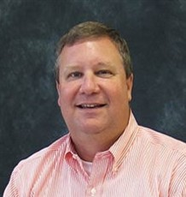
Jeff Jones, Automation Group Manager, McNaughton-McKay
Rockwell Council Member
Contact Info:
Email: jonesj@mc-mc.com
Phone: 770.825.8674
LinkedIn
Personal Intro:
Employee-owner at McNaughton-McKay for 32 years. Starting as our first inside technical specialist in Georgia.
I currently manage the engineering group of Rockwell specialist in Georgia.
Married to my wife Diane for 33 years and we live in a northwest suburb of Atlanta with our dog Brook and two cats Nala and Simba.
We have one daughter, Haley, who just recently started working at McNaughton-McKay.
I love to play tennis, golf, and watch movies in my home theater.

Slide 14
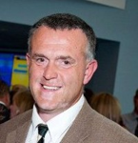
Tony Monday, Product Manager, Enclosures, Werner
Rockwell Council Member
Contact Info:
Email: tmonday@wernerelectric.com
Phone: 920.858.1993
LinkedIn
Personal Intro:
I have been with Werner Electric Supply for over 25 years as the Enclosure Product manager.
I have a family (1 son, 2 Daughters, grandson, and granddaughter). I enjoy anything outdoors. I am a Packer, Brewers, and Bucks fan.
I have learned being on the DAC for Grace how differently distributors and manufacturers think. The goal is the same, but executing the sales, marketing, and distributing of product is differently. Coming with new programs and ideas to help Grace succeed in the market. I would like to have more of the things we have talked about in past DAC implemented by Grace in 2025

Slide 15
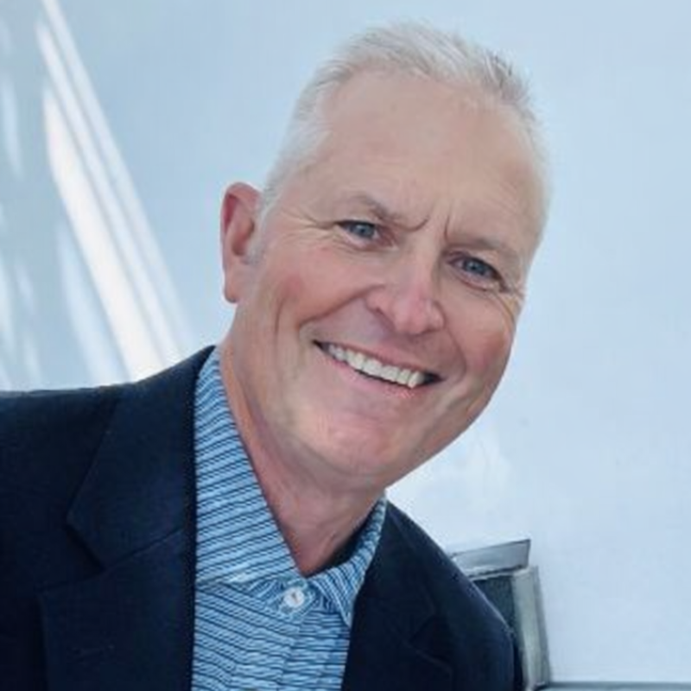
Ray Archer, VP Industrial Sales & Solutions, Crawford Electric
Rockwell Council Member
Contact Info:
Email: RArcher@crawfordelectricsupply.com
Phone: 251.654.1233
LinkedIn

Slide 16
Non-Rockwell Council Members
Bill Hirschinger, Director of Engineering, Standard Electric
Louie Scheiderer, Director – Engineering & Technical Services, Crescent Electric Supply Co.
Bill Stone, VP Digital Buildings and Factories, Mayer Electric
Dean Dobitz, VP Industrial Sales, Viking Electric
David Tozi, Director of Automation & Controls (West), Wesco
Benjamin Fordree, Industrial Sales Director, Border States

Slide 17
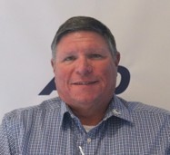
Bill Hirschinger, Director of Engineering, Standard Electric
Non-Rockwell Council Member
Contact Info:
Email: bhirschinger@standardelectricsupply.com
Phone: 414.231.2531 | Mobile: 262.617.4383
LinkedIn
Personal Intro:
I’ve been in the electrical industry over 35 years and at Standard Electric over 30 years.
I’ve been married to my wife Kathy for nearly 40 years. We have 3 grown kids, 4 grand kids, and two dogs.
I enjoy the outdoors, hunting, fishing and boating.
I would like to have a better understanding of Grace Technologies to promote and grow sales at Standard Electric Supply.

Slide 18
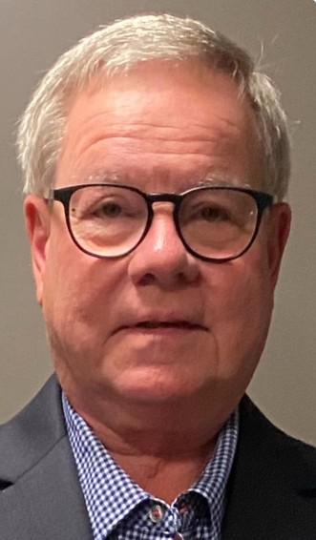
Louie Scheiderer, Director, Engineering & Technical Services, Crescent Electric
Non-Rockwell Council Member
Contact Info:
Email: Louie.Scheiderer@cesco.com
Phone: 419.306.6700
LinkedIn
Personal Intro:
Married to my wife Karen for 42 years and we live in Ohio. We have three children Andrea, Elizabeth, Jeremy and seven grandchildren. I enjoy spending time with my wife and family and our dog Winchester. All of our children live in Ohio which it makes it easy for us to see visit them.
My hobbies include Bicycling, Hunting, Shooting and photography.
I have spent my entire 38 year career in the automation & control field which includes engineering and sales. I currently lead a team of 26 engineers across the United States.

Slide 19
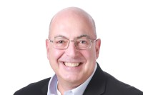
Bill Stone, VP Digital Buildings & Factories, Mayer Electric
Non-Rockwell Council Member
Contact Info:
Email: bstone@mayerelectric.com
Phone: 205.532.8752
LinkedIn
Personal Intro:
Believer, Husband, Father, Grandfather, Servant
  Wife: Marian; Children: Adrian, Brant (Katie), Trey; Grandsons: Ellis, Eddy, Finn, Charlie, Cooper
  Reside in Gadsden, AL
  36 years in the Electrical and Automation Industry
  Deacon, 1st Baptist Church Gadsden
Auburn Man and Fan (Former President of the Auburn Alumni Association)
I seek to continue to learn, grow, and lead our Mayer Team to greater joy, success, and profitability.

Slide 20
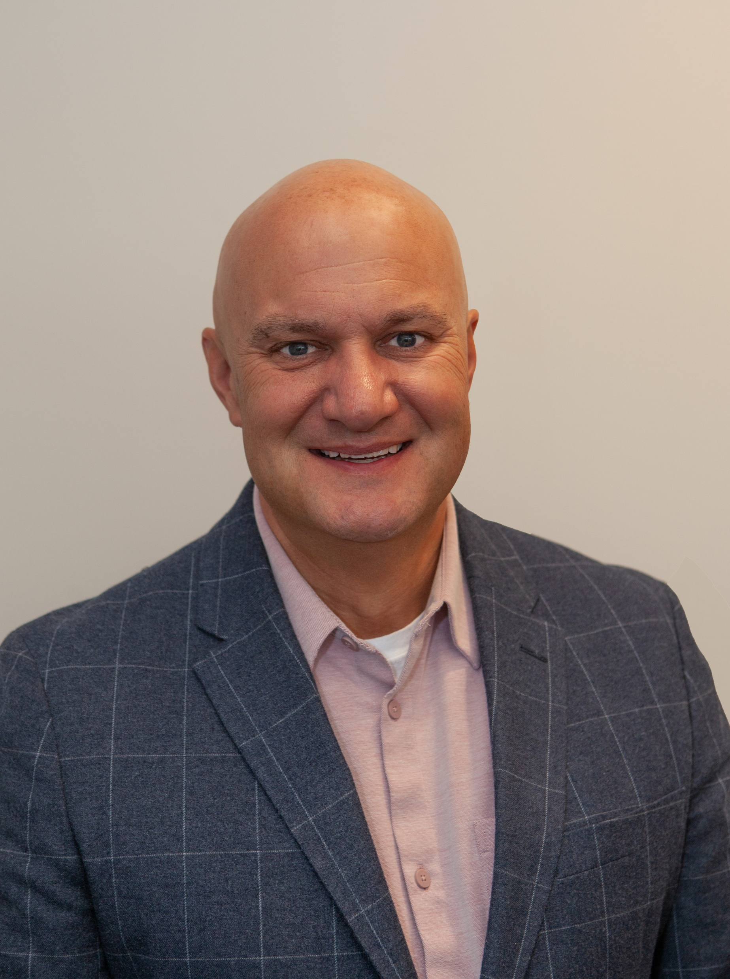
Dean Dobitz, VP of Industrial Sales, Viking Electric
Non-Rockwell Council Member
Contact Info:
Email: dean.dobitz@vikingelectric.com
Phone: 612.246.9497
LinkedIn
Personal Intro:
I live in a suburb of Minneapolis with my wife, Aleecia
We have three children ages 23, 22, and 20
Hobbies are playing a lot of golf and boating
Been in the Industrial Automation distribution business since 1997
What I am hoping to get from the DAC is another networking opportunity with leaders in our space

Slide 21
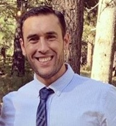
David Tozi, Sales Director, Automation & Controls, Wesco
Non-Rockwell Council Member
Contact Info:
Email: dtozi@wescodist.com
Phone: 209.224.4834
LinkedIn
Personal Intro:
With over a decade of leadership experience in electrical distribution, I am passionate about serving, developing, and empowering people and teams to achieve their full potential and deliver exceptional results.
I am currently the Automation Sales Director for the Western United States at WESCO Distribution, a Fortune 200 company and a leading provider of electrical, industrial, and communications products and services. In my role, I lead a team of Application Engineers and Business Development Managers who are responsible for driving new and growing existing Control, Automation, and IoT business in the Western Region of the U.S.
I’ve been married to my beautiful wife, Katie, coming up on 15 years and am the father of three amazing kids: Grace (13), Emma (13), and Jacob (12). In my free time you’ll find me spending time with my family and friends, helping coach my son’s various sports teams, serving with youth in my church, or getting after it on the Jiu-Jitsu mats.
For New Members: I am looking forward to learning and sharing strategies and best practices of how distributors have been successful in growing their Grace business and sales. In addition to that, I’m looking forward to also understanding some of the shared struggles other distributors have had and the strategies that have worked to help overcome those shared struggles in driving the Grace business.

Slide 22
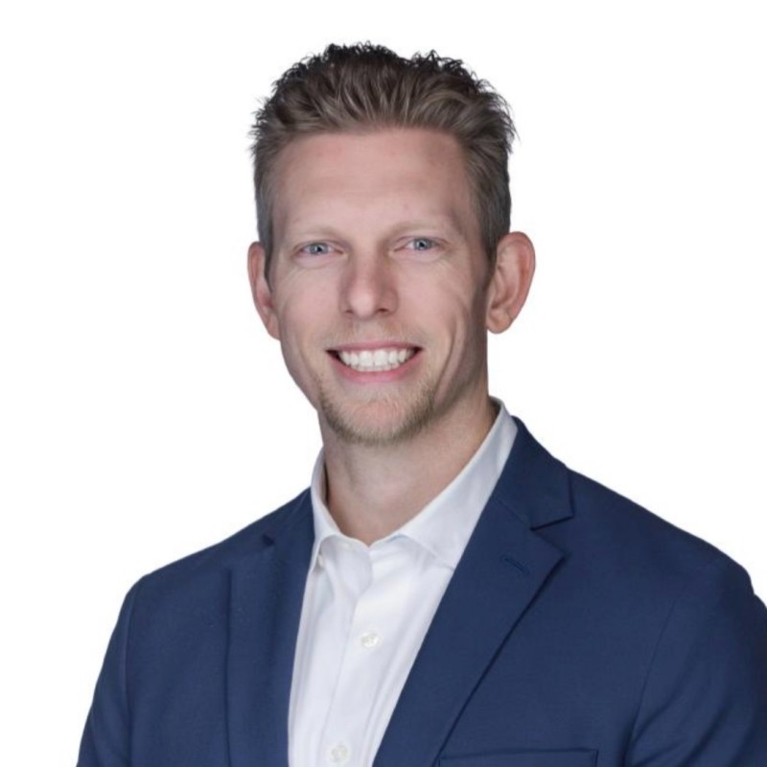
Ben Fordree, Industrial Sales Director, Border States
Non-Rockwell Council Member
Contact Info:
Email: bfordree@borderstates.com
Phone: 803.216.4280
LinkedIn
Personal Intro:
I live in Columbia, SC where I have been for the past 12 years. My wife, Abby, and I have been married for 16 years and we have two daughters – Harper (10) and Bekah (7). Our family is in the throes of school, karate, and volleyball at the moment, and we love to get out on the lake!
I mostly just want to be outside. Put me in the mountains, on the lake, in the woods… whatever! I enjoy hunting, golf, and working out.
I was at Shealy Electrical Wholesalers for two years before Border States acquired us. So in total, I’ve been in the industry for 12 years. I started as a warehouse associate, was asked to join our two-year training program, graduated that program and went into inside sales support. After six months of inside support, I was selected to be an Industrial Account Manager in the Augusta Market. I did that for 4.5 years until I was promoted to the Industrial Area Sales Manager for the Carolinas. I grew my team from 18 to 26 in 3.5 years and then became the Industrial Sales Director, which is my role today. I have 5 Area Sales Managers on my team and they manage roughly 60 Account Managers.
I want to help better position Grace Tech within Border States and ultimately out into the field. Keeping more customers informed on their equipment and more technicians safe!

