Slide 2













We develop intuitive solutions for a wide variety of application challenges that industries face today. From GracePort panel interface connectors and GracePESDs voltage indicators/portals to
GraceSense asset health monitoring. Grace is contributing
each day to safer, more productive, and brighter future.
DAVENPORT, IOWA
Sales presence in
60+ countries around the world

Slide 3
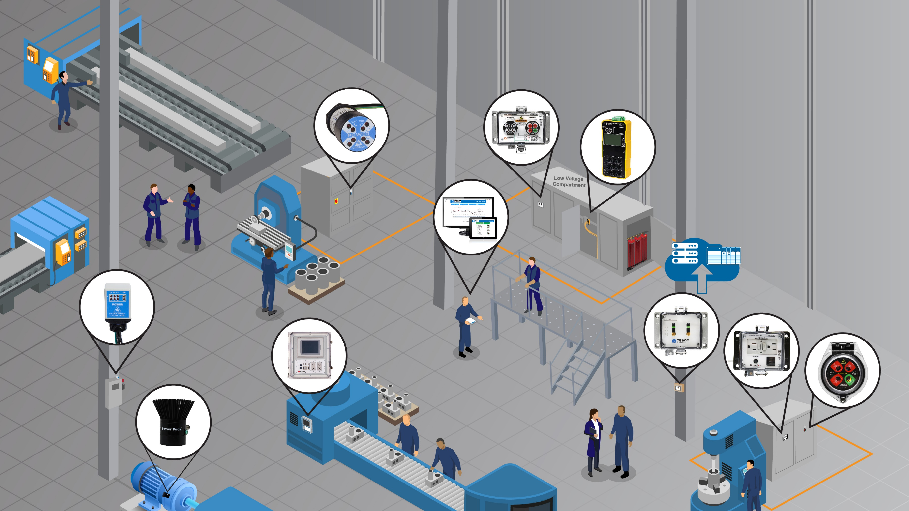

Improving safety and productivity in your entire facility

Slide 4
Panel Interface Connectors

Slide 5

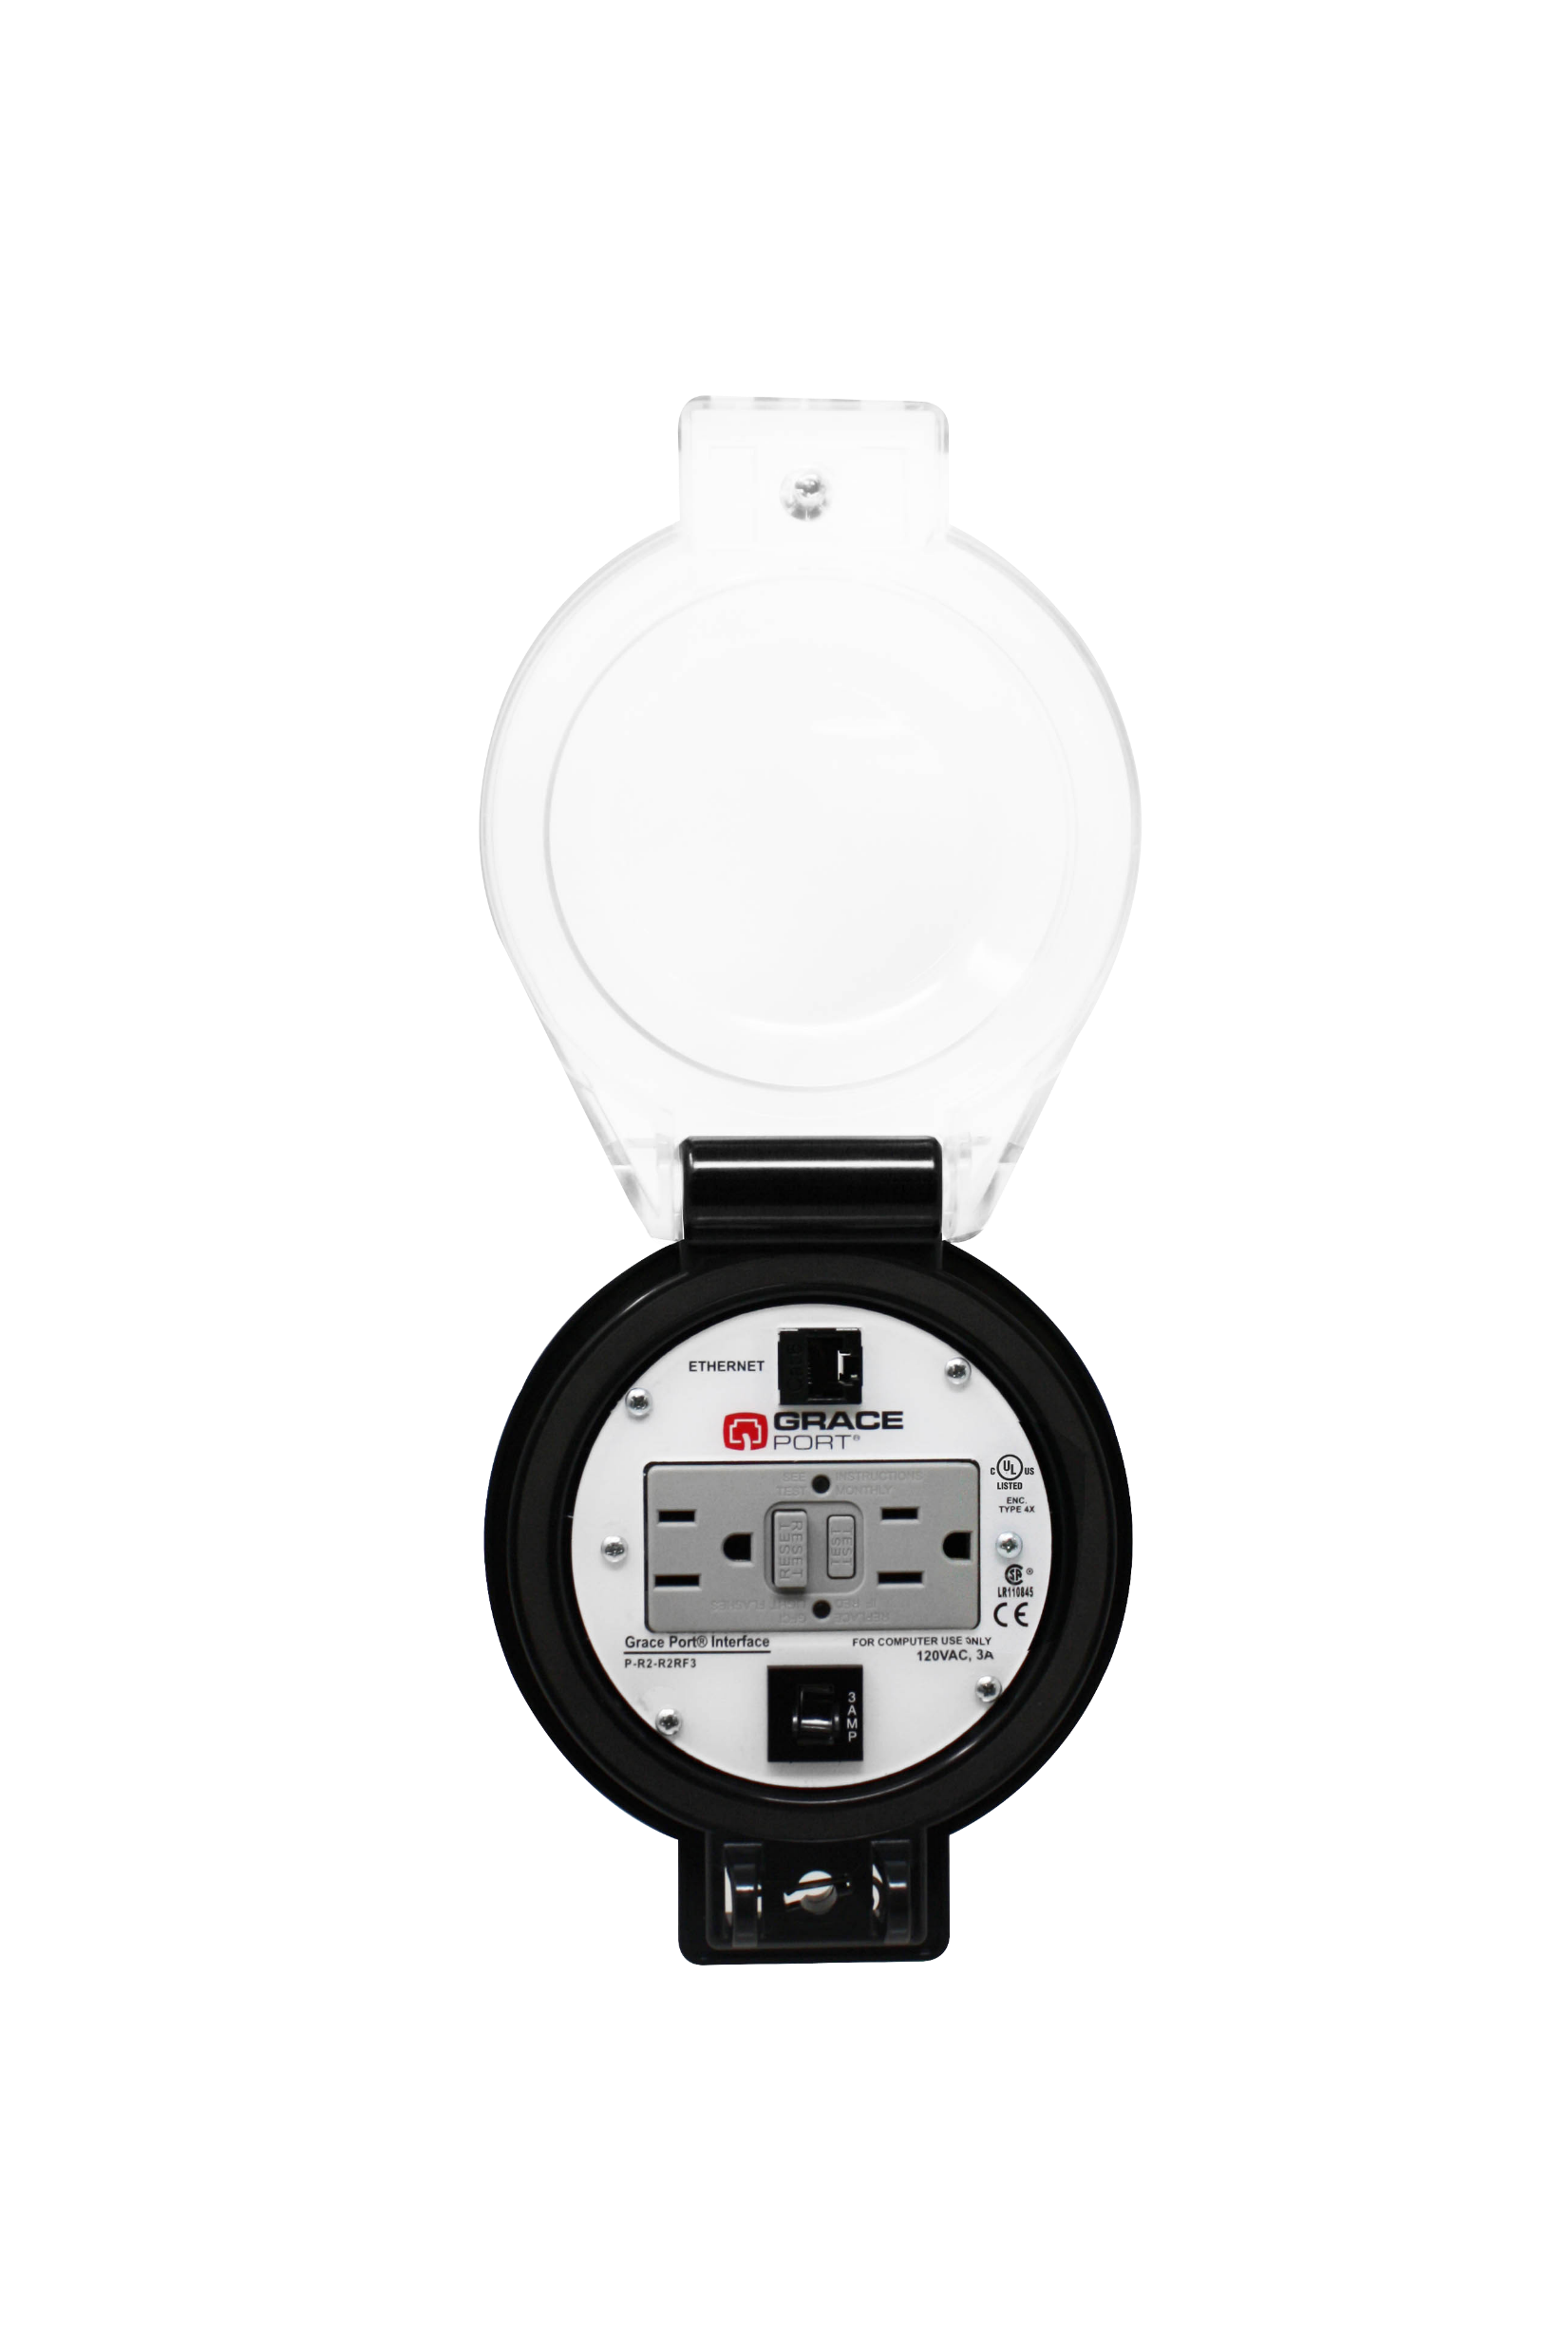
Advantages of GracePorts®
Elimination
Substitution
Elimination: Reduce or eliminate incident energy exposure by keeping your enclosure door closed by installing our GracePort Panel Interface connector accessing connections on the inside of your control panels.
Substitution: a programming task from outside the panel in a Normal operating condition.
Engineering Controls: Easily access any connection inside of a PLC Control Cabinet thru closed doors. Keeping the harsh production floor environment from getting inside of your control equipment.
Engineering Controls
Awareness
Administrative
Controls
Panel Interface Connectors like GracePorts can improve task productivity by about
^{90%}
PPE
P-R2-R4RF3
Notes:
Open doors makes maintenance less safe and allows for environmental conditions to get inside of the control cabinet. Environmental hazards and personnel hazards.
Risk hierarchy of controls. We want to be in the first three buckets. The least effective is PPE. Often in facilities we jump right to suiting up in high calories PPE. Risk is measured in dollars. Even a human life has a dollar value. Eliminate, substitute, and engineer around the risk.
The pressure wave is whats going to hurt or kill you. There is a flashover and shock when making contact with a live conductor.

Slide 6
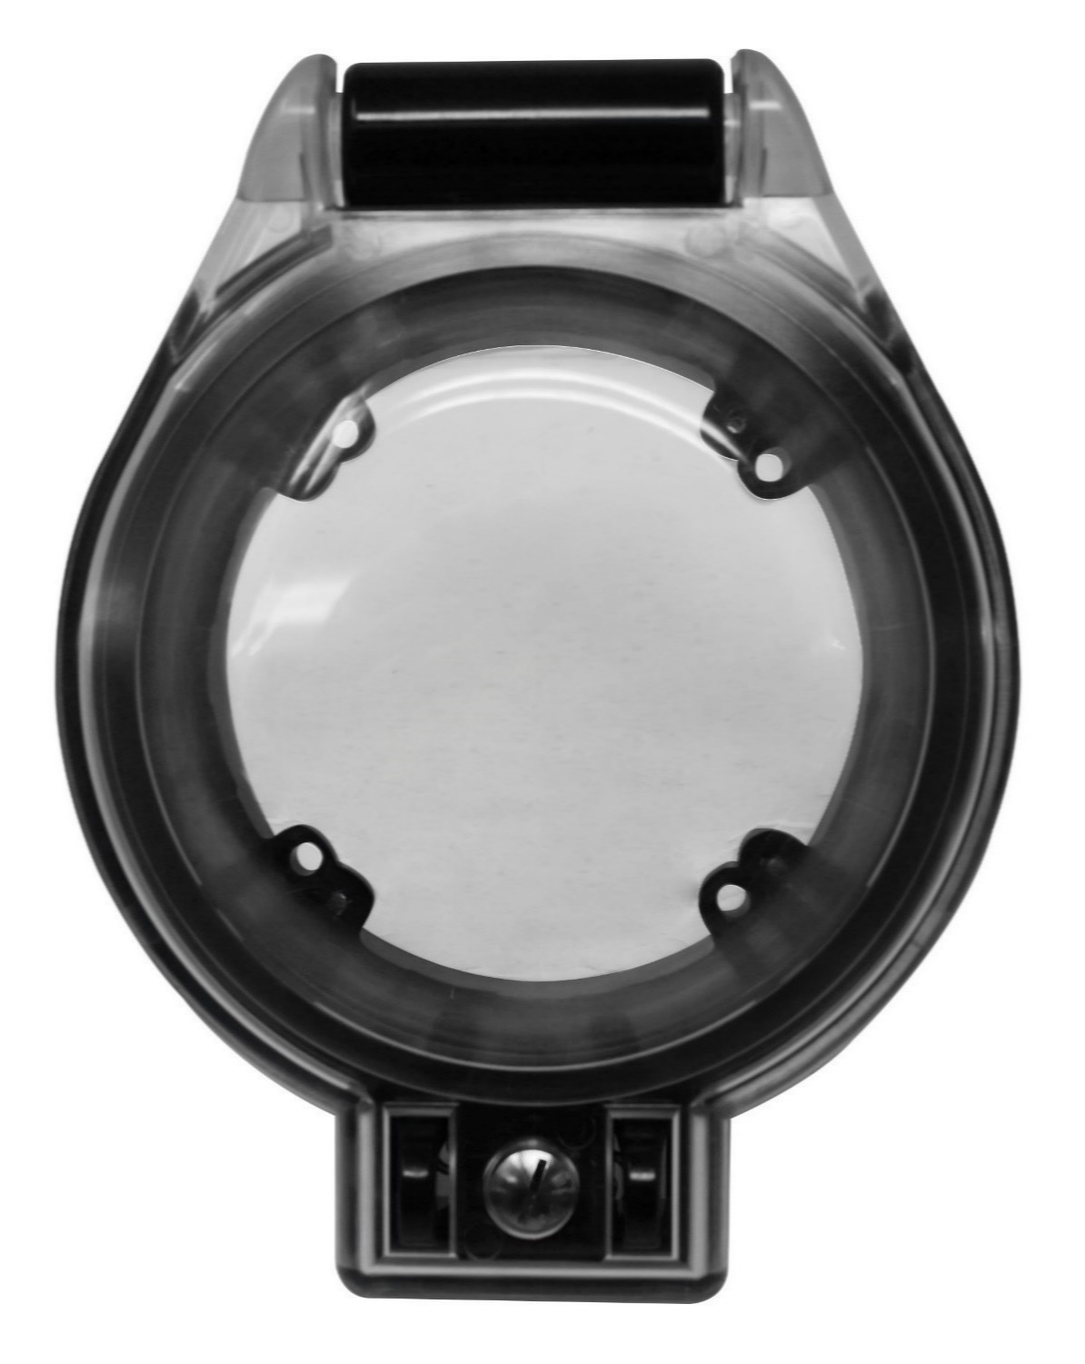

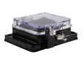
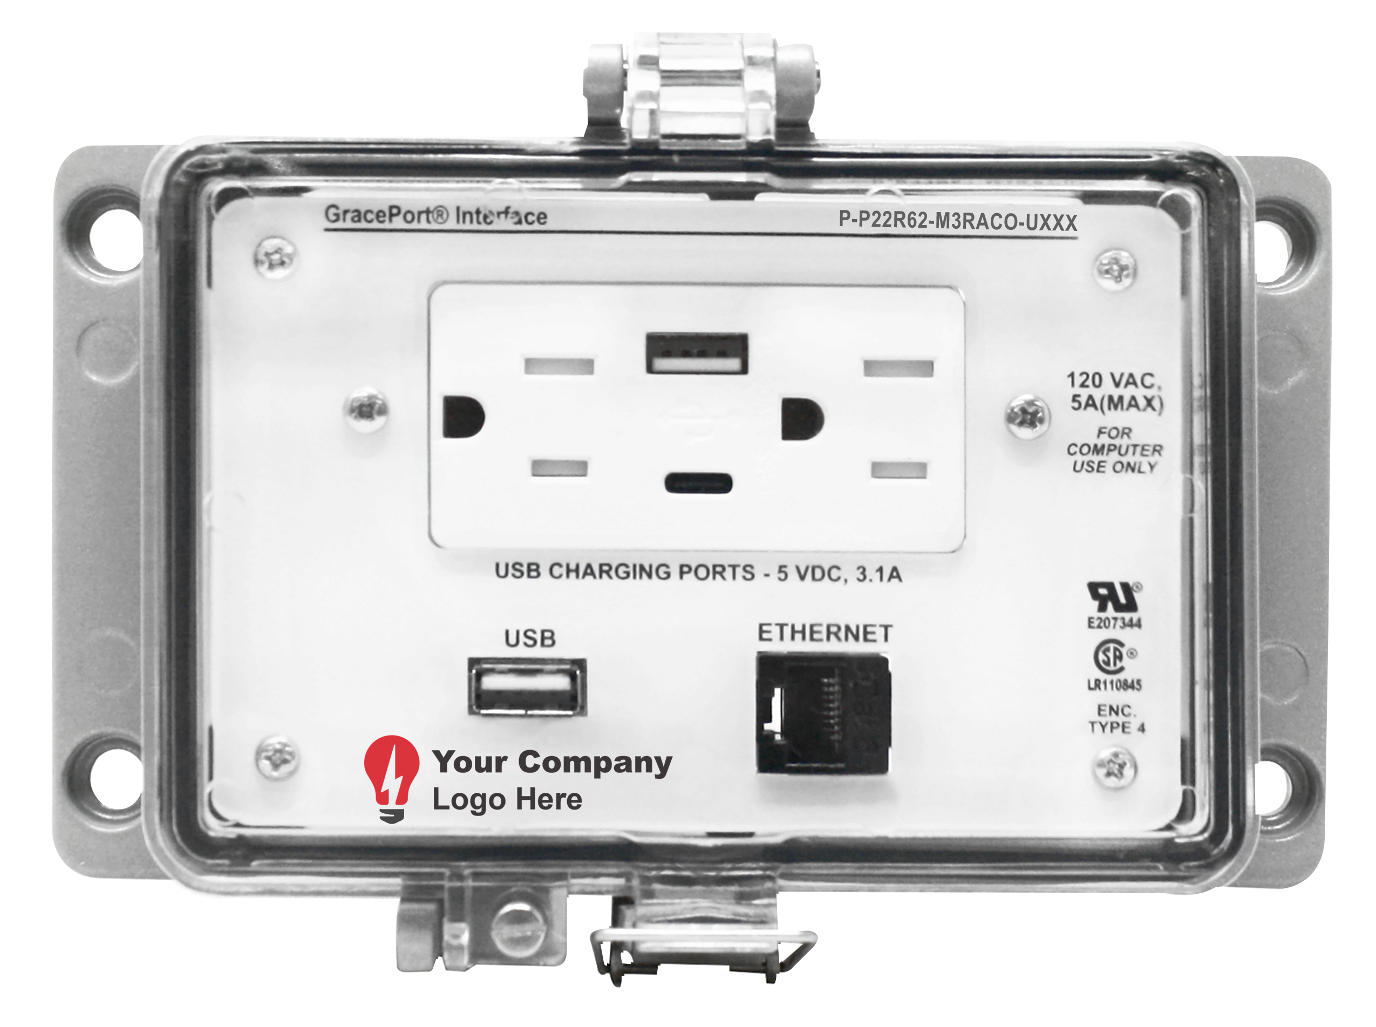
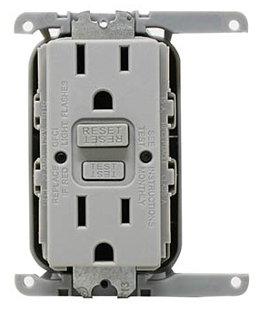
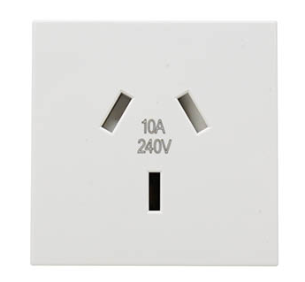
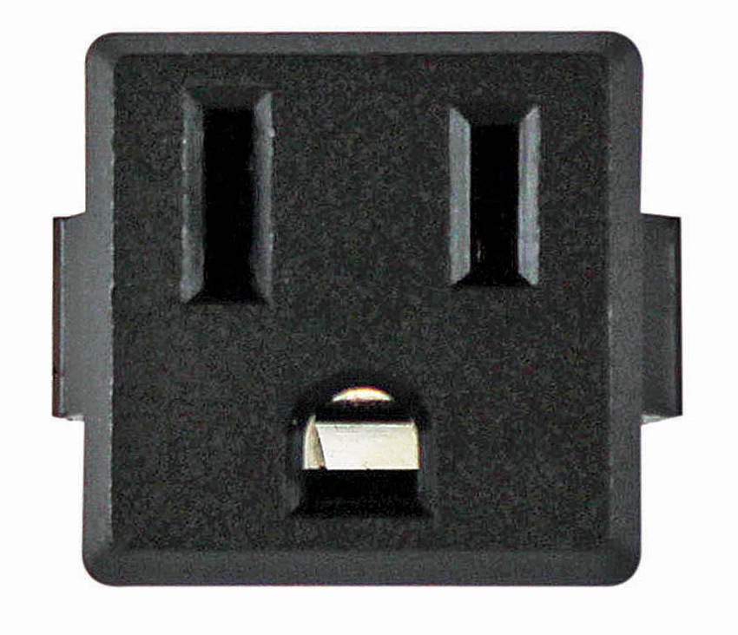
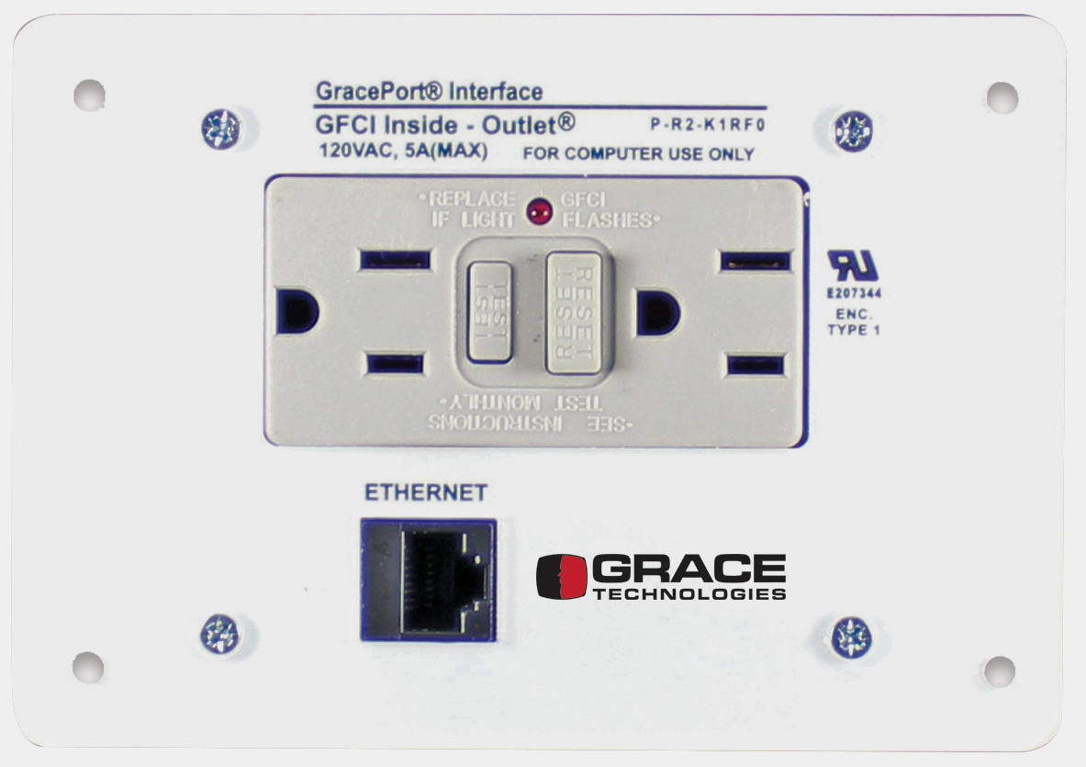
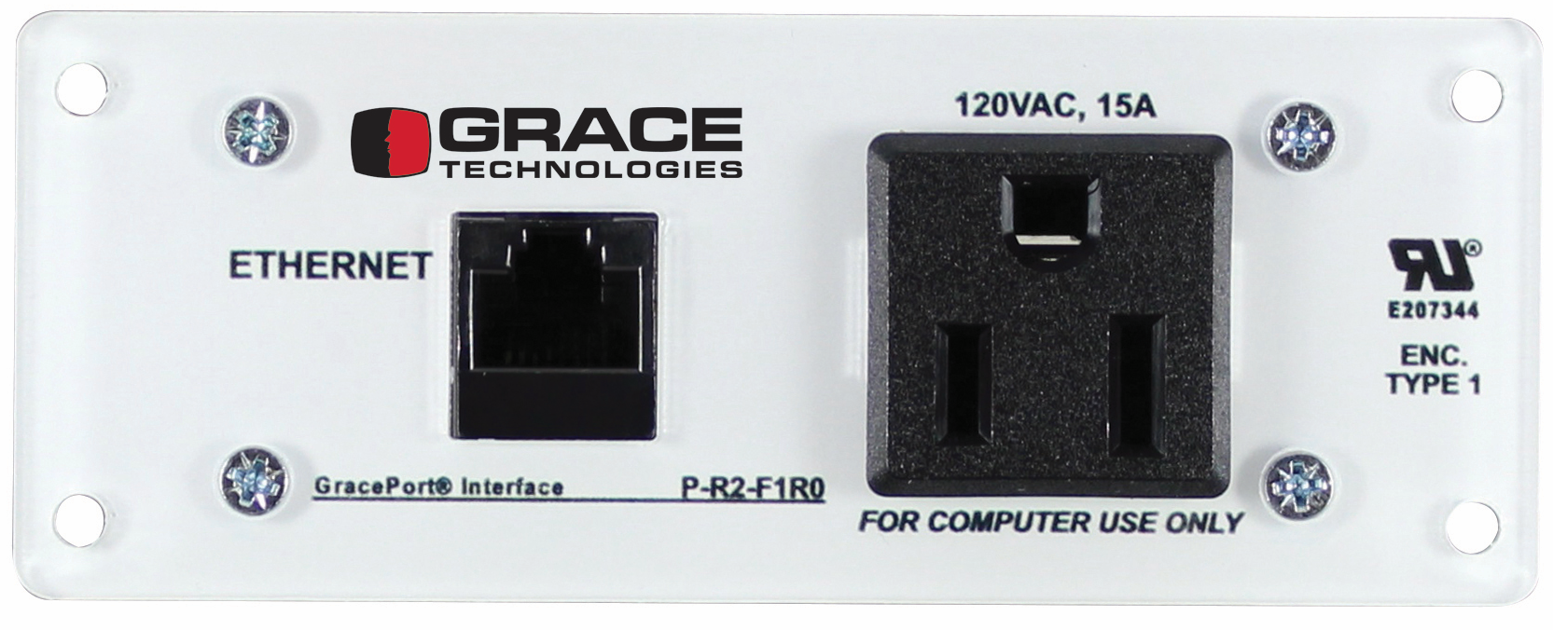
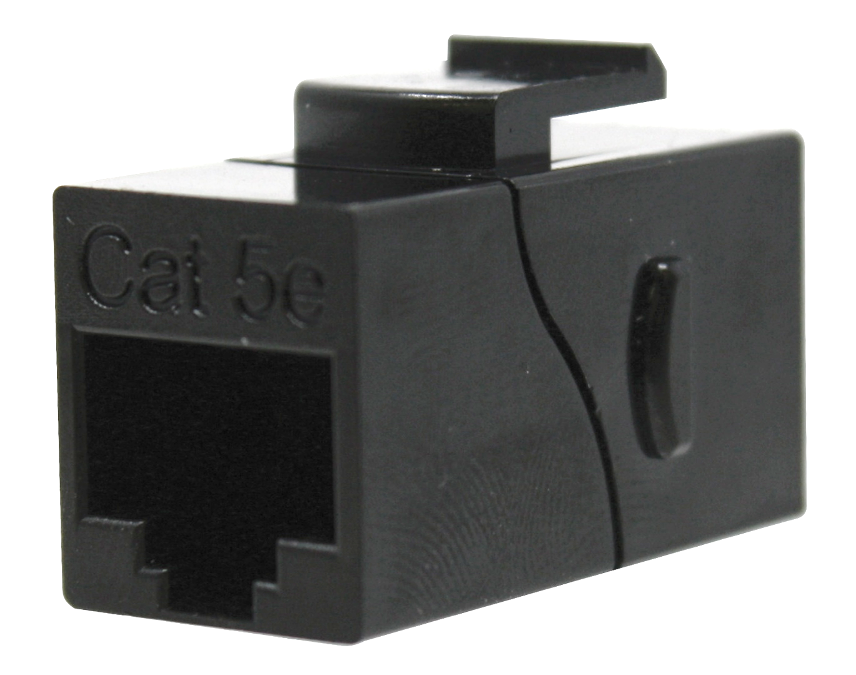
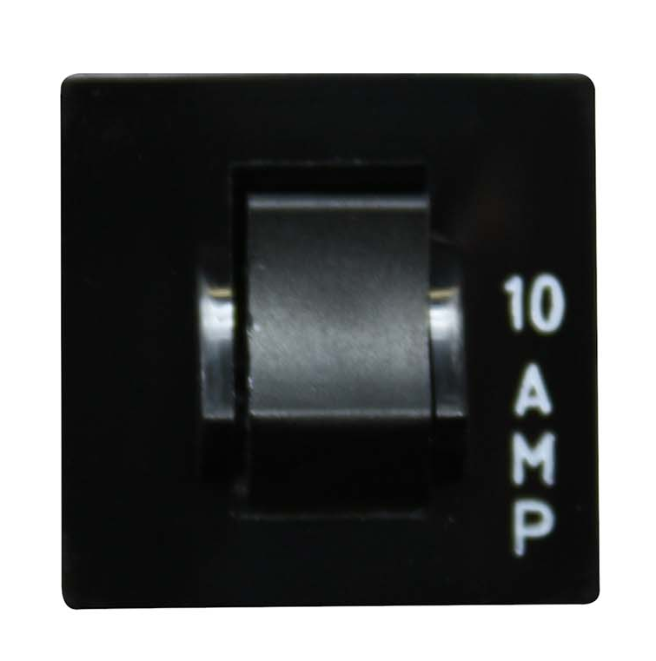
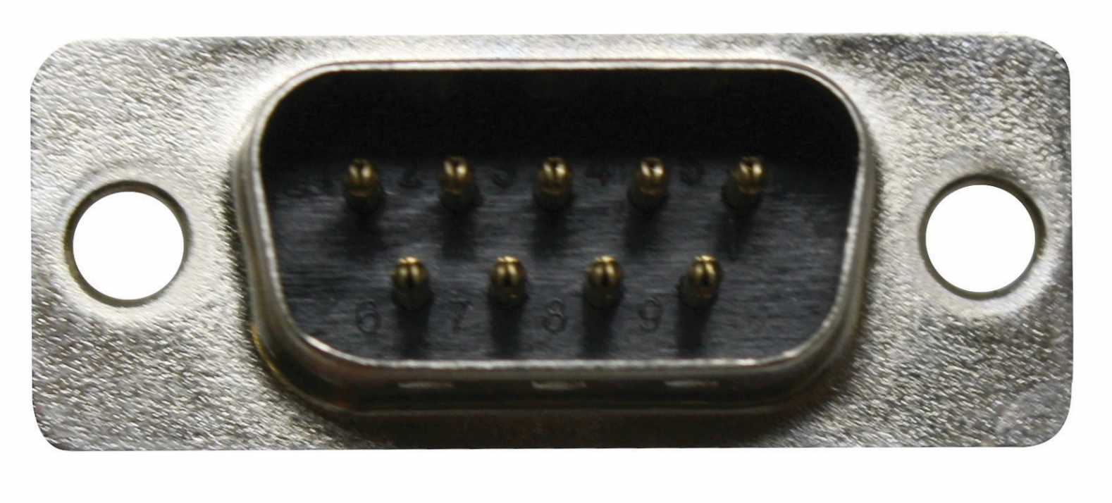
The Possibilities are Endless
Add Your Logo
Choose a Housing from UL Type 1 (no housing), 4, 4X, or 12
Choose your components and power options (both domestic and international options available)
Add special cutouts, cable lengths, text, and logos
We can create a custom-built GracePort, including special text, cut-outs, cable lengths,
and even adding your company logo, all in just 2 - 3 days– created just the way you want it.
Notes:
Enclosure sizes reference / Reference universal outlet RUV - Add USB-C – Add IP Ratings as well
Add an International slide only (CE, CSA, UKCA, etc.)
Add part number structuring.
If you have machines going overseas, we have international components as well.
If you need a logo, send us a JPEG file format and we will create a special U-code associated with your GracePort
Wide variety of GracePorts are available in ePlan. You can pull these from ePlan

Slide 7


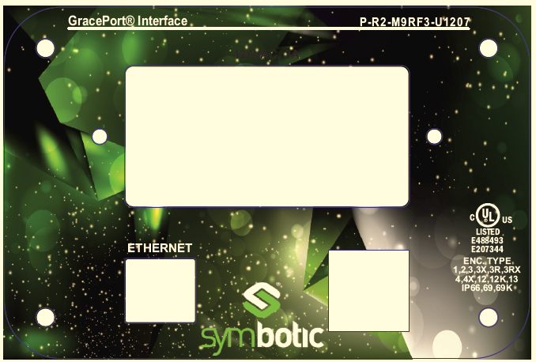
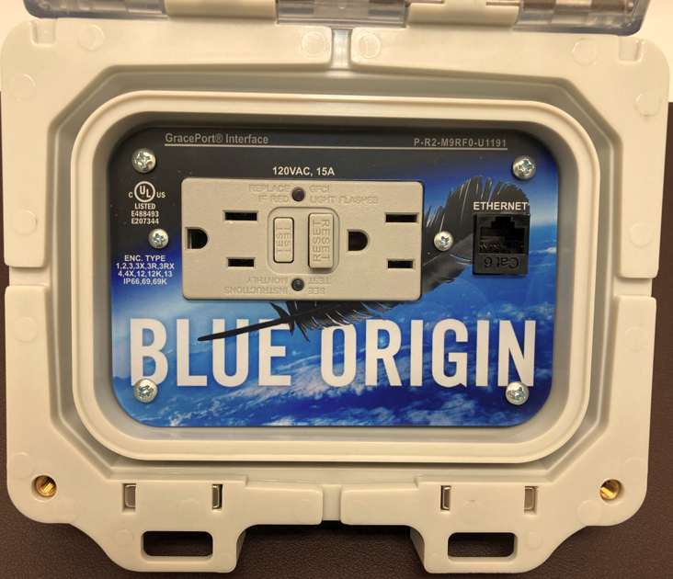
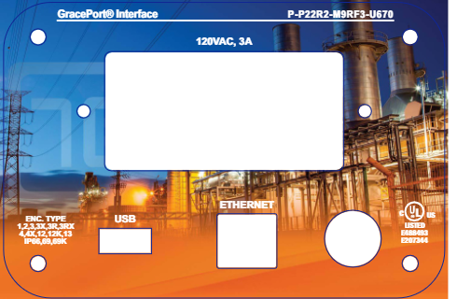
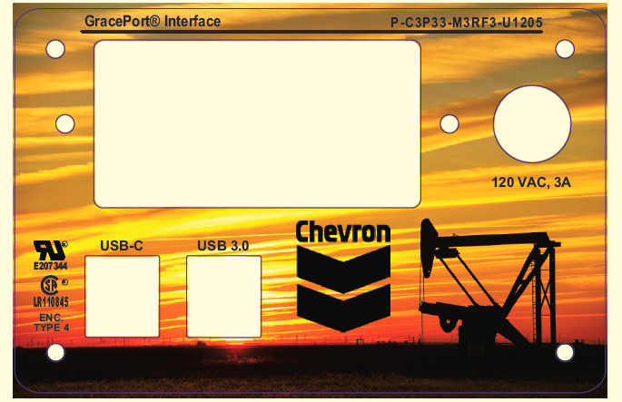
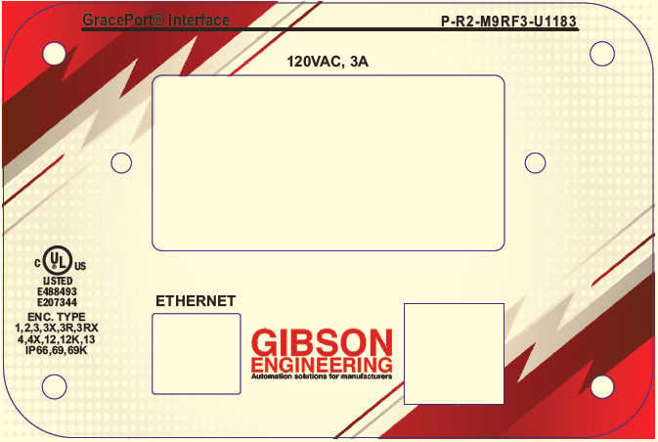
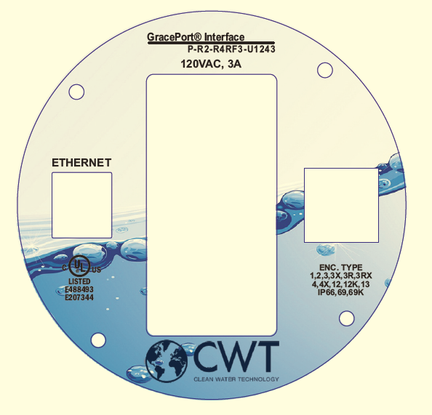
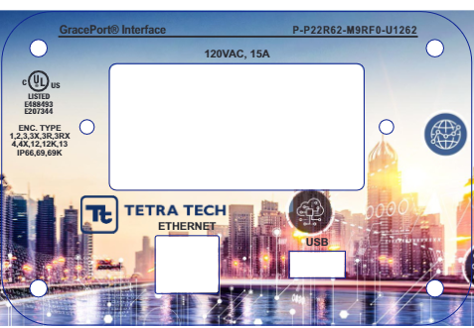
Custom GracePorts

Slide 8
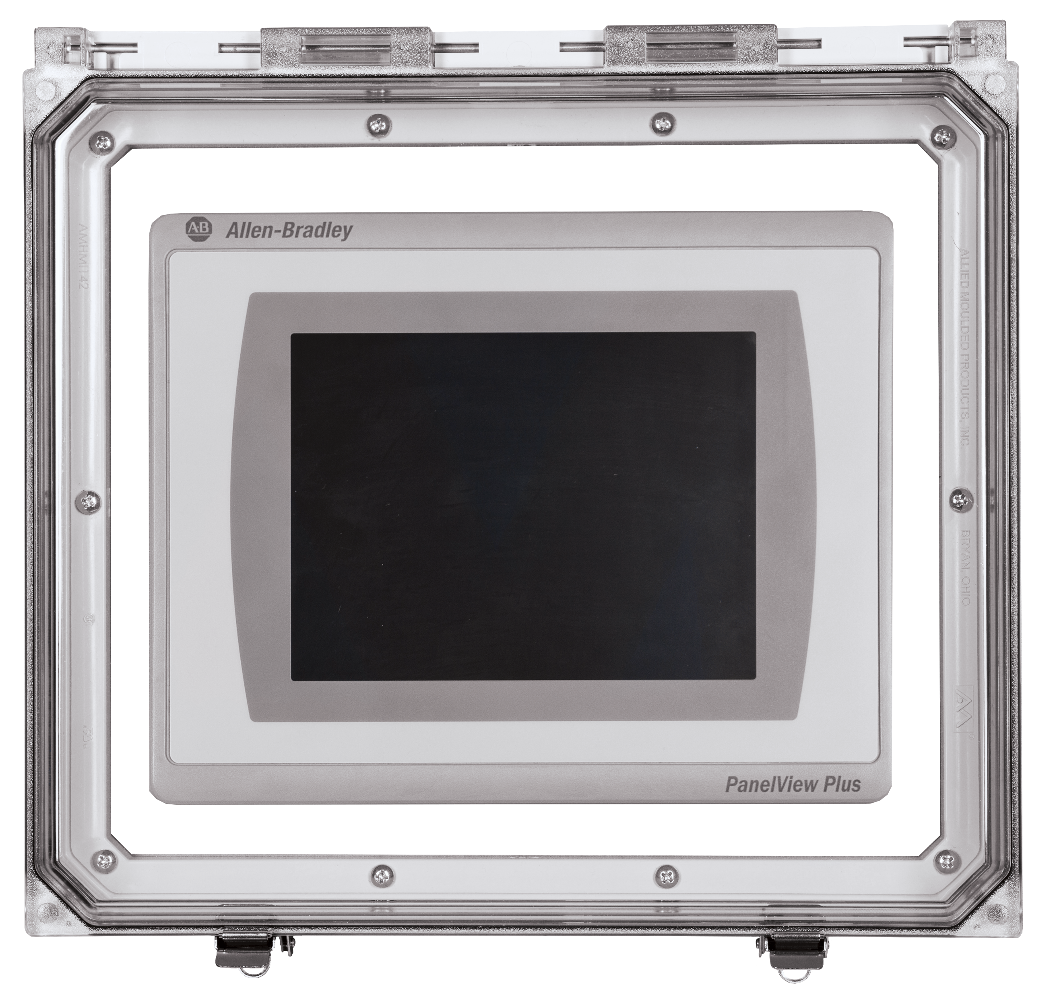
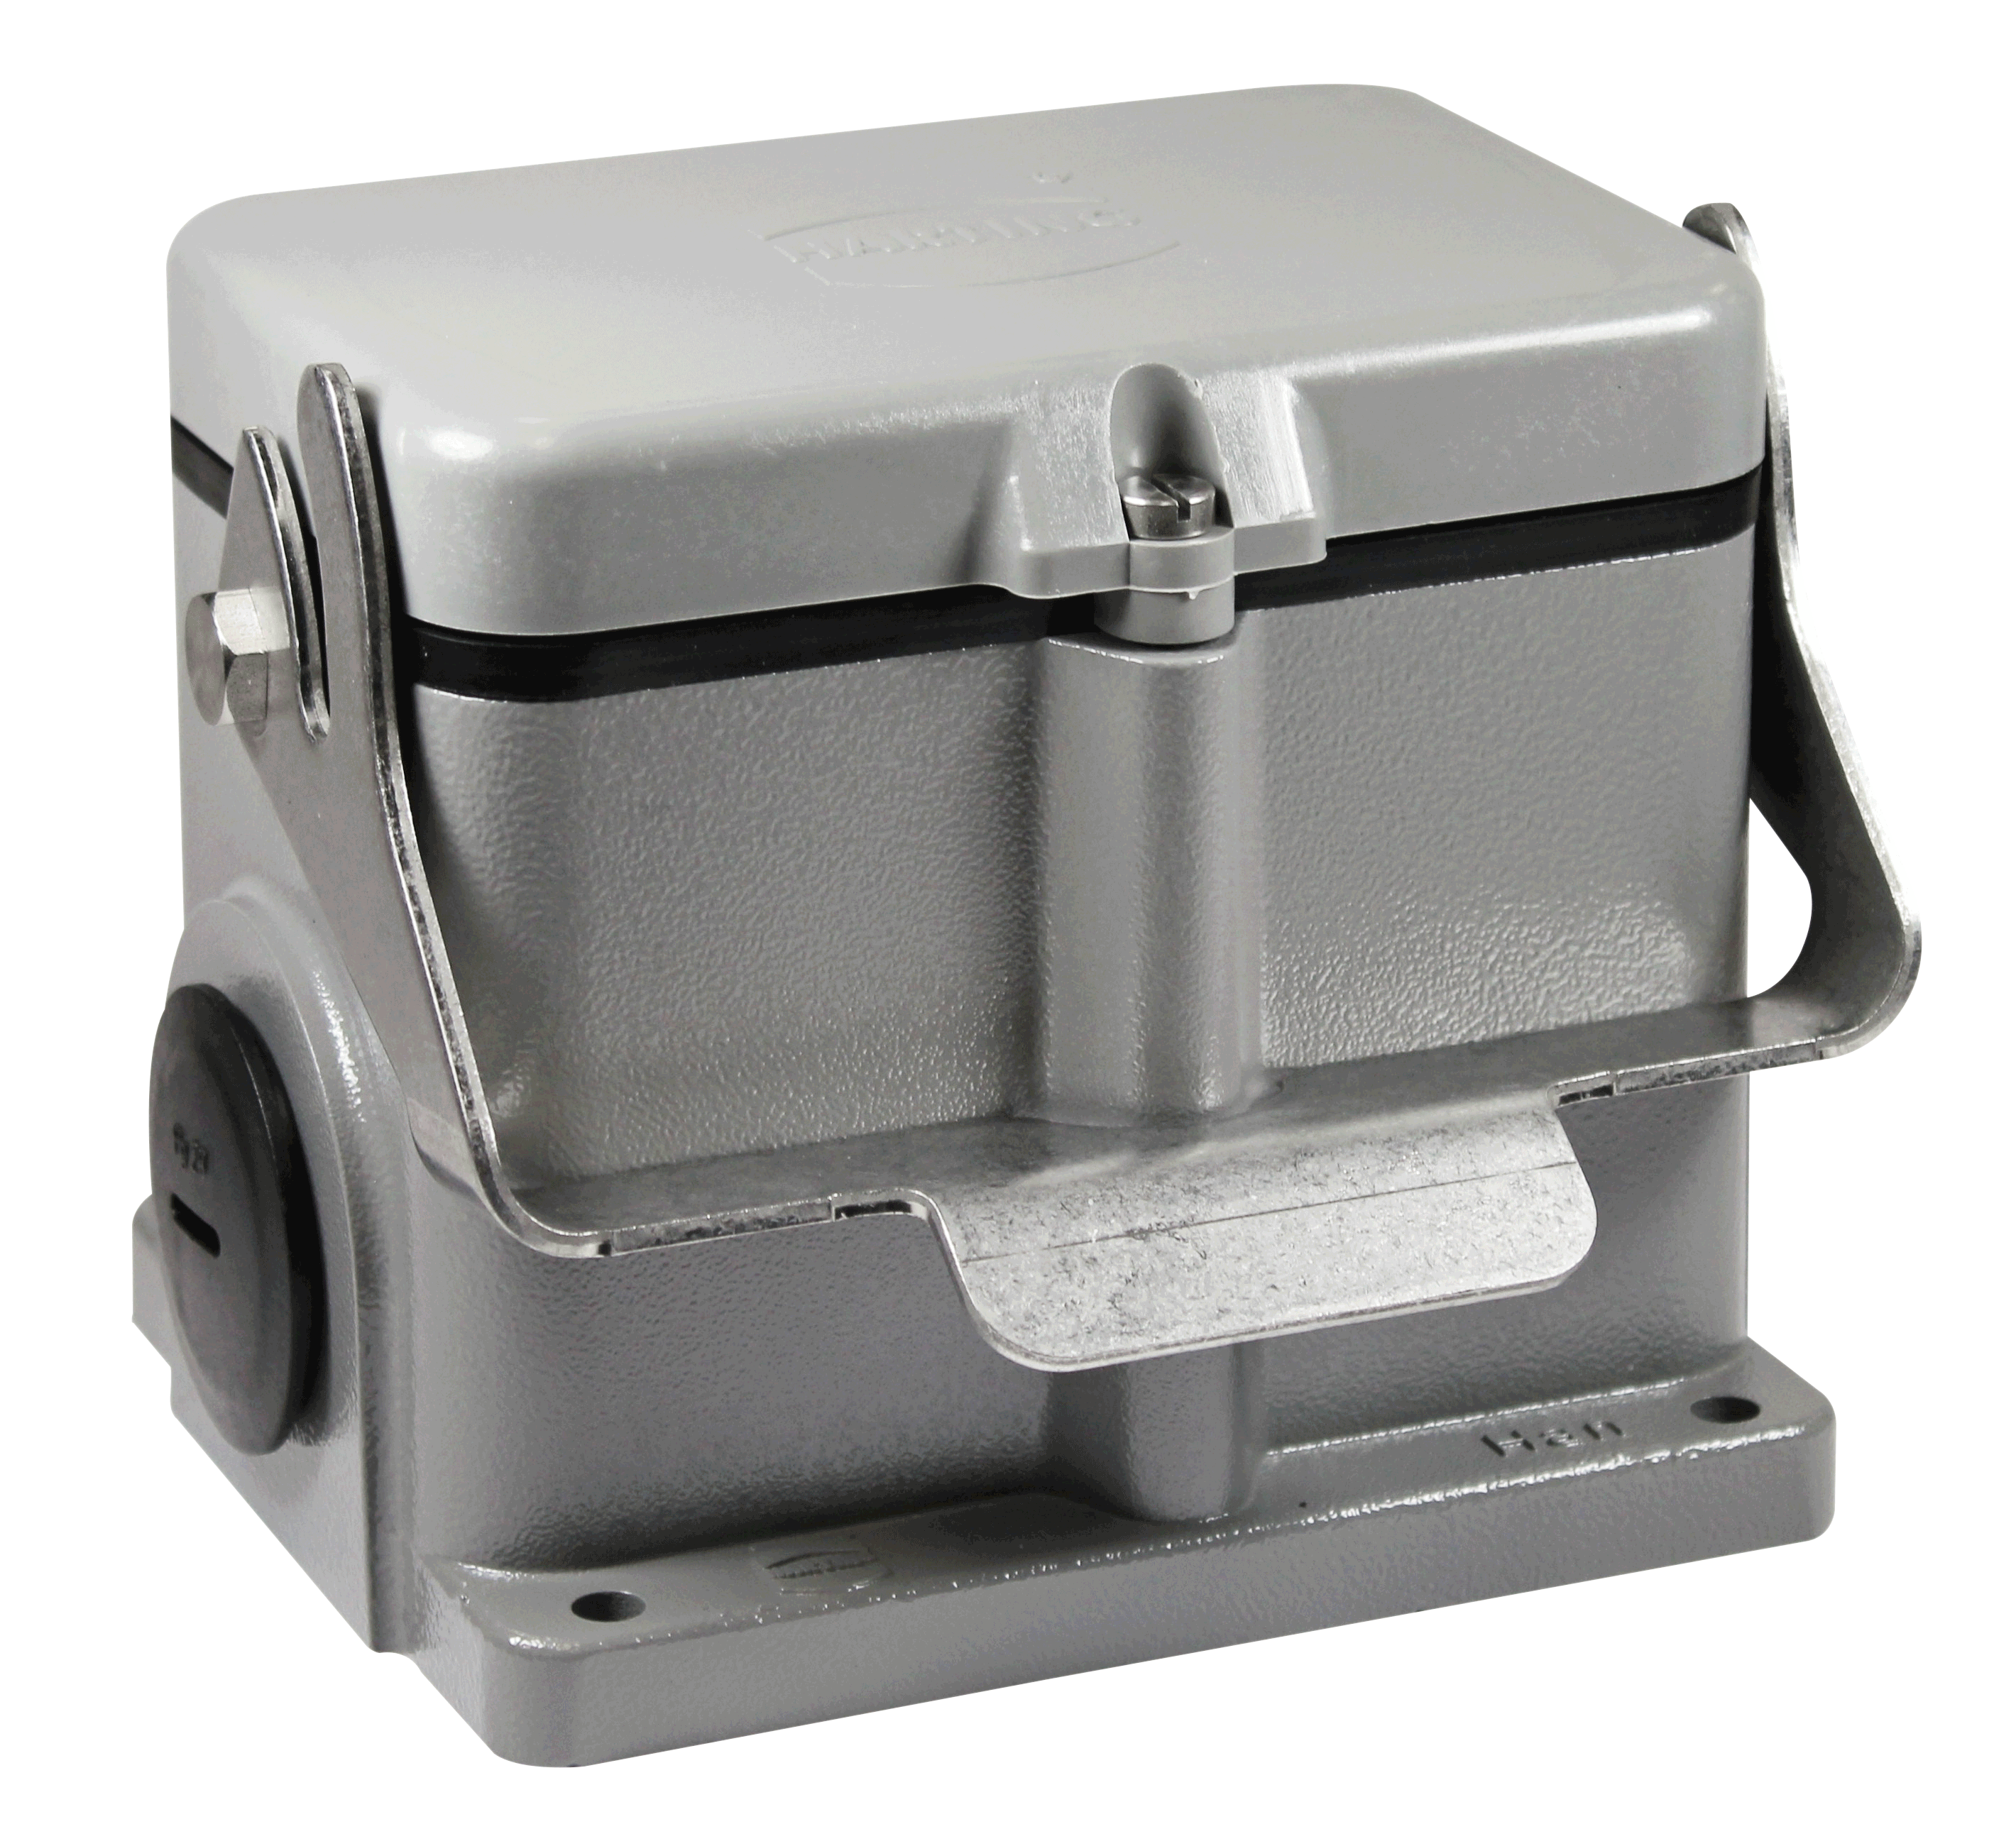
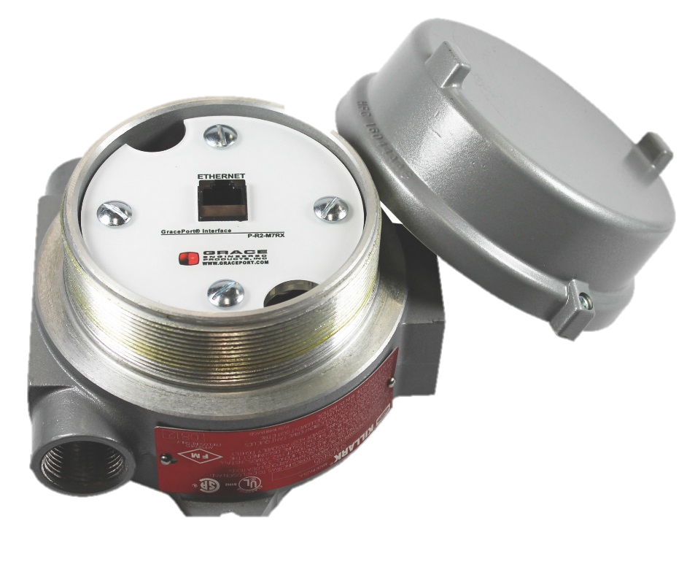
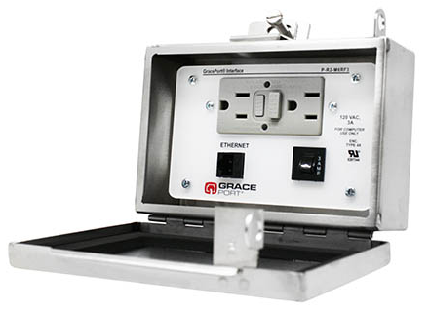
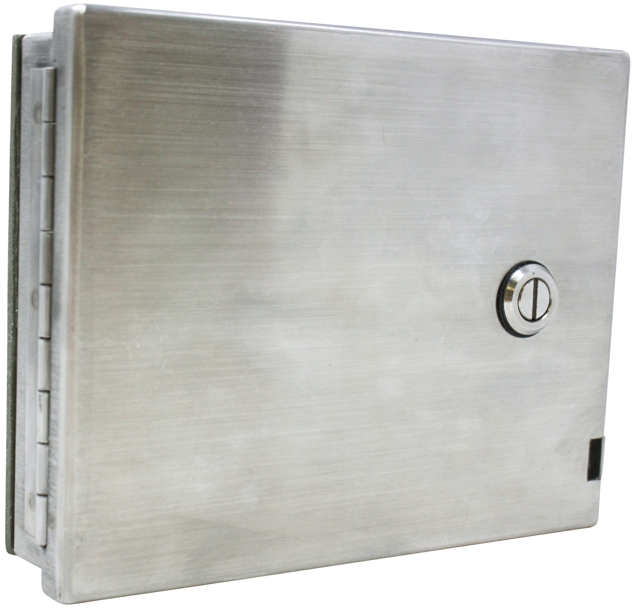
Specialty Housings
GracePort+
A HMI cover kit designed to protect valuable equipment in harsh industrial environments
Stainless Steel
100% stainless steel housing designed to meet rigorous environments. Also available in a low-profile design.
Surface Mount
IP65 and UL Type 4 Rated. Suitable for corrosive environments and/or areas that require frequent washdowns.
Hazardous Location
Intended for environments where the user must perform a “sniff test” and typically obtain a “Hazardous Work Permit” before opening the enclosure.
Notes:
Surface Mount verbiage re-work.
Stainless steel 304/316
Heavy Duty field mount connectors.
GracePort+ is a great way to protect HMIs and prevent interruptions due to damage caused to an HMI. It’s much easier to replace the GracePort+ than to pay for a system integrator or Controls Engineer to fix or repair a damaged HMI.
Working with sequestered panels you can drop the voltage down below 50V’s and still work on your panels.

Slide 9
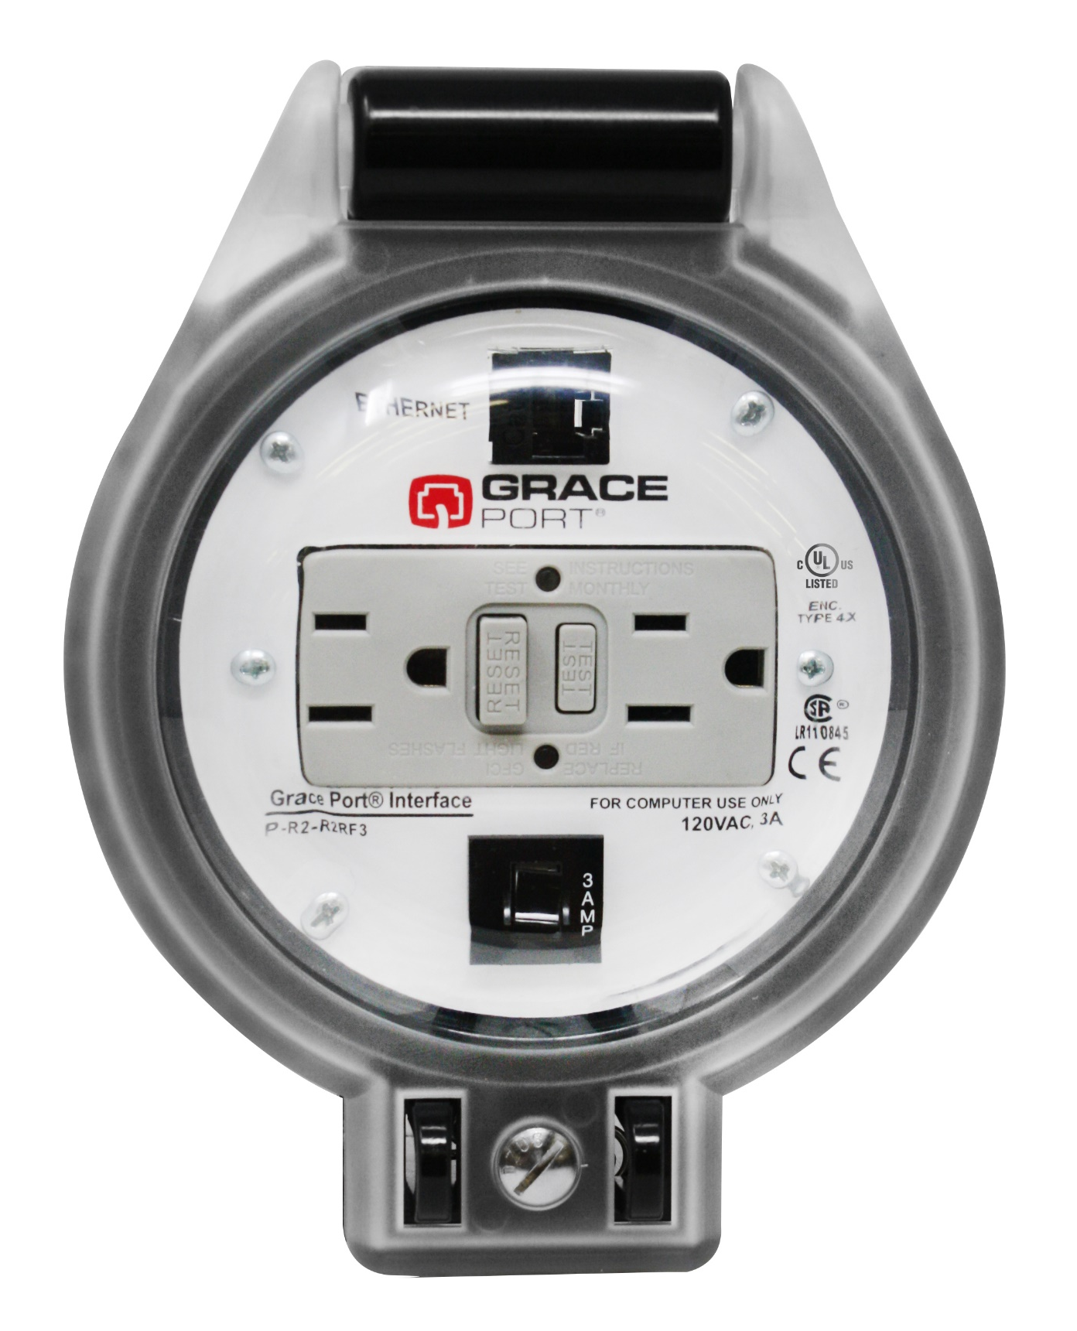
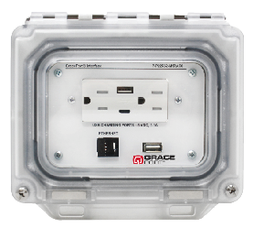
Newest Innovations
P-R2-R4RF3
P-P22R62-M9RAC0
ThruView™ 360
UL Listed: Seamlessly integrates with existing UL-certified systems, ensuring compliance and reliability in safety standards.
Rapid Punch Installation: Features a circular design that fits a standard knockout punch, enabling quick and easy installation in under 10 minutes.
High-Level Protection: IP66 and IP69* rated, these products offer superior protection against dust, oil, and high-pressure water and are suitable for harsh industrial environments.
*IP69 pending approval
MagView™
UL Listed: Ensures compliance with rigorous safety standards, allowing seamless integration with existing UL-certified equipment.
Patented Magnetic Seal: Features a hands-free magnetic seal that magnetizes to the panel when open, allowing easy access while reducing safety risks.
Robust Environmental Protection: Offers superior shielding against environmental elements with UL Types and IP ratings, including IP66, IP69, and IP69K, ensuring durability in diverse operating conditions.

Slide 10
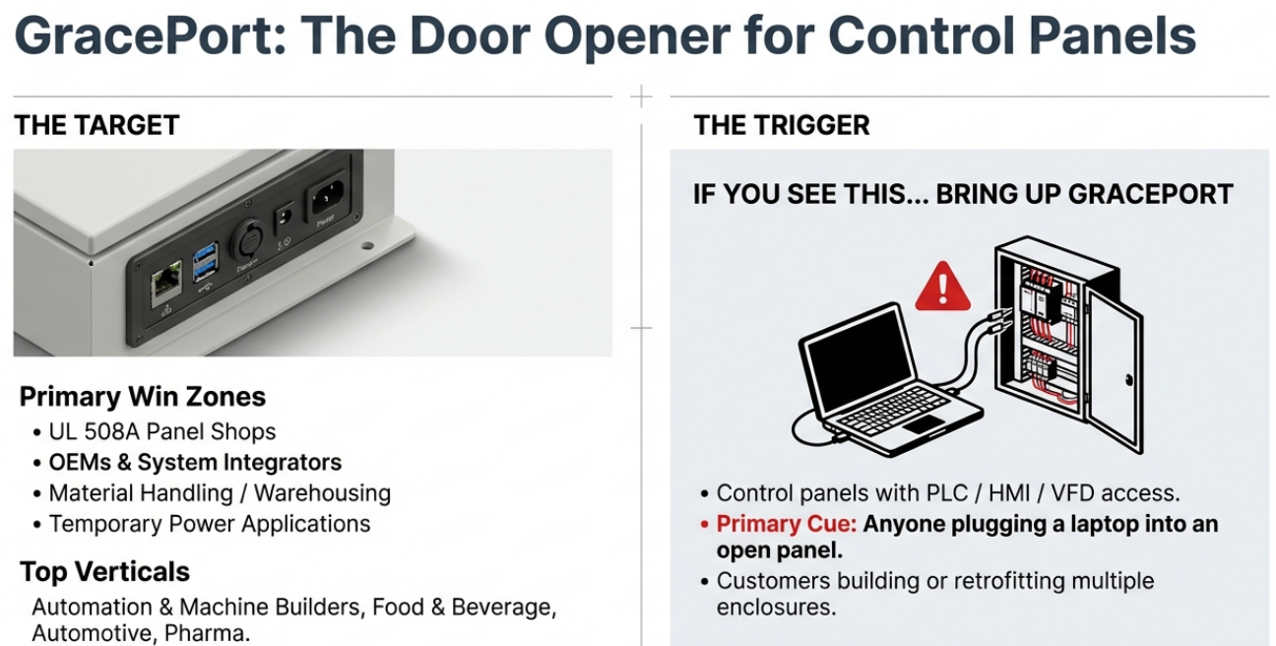
Who to Target

Slide 11
Permanent Electrical Safety Devices

Slide 12

Did you know….
70%
Of all workplace injuries happen during reactive maintenance
35%
Due to direct contact with wiring, transformers or other electrical components
Occurred on 3-phase low voltage systems
60%
Open Door Testing with Meter is a leading cause of Arc Flash
PPE
The cost of these preventable incidents can cost $50,000 - $10 Million+
Notes:
Open door testing with a meter is a leading cause of arc flash*
70% statistic needs to be proved/application? Change to 3-5X? More likely to touch before you test during reactive maintenance*
Reduce non-compliance to electrical safety standards NFPA 70E. Skilled labor shortage. Compliance = Safety / Productivity Discussion – Reduction in PPE / Closed door verification of voltage.
Maintenance personnel are being pressured and are rushing to
We know electrical safety is an important part of every industry. Electrical injuries are very prevalent during reactive maintenance. 60% of those injuries occurred in low voltage 3-phase systems. You’d think that medium voltage would be more common due to it being higher voltage, but with low voltage corners might be cut more frequently.
Testing with a meter is a high risk action. You’re right there at the live conductor.

Slide 13

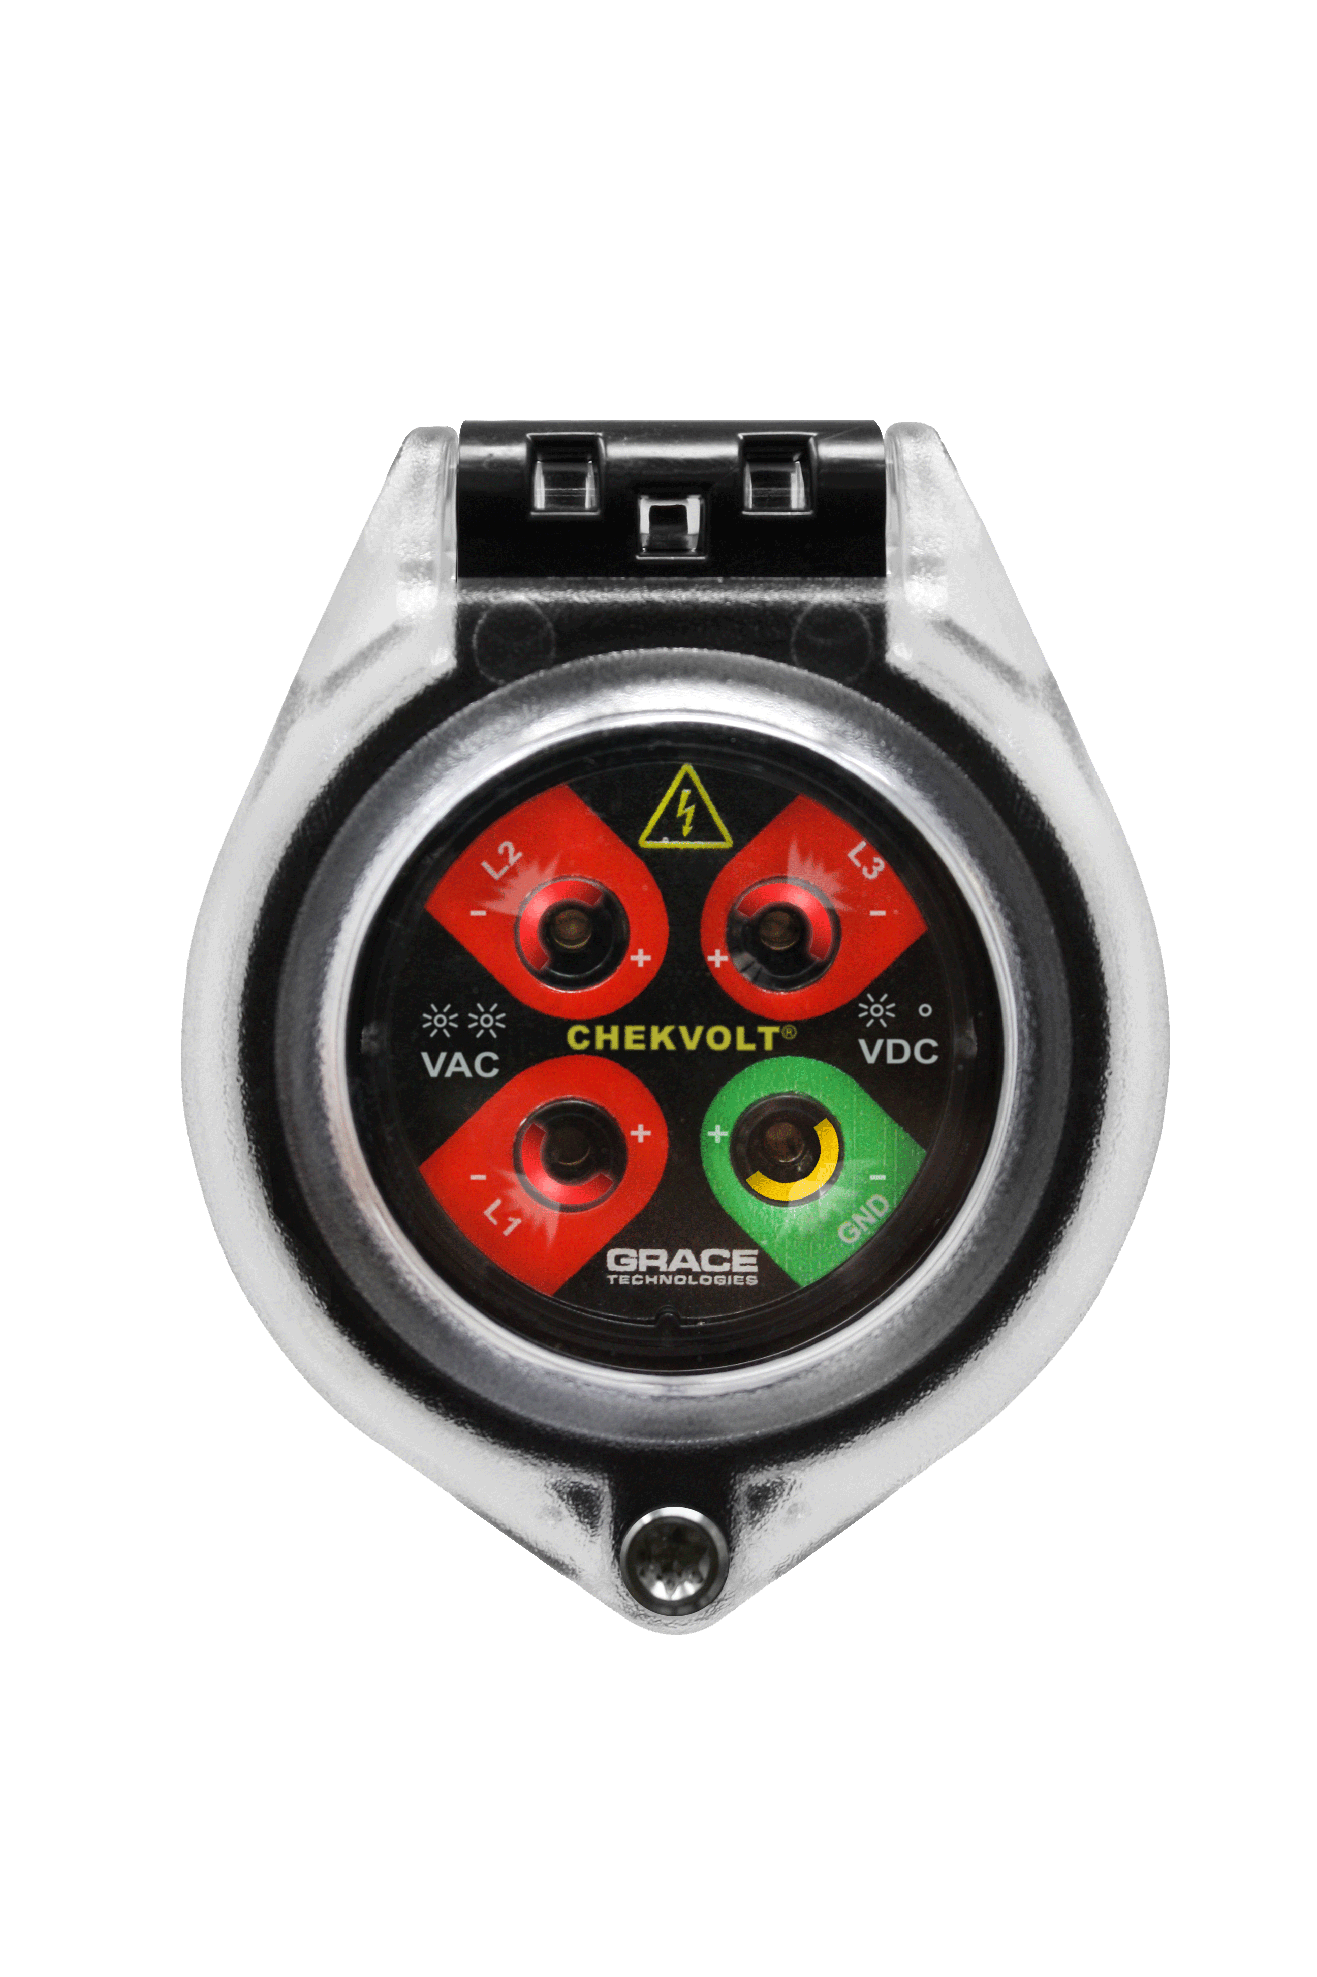
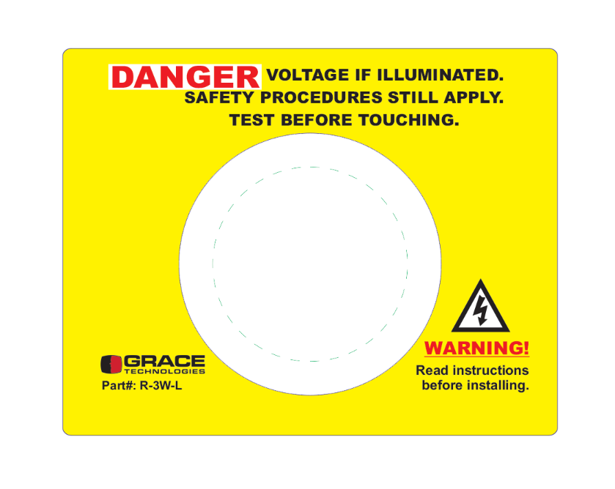
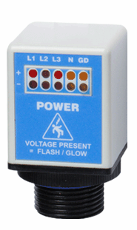
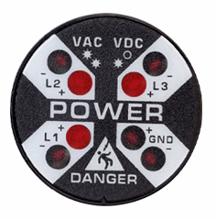
Advantages of PESDs®
Elimination
For electrical and mechanical LOTO, cost effective, high impact risk reduction
Substitution
Engineering Controls
R-3MT-VI
ChekVolt, Safe-Test Point, and Voltage Test Station PESDs
pay for themselves after 2-3 LOTO Procedures
Awareness
Administrative
Controls
R-3D2
R-3W-L-KIT
PPE
Notes:
Hierarchy of Risk Controls (NFPA 70E) Article 120.6 process for establishing an electrically safe working condition
For electrical and mechanical LOTO, we do our best to eliminate risk altogether. These devices are in-expensive, low hanging risk reduction fruit. They pay for themselves within 2-3 LOTO procedures and are installed using a 30mm hole punch

Slide 14
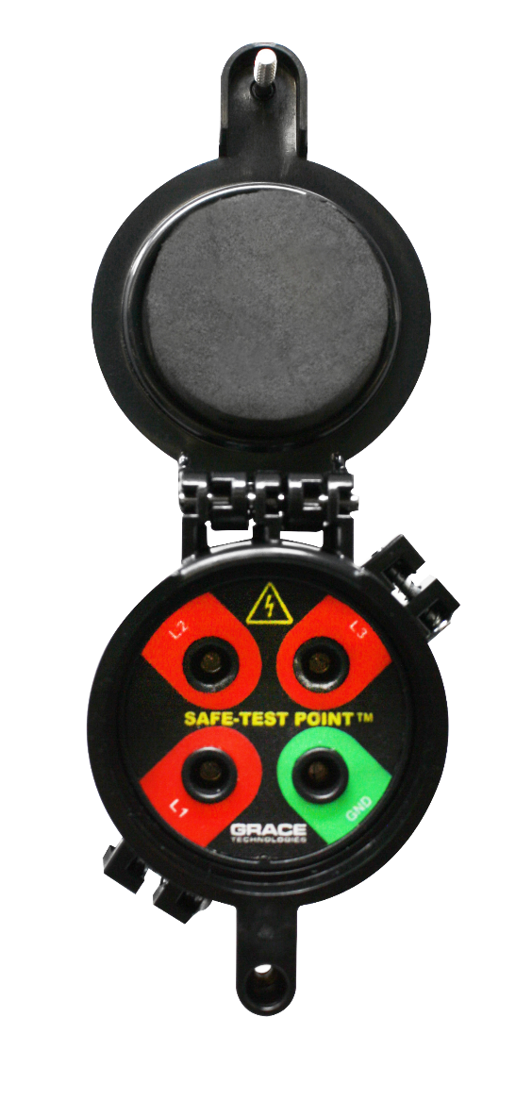
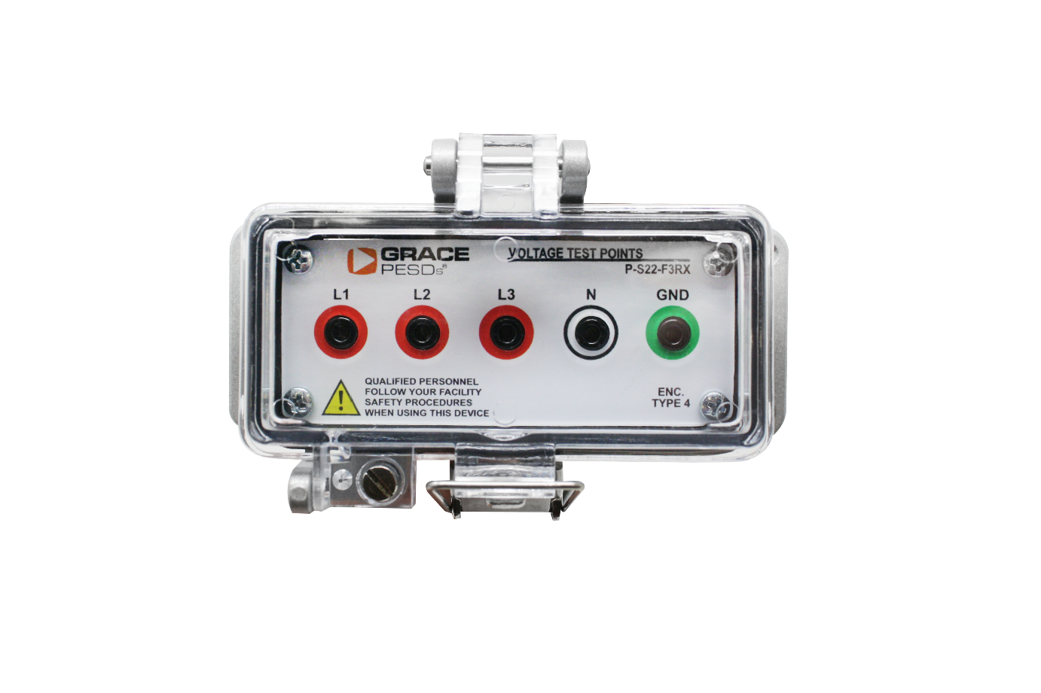
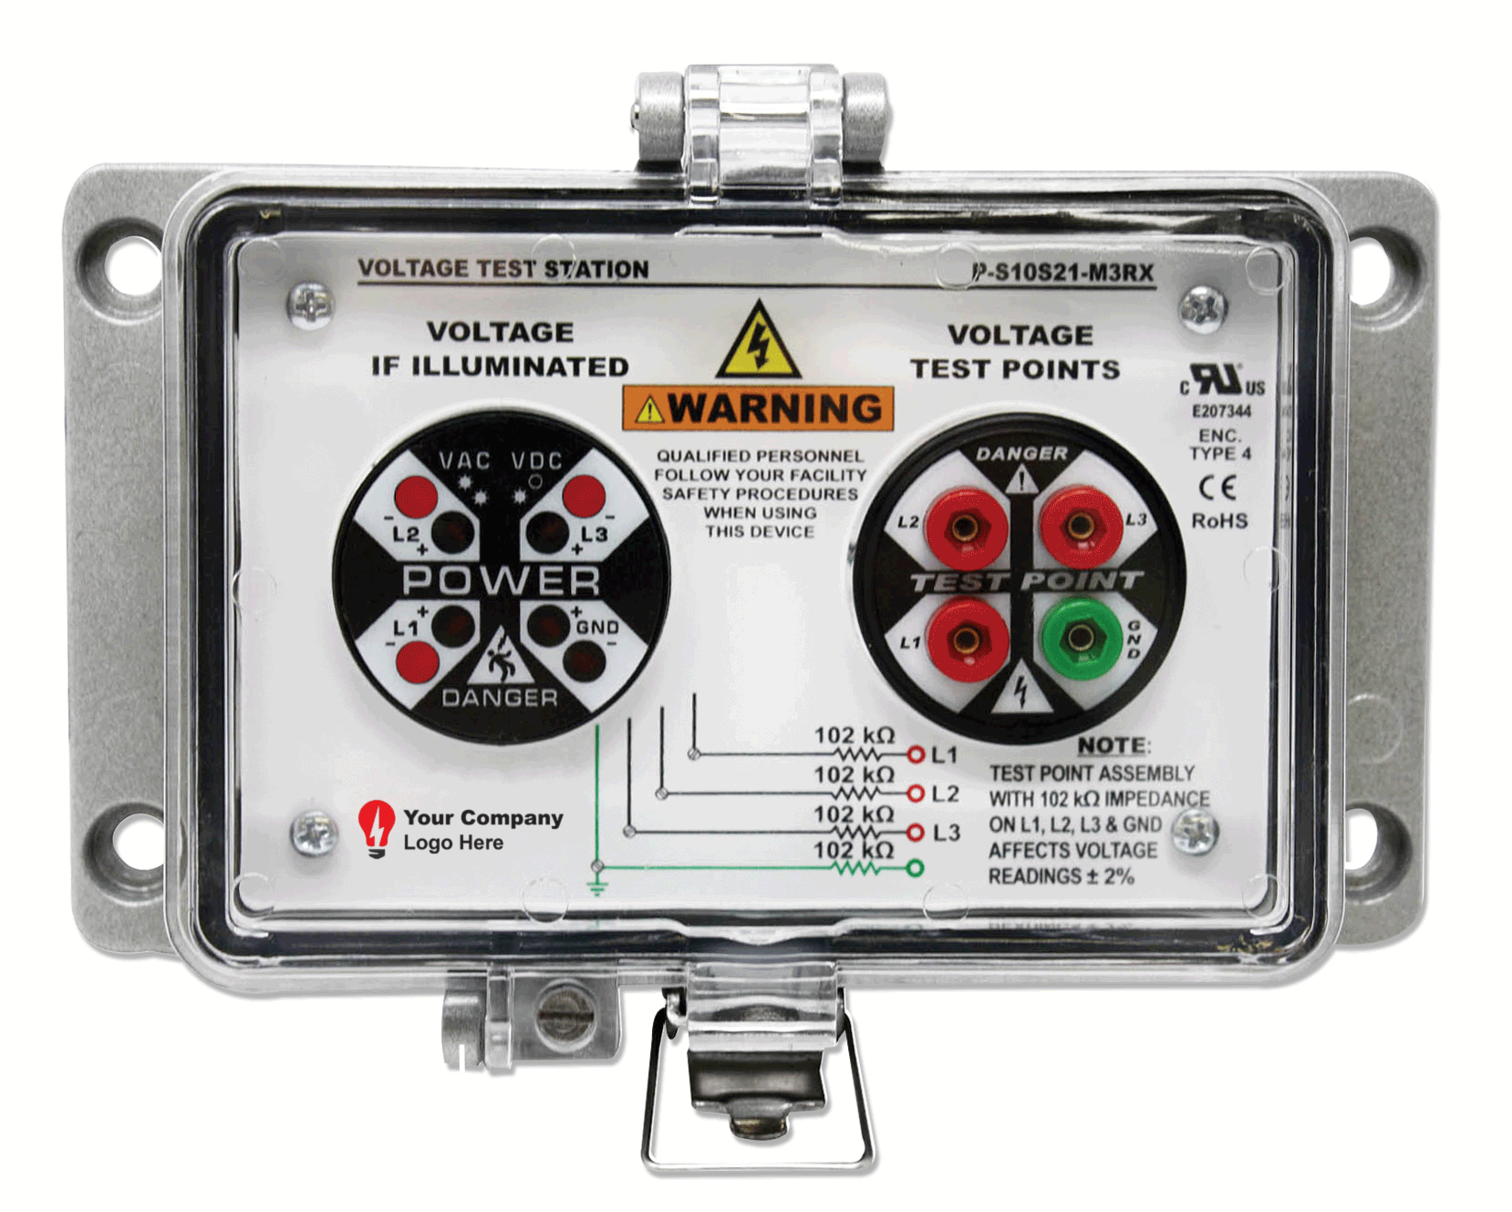
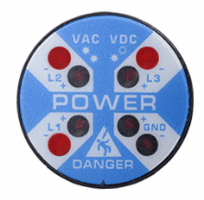
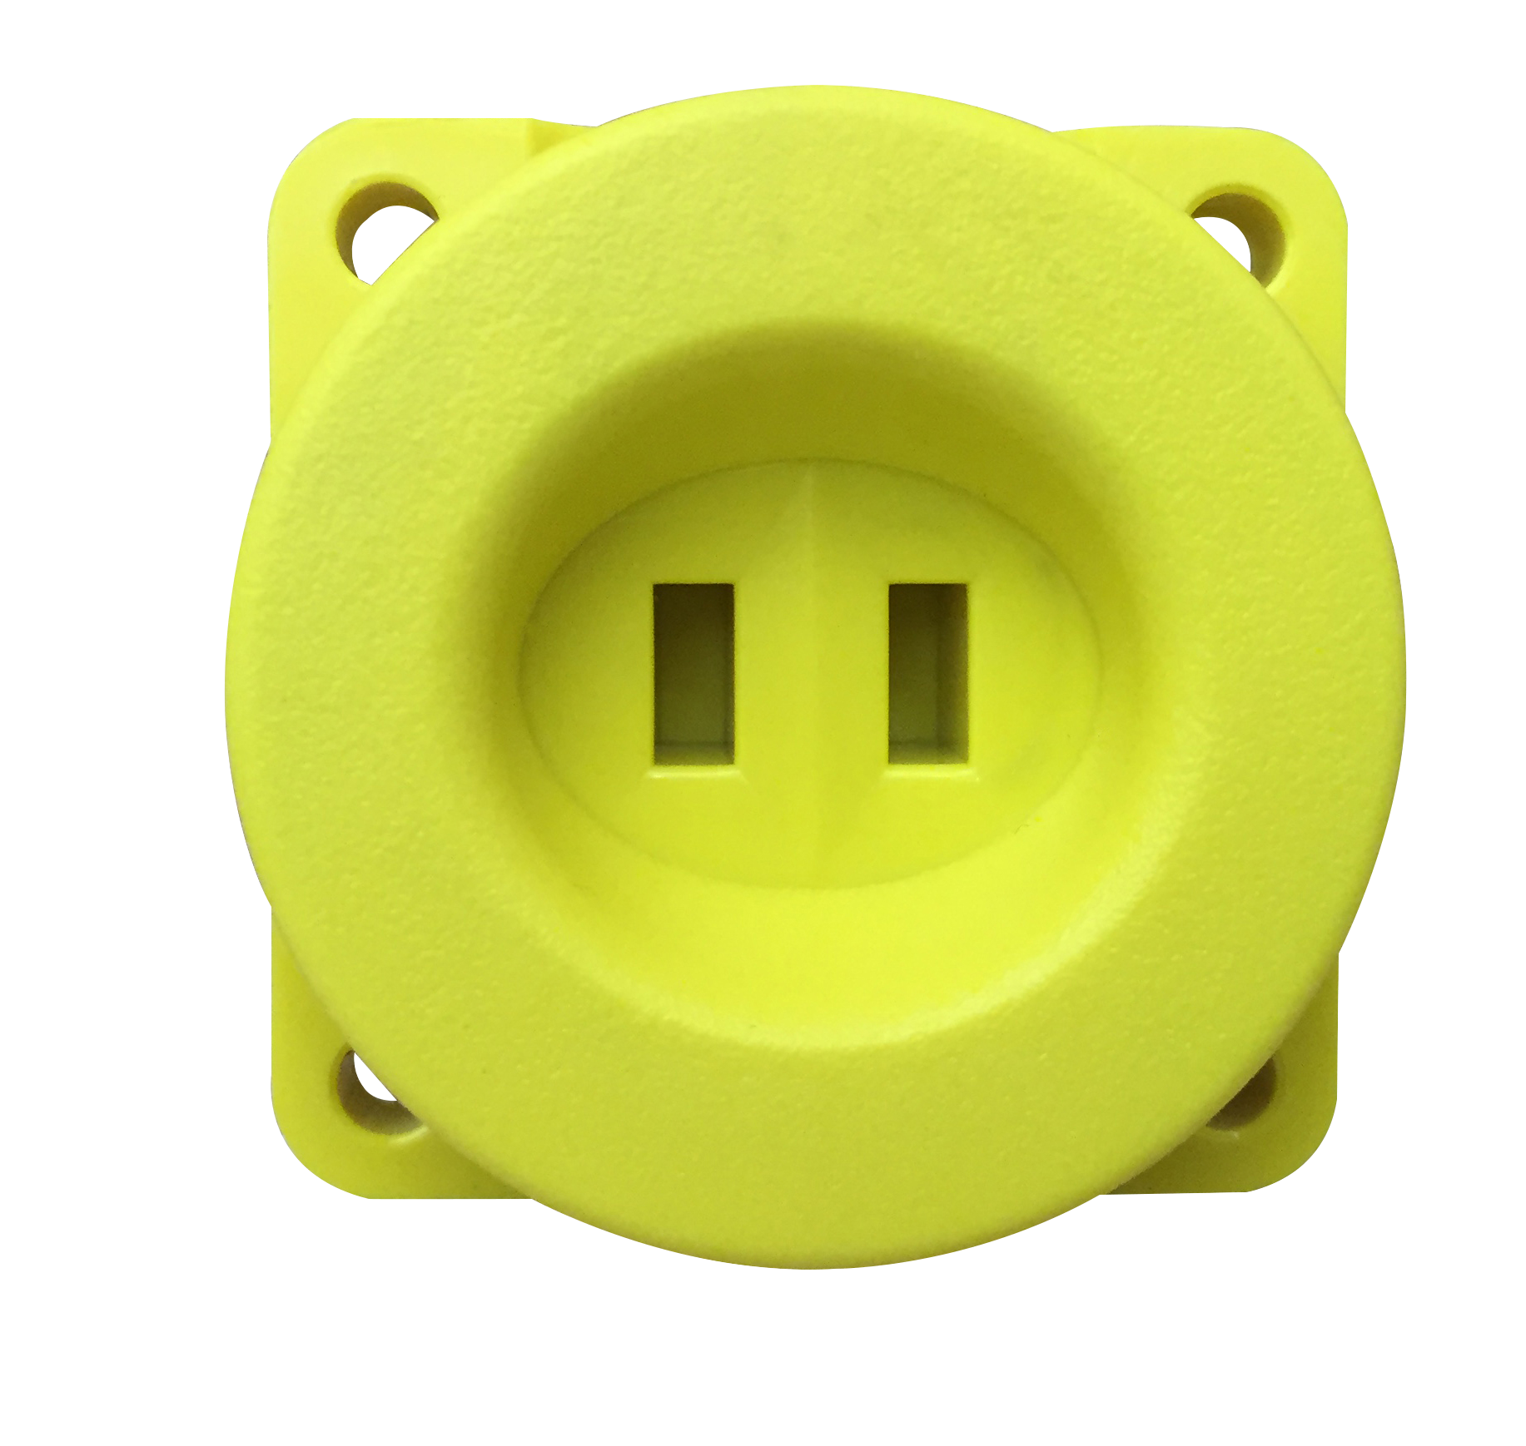
A PESD for Every Application
R-3W2
R-3K
P-S10S21-M3RX
R-3MT-VI
R-5MT
R-3MT-1K
Voltage Indicators
Voltage Portals
Voltage Test Station
ChekVolt
Safe-Test Point
Notes:
Add the trouble shooting capabilities of the R-3W -> I.e. phase loss, stuck blade, etc. Be sure to distinguish between mechanical vs. electrical LOTO and reference a bump/try test when using Voltage Indicators only.
Reducing time spent locking-and-tagging out equipment by 74%.
Voltage Indicators are primarily used in mechanical LOTO and also used in conjunction with the OSHA required try or bump test. This means you try to start the machine after isolation of power using a starter switch. If you are pressing a green button to try to do a “try” test, it isn’t as a sure way to ensure the power is isolated. When adding the Voltage Indicator this is an additional opportunity to verify voltage. It also has other features such as phase loss, stuck blade, etc.
ChekVolt is THE fastest selling new product we offer.

Slide 15
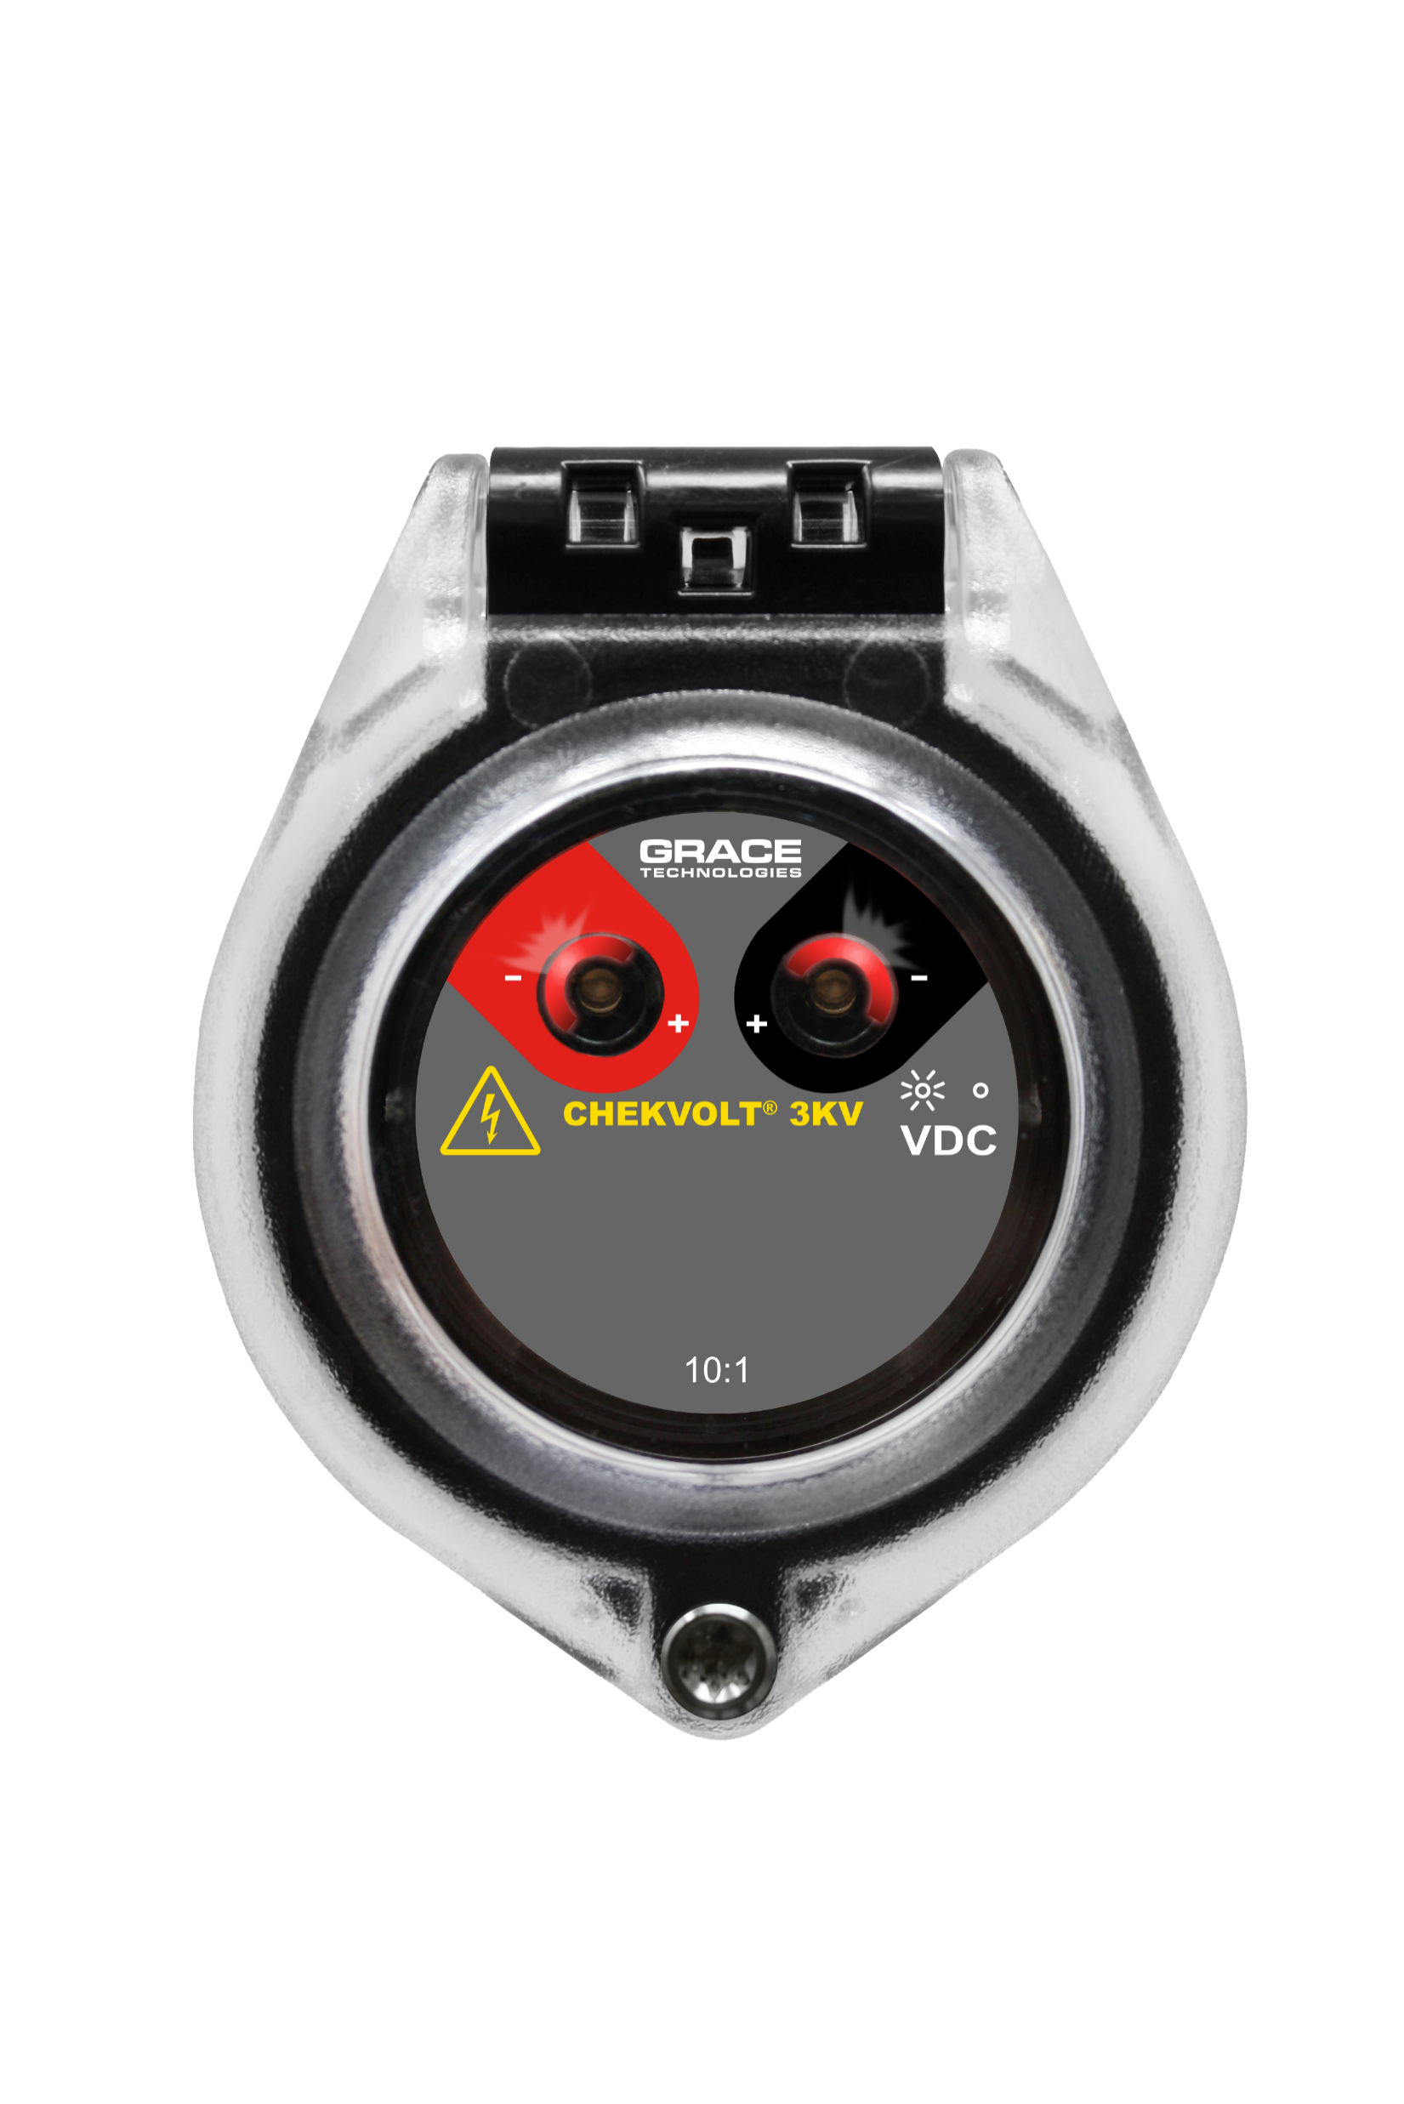
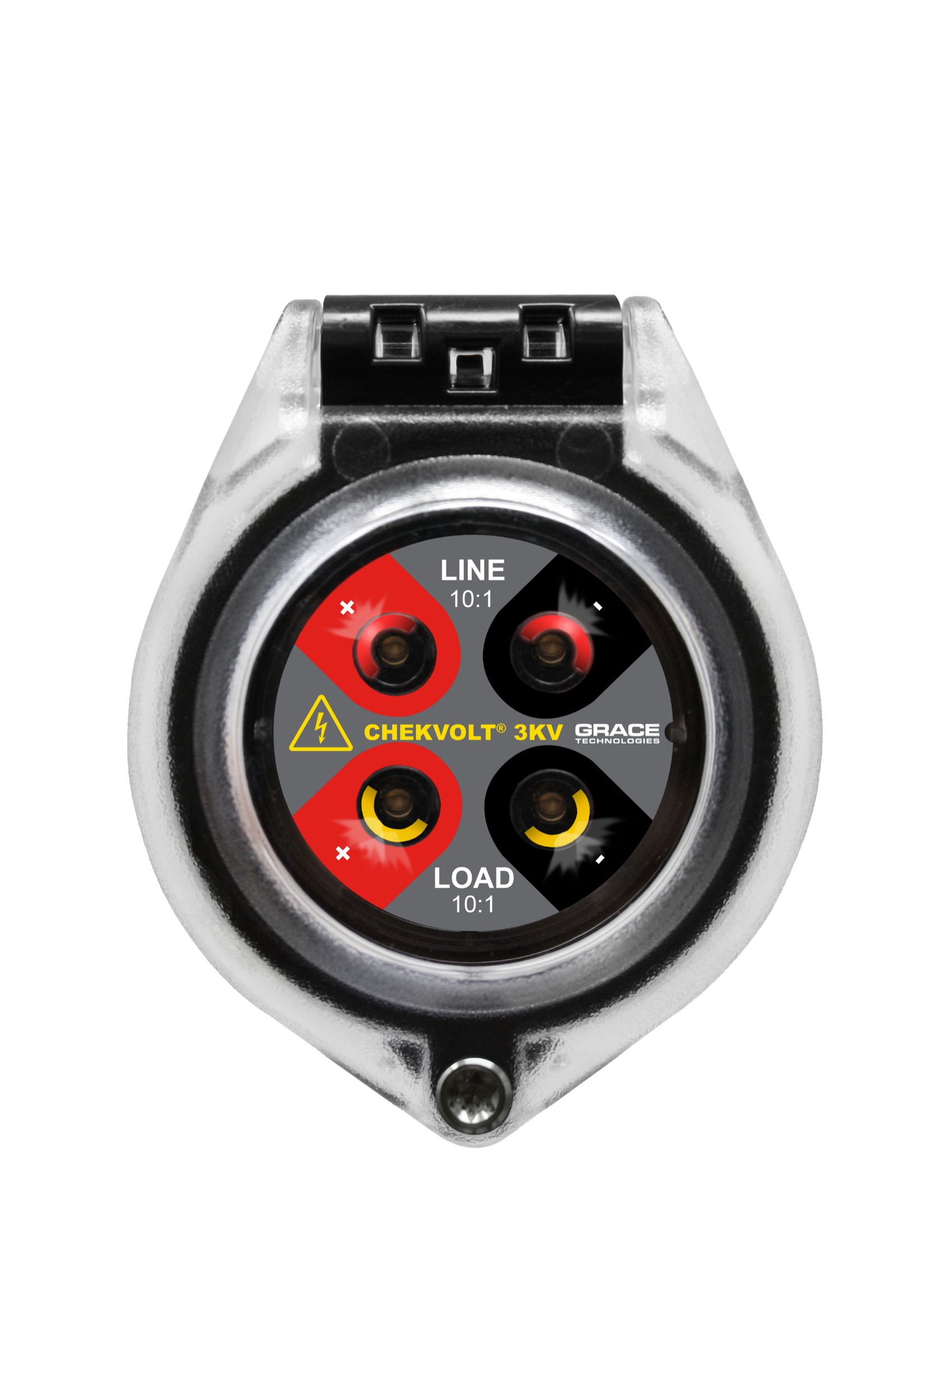
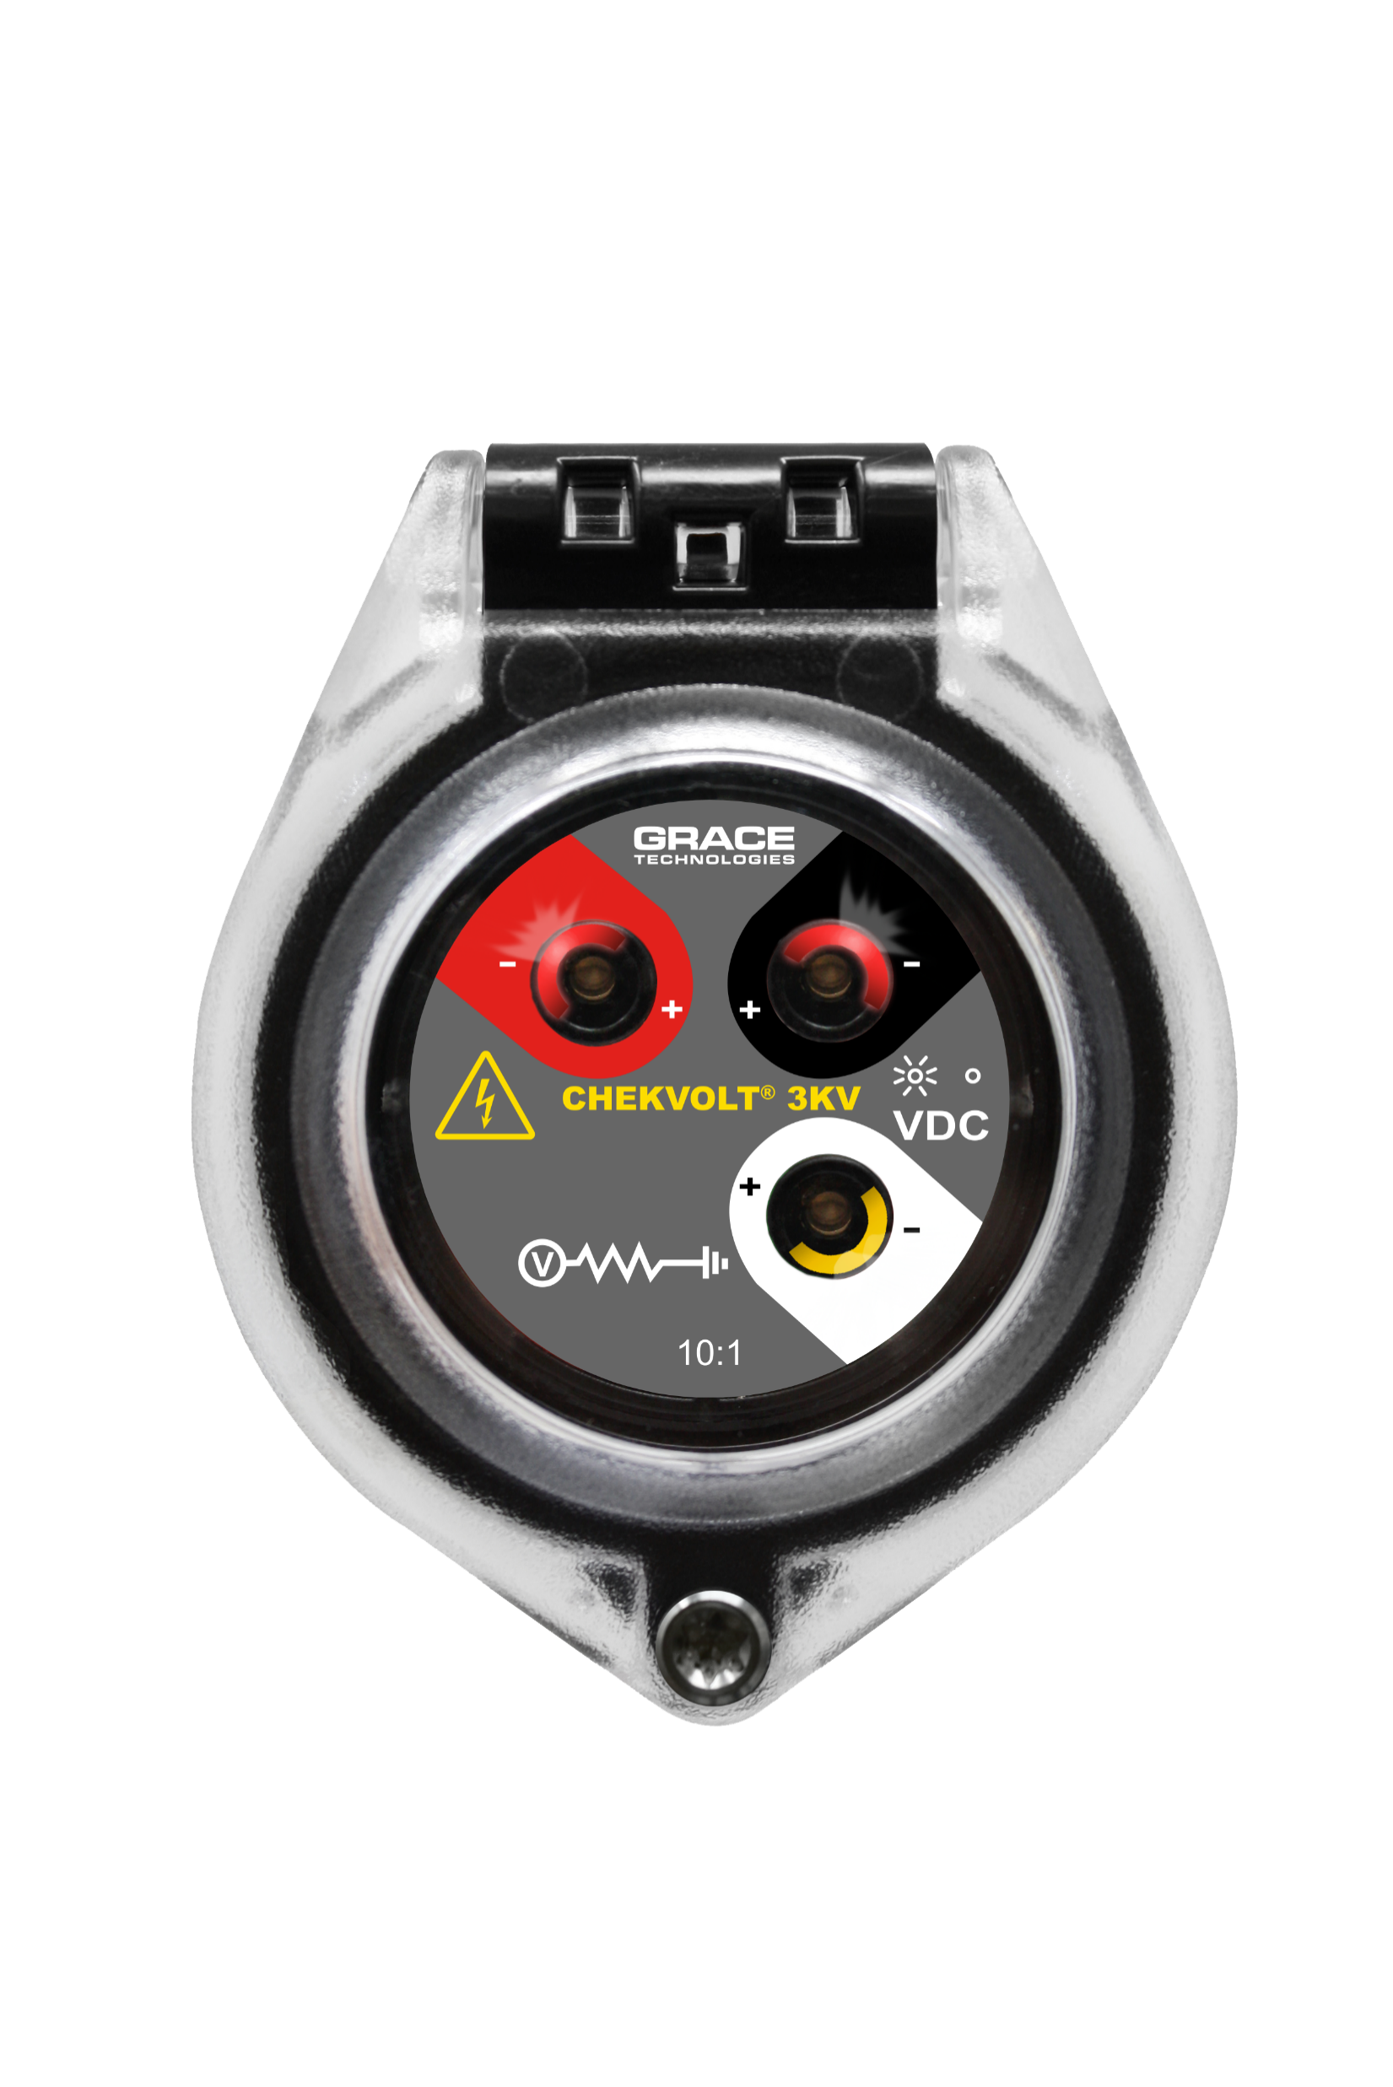
Electrical LOTO - ChekVolt®
Voltage Range: 0-1,000 VAC
0-1,000 (3K) VDC
High impedance protected test points (164KΩ)
  480V/√3/(164k * 2 *.95) = 1.5mA (Phase-to-Phase)
  600V/ √3/(164k * 2 *.95) =1.9mA (Phase-to-Phase)
  1000V/ √3/(164k * 2 *.95) =3.2mA (Phase-to-Phase)
CAT III (to 1000 VAC) & CAT IV (to 600 VAC)
Measures full voltage with -3.3% accuracy
UL/IEC 61010, CE, UKCA & CSA C22.2 No. 94.2/UL 50E
  UL Type 4, 4X, 12, and 13 & IP66, IP69
R-3MT-VI-3K10-DC2
R-3MT-VI-3K10-DCLL
R-3MT-VI-3K10-DC3
R-3MT-VI

Slide 16
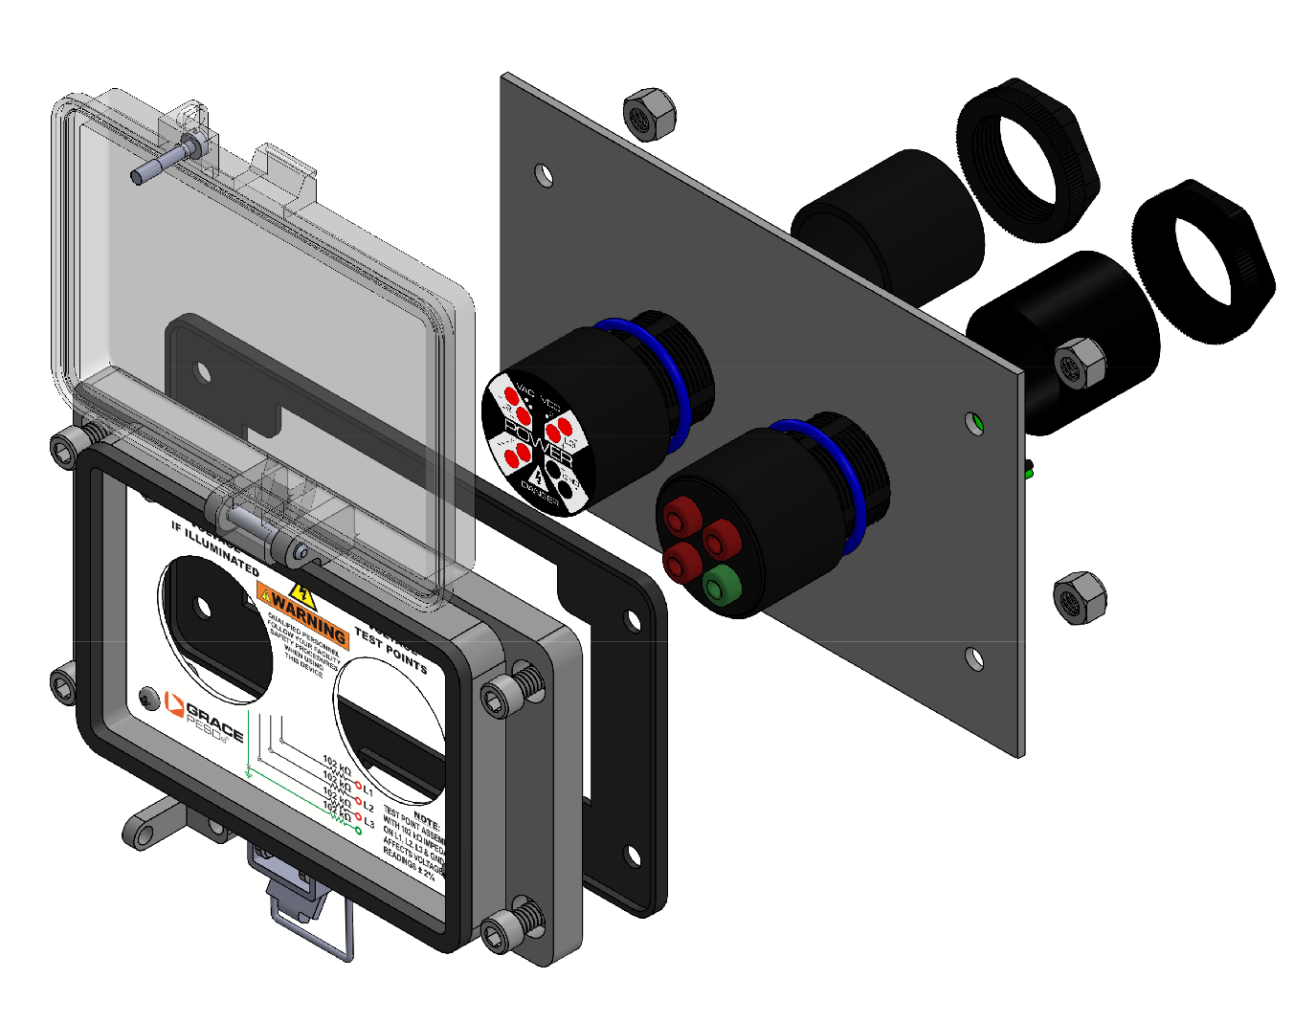
Electrical LOTO - Voltage Test Stations
Voltage Range: 0-1,000 VAC
0-1,000 VDC
High impedance protected test points (164KΩ)
  480V/√3/(164k * 2 *.95) = 1.5mA (Phase-to-Phase)
  600V/ √3/(164k * 2 *.95) =1.9mA (Phase-to-Phase)
  1000V/ √3/(164k * 2 *.95) =3.2mA (Phase-to-Phase)
CAT III (to 1000 VAC) & CAT IV (to 600 VAC)
Measures full voltage with -3.3% accuracy
UL/IEC 61010, CE, UKCA & CSA C22.2 No. 94.2/UL 50E
  UL Type 4, 4X, 12, and 13 & IP66, IP69
P-S10S21-M3RX
H-S10S21-M3RX

Slide 17
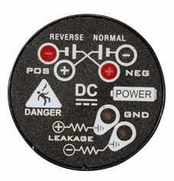
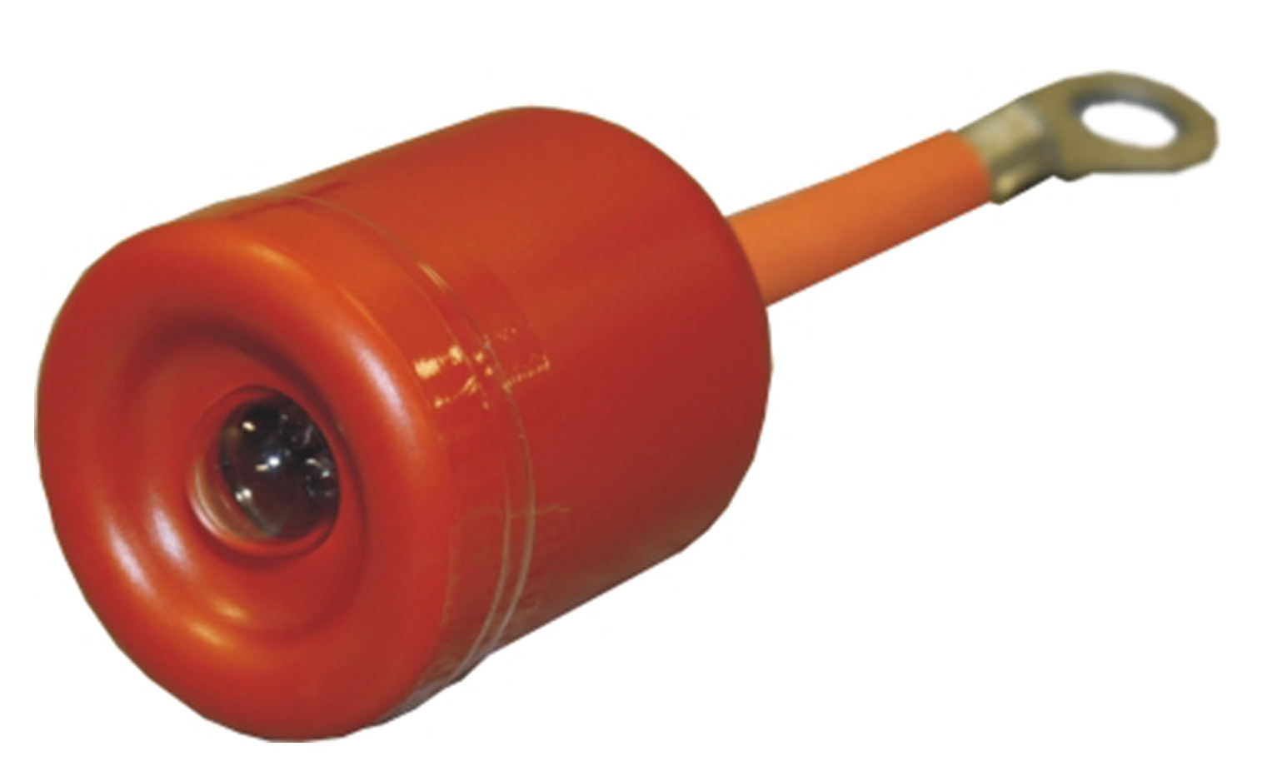
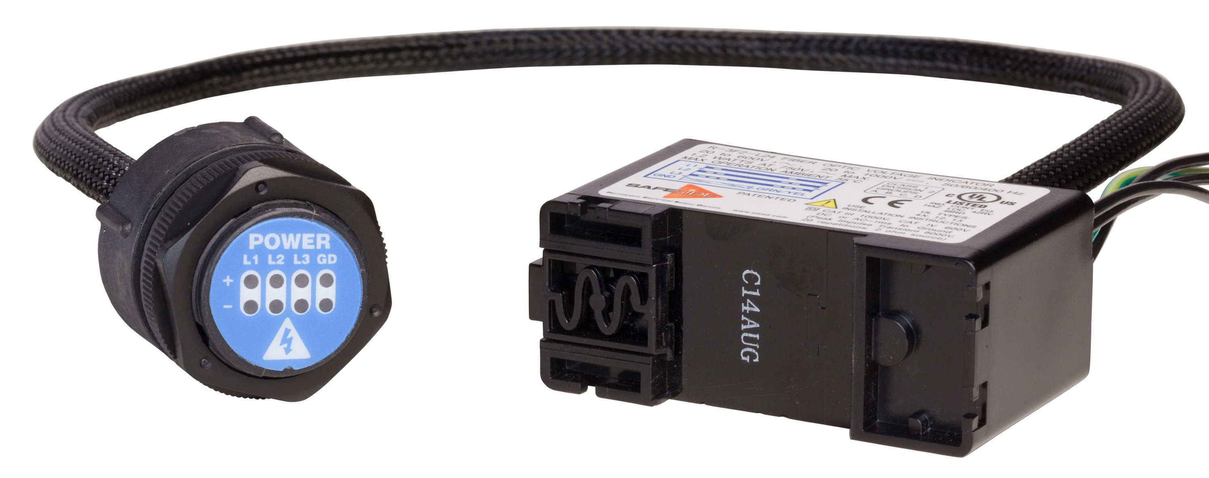
Voltage Indicators & Portals
Different options for Voltage Indicators
  Fiber Optic, Class I Div II, Medium and DC Voltages, etc.
Mechanical LOTO
Visual Indication of Presence of Voltage
Easily troubleshoot stuck blades, phase loss, or stray voltage running to the ground
R-3W
R-3W2
R-3W-DC
R-3D2
R-1VL003 & R-1VH003
R-3K
R-3F2

Slide 18
Safe-Test Point
Electrical LOTO Made Easier & Safer
Voltage Range: 0-600 VAC
0-600 VDC
Frequency: 0-3,000Hz, 50/60/400Hz
High impedance protected test points (102KΩ)
  480V/√3/(102kΩ)= 2.35mA (Phase-to-Phase)
  600V/ √3/(102kΩ)=2.94mA (Phase-to-Phase)
IP2X & UL 600 V Touch Safe
CAT III/IV
Measures full voltage with -2% accuracy
Feature Dust Cap
CE, UL Listed 12, 13, 4, 4X
R-5MT
R-3MT-1K-KIT
R-3MT-KIT
Notes:
Built in impedance on the backside of the device. You will still test full voltage, but shock is derived from current, not voltage. With the built-in impedance of the device, we reduce the max fault current to 2.3 mA.

Slide 19
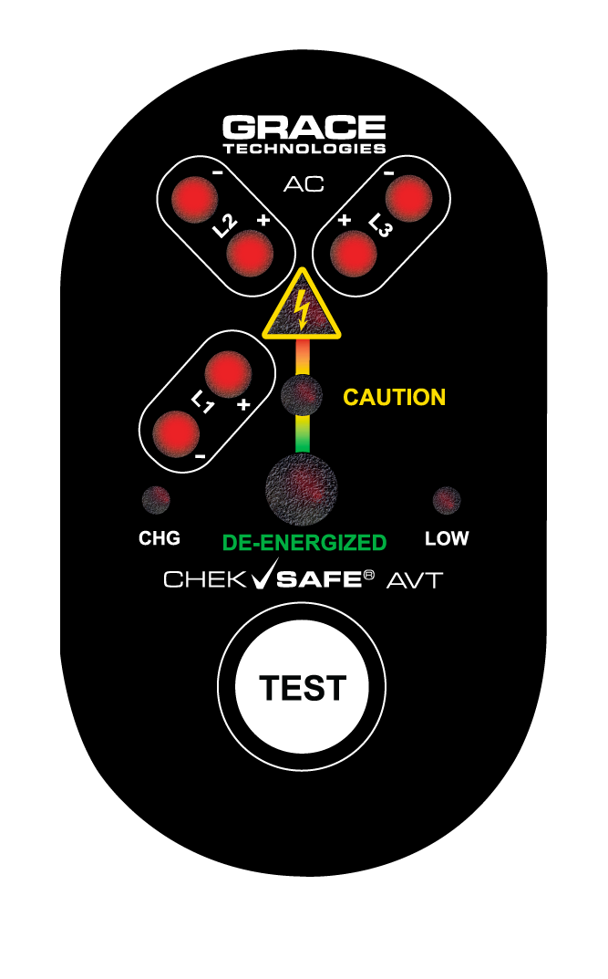

New Innovations
5X Smaller footprint: Installs through a single 30 mm knockout and ; fits small isolators, unusable panel space and disconnects.
Error-proof installation: Innovative termination design ensures proper wiring; the device disables itself if connections are incorrect. Nothing to pull in, fully assembled.
No connectors, no battery, no problem: Factory-sealed and self-powered for maximum reliability.

Slide 20
ChekSafe Operation
Hazardous Voltage
RED LED > 20V
Line Powered Phase Voltage Presence LED Pairs
CAUTION (>3V RMS to ~20V)
DE ENERGIZED (<3V RMS)
Low Charge-TEST Disabled
Charging
TEST Pushbutton

Slide 21
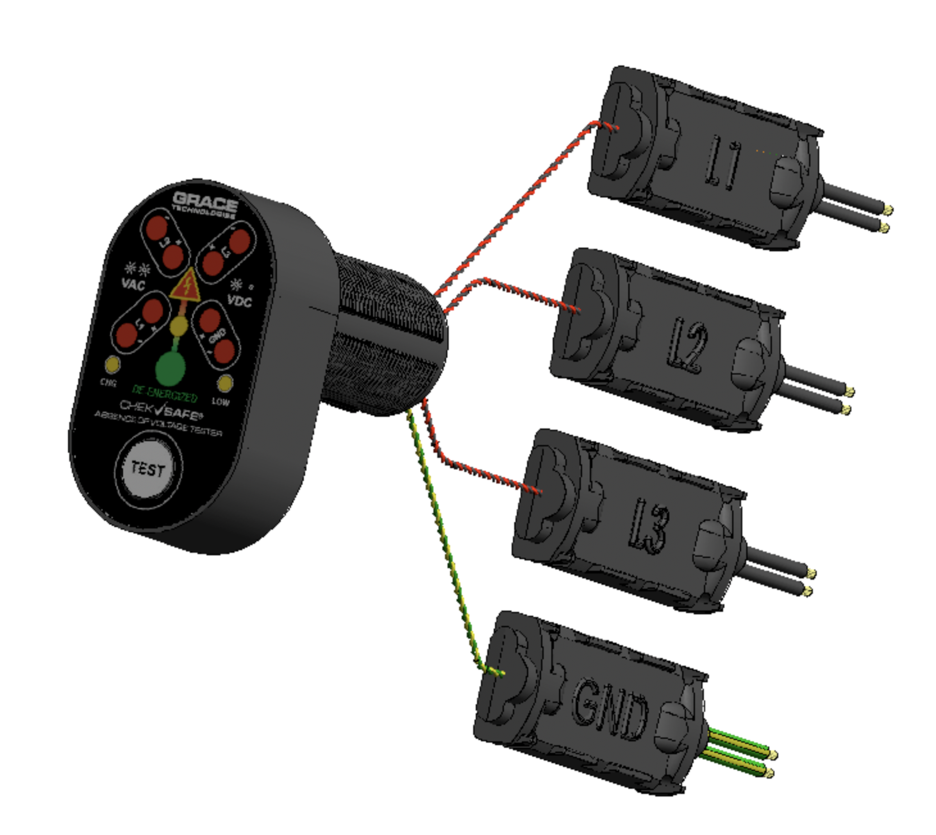
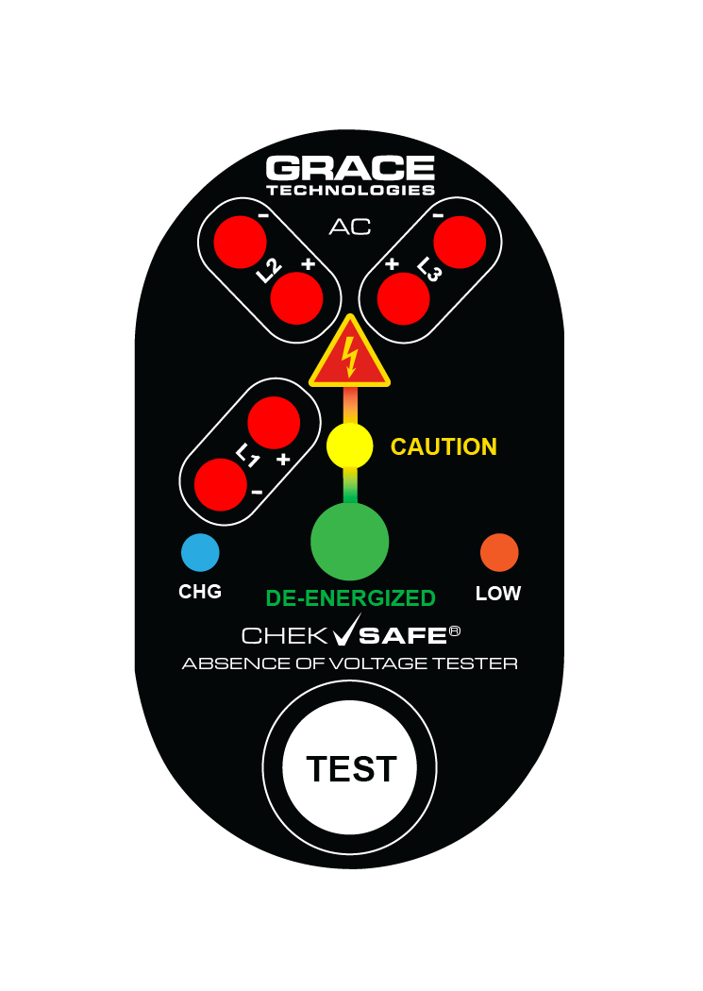
ChekSafe Mechanical Architecture
HMI unit mounts in 30mm hole
Voltage Continuity Interfaces (VCI) for each phase.
NO Connectors, All Hardwired
#14 AWG Voltage Termination Lead-wires
100% Analog Circuitry: low power, no heat dissipation, smaller size, higher noise immunity, lower EMI.

Slide 22
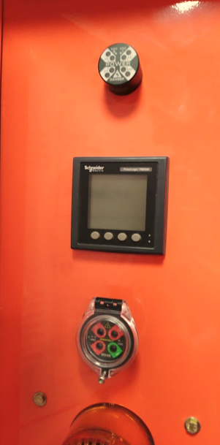
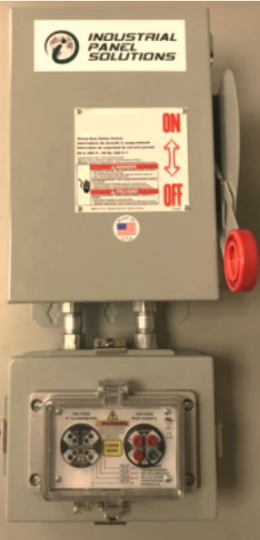
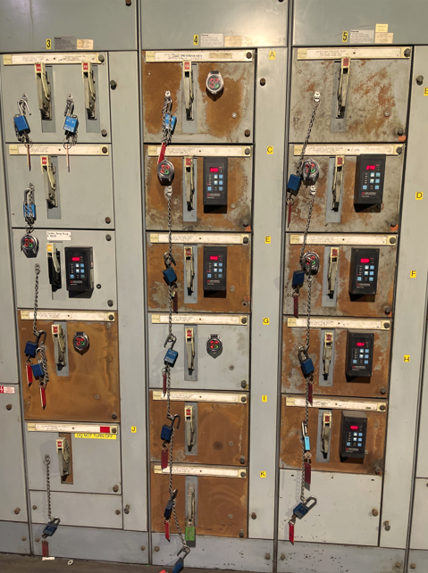


Product installs

Slide 23

Our Experts are here to Help
Our Expert Network can work with you to develop and implement an Electrical Safety Program that will save lives, ensure confidence and consistency across your enterprise.
On every order over $10,000 we include
2 hours of free remote consulting with one of our experts

Slide 24

Who to Target

Slide 25
Intelligent Machine Health Monitoring

Slide 26
Did you know….
The cost of unplanned downtime in process industries per year
70%
of All Workplace Injuries Happen During Reactive Maintenance
$20 Billion
PPE
The compounding effects of these preventable injuries go beyond just the day
of an incident and adversely affect the future of our economies

Slide 27
What’s Your Approach to Maintenance?
Run-to- Failure
Schedule-Based
Risk- Based
Condition-Based
Predictive
Prescriptive
There are many approaches to maintaining equipment
  No one-size-fits-all solution
  Every situation is different
  Criticality assessment is the start of smarter maintenance
However, the goal of any maintenance program is: Optimal Maintenance Budget Allocation

Slide 28

Advantages of the GraceSense®
Predictive Maintenance System
Robust wireless sensor hardware handles nearly all industrial applications
and assets
Ability to integrate existing 3rd Party Sensors
Cloud-based data storage, analysis, and visualization
Real-time alerts contain customizable remediation instructions
  Comprehensive single-platform data collection capabilities
  Meaningful alarms and alerts via SMS, e-mail, CMMS, etc.
  Seamless integration with existing systems (PLC/SCADA/DCS/etc.)
We save our customers money by minimizing unplanned downtime and enabling optimal maintenance budget allocation
Notes:
Each asset requires a different sensing approach
Electrical systems: voltage, frequency, current, power quality
Rotating equipment: vibration, current, temperature
Structural systems (cranes/etc): strain, vibration
Air handlers: temperature, differential pressure, air flow
Conveyors, presses, robots, etc: sensors vary by application

Slide 29




Maximize Production and
Profits with IIoT
Field Mount
Vibration & Temperature
Panel Mount
Customizable Node and Gateways
Hot Spot Monitor
Non-conductive temperature
Maintenance Hub
Data visualization, analysis, and alerting

Slide 30














Condition Monitoring Overview
GraceSense™ Predictive Maintenance
Wireless
Vibration Sensors
Cloud Gateway
Cloud
Maintenance Hub
Hot Spot Monitor
Combo Gateway
Public API
CMMS / SCADA
OR PLC
Wireless Panel-Mount
Sensors
Control Gateway
30

Slide 31

Wireless Vibration & Temperature Node (VBTx)
  3 Axis Acceleration and Temperature
    Bandwidth Ranges of 4600 Hz (XY), 2200 Hz (Z)
    Sampling Rates up-to 25.6kHz
  Magnetometer for more accurate shaft speed detection
  Edge Processing = Longer battery life, lower bandwidth
  Replaceable long-life battery (6-8+ years) at default of 1 hour sample rate
  ZigBee-compatible wireless connectivity
  IP69K
  Magnetic Mounted
  Wireless range - 50m LOS
  Over-the-Air Updates

Slide 32


Panel Mount Nodes & Gateways
Panel Mount Nodes
Easy-to-install GracePort Housing
Completely customizable transducer options (via rear terminal block)
  Accelerometers, RTD, CT, Rogowski Coils , Flow,
  Pressure, Strain, Humidity, Fluid Level
IP65, UL Type 4, 4X, 12 & 13
Special analytics for GraceSense™ Hot Spot Monitor
Gateways
  Can add Zigbee, LTE and WiFi wireless to all PM Nodes
  Bidirectional Modbus and EtherNet/IP™ interfaces

Slide 33
Hot Spot Monitor (HSM)
Non-conducting polymer fiber. (Can be run with power or comm wires)
Easily Trimmable
Repeatable sensor performance
In the market since 2010 with thousands in the market today
-4° F to 248 °F (-20° C to 120° C)
  Resolution: 1° F (1°C)
  Accuracy: ±3° F (±2° C)
Din Rail Mount
Power: 24 VDC / 0.2 A / 3W
Internal N/O Relay for Hardwiring to Remote Devices
Internal Memory for Data Logging – 16MB (350,000 logs)
Communication: Modbus RTU, Modbus TCP/IP, EtherNet/IP™
cUL Recognized, CSA, CE, FCC

Slide 34


MV Switchgear Potential Failure Points
PT Rollout
Other PFP’s in MV Swgr
Typical: Line/Load of Breaker, Main Bus, Field Terminations
CPT

Slide 35



Condition Monitoring Overview
Maintenance Hub Web Application
  Data Storage
  Data Visualization
  Alerts/Alarming
  User Admin
  Company Admin
  Secure Transmission
  Scalable Architecture
  On-Premise Options

Slide 36

Condition Monitoring Overview
Defect Classification - Introduction
Defect Classification assists in streamlining maintenance.
This is done by providing the most likely defect, based off a few factors.
    Vibration
    Axis
    Phase
These are data sets we use a tools in the classification process of defects
We also provide explanations as to what each determining factor is and how they are used.

Slide 37

Condition Monitoring Overview
Defect Classification – Defect Indicator Bar
Defect Classification Bar has a few indicators of what the potential fault is
Provided information outlining the definitions of each indicator and how they’re utilized in the process of classifying faults

Slide 38

Condition Monitoring Overview
Defect Classification – Frequency Analysis
Defect Classification utilizes Phase Analysis in the determination of faults.
Phases Analysis is used to determine the relationship of different positions on an asset move in relation to each other.
We outline why Phase Analysis is an important tool when determining Vibration faults

Slide 39

Visibility Issues with IR Scanning
Lack of Visibility
  Engineering Mishaps
  Cable Chimney Interference
  Compartment Isolations required by ANSI, CSA, or IEC manufacturing specifications
Notes:
The need is not always associated with a catastrophic event. Could just be needed do to

Slide 40
White Glove Delivery
Included in Your Order
  Account Set Up
  Data structure, assign nodes to assets before they arrive
  Nodes come fully labeled per asset location
On-boarding consulting
  Up to 12 weeks of 1 hour of remote technical consulting ($1500 Value)
  Define journey and schedule
  Training
  Alarm/Alert Set Up assistance
  Account configuration
6 month and 12-month check-ins
  Additional consulting or on-site options are available

Slide 41




New Innovations
Universal Applications: Protects LV drives, power distribution units (PDU’s), remote power panel (RPP’s), switchgear, switchboards, MCCs, transformers, conductor cables, and bus bars across all industries.
Scalable Architecture: The network module uses a single cable to power and communicate with up to 12 remote modules (6 sensors each) for 78 monitored points, eliminating the need for additional power supplies or other networking devices.
Rise Over Ambient Accuracy: Direct sensor ambient input, external to electrical equipment, delivers a more precise ΔT calculation, aligning with IEEE, UL, CSA, IEC, and NFPA 70B standards.
Dew Point Alarming: Built-in calculation with configurable thresholds warns of condensation risks before damage occurs.
Smart Alarming: Latching alarms require reset (local, web utility, or PLC), ensuring operators never miss a critical thermal event.
Compact Installation: The small, low-profile modules mount easily within most low-voltage compartments and offer flexible installation options, including surface or DIN rail mounting.
UL 600V Rating: The entire system including the temperature sensors are cUL listed for operation up to 600V.
Integration Ready: Seamless PLC/SCADA integration via Modbus TCP/IP or EtherNet/IP™ (including a Rockwell Automation Studio 5000 add-on profile) plus a built-in web utility interface for easy configuration.

Slide 42

HSM 600 Network
HSM 600 Network Module supports up to 12 Remote Modules

Slide 43

Who to Target

Slide 44

Who to Target

Slide 45

Making Maintenance Safer, Smarter, and More Productive

Slide 46

Human Error
is the
#3
Cause of
Workplace Death
95%
Of near misses are unreported
Over 80%
Of workers confirmed that they had been shocked on the job
The cost of these preventable incidents can cost
^{$50,000 - $10 Million+}

Slide 47




The Solution to Human Error
Multi-Voltage: Enable users to calibrate warnings on the fly from 480V – 500kV
Non-Conductive Material
Mute: Silence alarms when workers acknowledge they are working energized
Compatibility:
iOS & Android Capable

Slide 48


Slide 49
Synergy of LOTO, PESDs, and Proxxi Band
Enhance LOTO procedures by verifying voltage absence with PESDs and monitoring voltage presence with the Proxxi Band.
Isolate:
LOTO
Enhanced Verification: PESDs
Enhanced Monitoring:
Proxxi Band
Purpose: Physically isolate energy sources to prevent accidental energization.
Purpose: Verify absence of voltage using PESDs at the point of work.
Purpose: Provide real-time alerts if energized equipment is approached or unexpected voltage is detected.
Benefit: Ensures equipment remains de-energized during maintenance and repair
Benefit: Safely verify de-energization without exposure to live parts.
Benefit: Continuous monitoring for unforeseen electrical hazards during work activities.
Integrating these three steps creates a layered safety protocol that enhances worker protection and compliance with OSHA, NFPA 70E, and CSA Z462 safety standards.

Slide 50

Dashboard: Data Analytics & Insights
Identify precursor incidents
Tack usage and drive compliance
See interactions with energized equipment

Slide 51



Proxxi Voltage - How it Works
Initial Alert: Voltage will alert as you enter the initial alert zone.
The alert consists of haptic feedback (vibrations) well as audible and visual alerts.
These alerts increase in frequency as you near the limits of approach
High Alert: Once the limit of approach has been breached, the alert because persistent, indicating a potential near miss.

Slide 52

Who to Target

Slide 53





Trusted By:

Slide 54












Additional Resources
Long-Life Power for Wireless Transmitters
Visit www.graceport.com to shop and chat with one of our Representatives
180+ GracePorts and all PESD’s now available in ePlan data portal
Grace Technologies Master Catalog
Check out our Knowledge Base Articles with over 250 articles

