Slide 1

Data Center Solutions

Slide 2














We develop intuitive solutions for a wide variety of application challenges that industries face today. From GracePort panel interface connectors and GracePESD voltage indicators/portals to GraceSense asset health monitoring, Grace is contributing each day to a safer, more productive, and brighter future.
DAVENPORT, IOWA
Sales presence in
60+ countries around the world

Slide 3
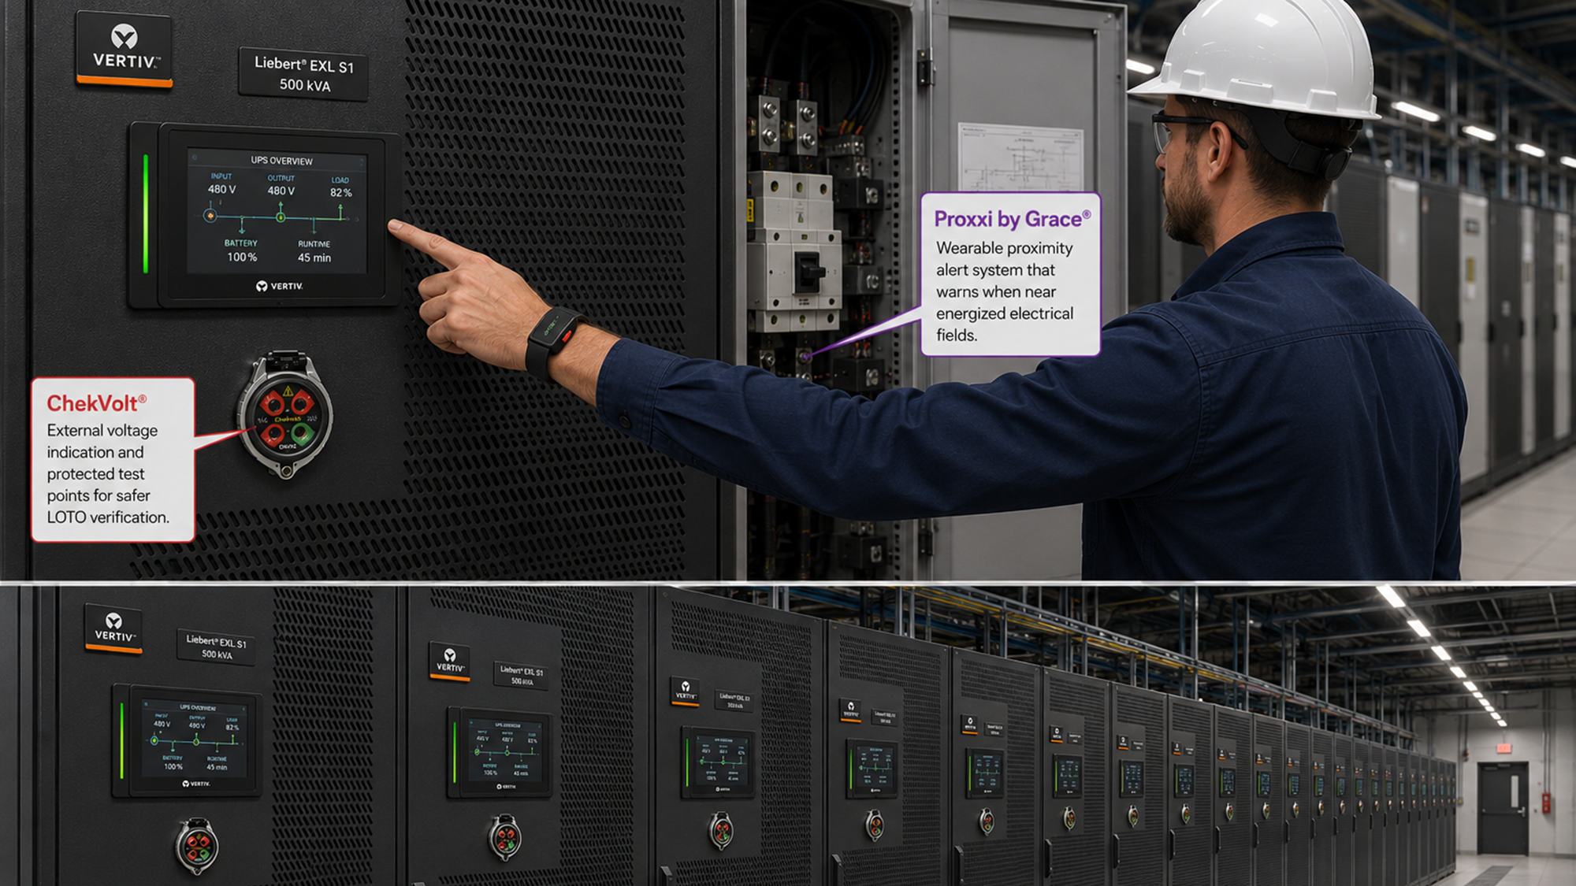

Slide 4
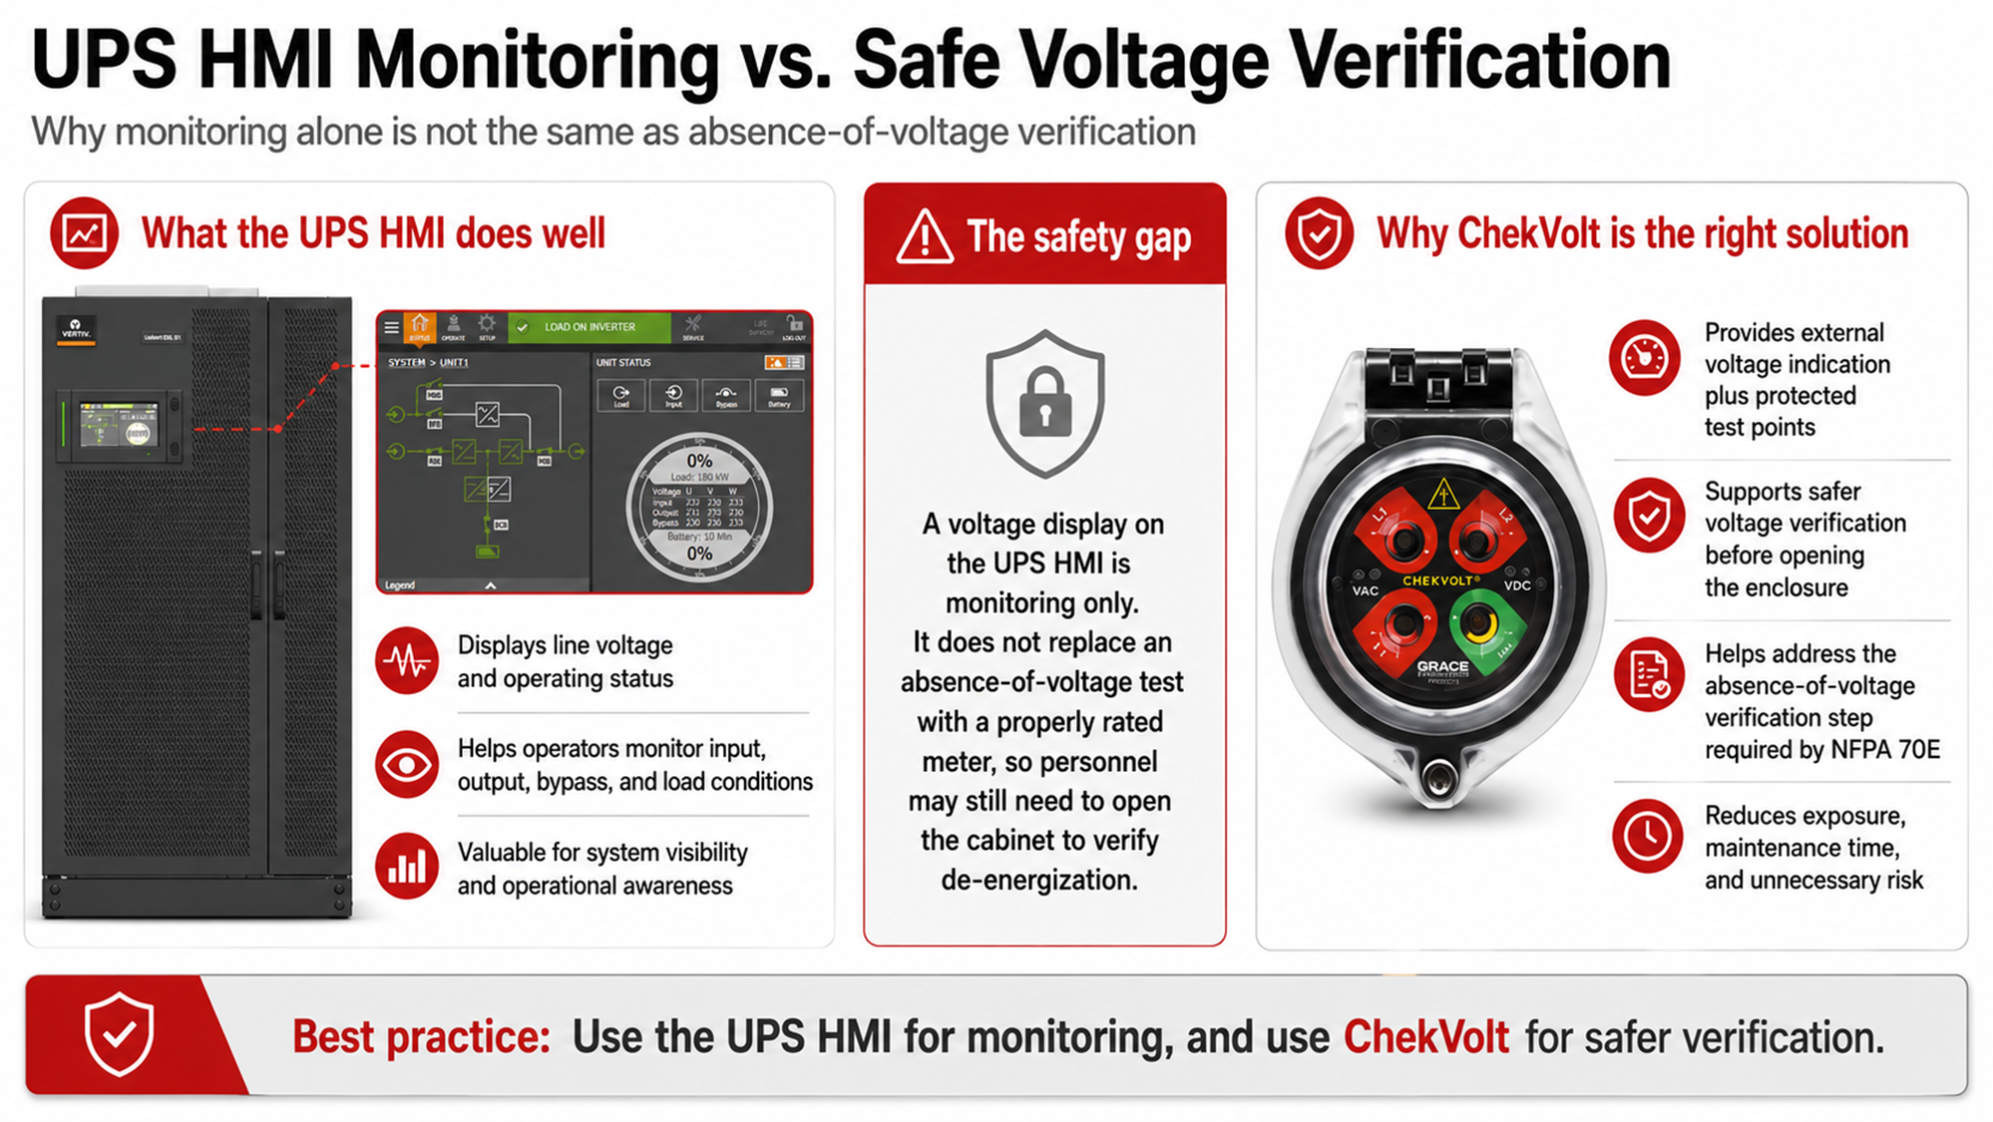

Slide 5
A Recipe for Disaster
Data centers are now industrial power plants, not IT rooms.
  AI-driven density, massive UPS systems, parallel generators, oversize transformers and multi-path distribution have pushed fault currents and stored energy to levels where incident energy levels can exceed 100 Cal/cm^2
Uptime pressure is driving unsafe energized work.
  The business mandate to “never shut down” has normalized live troubleshooting and maintenance—exactly the scenario NFPA 70E is designed to prevent unless strict controls, permits, and PPE are enforced.
Deferred maintenance has become a hidden reliability and safety risk.
  NFPA 70B now explicitly links poor maintenance to elevated failure and arc-flash risk, making “we’ll fix it later” not just bad practice—but a defensibility problem after an incident.
Electrical systems are changing faster than safety documentation.
  Capacity expansions, AI pods, additional generators, and UPS upgrades are often installed without timely updates to arc-flash studies, labels, and procedures—leaving workers exposed to unknown incident energy.
Stored energy is the new silent killer.
  UPS batteries, capacitors, and DC systems introduce hazards that persist even when equipment appears “off,” creating shock and arc risks that traditional lockout/tagout alone does not address under 70E.
Human factors are now the dominant failure mode.
  Fatigue, contractor turnover, inconsistent training, and normalization of deviance (“we’ve always done it this way”) are driving incidents—exactly the behavioral risks NFPA 70E calls out but many data centers underinvest in.
NFPA 70B has shifted from “best practice” to legal exposure.
  With formalized maintenance expectations, failure to inspect, test, and document electrical assets can now be used to demonstrate negligence after outages, fires, or injuries.
The scale of consequence has exploded.
  One electrical failure today doesn’t just trip a breaker—it can cascade across AI workloads, cloud regions, and financial markets, turning electrical safety and reliability into a board-level risk, not a facilities issue.

Slide 6
Real Life- Arcs and Shocks
UPS Inspection Electrocution – Tesla "Giga" Factory
Date: August 1, 2024
Location: Austin, Texas
Description: A QA technician was electrocuted while inspecting a UPS cabinet. Although the main breaker was off, the "Bypass" line remained active (backfeed), creating a lethal hazard that was not identified during LOTO verification.
Root Cause: Failure to identify all energy sources (Complex LOTO) for a UPS system.
Substation Arc Flash – Google Data Center
Date: August 8, 2022
Location: Council Bluffs, Iowa
Description: Three electricians were hospitalized (one airlifted) after an arc flash occurred at the substation providing power to the campus. They were working near the cabinet when the blast happened.
Root Cause: Proximity to energized high-voltage gear without adequate isolation.
Vault Explosion – Santa Clara Tech Campus
Date: May 13, 2008 (Historical Context)
Location: Santa Clara, California
Description: A foreman stood on top of switchgear in an underground vault to splice cables. He disconnected a "candle elbow" that was still live.
Root Cause: Failure to "Test Before Touch."
"Ghost Voltage" Shock – Meta/Facebook Campus
Location: Prineville, Oregon
Description: Electrician shocked by a neutral wire in a Remote Power Panel (RPP) that was carrying harmonic current from servers.
UPS Capacitor Discharge – Ashburn/Northern VA
Location: Loudoun County, Virginia
Description: Technician shocked by DC bus capacitors inside a UPS because he did not wait the required 5 minutes for bleed-down after LOTO.
Dual-Cord Server Shock – Colocation Facility
Location: Chicago, Illinois
Description: IT tech shocked by a motherboard energized by the redundant power supply (Source B) after only unplugging Source A.
Generator Heater Short – Microsoft Region
Location: Cheyenne, Wyoming
Description: Worker burned while servicing a generator block heater; the heater circuit was not locked out (only the generator start controls were).
HVAC Control Shock – Phoenix, AZ
Description: HVAC tech shocked by foreign voltage from a UPS feed powering the control board of a CRAH unit, despite the mechanical power being off.
Fidelity data-center electrical project (substation/switchgear) — OSHA citations litigated (procedure didn’t ensure de-energized/locked condition)
In the OSHRC decision record, OSHA issued serious citations after an electrician was injured, and the narrative includes that management did not check whether a tie breaker was “open and locked” and the method-of-procedure lacked the step to de-energize that tie breaker.
xAI Data Center "Colossus 2" Site
Location: Southaven, Mississippi (Stanton Road)
Incident Type: Electrocution / Electrical Shock (Non-Fatal)
Victims:
Primary Victim: A 23-year-old third-party contractor (Hospitalized in stable condition).
Secondary Victim: A 36-year-old worker who attempted to pull his colleague off the live wire (Sustained minor injuries—a classic "rescuer trauma" scenario).
Context: The facility was under intense pressure to scale; reports indicate this site was part of the rapid expansion utilizing mobile gas turbines to bypass utility lead times.

Slide 7
Real Life- Electrical Maintenance
The "Trading Halt" Meltdown – CME Group / CyrusOne
Date: November 28, 2025
Location: Aurora, Illinois (Chicago Metro)
The Thermal Event: This was a facility-wide thermal failure. A chiller plant malfunctioned, causing the ambient temperature in the data halls to spike from 68°F to over 120°F (49°C) in minutes.
The "Hotspot" Relevance: While not a single loose wire, this highlights thermal inertia. Servers began to shut themselves down to prevent silicon damage ("thermal throttling"), effectively halting global trading markets for 10 hours.
Impact: Trillions of dollars in futures trading halted; massive reputational damage.
The "Chimney Effect" Disaster – OVHcloud
Date: March 10, 2021
Location: Strasbourg, France
The Thermal Event: A fire destroyed the SBG2 data center. Firefighters using thermal imaging cameras identified two specific UPS units that were "glowing hot" shortly before the blaze consumed the building.
May 22, 2025 — Digital Realty (Hillsboro, Oregon) used by X
Equipment involved: Schneider Electric Galaxy VX UPS/power cabinet
What happened (publicly documented): Authorities indicated the fire likely started due to an electrical or mechanical issue inside a UPS cabinet; the reporting discusses overheating/ventilation context and that the cabinet had cooling fans.
The "Loose Neutral" Fire: Financial Data Center (NY)
The Incident: A 300kVA transformer failed due to a loose neutral connection, causing a fire. The Physics:
In data centers, "Harmonic Currents" (from computer power supplies) often heat the Neutral Wire more than the live wires.
Maintenance teams often scan the "Phases" (A, B, C) but forget to scan the Neutral because they assume it carries no load.

Slide 8
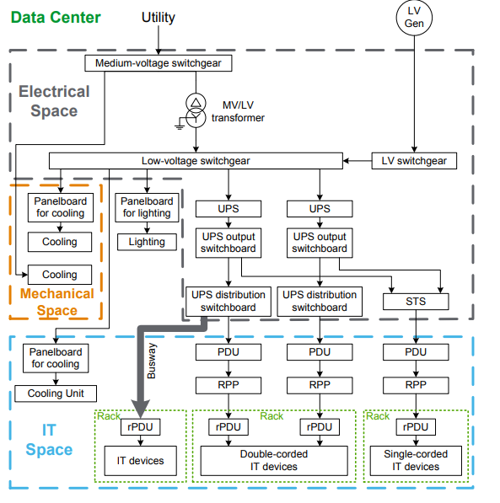
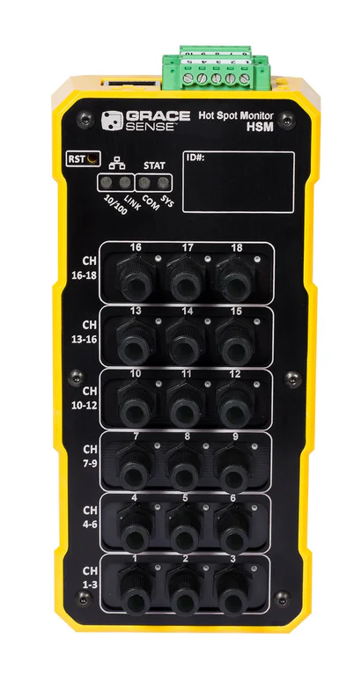
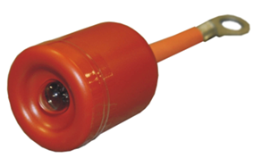
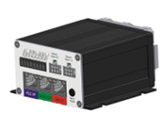
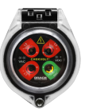
Electrical Safety and Power Distribution Condition Monitoring Solutions for Data Centers
MV Voltage Indicator
HSM MV Continuous Thermal Monitoring
ChekVolt Voltage Indication and LOTO Test Points for up to 1kV AC and 3kV DC applications
HSM LV Continuous Thermal Monitoring
Source: Schneider Electric White Paper 61

Slide 9
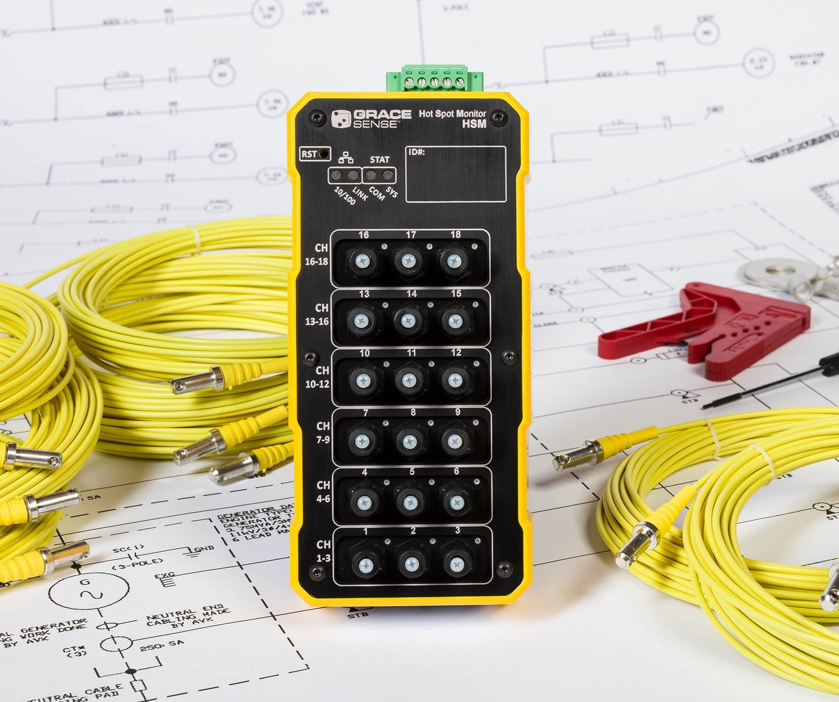
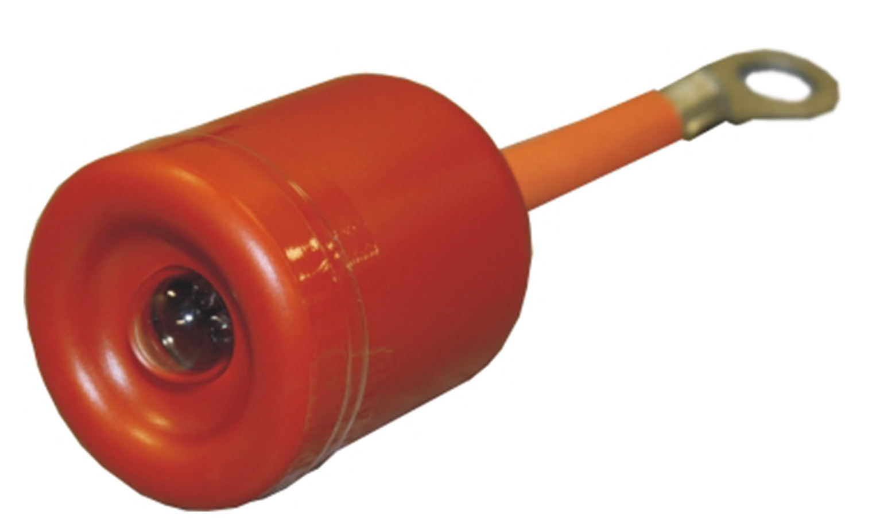
HV/MV Safety and Reliability Solution Applications
Transformers
GraceSense HSM
  Measurement points for transformers shall include core of neutral grounding connections, high current bolted connections and terminal lugs, tap changers, busbar termination between transformer and switchgear, and critical splice joints or jumper.
MV Switchgear
GraceSense HSM
  Measurement points for medium voltage switchgear shall include bolted connections on each phase of the breakers line and load stabs, interconnect busing splices, main incoming terminations from transformers, and outgoing load terminations.
MV Voltage Indicator
  Voltage indicators shall be installed on each medium voltage compartment where visual indication of bus voltage is required, including line and load sides of circuit breakers and fuses.
MV MCCs
GraceSense HSM
  Measurement points for medium voltage MCCs shall include interconnect busing splices and outgoing load terminations.
MV Voltage Indicator
  Voltage presence indicators shall be installed in each MCC section or starter compartment where a visible indication of energized conductors is required, including:
    Line and load terminals of motor starters and fuses
    Feeder circuits and bus splices
    Incoming main and tie sections of the MCC lineup
G-HSM-18K (18 Point)
G-HSM-9SK (9 Points)
G-HSM Datasheet
R-1VL003 (2-15KV)
R-1VH003 (15-43KV)
MV Indicator Datasheet:

Slide 10
GraceSense HSM MV Spec Language
Hot Spot Monitor (HSM) SPECIFICATION LANGUAGE
The medium-voltage switchgear/ MCC shall have a continuous temperature monitoring system instead of intermittent field inspections, such as open-door thermography or infrared windows. This method shall not inhibit or compromise standard construction practices of the equipment, such as bus or booting insulation. The temperature measurement technology shall use a non-conductive, direct-connect method tested to a minimum of 80kV dielectric, utilizing polymer fiber-optic cabling. It shall not require batteries or interval calibration. The temperature conversion module shall be located inside a low-voltage compartment and include internal memory for local logging and storage of temperature values. An integral alarming output contact shall send a warning indication of a rise in temperature to the facility’s power management and/or control system. All equipment shall be cUL recognized, FCC, and CE approved. The conversion module shall be capable of integrating with the SCADA system using EtherNet/IP, Modbus RTU, or Modbus TCP I/P.
Applications
Medium Voltage/MCC /Switchgear
Measurement points for medium voltage switchgear shall include bolted connections on each phase of the breaker’s line and load stabs, interconnect busing splices, main incoming terminations from transformers, and outgoing load terminations.
Medium Voltage MCCs
Measurement points for medium voltage MCCs shall include interconnect busing splices and outgoing load terminations.
Suggested Model: GraceSense HSM (P/N: G-HSM-9SK or G-HSM-18K)

Slide 11
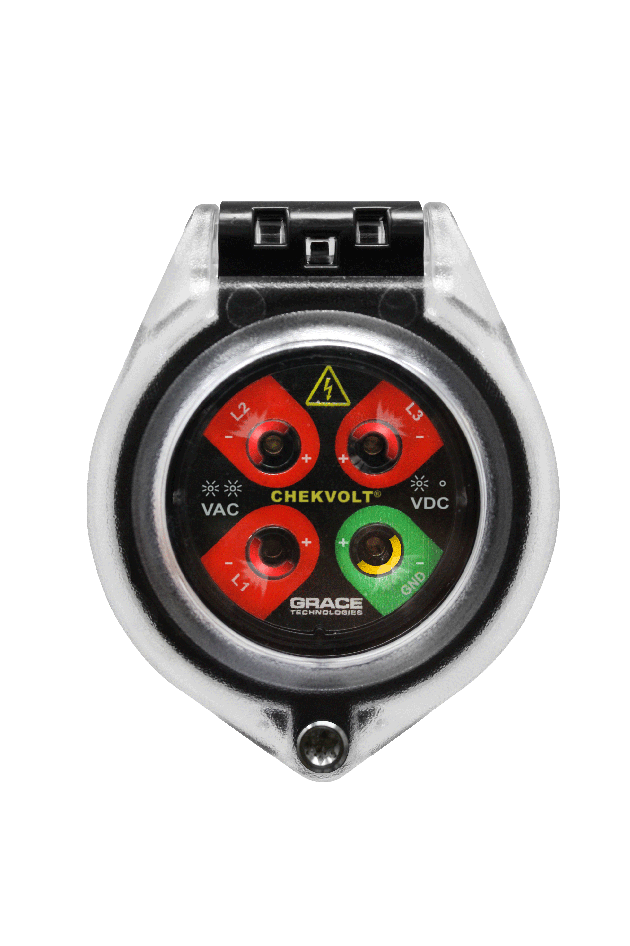
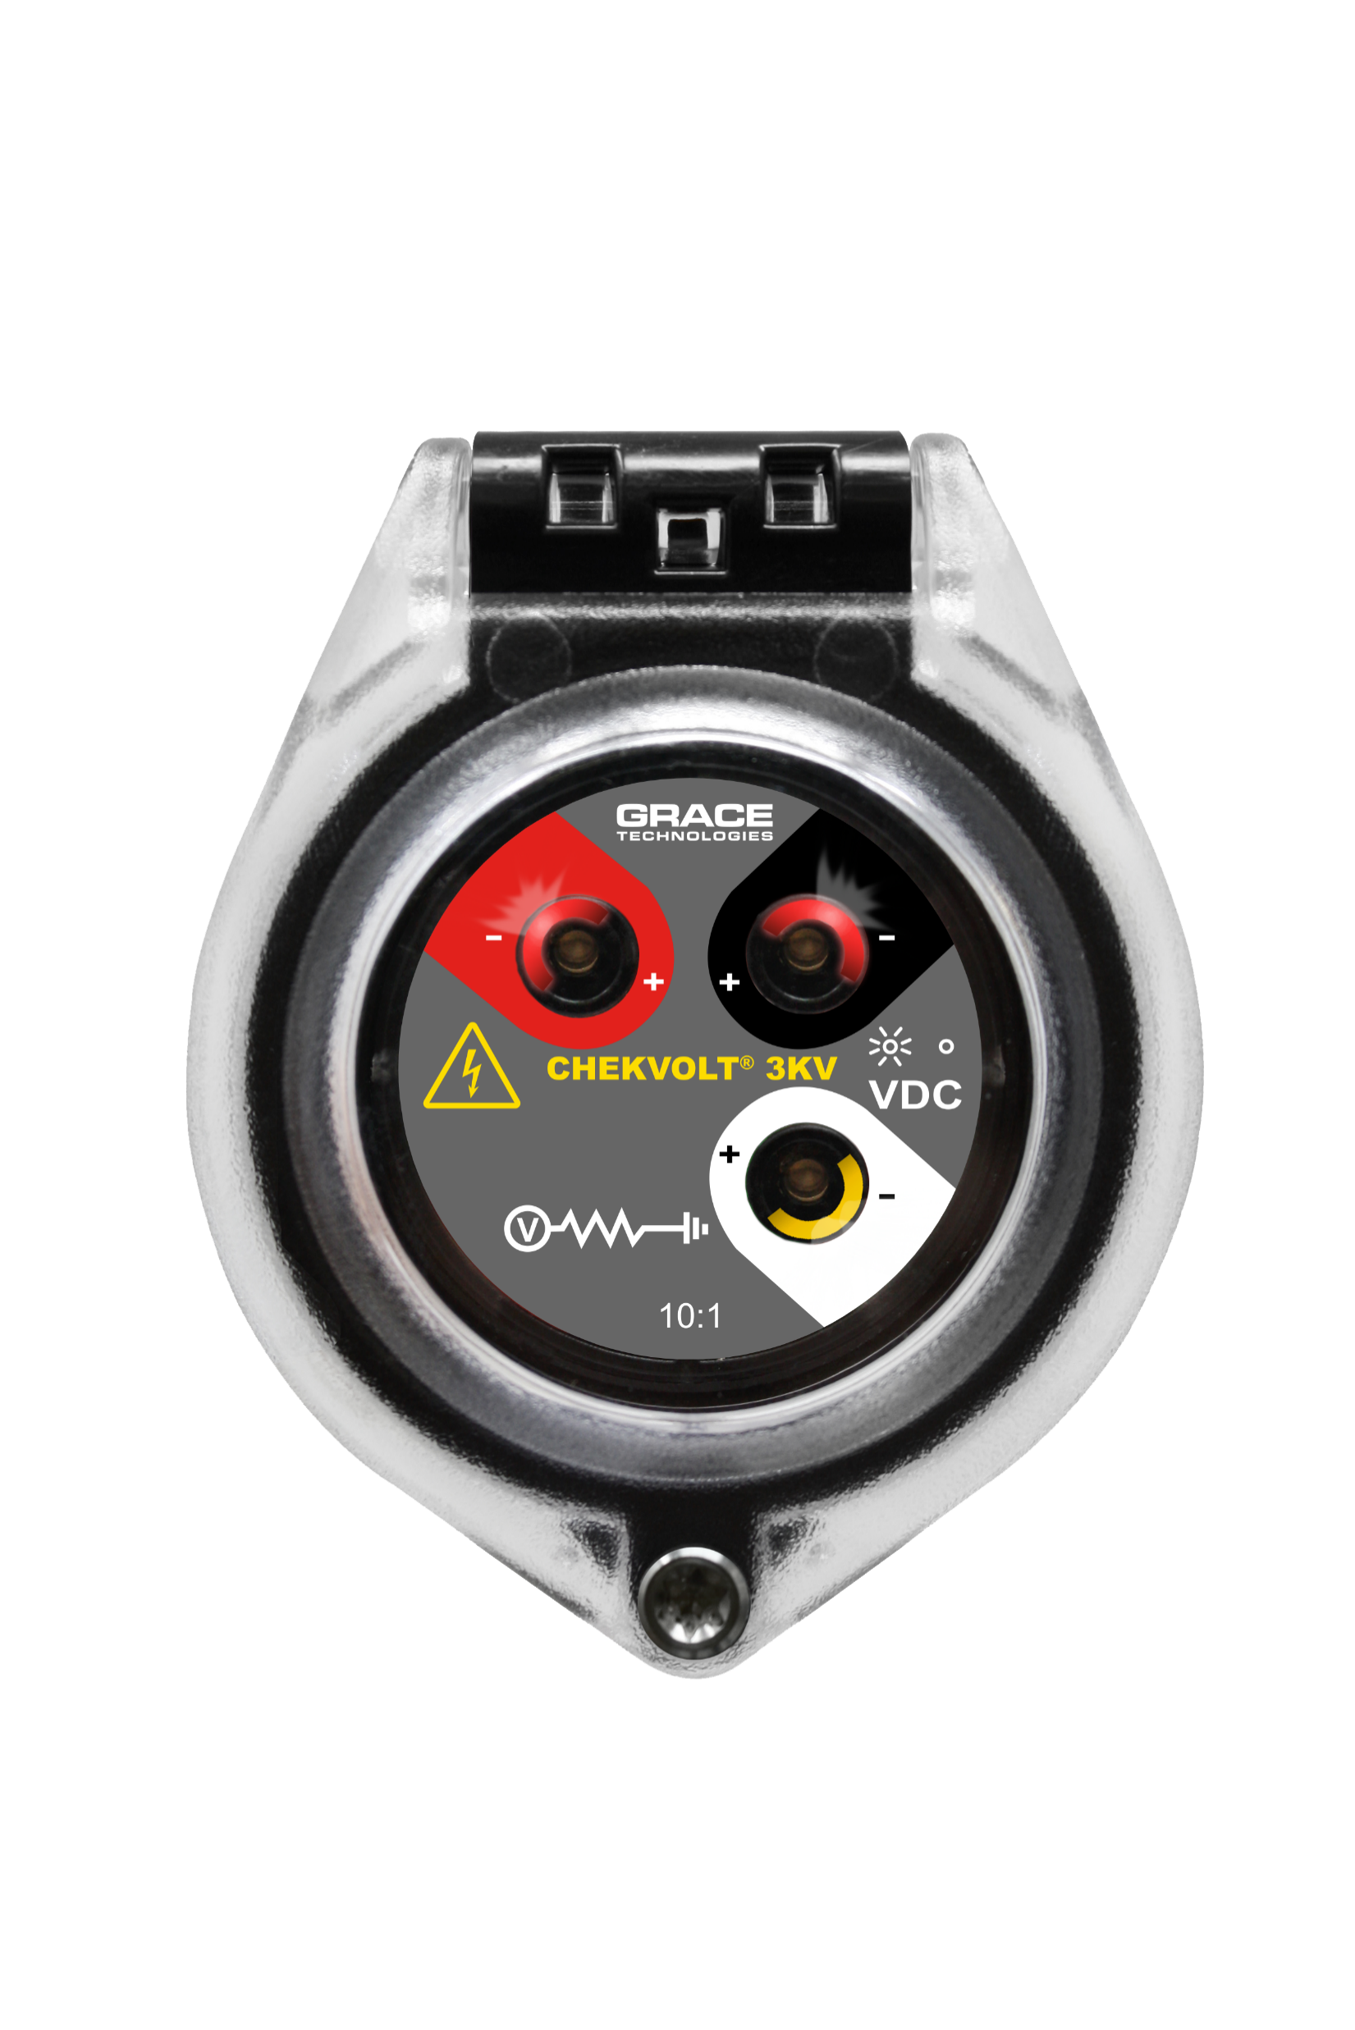
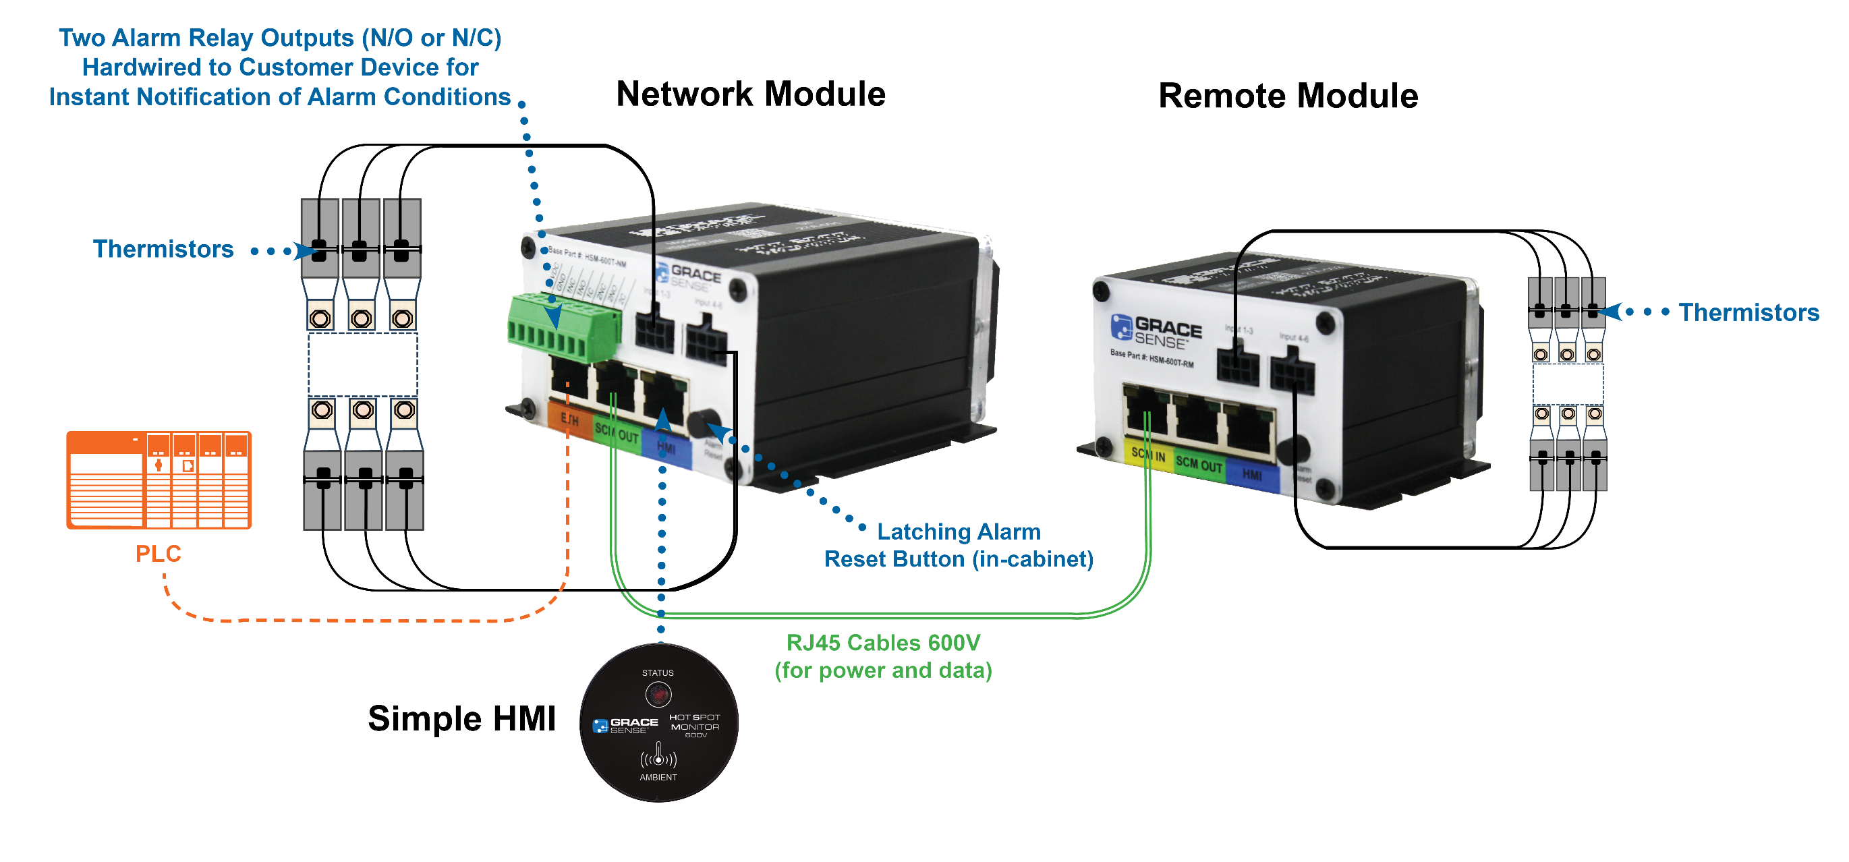
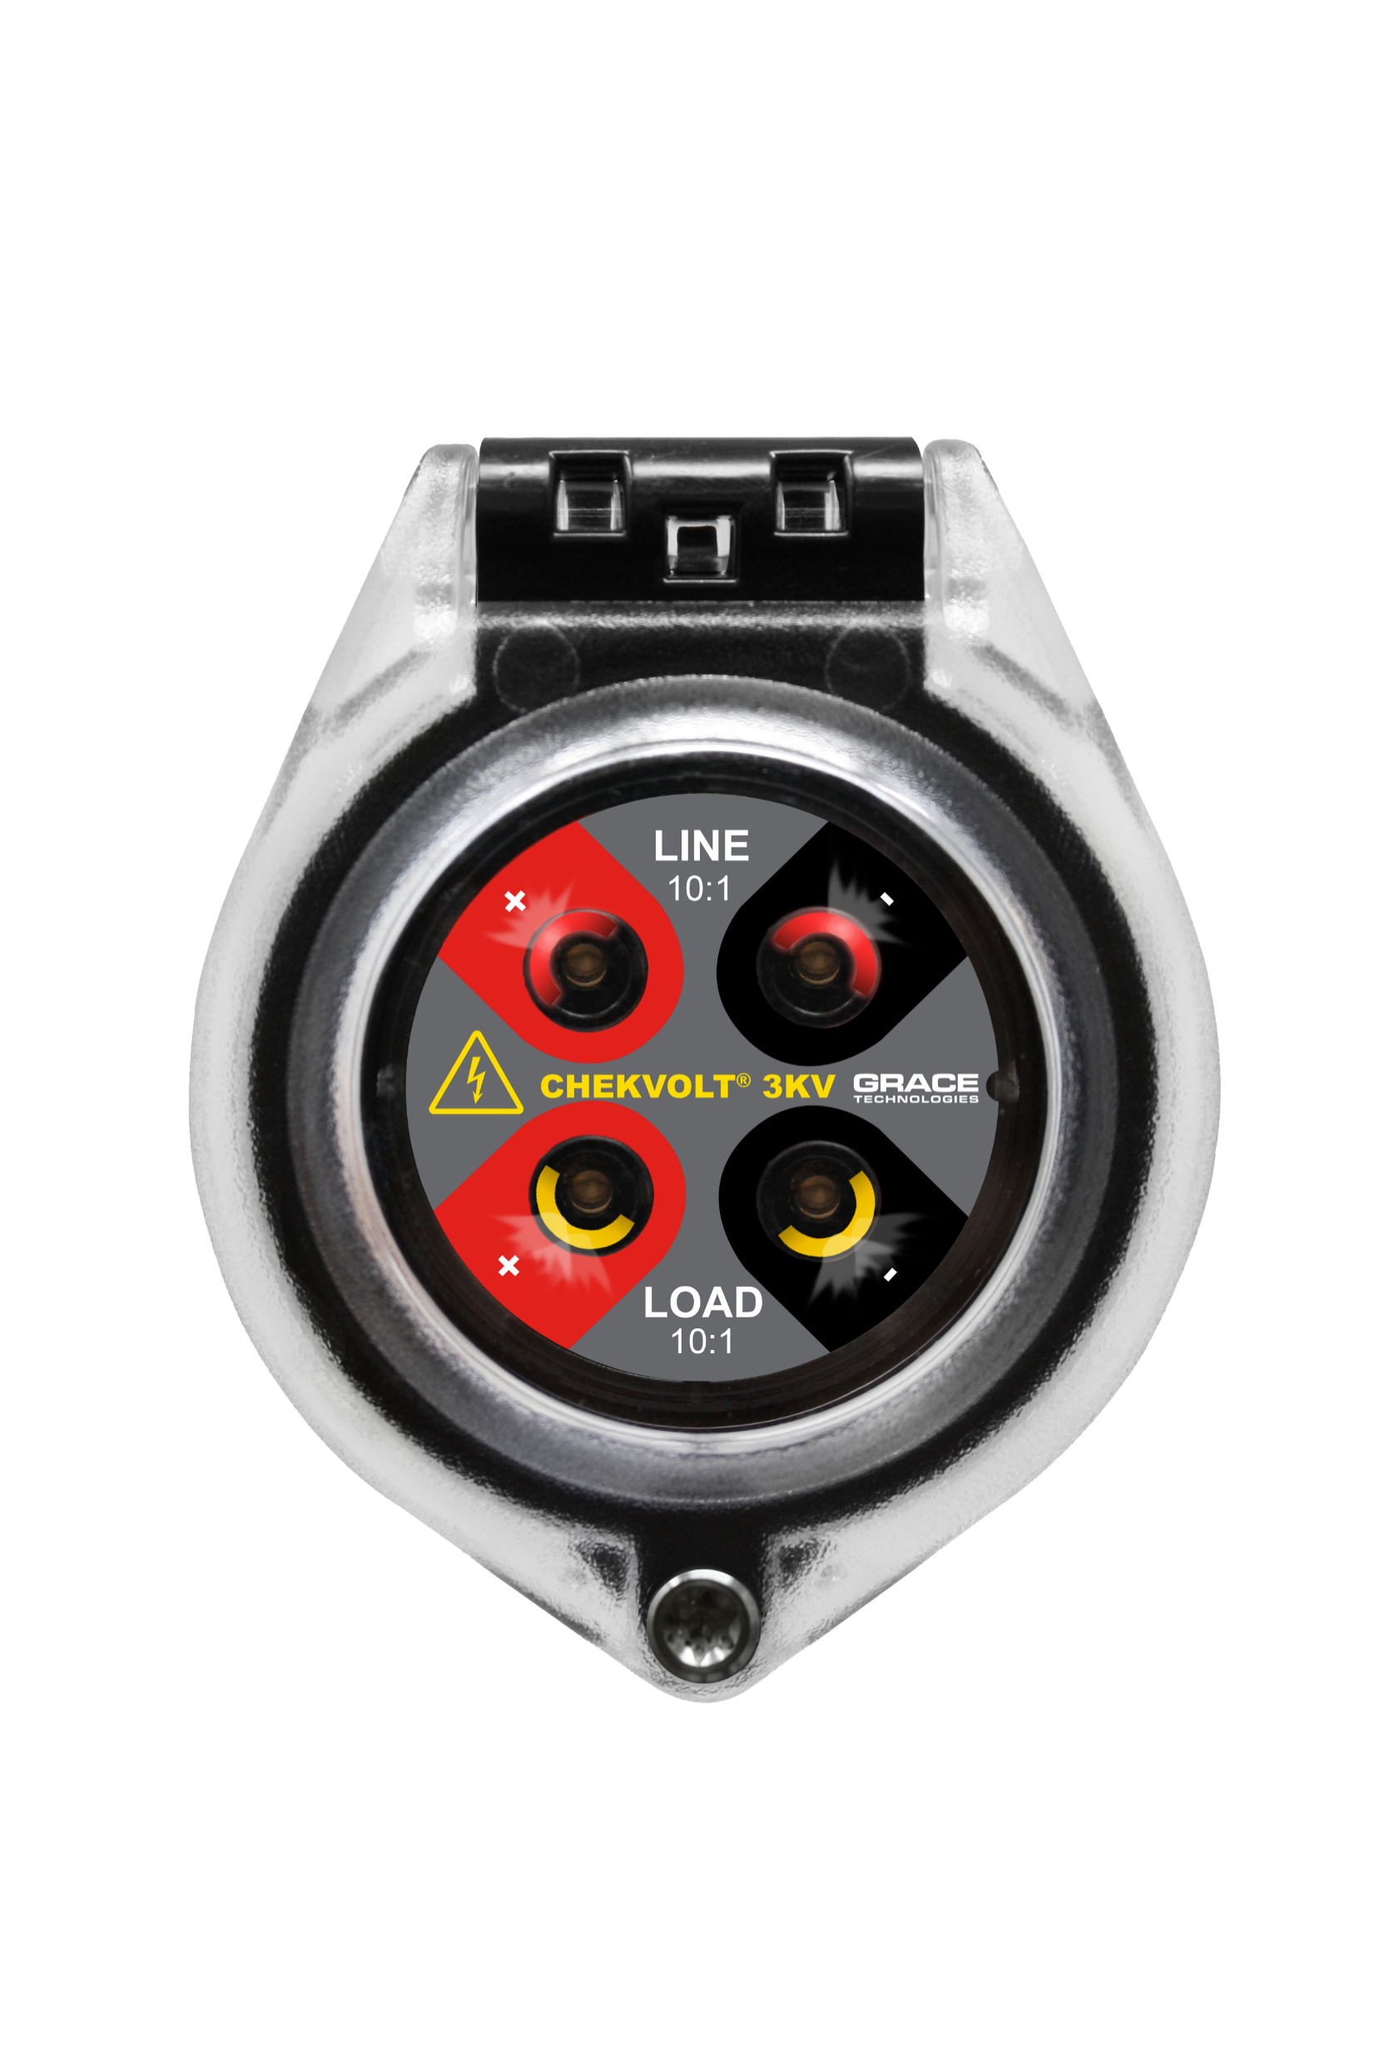
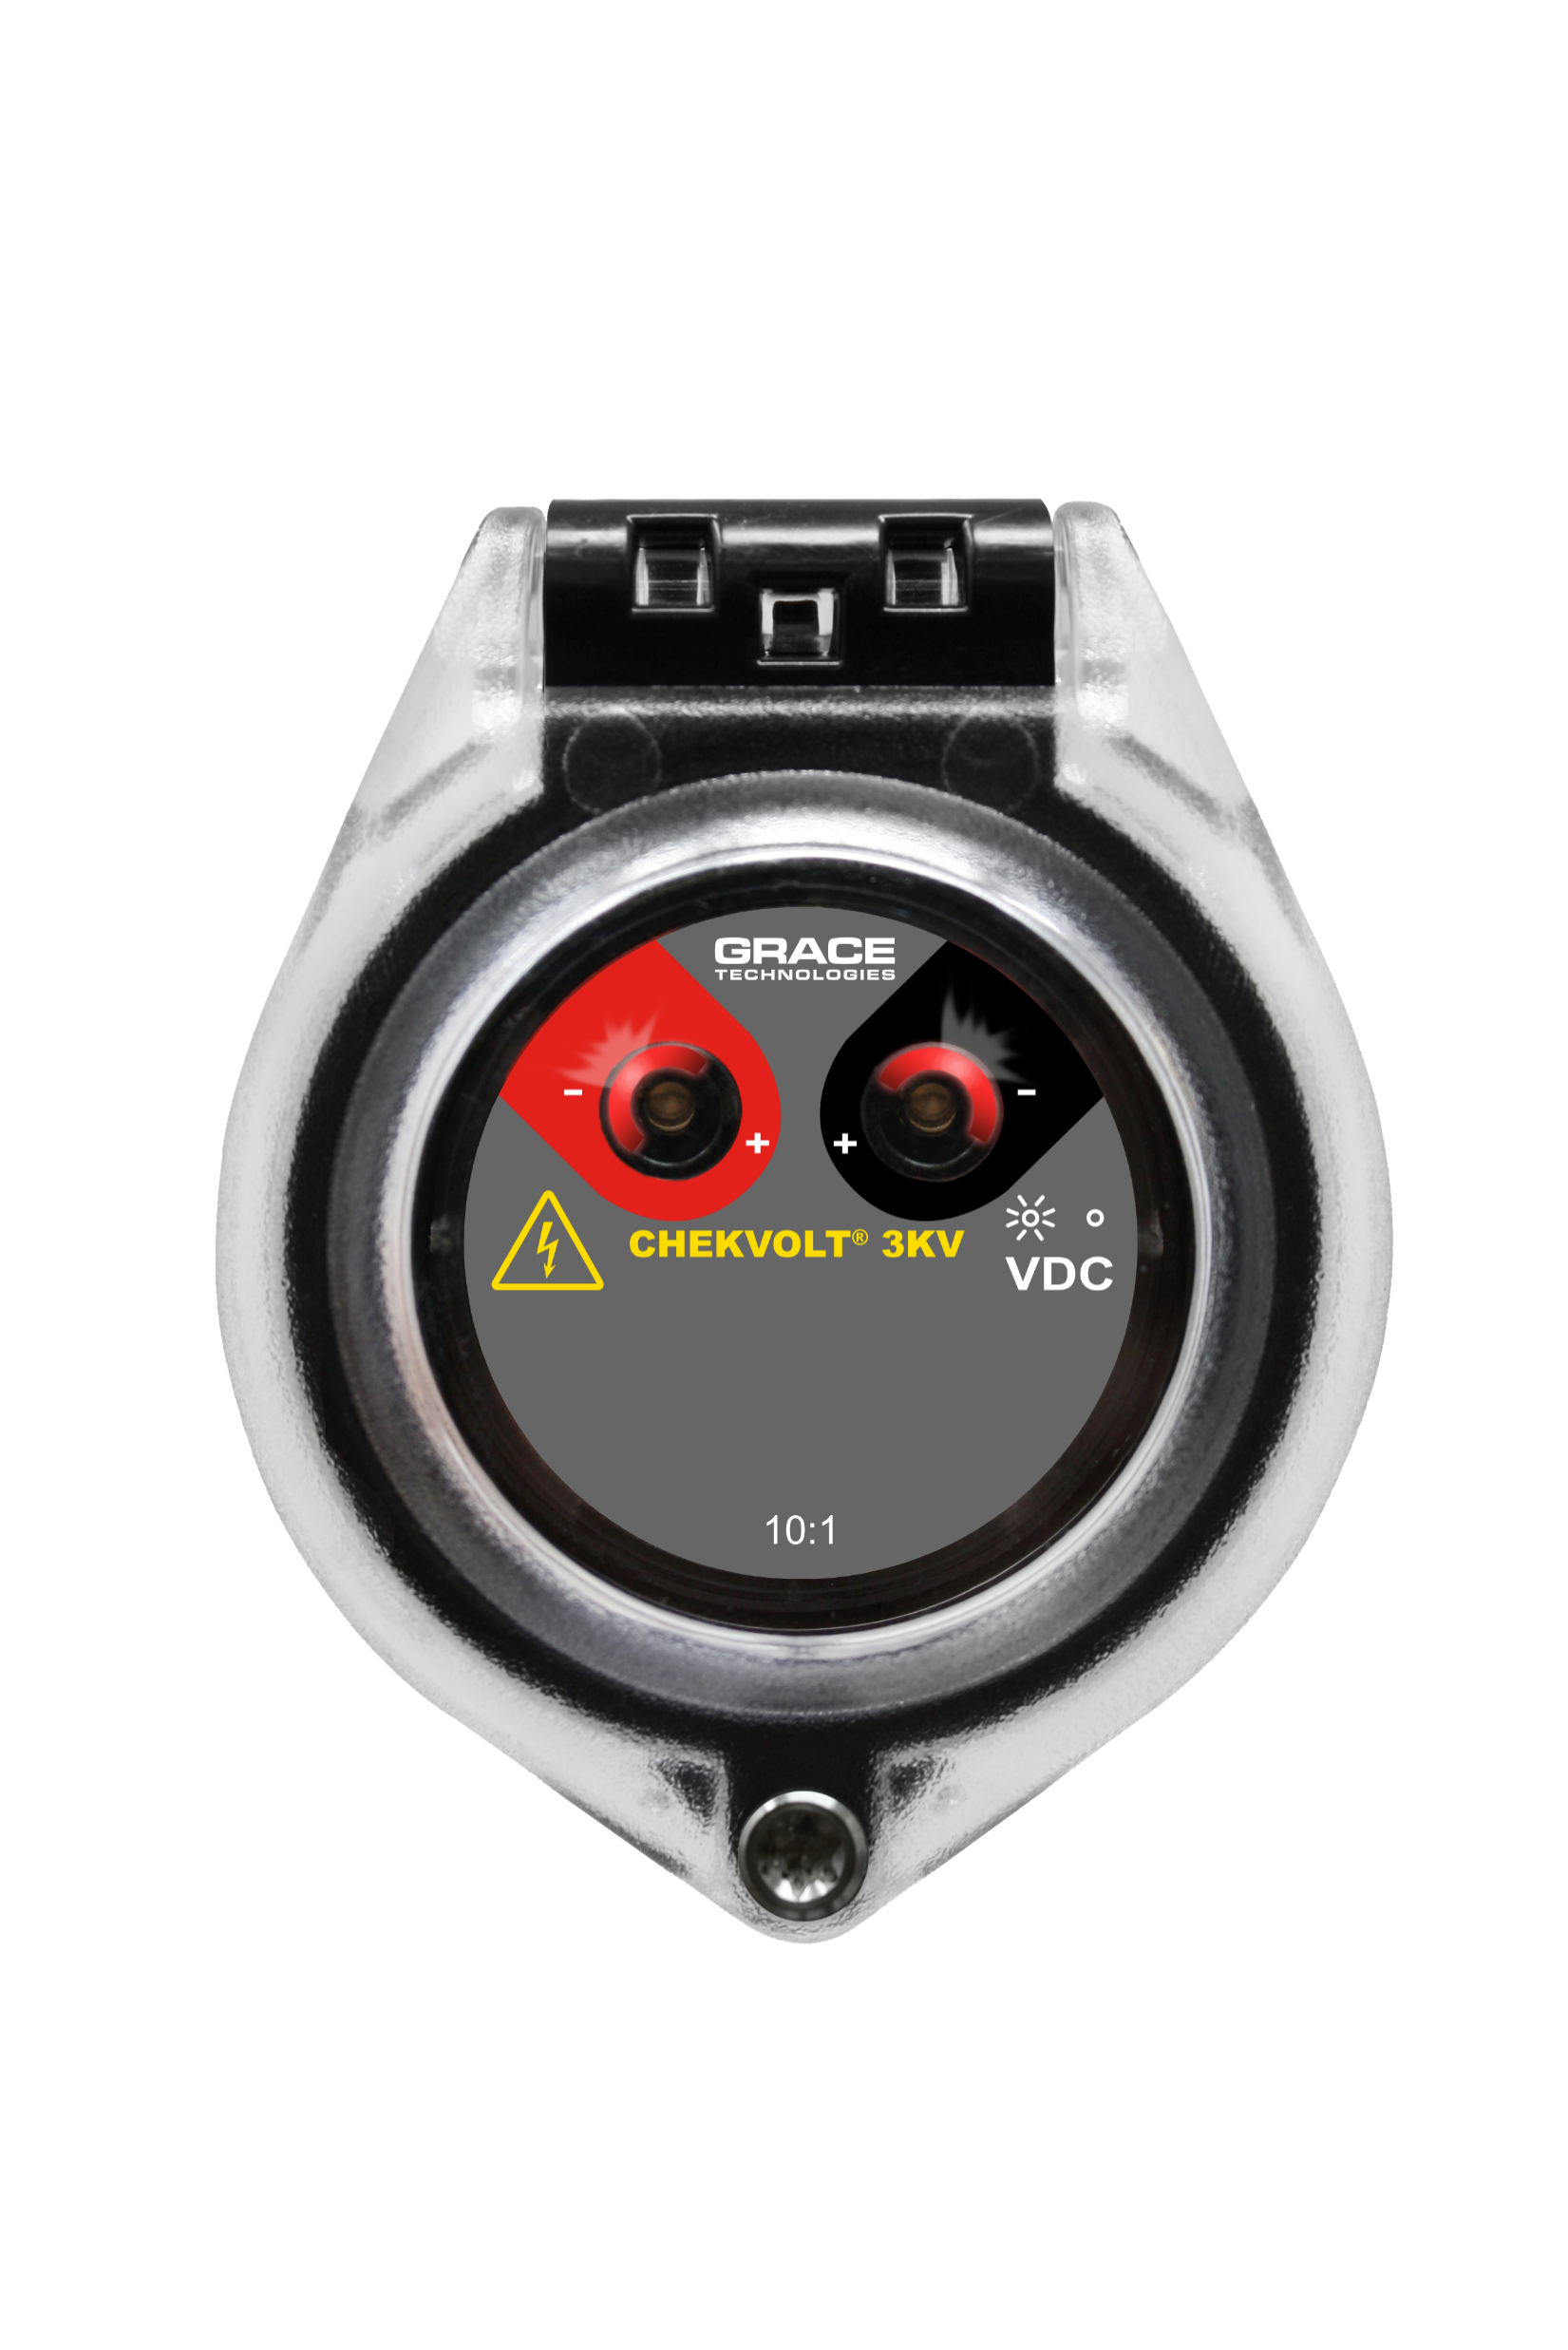
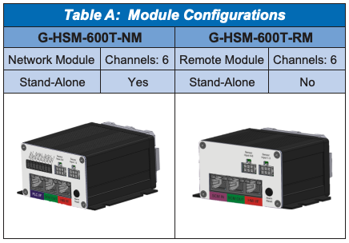
LV Safety and Reliability Solutions
R-3MT-VI-KIT-U1352
1kV AC ChekVolt
Google labels
R-3MT-VI-3K10-DC3-U1352
3-wire ChekVolt up to 3kV DC
R-3MT-VI-3K10-DCLL-U1352
Dual 2-wire line/load ChekVolt up to 3kV DC
R-3MT-VI-3K10-DC2-U1352
2-wire ChekVolt up to 3kV DC
Product Page Including Datasheet and Drawings

Slide 12
LV Safety and Reliability Applications - 1
LV Switchgear, LV MCC, PDU, RPP
G-HSM-600
  Each Low Voltage Switchgear, MCC, PDU, and RPP shall include a continuous thermal monitoring system to detect and record temperature rises versus ambient at critical electrical connection points (Potential Failure Points, or PFPs). The system shall eliminate the need for periodic infrared inspections or open-door thermography while maintaining full compliance with NFPA 70B, NFPA 70E, and IEEE PCIC 2969-2025 recommendations for continuous thermal condition monitoring. The system shall also monitor dew-point conditions.
R-3MT-VI-U1352
  Each Isolator Switch or Circuit Breaker at a minimum shall be equipped with two integrated Voltage Portal/Indicators that are shock safe and fulfill the latest Zero Voltage Verification requirements. One of the test portals shall be connected to the line side of the Isolator Switch, and the second portal shall be connected to the load side. The line-side Voltage Test portal shall be labelled to indicate that it is always live and provides a ‘Good known voltage source’ for the Zero Voltage Verification Procedure.
Busway
G-HSM-600
  Each Busway System shall incorporate a continuous thermal monitoring system at critical connection points to detect abnormal heating caused by loosened joints, corrosion, or high-resistance terminations. The monitoring system shall replace periodic infrared inspections and comply with NFPA 70B, IEEE PCIC 2969-2025, and UL 857 guidelines for busway condition monitoring.
R-3MT-VI-U1352
  For busway systems in data centers, industrial facilities, and power distribution infrastructure, ChekVolt devices shall be installed at the following locations to provide safe, closed-door voltage verification:
    Plug-In Units / Tap-Off Boxes: Installed adjacent to MCCB or fused disconnect terminations to verify voltage presence on each phase.
    Main Feed and Termination Points: Installed near incoming power sections and end feed boxes to verify line voltage before lockout or isolation.

Slide 13
LV Safety and Reliability Applications - 2
UPS
G-HSM-600
  Each Uninterruptible Power Supply (UPS) system shall include a continuous temperature monitoring system to detect abnormal heating at critical electrical connection points (Potential Failure Points, or PFPs) throughout the UPS input, rectifier, inverter, and output circuits.
    The monitoring system shall provide real-time visibility into connection and termination temperatures, reducing or eliminating the need for infrared inspections, and supporting compliance with NFPA 70B, NFPA 70E, IEEE PCIC 2969-2025, and UL 1778 for thermal condition monitoring of power conversion equipment.
R-3MT-VI-U1352
  For UPS systems in data centers and industrial facilities, ChekVolt devices shall be installed at the following locations to allow safe, closed-door verification of electrical energy:
    Input Section: Installed on incoming AC mains to confirm de-energization before maintenance.
    Bypass Section: Mounted on bypass input and output conductors to verify isolation before transfer or bypass testing.
    Inverter Output Section: Installed at output terminals or feeder connection points for voltage verification before lockout/tagout (LOTO).
    Maintenance Bypass Panel: Installed adjacent to circuit breakers or transfer switches to indicate live conductors and enable safe verification prior to isolation.

Slide 14
G-HSM-600 Hot Spot Monitor Spec Language
Low Voltage Switchgear, MCC, PDU, RPP, UPS, and Busway
The Low Voltage switchgear, MCC, PDU, RPP, UPS, and Busway systems shall be equipped with a continuous temperature monitoring system instead of intermittent field inspections, such as open-door thermography or infrared windows. This method shall not inhibit or compromise standard construction practices of the equipment, such as insulation, bus bracing, or cable routing. The temperature measurement technology shall utilize an insulated, direct-contact method using 600 VAC–rated NTC thermistor sensors that do not require batteries or interval calibration. The temperature conversion module shall be located inside the low-voltage control or instrument compartment and shall include internal memory for local logging and storage of temperature values.
The monitoring system shall also include ambient and dew point monitoring functionality to provide relative humidity-based alarming and early warning of condensation risks. An integral alarm contact shall provide an output signal indicating a rise in temperature or proximity to the dew point to the facility’s power management or control system.
All components shall be cUL recognized, FCC, CE, and RoHS compliant. The monitoring system shall be capable of integration with SCADA or building management systems via Ethernet/IP, Modbus RTU, or Modbus TCP/IP.
Applications
  Low Voltage Switchgear
  Measurement points shall include bolted connections on each phase of the main and feeder circuit breakers, interconnect bus splices, transformer terminations, and outgoing load terminations.
  Low Voltage MCCs
  Measurement points shall include the line and load terminals of each motor starter, vertical and horizontal bus joints, and main incoming and outgoing feeder lugs.
  Power Distribution Units (PDUs)
  Measurement points shall include the transformer primary and secondary terminations, main and feeder breaker lugs, and key bus splice joints.
  Remote Power Panels (RPPs)
  Measurement points shall include the main input terminations, internal bus links, and outgoing branch circuit connections.
  UPS Systems
  Measurement points shall include AC input breaker terminations, DC link and battery lugs, inverter and bypass bus joints, and output feeder terminations.
  Busway Systems
  Measurement points shall include joint packs, elbows, tees, offsets, and expansion fittings, as well as plug-in unit stabs, MCCBs, fused disconnects, and outgoing whip connections.
Suggested Model
GraceSense™ Hot Spot Monitor 600 (HSM 600) (P/N: G-HSM-600T-NM or G-HSM-600T-RM)

Slide 15
ChekVolt Spec Language
Low Voltage Switchgear, MCC, PDU, RPP, UPS, and Busway
The Low Voltage switchgear, MCC, PDU, RPP, UPS, and Busway systems shall be equipped with a permanently mounted voltage presence and absence indication device to allow qualified personnel to perform Lockout/Tagout (LOTO) procedures safely and efficiently in compliance with NFPA 70E Article 120.6. This method shall eliminate the need for open-door voltage testing or direct exposure to live parts, thereby reducing arc flash and shock hazards. The voltage indication system shall not compromise the electrical or mechanical integrity of the equipment enclosure and shall be suitable for installation in any standard 30 mm knockout location.
The voltage indication device shall utilize a high-impedance, touch-safe direct-connect circuit that requires no external power source, batteries, or interval calibration. The device shall provide both redundant LED voltage presence indication and high-impedance test points for voltmeter verification of voltage absence in accordance with NFPA 70E 120.6(4) and 120.6(7). The LED indicators shall illuminate when hazardous voltage is present until stored electrical energy is fully released, and the test points shall allow safe phase-to-phase and phase-to-ground voltage testing using a standard portable voltmeter.
The voltage indication device shall be rated for systems up to 1000 VAC/VDC, CAT III (1000 V) and CAT IV (600 V), and designed to maintain the original NEMA 4/4X/12/13 or IP66/IP69 environmental rating of the enclosure. The device shall include two to four potted lead wires, depending on the model, and be constructed of flame-rated, industrial-grade polymer materials to withstand vibration, moisture, and harsh environments.
All components shall be UL Listed, cUL Recognized, CE Compliant, CSA Certified, and RoHS Conformant. The device shall comply with UL/IEC 61010, CSA C22.2 No. 94.2/UL 50E, and NFPA 70E “Process for Establishing and Verifying an Electrically Safe Work Condition.”
The ChekVolt® shall enhance productivity and safety by enabling absence-of-voltage testing without enclosure access, reducing average LOTO procedure time by 35 to 45 minutes, and providing a permanent, reliable indication of electrical energy presence.
Applications
Low Voltage Switchgear
ChekVolt® shall be installed on the line and load side of main and feeder circuit breakers, as well as transformer terminations, to confirm voltage presence prior to service.
Low Voltage MCCs
ChekVolt® shall be mounted on motor starter line and load terminals, vertical and horizontal bus connections, and incoming feeder lugs for voltage presence verification.
Power Distribution Units (PDUs)
ChekVolt® shall be applied at transformer primary and secondary terminations, main and branch breaker lugs, and key distribution bus splices.
Remote Power Panels (RPPs)
ChekVolt® shall be installed at main input terminals, bus links, and outgoing branch circuits to confirm safe isolation prior to maintenance.
UPS Systems
ChekVolt® shall be installed on AC input, bypass input/output, inverter output, and maintenance bypass circuits to verify voltage presence and absence during transfer or LOTO procedures.
Busway Systems
ChekVolt® shall be applied at joint packs, plug-in units, tap-off boxes, fused disconnects, elbows, tees, offsets, and end-feed terminations to confirm energized or de-energized conditions prior to maintenance or reconnection.
Suggested Model: ChekVolt® (P/N: R-3MT-VI-KIT-U1352, R-3MT-VI-AC3-KIT-U1352, R-3MT-VI-DC2-KIT-U1352, R-3MT-VI-DC3-KIT-U1352)

Slide 16
Control Panel Safety and Reliability Solutions
GracePort® Applications
Control enclosures containing components requiring programming and or monitored by software/handled devices (I.E., Controllers, PLCs, VFDs, Servo Controllers, etc.) shall provide a programming interface port on either side of the control enclosure. Interface port shall provide:
  A means of connecting to each type of component within the control enclosure without requiring opening and switching internal cables (I.E. internal network.)
  Shall retain the integrity of the control enclosure to which it is mounted and be padlockable.
  A receptacle powered by an isolated internal power source protected by a ground fault interrupter with a 3-amp reset.
  Receptacle labeled “For Laptop Computers ONLY”.
  USB type B female port connected to PLC USB B port (only for Allen-Bradley PLCs). This port can be part of an interface port or could be standalone, installed in a knockout hole.
The preferred programing interface port is Grace Technologies P-Q51R2-M9RF3-U1352
ChekVolt Applications
Control enclosures containing power or control circuits above 50 VAC shall provide a combination voltage presence indicator and impedance-protected test point device mounted through the enclosure wall.
The device shall:
  Provide LED voltage indication of hazardous voltage presence on incoming and/or internal power circuits.
  Include high-impedance protected test points allowing a qualified person to safely verify the absence of voltage using a standard voltmeter without opening the enclosure, per NFPA 70E Article 120.6(4) and 120.6(7).
  Be self-powered through direct connection to the monitored circuit, requiring no batteries, external power, or calibration.
  Maintain the original environmental and safety rating of the enclosure to which it is mounted (minimum NEMA 4/4X/12/13 / IP66/IP69).
  Be suitable for use up to 1000 VAC/VDC, rated CAT III (1000 V) and CAT IV (600 V).
  Include potted, color-coded leads for connection to the line conductors (two to four leads depending on model).
  Be constructed of flame-rated, industrial-grade polymer materials suitable for vibration and harsh environments.
  Comply with UL/IEC 61010, CSA C22.2 No. 94.2 / UL 50E, NFPA 70E, OSHA 1910.333(b), and CSA Z462.
  Be UL Listed, cUL Recognized, CE Compliant, CSA Certified, and RoHS Conformant.
The preferred voltage indication device is ChekVolt®, models: R-3MT-VI-KIT-U1352, R-3MT-VI-AC3-KIT-U1352, R-3MT-VI-DC2-KIT-U1352, R-3MT-VI-DC3-KIT-U1352.

Slide 17
Permanent Electrical Safety Devices

Slide 18

Did you know….
70%
Of all workplace injuries happen during reactive maintenance
35%
Due to direct contact with wiring, transformers or other electrical components
Occurred on 3-phase low voltage systems
60%
Open Door Testing with Meter is a leading cause of Arc Flash
PPE
The cost of these preventable incidents can cost $50,000 - $10 Million+
Notes:
Open door testing with a meter is a leading cause of arc flash*
70% statistic needs to be proved/application? Change to 3-5X? More likely to touch before you test during reactive maintenance*
Reduce non-compliance to electrical safety standards NFPA 70E. Skilled labor shortage. Compliance = Safety / Productivity Discussion – Reduction in PPE / Closed door verification of voltage.
Maintenance personnel are being pressured and are rushing to
We know electrical safety is an important part of every industry. Electrical injuries are very prevalent during reactive maintenance. 60% of those injuries occurred in low voltage 3-phase systems. You’d think that medium voltage would be more common due to it being higher voltage, but with low voltage corners might be cut more frequently.
Testing with a meter is a high risk action. You’re right there at the live conductor.

Slide 19


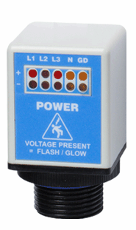
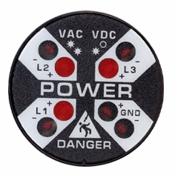
Advantages of PESDs®
Elimination
For electrical and mechanical LOTO, cost effective, high impact risk reduction
Substitution
Engineering Controls
R-3MT-VI
ChekVolt, Safe-Test Point, and Voltage Test Station PESDs
pay for themselves after 2-3 LOTO Procedures
Awareness
Administrative
Controls
R-3D2
R-3W-L-KIT
PPE
Notes:
Hierarchy of Risk Controls (NFPA 70E) Article 120.6 process for establishing an electrically safe working condition
For electrical and mechanical LOTO, we do our best to eliminate risk altogether. These devices are in-expensive, low hanging risk reduction fruit. They pay for themselves within 2-3 LOTO procedures and are installed using a 30mm hole punch

Slide 20
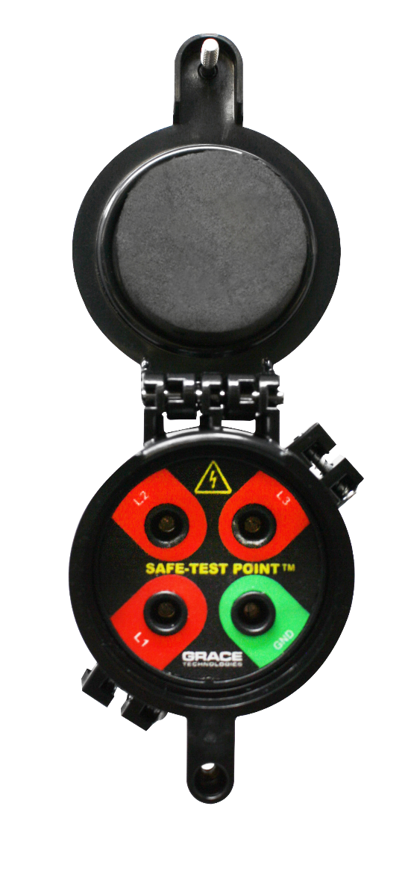
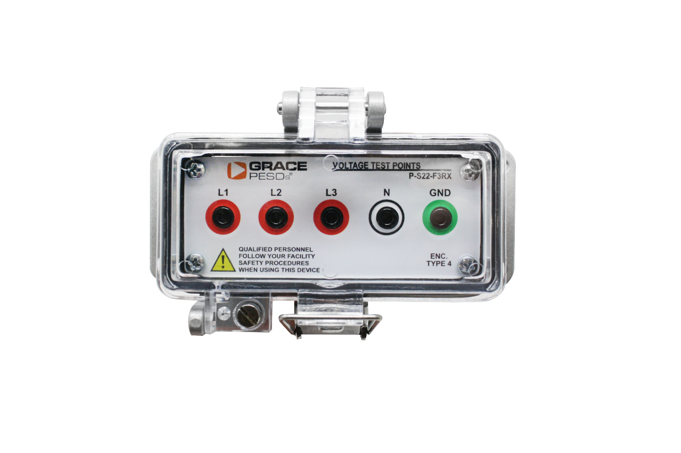
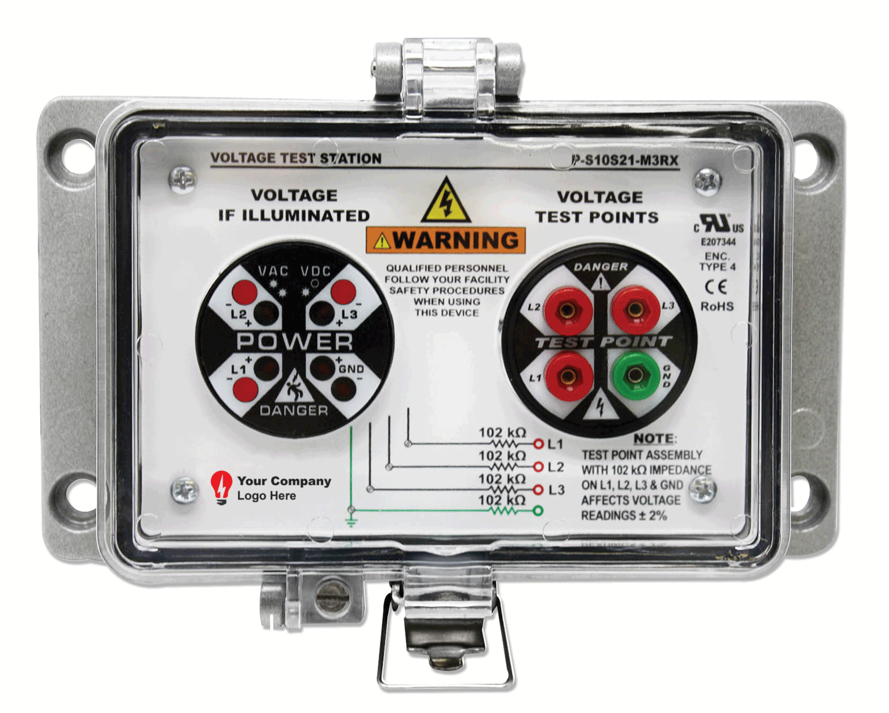
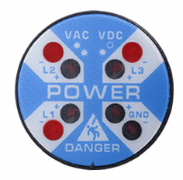

A PESD for Every Application
R-3W2
R-3K
P-S10S21-M3RX
R-3MT-VI
R-5MT
R-3MT-1K
Voltage Indicators
Voltage Portals
Voltage Test Station
ChekVolt
Safe-Test Point
Notes:
Add the trouble shooting capabilities of the R-3W -> I.e. phase loss, stuck blade, etc. Be sure to distinguish between mechanical vs. electrical LOTO and reference a bump/try test when using Voltage Indicators only.
Reducing time spent locking-and-tagging out equipment by 74%.
Voltage Indicators are primarily used in mechanical LOTO and also used in conjunction with the OSHA required try or bump test. This means you try to start the machine after isolation of power using a starter switch. If you are pressing a green button to try to do a “try” test, it isn’t as a sure way to ensure the power is isolated. When adding the Voltage Indicator this is an additional opportunity to verify voltage. It also has other features such as phase loss, stuck blade, etc.
ChekVolt is THE fastest selling new product we offer.

Slide 21
Electrical LOTO - ChekVolt®
Voltage Range: 0-1,000 VAC
0-1,000 (3K) VDC
High impedance protected test points (164KΩ)
  480V/√3/(164k * 2 *.95) = 1.5mA (Phase-to-Phase)
  600V/ √3/(164k * 2 *.95) =1.9mA (Phase-to-Phase)
  1000V/ √3/(164k * 2 *.95) =3.2mA (Phase-to-Phase)
CAT III (to 1000 VAC) & CAT IV (to 600 VAC)
Measures full voltage with -3.3% accuracy
UL/IEC 61010, CE, UKCA & CSA C22.2 No. 94.2/UL 50E
  UL Type 4, 4X, 12, and 13 & IP66, IP69
R-3MT-VI-3K10-DC2
R-3MT-VI-3K10-DC3
R-3MT-VI
R-3MT-VI-3K10-DCLL

Slide 22

Electrical LOTO - Voltage Test Stations
Voltage Range: 0-1,000 VAC
0-1,000 VDC
High impedance protected test points (164KΩ)
  480V/√3/(164k * 2 *.95) = 1.5mA (Phase-to-Phase)
  600V/ √3/(164k * 2 *.95) =1.9mA (Phase-to-Phase)
  1000V/ √3/(164k * 2 *.95) =3.2mA (Phase-to-Phase)
CAT III (to 1000 VAC) & CAT IV (to 600 VAC)
Measures full voltage with -3.3% accuracy
UL/IEC 61010, CE, UKCA & CSA C22.2 No. 94.2/UL 50E
  UL Type 4, 4X, 12, and 13 & IP66, IP69
P-S10S21-M3RX
H-S10S21-M3RX

Slide 23
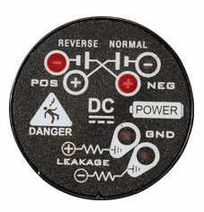
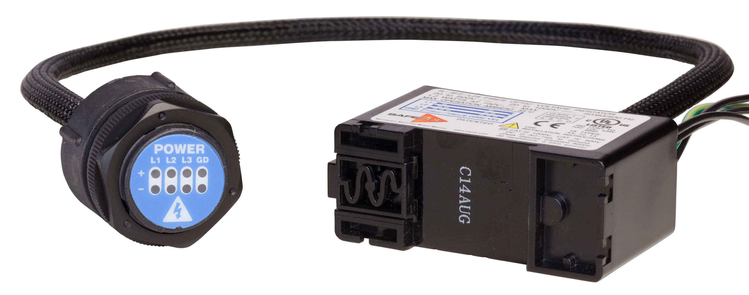
Voltage Indicators & Portals
Different options for Voltage Indicators
  Fiber Optic, Class I Div II, Medium and DC Voltages, etc.
Mechanical LOTO
Visual Indication of Presence of Voltage
Easily troubleshoot stuck blades, phase loss, or stray voltage running to the ground
R-3W
R-3W2
R-3W-DC
R-3D2
R-1VL003 & R-1VH003
R-3K
R-3F2

Slide 24
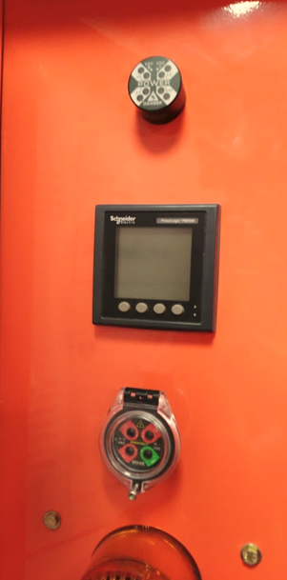
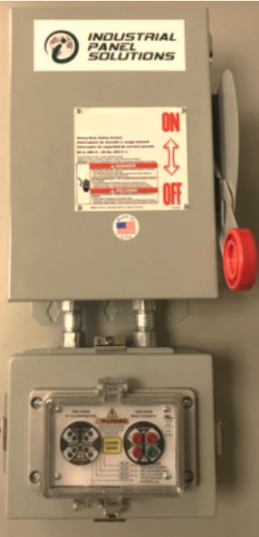
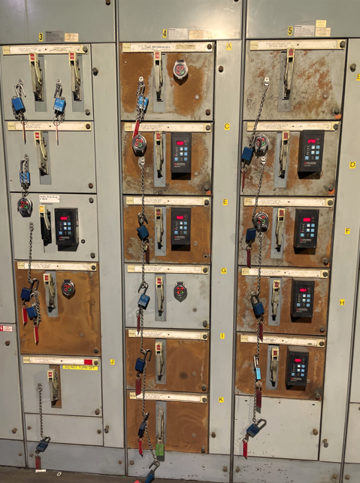
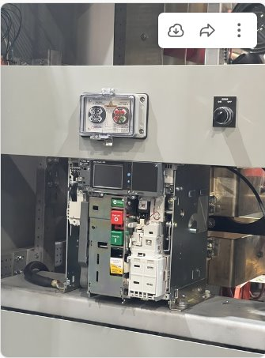
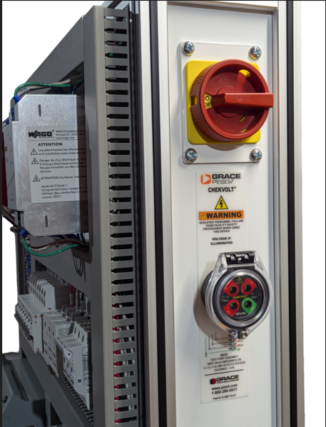
Product installs

Slide 25
Intelligent Machine Health Monitoring

Slide 26
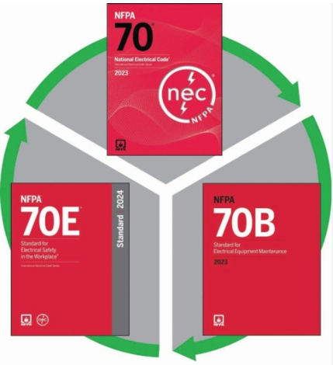



NFPA 70
National Electrical Code
NFPA 70e
“Standard for Electrical Safety In The Workplace”
(Latest Publication 2024)
NFPA 70B
“Standard for Electrical Equipment Maintenance”
(Latest Publication 2023)
NFPA Standards Updates
2024
2023

Slide 27
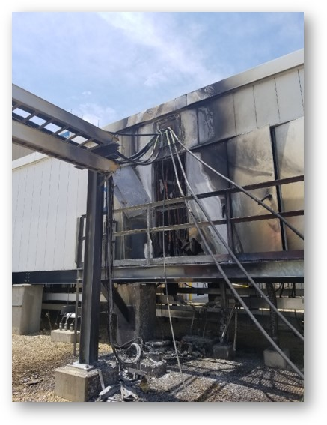
NFPA 70E
Workplace Safety
!
“Temperatures over design levels for prolonged periods can reduce the electrical life of organic insulating materials” and can “cause physical deterioration of the materials, resulting in lowered mechanical strength.” NFPA70E

Slide 28
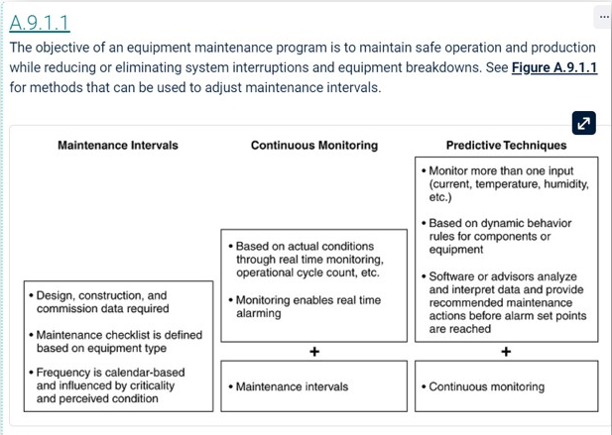
NFPA 70B Maintenance Plan
CTM Considerations
9.1.1.1
“Continuous monitoring or predictive techniques shall be permitted to be used as a consideration when determining maintenance intervals.”
9.1.1.2
“Continuous monitoring or predictive techniques shall be based on manufacturer’s recommendations or accepted industry practices.”
A.9.1.1.2
“…The use of real-time data and actual performance of the equipment of the equipment can be used to modify (shorten or lengthen) a predetermined maintenance interval.”

Slide 29



IEEE PCIC 2969-2025 “A Guide for Continuous Thermal Monitoring of Switchgear and Motor Control Centers up to 52kV”
Joint Standard: Industry Application Society ↔ Power & Energy Society (Switchgear)
Submitted to the IEEE Standards Association (Audit Committee) for vote in Dec 2025
Highlights of Coverage:
  General Requirements and Application Considerations
  System Requirements
  Installation for New Construction
  Recommendations for Retrofit Installations
  Maintenance
  Advantages of CTM Technologies (informative)
  Heat Transfer Considerations (generation, transfer, and abnormalities)

Slide 30
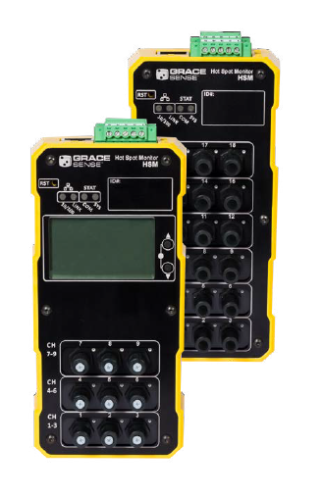
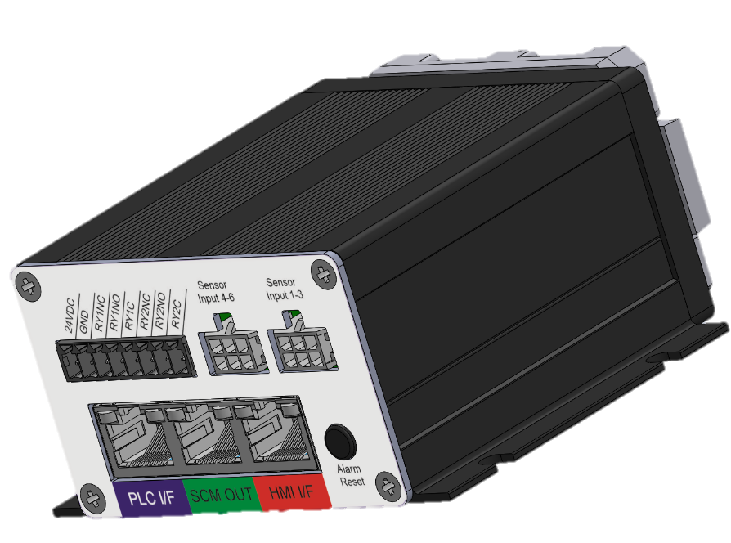
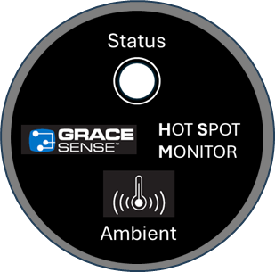


Hot Spot Monitoring (HSM)
by Grace Technologies
Thermistor-based Thermal Monitoring
Systems Rated ≤ 600Vac
Fiber-based
Phosphor Thermometry
Ideal for Systems Rated ≥ 1000 Vac
In the market since 2010

Slide 31
HSM 600 Network
by Grace Technologies
Connect up to 12 remotes in the network

Slide 32
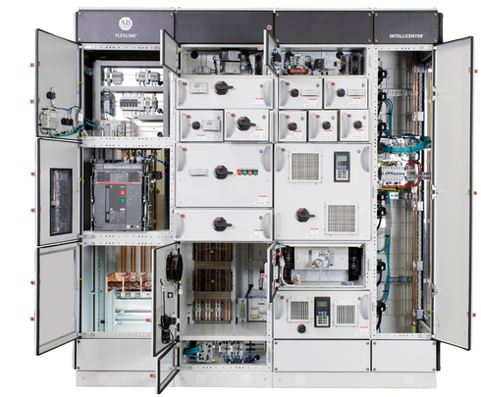
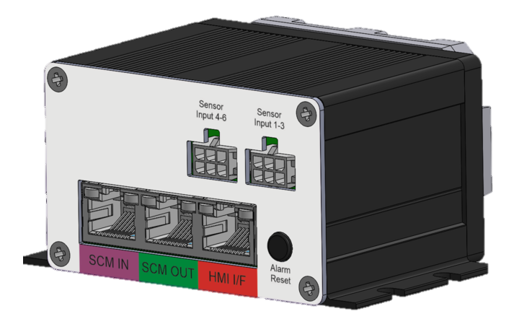
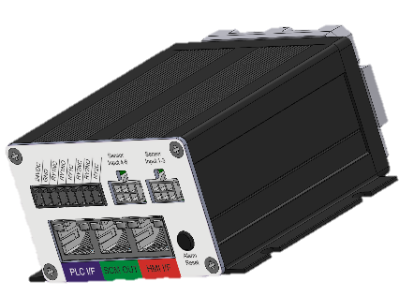
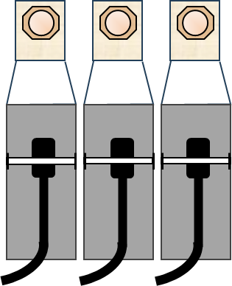
HSM 600 Equipment Layout
by Grace Technologies
Simple HMI
Status Indicating Light
Ambient Sensor for ∆T
Remote
Module(s)
Networking
Module
Sensor Conditioning Remote Module (SCM-R)
Daisy-chain power and comms via RJ45
Up to 12 units in daisy-chain
(6) Inputs – Sets of 3
Latching Alarm Reset Button
∆T Calculation
Dew Point Sensor
Thermistors
600V
Sensor Conditioning Network Module (SCM-N)
Daisy-chain power and comms via RJ45
Up to 12 units in daisy-chain
Ethernet I/P and Modbus TCP
(6) Inputs – Sets of 3
Latching Alarm Reset Button
External Latching Alarm Outputs
∆T Calculation
Dew Point Sensor

Slide 33
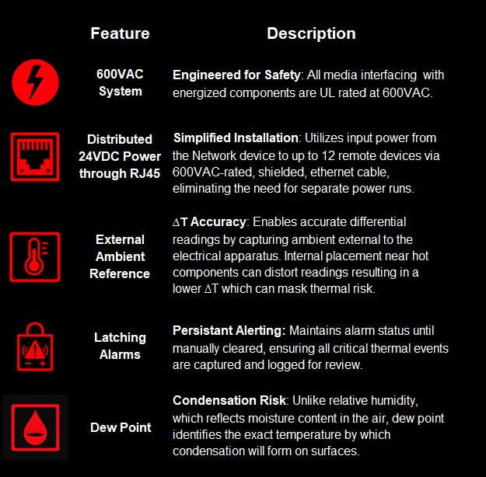

Standout Features
of the
HSM 600
Come Chat with Me!
Equipment on Display
after Presentation
Notes:
Technology, no conduct, tunnels light to a tip and responds back with a different temperature.
One thing to keep in mind is to use a 6 gauge ring terminal because this is not a compression type installation. If it is a compression installation you have essentially voided the use of the fiber connection point.

Slide 34

Hot Spot Monitor (HSM)
Non-conducting polymer fiber. (Can be run with power or comm wires)
Easily Trimmable
Repeatable sensor performance
In the market since 2010 with thousands in the market today
-4° F to 248 °F (-20° C to 120° C)
  Resolution: 1° F (1°C)
  Accuracy: ±3° F (±2° C)
Din Rail Mount
Power: 24 VDC / 0.2 A / 3W
Internal N/O Relay for Hardwiring to Remote Devices
Internal Memory for Data Logging – 16MB (350,000 logs)
Communication: Modbus RTU, Modbus TCP/IP, EtherNet/IP™
cUL Recognized, CSA, CE, FCC

Slide 35
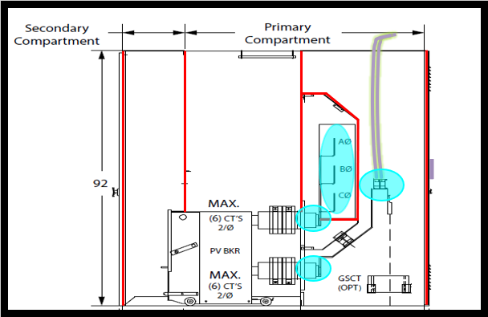
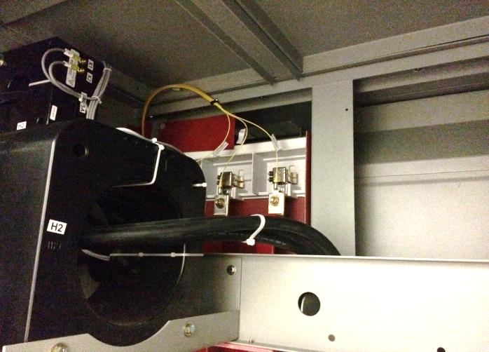
MV Switchgear Potential Failure Points
PT Rollout
Other PFP’s in MV Swgr
Typical: Line/Load of Breaker, Main Bus, Field Terminations
CPT

Slide 36

Making Maintenance Safer, Smarter, and More Productive

Slide 37


What Are Workers
Saying About Risk?
Elimination
Lack of confidence in the electrical diagrams provided
Lack of confidence in those performing LOTO
Previous experience with mistakes made by themselves or others
Substitution
ChekVolt
Engineering Controls
Voltage Indicator
Awareness
Administrative
Controls
Grace realizes PESDs can’t be in every location, although we wish they could.
Proxxi Band adds an extra layer of protection when the unexpected happens
PPE
Proxxi Band

Slide 38
Synergy of LOTO, PESDs, and Proxxi Band
Enhance LOTO procedures by verifying voltage absence with PESDs and monitoring voltage presence with the Proxxi Band.
Isolate:
LOTO
Enhanced Verification: PESDs
Enhanced Monitoring:
Proxxi Band
Purpose: Physically isolate energy sources to prevent accidental energization.
Purpose: Verify absence of voltage using PESDs at the point of work.
Purpose: Provide real-time alerts if energized equipment is approached or unexpected voltage is detected.
Benefit: Ensures equipment remains de-energized during maintenance and repair
Benefit: Safely verify de-energization without exposure to live parts.
Benefit: Continuous monitoring for unforeseen electrical hazards during work activities.
Integrating these three steps creates a layered safety protocol that enhances worker protection and compliance with OSHA, NFPA 70E, and CSA Z462 safety standards.

Slide 39

Human Error
is the
#3
Cause of
Workplace Death
95%
Of near misses are unreported
Over 80%
Of workers confirmed that they had been shocked on the job
The cost of these preventable incidents can cost
^{$50,000 - $10 Million+}

Slide 40
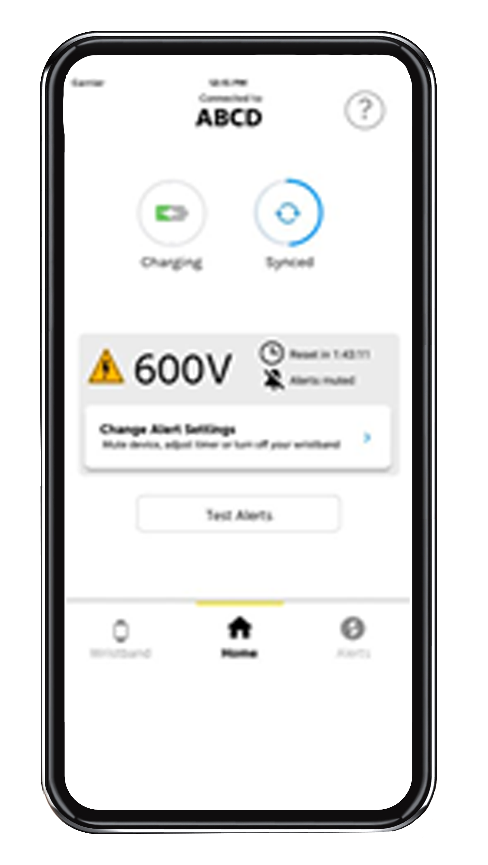

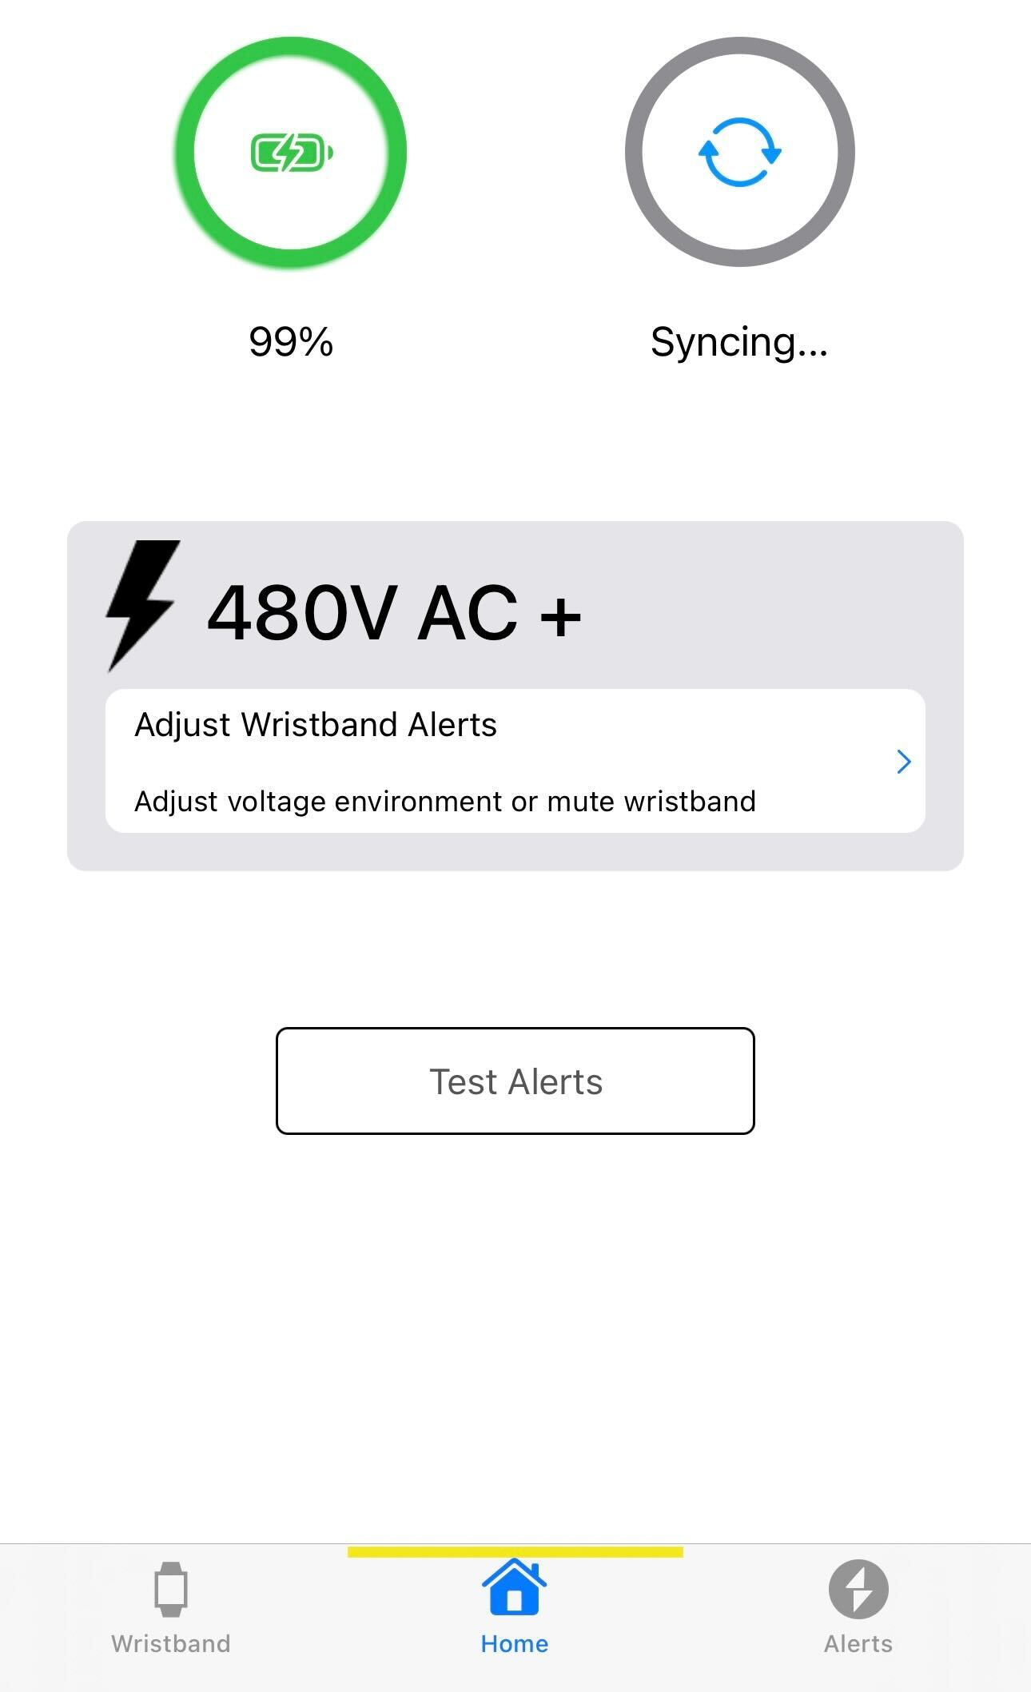

Proxxi by Grace - An Added Layer of Safety
Multi-Voltage: Enable users to calibrate warnings on the fly from 480V – 500kV
Non-Conductive Material
Mute: Silence alarms when workers acknowledge they are working energized
Compatibility:
iOS & Android Capable

Slide 41
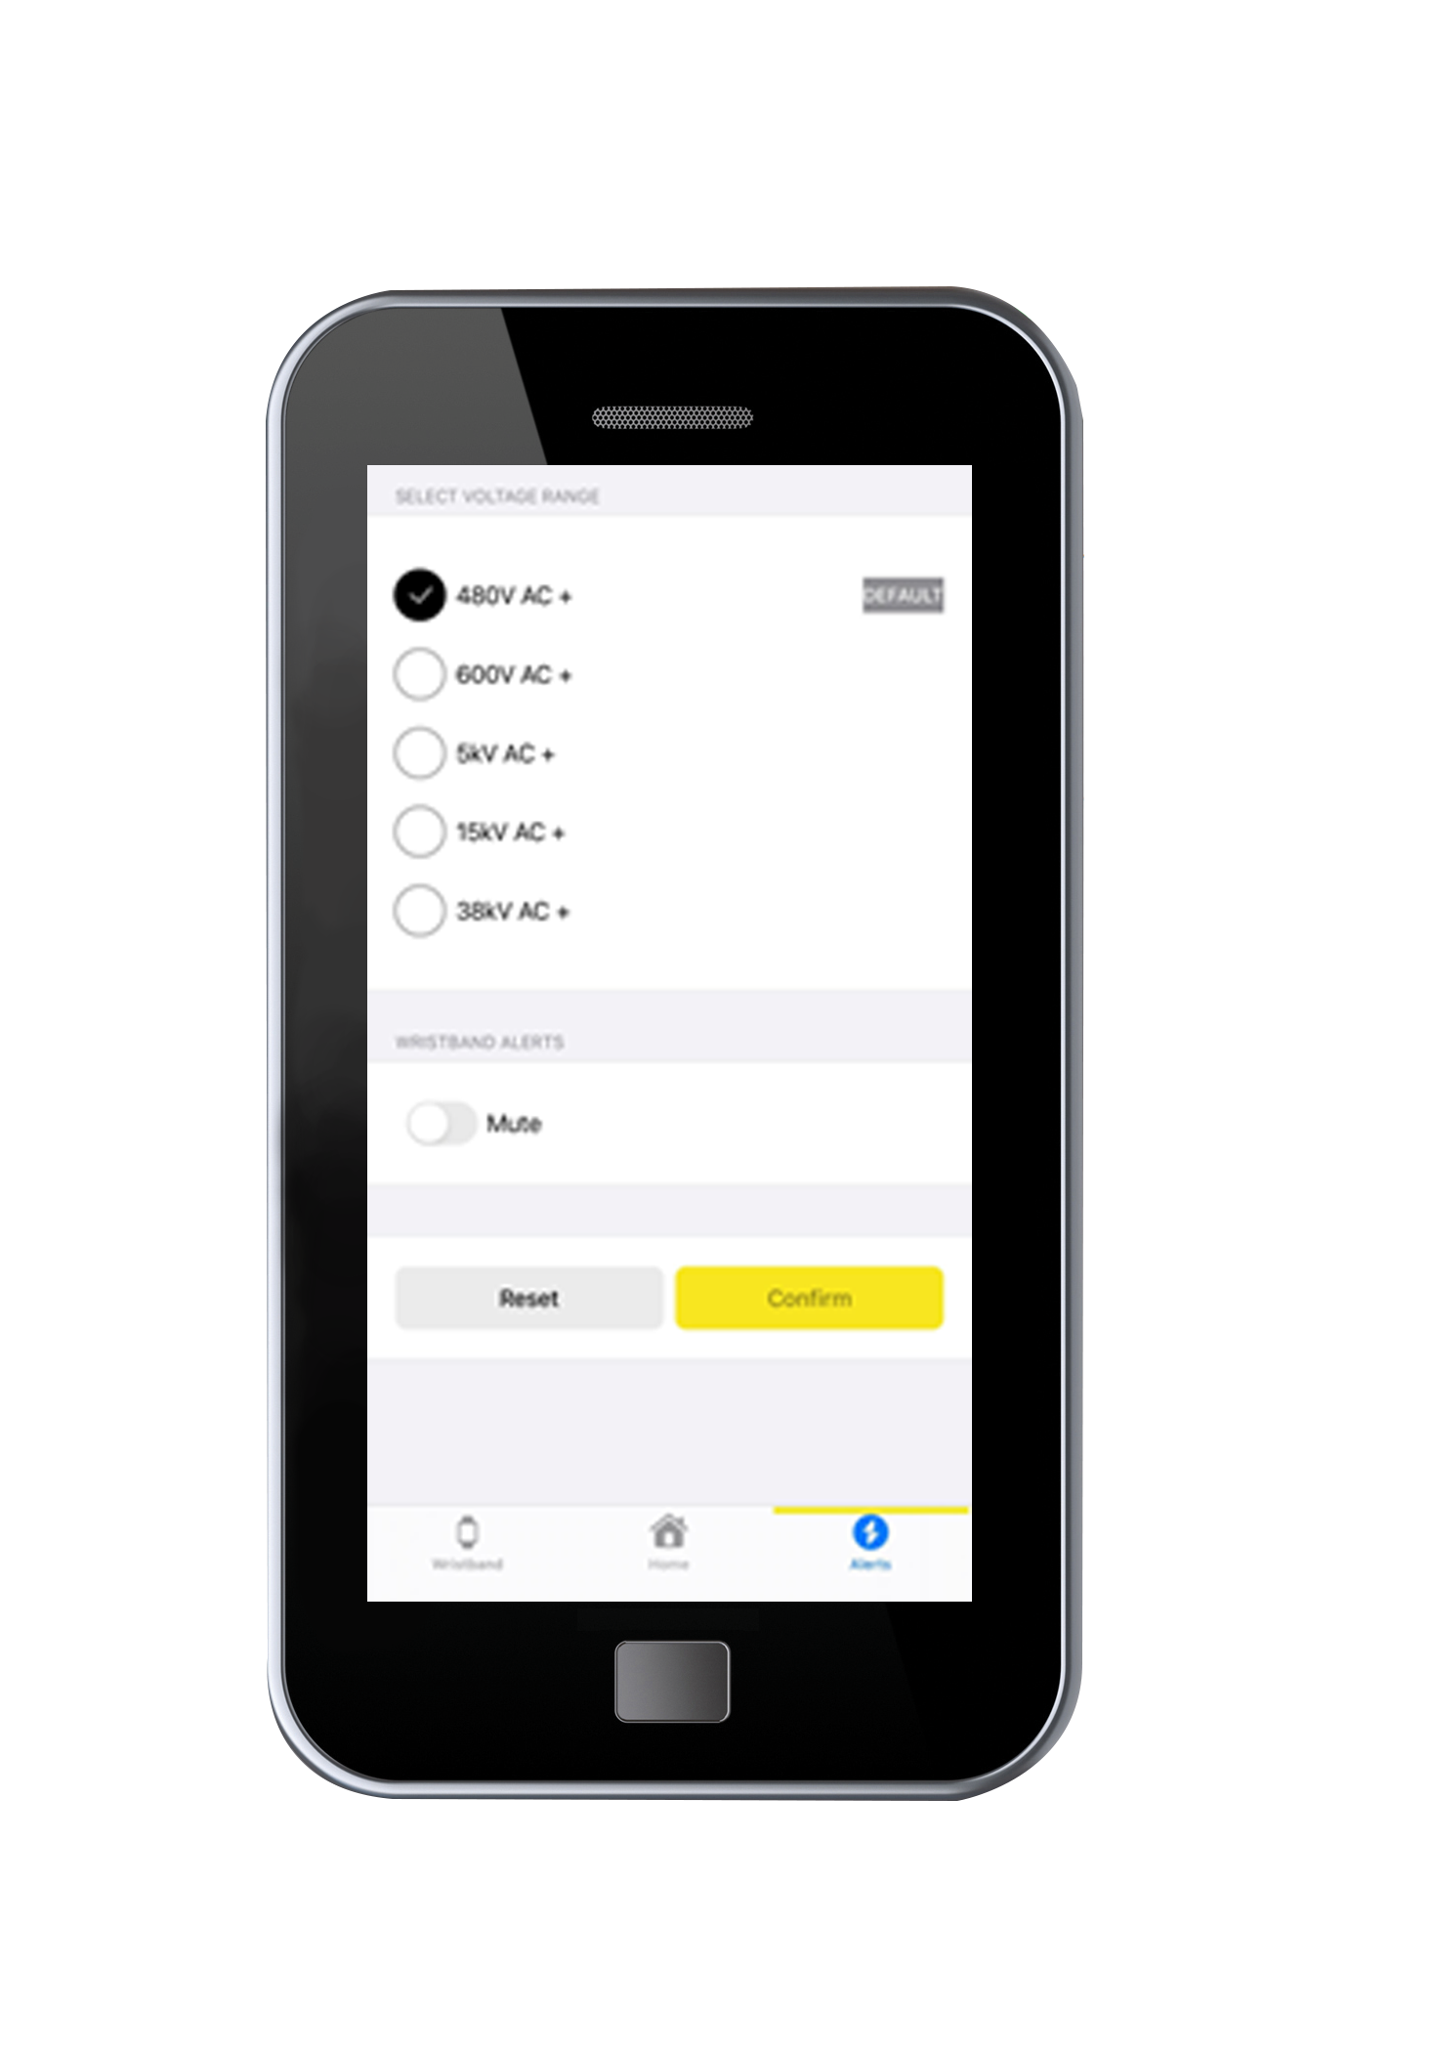
Proxxi by Grace - How it Works
How Alerts Work: The band senses electric field strength—not actual voltage or distance. Settings adjust the field strength needed to trigger an alert. Higher voltages alert from farther away; lower voltages require closer proximity.
Default Setting: By default, the band’s 480V setting triggers alerts at distances equivalent to 480V field strength—18 in for the initial alert, 12 in for the high alert.
    Adjustable Sensitivity: Voltage sensitivity can be changed in the app. Each setting adjusts the alert threshold to match the voltage level of the equipment being worked on.

Slide 42
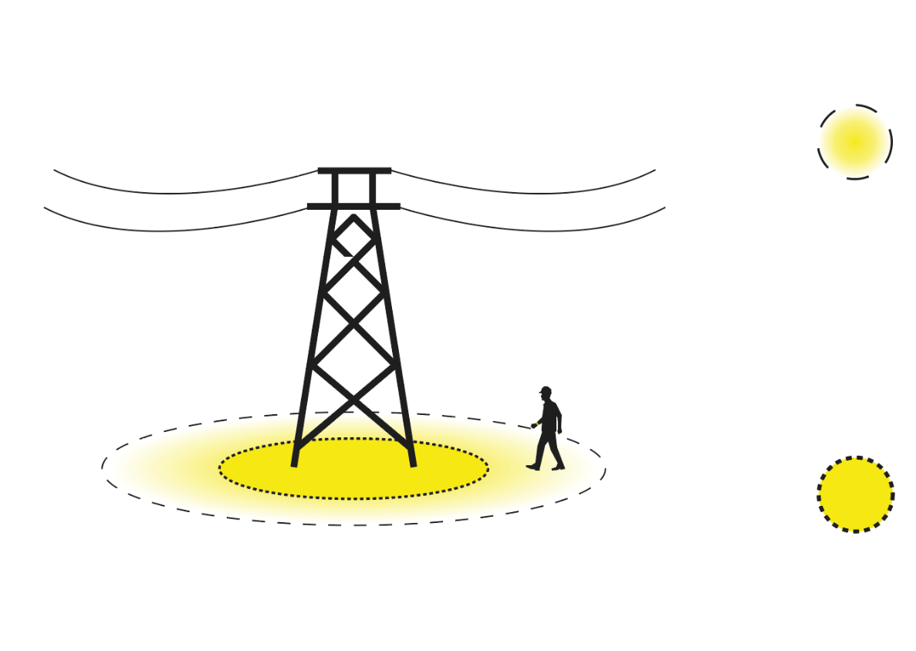
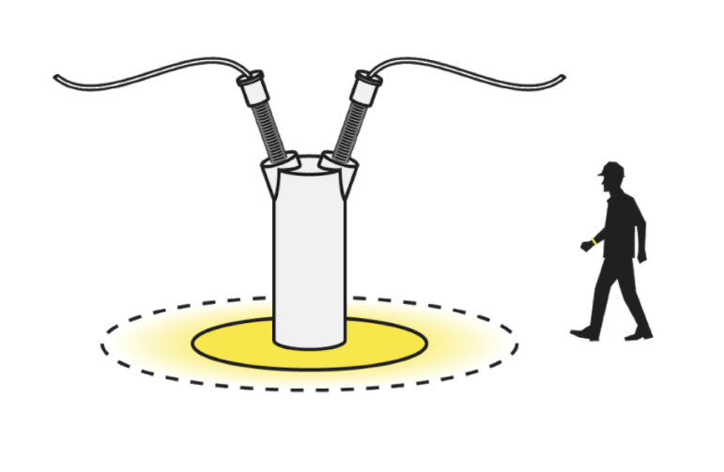

Proxxi by Grace - How it Works
Initial Alert: Voltage will alert as you enter the initial alert zone.
The alert consists of haptic feedback (vibrations) well as audible and visual alerts.
These alerts increase in frequency as you near the limits of approach
High Alert: Once the limit of approach has been breached, the alert because persistent, indicating a potential near miss.

Slide 43
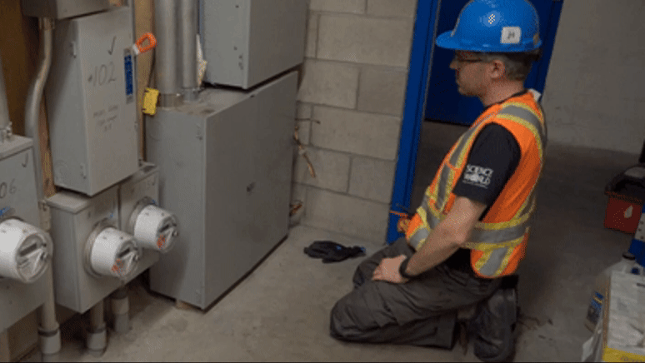

Slide 44
Proxxi by Grace - Use Cases
Recommended Use:
Use the wristband on the default or other environment setting for:
Any environment where the equipment should be de-energized, or is presumed to be electrically safe
When intending to stay outside of the restricted approach boundary of live equipment
Non-Recommended Use:
Mute, power down, put on charge, or do not wear the wristband for:
Live work and Live testing
DC equipment
When not performing work (home, office, breaks, commuting)
Notes:
This was true both when they LOTO themselves and when it was performed by someone else
When they have seen mistakes made, the causes have been:
Network modification (22%)
Human error (22%)
Electrical diagram error (22%)
Identification error (33%)

Slide 45
Tailor Settings to Customer Usage
We can customize the following with the customer:
Create custom voltage sensitivity settings for different use cases
Rename the voltage sensitivity settings on the app
Adjust default settings
Add/Remove settings entirely

Slide 46

Proxxi Dashboard - Data Analytics & Insights
Identify precursor incidents
Track usage and drive compliance
See interactions with energized equipment

Slide 47
Proxxi Dashboard - What Does the Wristband Record?
What is recorded:
Assignment status and assignee
Sync status
Firmware version
Charge and use information
Setting and mute information
Alert and voltage sensing information
What is not recorded:
GPS/location data
Health metrics (ex. heart rate)
Step count
Context (ex: whether an alert was a near miss or a known source)

Slide 48
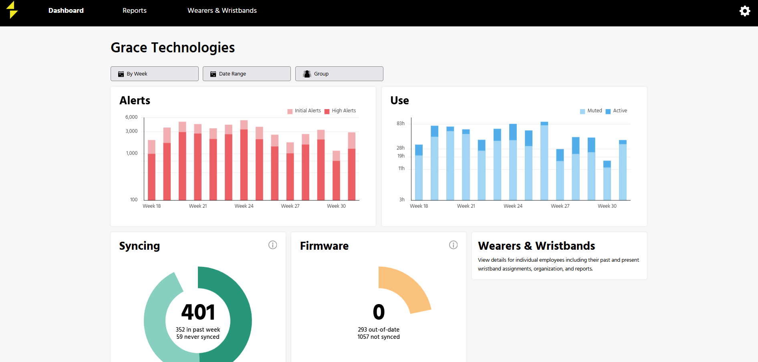
Notes:
This was true both when they LOTO themselves and when it was performed by someone else
When they have seen mistakes made, the causes have been:
Network modification (22%)
Human error (22%)
Electrical diagram error (22%)
Identification error (33%)

Slide 49
Proxxi Dashboard - Key Benefits
Uncover Hidden
Near Misses
Alert data captures instances where workers come dangerously close to energized equipment—providing critical insights into near misses that often go unnoticed. Use this to proactively mitigate risks and refine safety training.
Identify High-Risk Environments
and Behaviors
Analyze patterns in alerts to uncover high-risk locations, tasks, or individuals. This enables you to take focused, data-driven steps to reduce exposure and improve procedures.
Drive Safety Compliance and Accountability
Usage reports offer visibility into how the bands are configured and used—including voltage settings and mute status—supporting regulatory compliance, identifying training gaps, and reinforcing accountability.
Customize
Your Insights
Tailor notifications to your specific safety priorities. Whether tracking frequent alerts, monitoring usage behavior, or focusing on critical voltage thresholds, the platform delivers insights aligned to your goals.
Notes:
Have Brooke

Slide 50
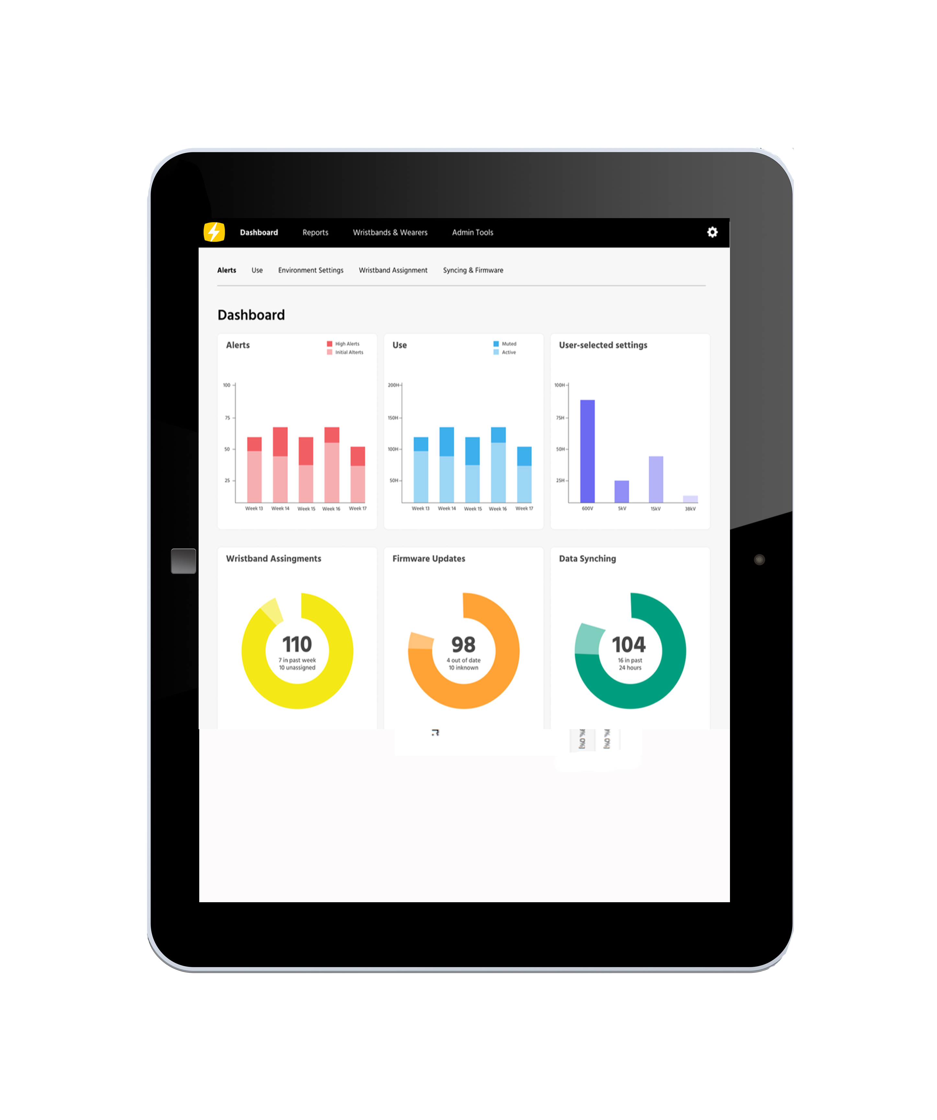

Proxxi by Grace Pilot Program
What’s Included in the Pilot? (Part No. W-PRX-PLT6)
6 Proxxi Wristbands
White Glove Onboarding
Dashboard Access
Try It On Your Terms: Test Proxxi in your environment before a full rollout.
Spot Safety Gaps Sooner: Use dashboard insights to flag exposure trends and training needs.
Easy, Expert Onboarding: Setup and training with four weeks of included support.
Add a Smart Layer of Protection: Real-time alerts add a critical layer to your safety program.
^{*Return for full hardware}
refund ($2,500); does not include setup and service fees.

Slide 51
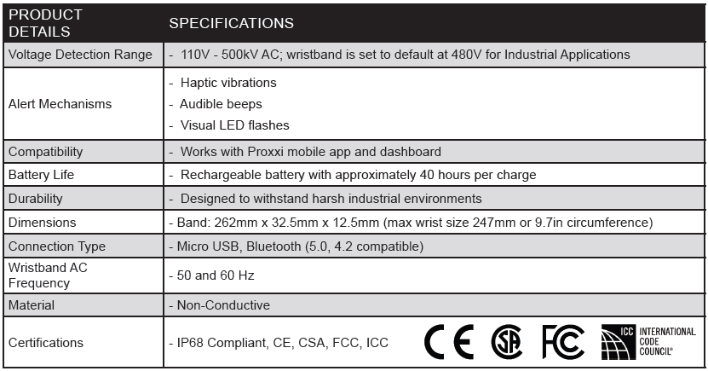
Proxxi by Grace - Specifications

Slide 52





Trusted By:
Notes:
Add Shermco to this slide

Slide 53












Additional Resources
Long-Life Power for Wireless Transmitters
Visit www.graceport.com to shop and chat with one of our Representatives
180+ GracePorts and all PESD’s now available in ePlan data portal
Grace Technologies Master Catalog
Check out our Knowledge Base Articles with over 250 articles

