Slide 1
Grace Technologies Partnership Explained
⭐Grace Successful Joint Lead Gen Partnership Easily Explained-
Investment from Distributor:
* No $ investment, minimal time investment to see BIG results.
45 mins for Grace to train team
30 mins to import email template and social media into system to send to proper audience (templates/images provided by Grace)
Work with local rep to set up joint calls to deliver sample & close the deal
Investment from Grace:
Prep and Training Sales Teams
Time to facilitate and set up trainings, campaigns, email template, unique landing page
$3500+ Paid Lead Gen Campaign
$350+ per sample sent - average of $8500+
BD time to vet all leads, communicate and share insight with Distributor team and issue sample
Time & support for continued follow up

Slide 2
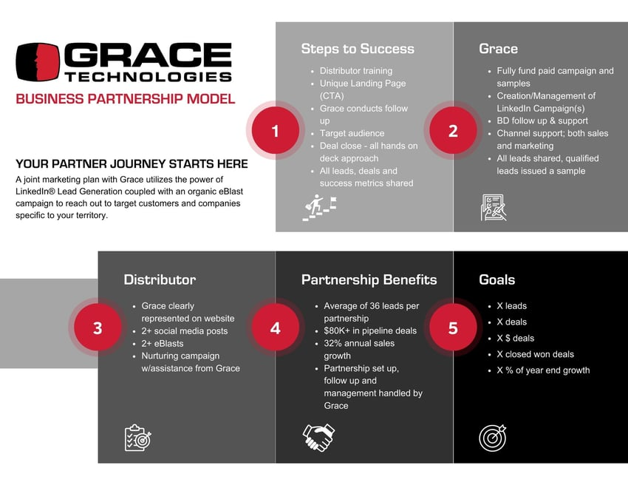
Grace Technologies Partnership Explained

Slide 3

Grace Technologies Partnership Opportunities
The WHY?

Slide 4
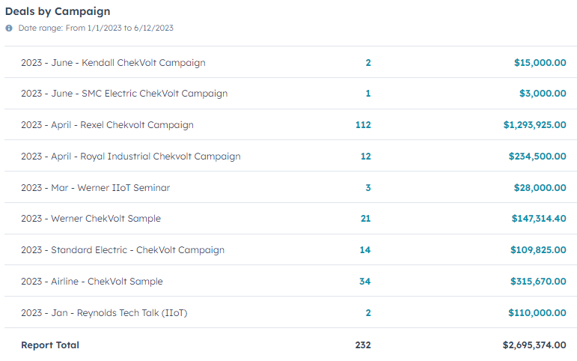
Current Partnership Success Metrics Q1-Current
Leads Created= 704
Deals Created= 232
Total Opportunity in Pipeline=2.7 Mil
Average Deal Size- $11,659
Focal Product- ChekVolt
8 Distributors Partnering in Q1
6 Distributors Partnering early Q2

Slide 5


Grace Technologies Partnership Opportunities
Free Evaluation Unit Program-
Training Conducted – Slide Deck & Recording Provided
Landing page
Social images
eBlast templates
Blog Post
BD team to vet leads- gather info about opportunities
Lead and opportunity insight shared
Free Sample Units Provided
Unique co-branded landing page provided
Social Media Images Provided

Slide 6
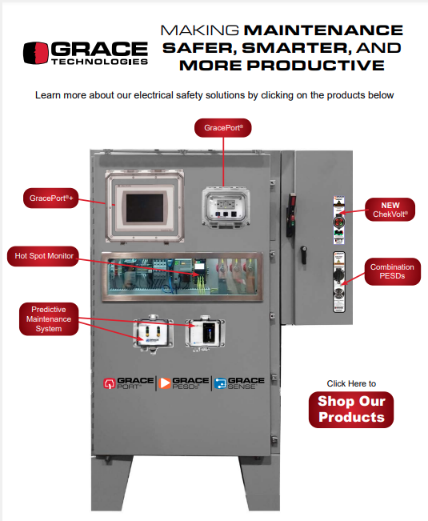
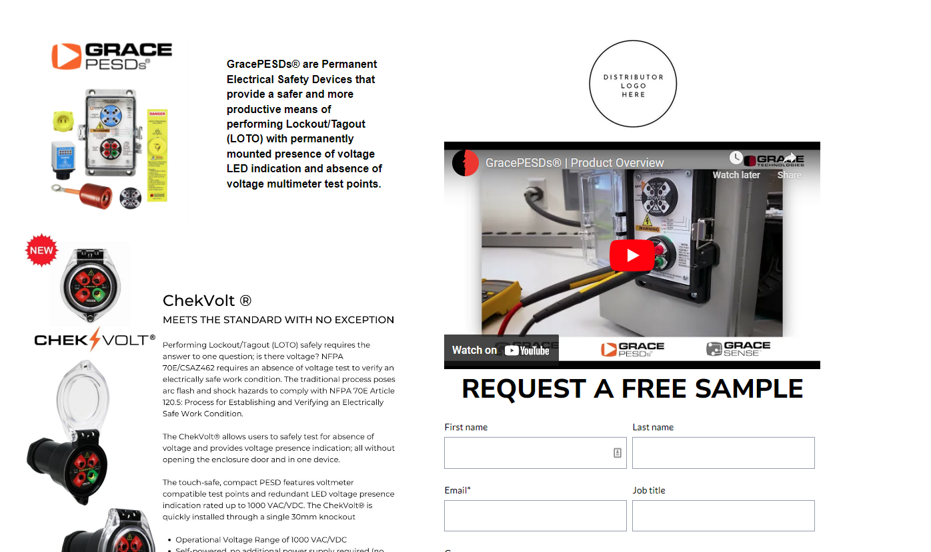
Grace Technologies Partnership Opportunities
Enclosure Promo-
Training Conducted – Slide Deck & Recording Provided
Landing page
Social images
eBlast templates
Blog Post
BD team to vet leads
Lead and opportunity insight shared
Free Sample Units Provided
Unique co-branded landing page provided

Slide 7

Grace Technologies Partnership Opportunities
Lunch & Learn- In-person or Virtual
Training Conducted – Slide Deck & Recording Provided
Trackable Invite Landing Page
All lead and activity insight shared
Social images- Event info
Lunch provided
Free Sample Units Provided
BD team to follow up

