Slide 1
Title
Presenter

Slide 2


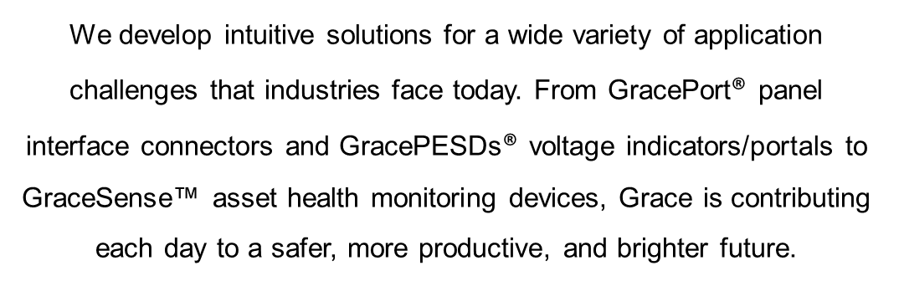







DAVENPORT, IOWA
Sales presence in
60+ countries around the world

Slide 3
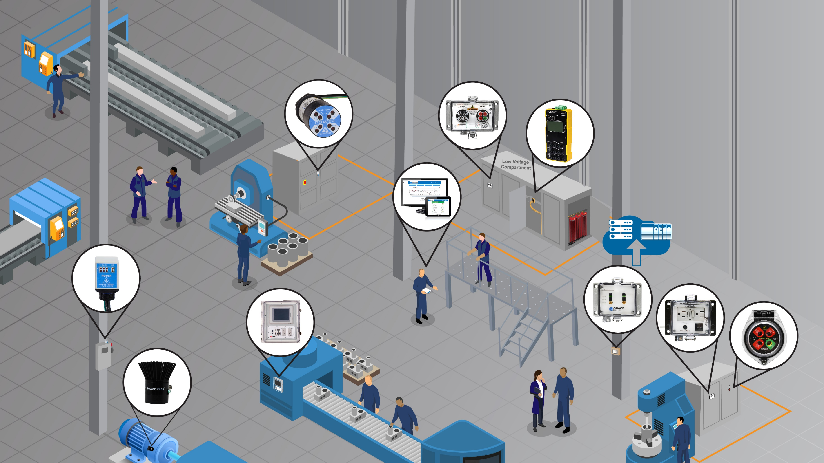

Improving safety and productivity in your entire facility

Slide 4





Most common reasons for Electrical Accidents and Failures in the Workplace
Underqualified Persons Performing the Task
Production Pressure from Management
Complacency
Work Culture
Poor Equipment Condition
PPE
The compounding effects of these preventable injuries go beyond just the day
of an incident and adversely affect the future of our economies
Notes:
Work culture – GracePorts are one piece of the puzzle and safety needs to be a part of the entire company top-down from the CEO to the workers performing the work
A lot of what you’ll see from Grace is common sense products.
Ask a question about exposure to shock and injury. Ask specifically if anyone has had a close call with a shock injury.
Poor Equipment Condition – keep the harsh and dirty environment from getting inside your panel.

Slide 5
Panel Interface Connectors

Slide 6

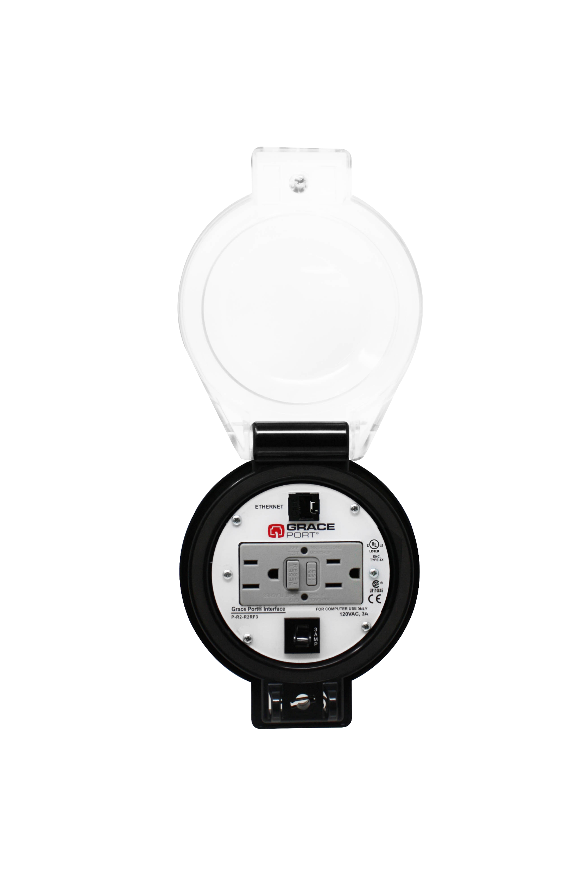
Advantages of GracePorts®
Elimination
Substitution
Elimination: Reduce or eliminate incident energy exposure by keeping your enclosure door closed by installing our GracePort Panel Interface connector accessing connections on the inside of your control panels.
Substitution: a programming task from outside the panel in a Normal operating condition.
Engineering Controls: Easily access any connection inside of a PLC Control Cabinet thru closed doors. Keeping the harsh production floor environment from getting inside of your control equipment.
Engineering Controls
Awareness
Administrative
Controls
Panel Interface Connectors like GracePorts can improve task productivity by about
^{90%}
PPE
P-R2-R4RF3
Notes:
Open doors makes maintenance less safe and allows for environmental conditions to get inside of the control cabinet. Environmental hazards and personnel hazards.
Risk hierarchy of controls. We want to be in the first three buckets. The least effective is PPE. Often in facilities we jump right to suiting up in high calories PPE. Risk is measured in dollars. Even a human life has a dollar value. Eliminate, substitute, and engineer around the risk.
The pressure wave is whats going to hurt or kill you. There is a flashover and shock when making contact with a live conductor.

Slide 7
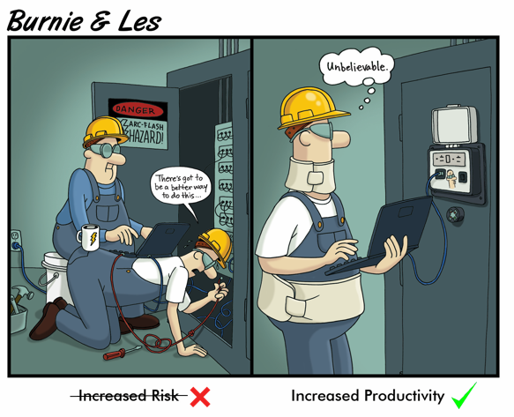
Who Uses GracePorts?
Automation Engineers
Electrical and Instrumentation Engineers
Maintenance Supervisors
Controls Engineers
OEM Service Technicians commissioning new equipment
Environment Health & Safety Teams
….Anyone frequently accessing or design PLC/drive cabinets
Notes:
Remove when we have customer facing discussions?
Tag line – Any connector, any connection, any component?
Anyone accessing or designing PLC/Drive Cabinets.
….Anyone frequently accessing or design PLC/drive cabinets – rework this
Accessing PLCs/and Drive cabinets. Decrease risk and increase productivity

Slide 8

Making Maintenance Safer, Smarter, and More Productive
Safer: GracePort enhances overall safety and productivity for maintenance workers while complying with minimum performance requirements of OSHA & NFPA 70E standards.
Smarter: Built and shipped within 2-3 days of ordering, the GracePort is fully customizable allowing users to choose from a seemingly endless variety of components, power options, and housing types
More Productive: Convenient access programming ports that keep voltage away from people by allowing access to PLCs safely behind closed doors. This two-pronged approach also allows for a more productive and efficient method of connecting to PLCs, control circuit components, and more.
Notes:
Reducing the risk of programming PLCs with the need to have the door open.
Grace does it smarter. We can build and ship our orders in 2-3 days. Over the last three years, we maintained a next day ship rate (98% on-time-delivery). Any connection, any cable, any combination any way you want it. Customer logos and text. 20,000 unique part numbers in our system currently. Ever week we add 5 new part numbers.
GracePort has become the golden standard. Kleenex analogy. All ports are referred to as GracePorts.
We found that having an electrician stand by while performing this maintenance isn’t a great use of resources. Grace believes every panel should have a GracePort from a safety and reliability perspective.

Slide 9
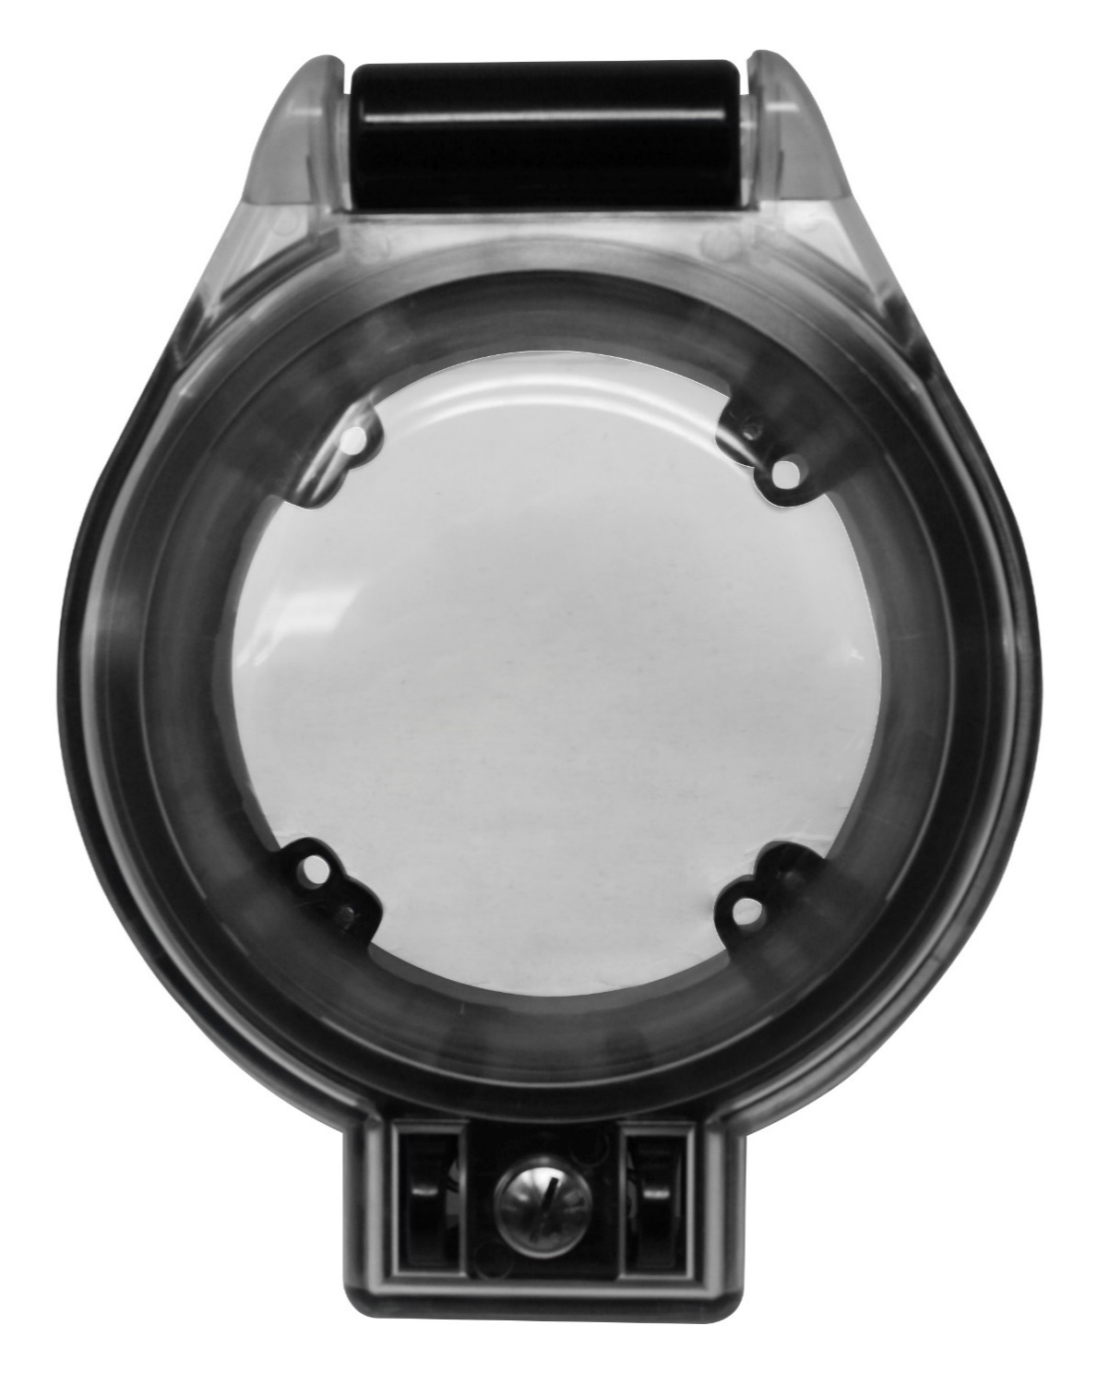
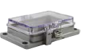
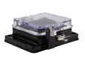
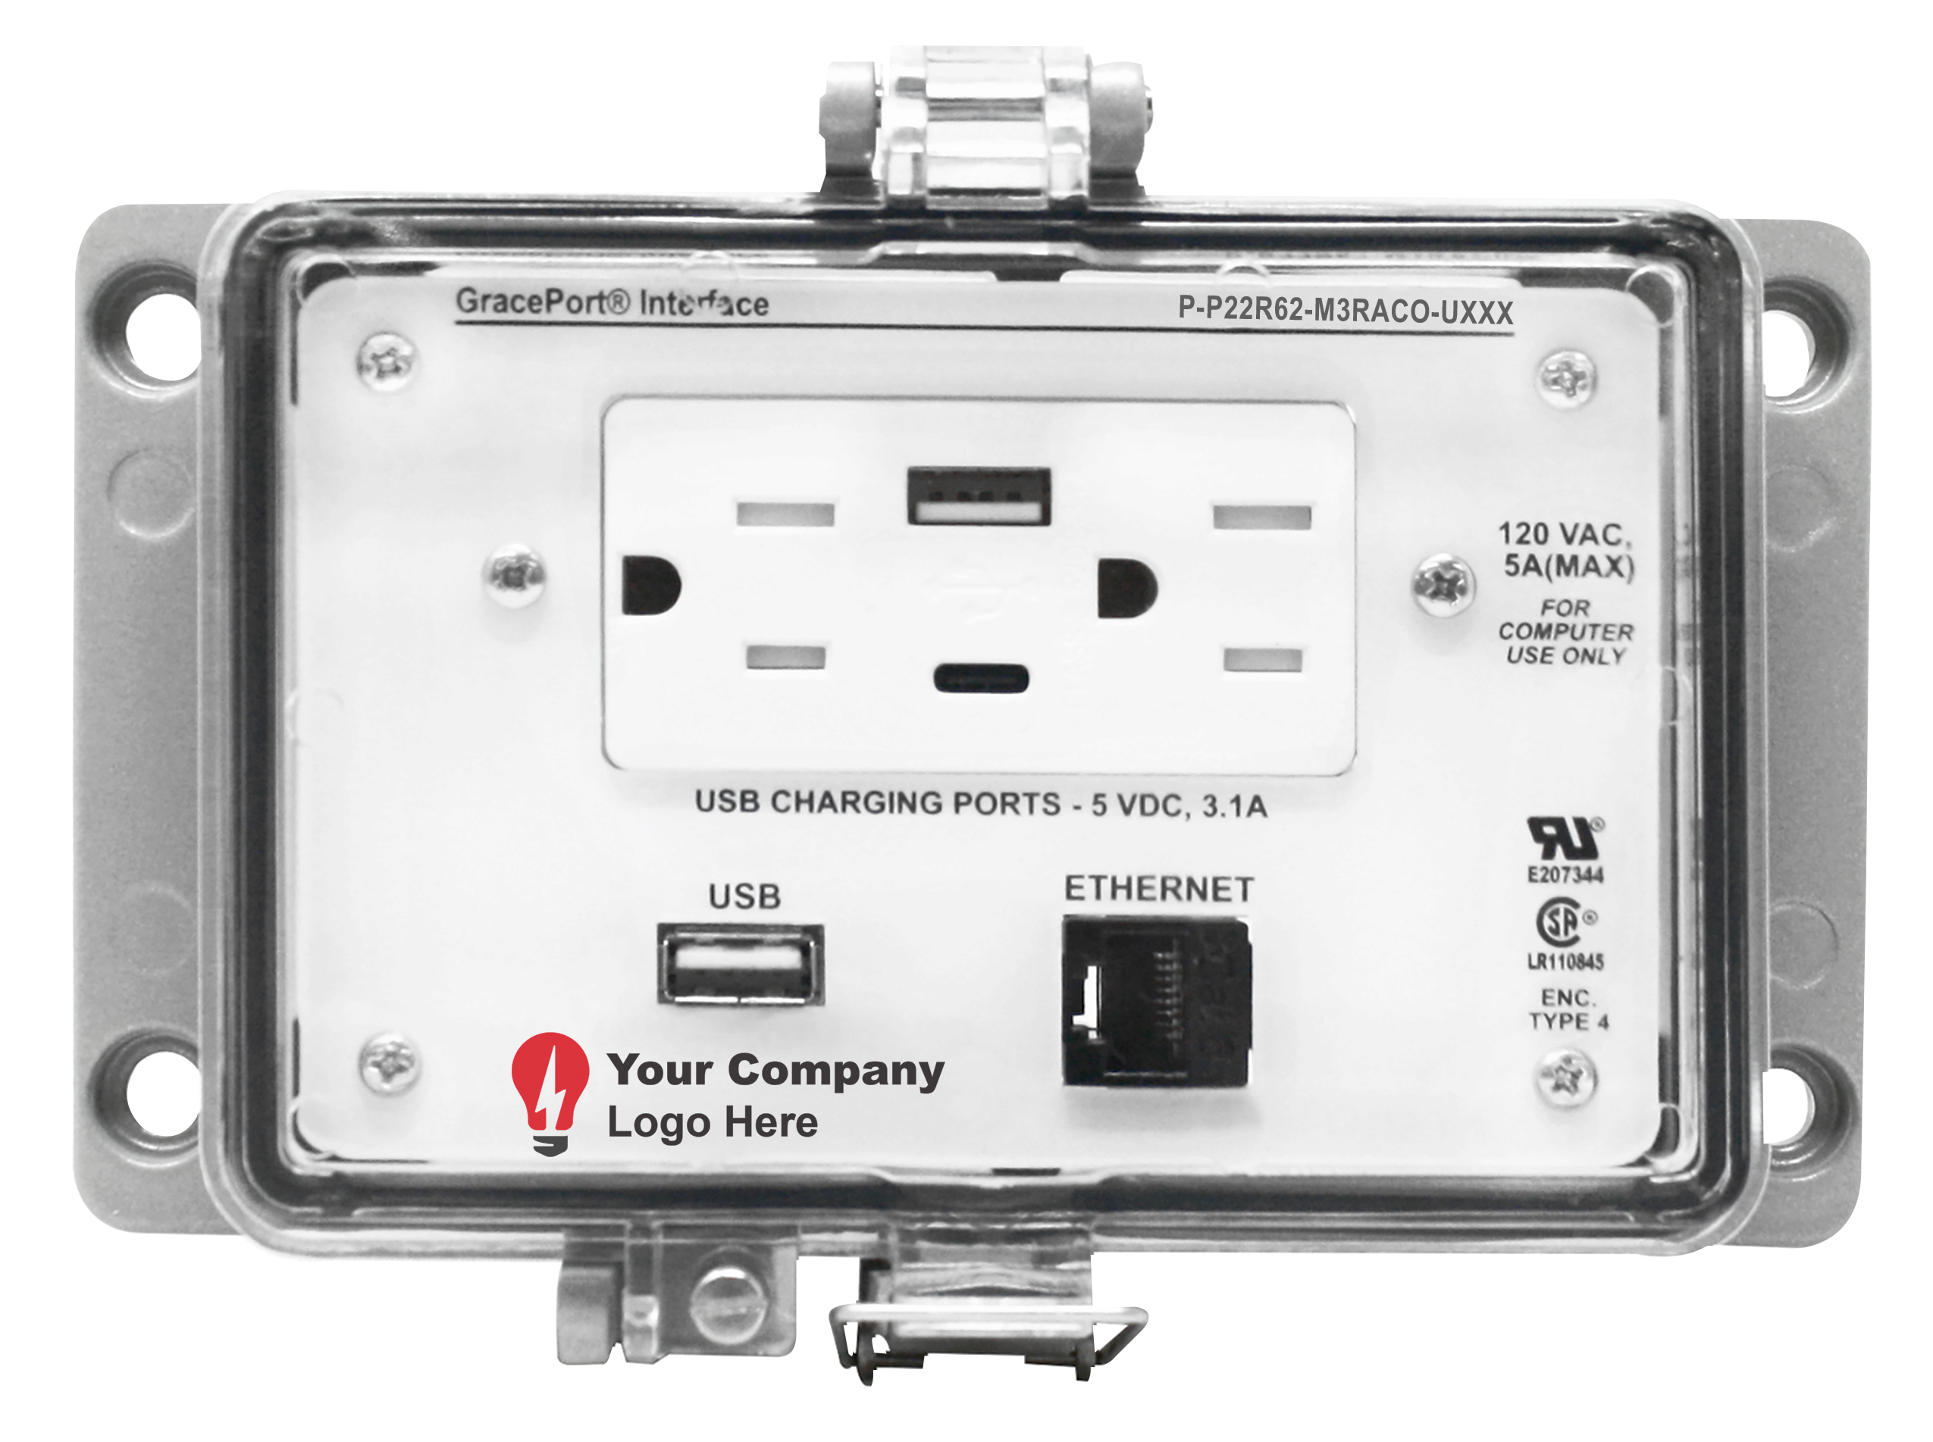
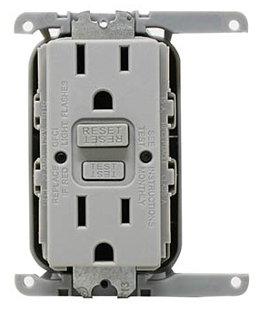
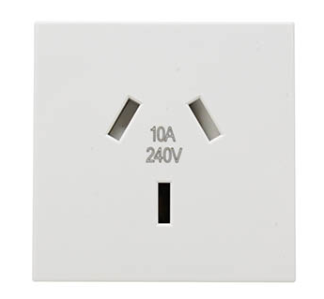
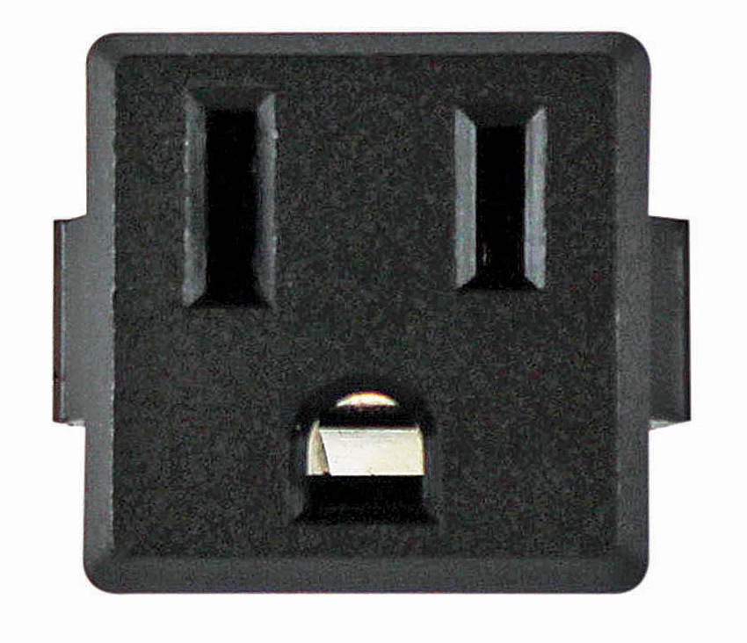
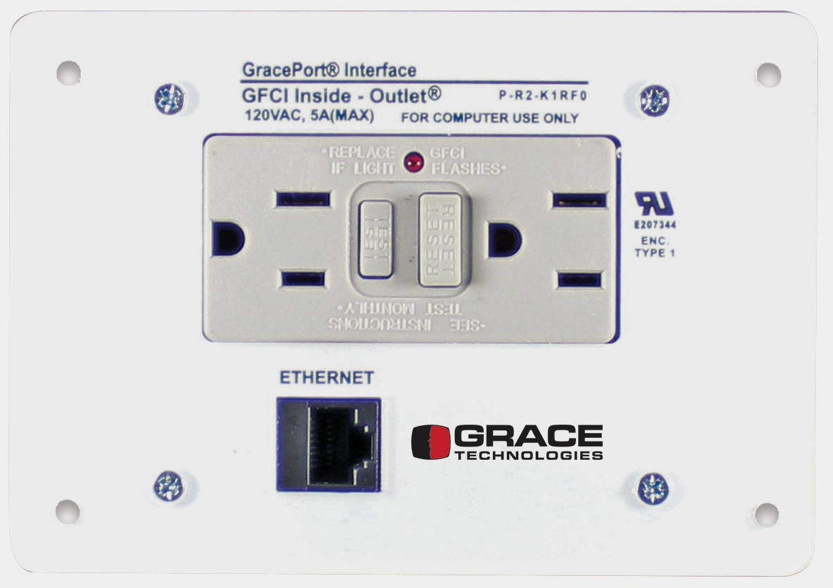
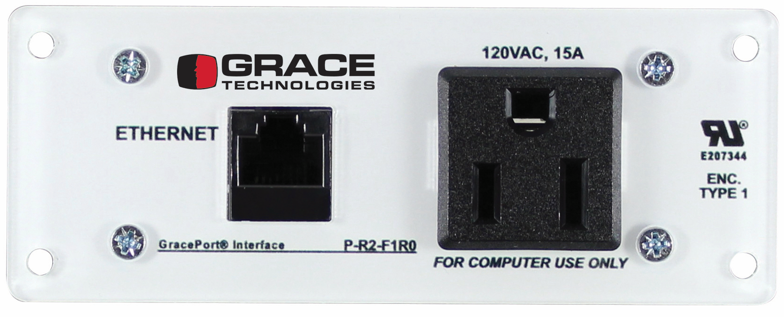
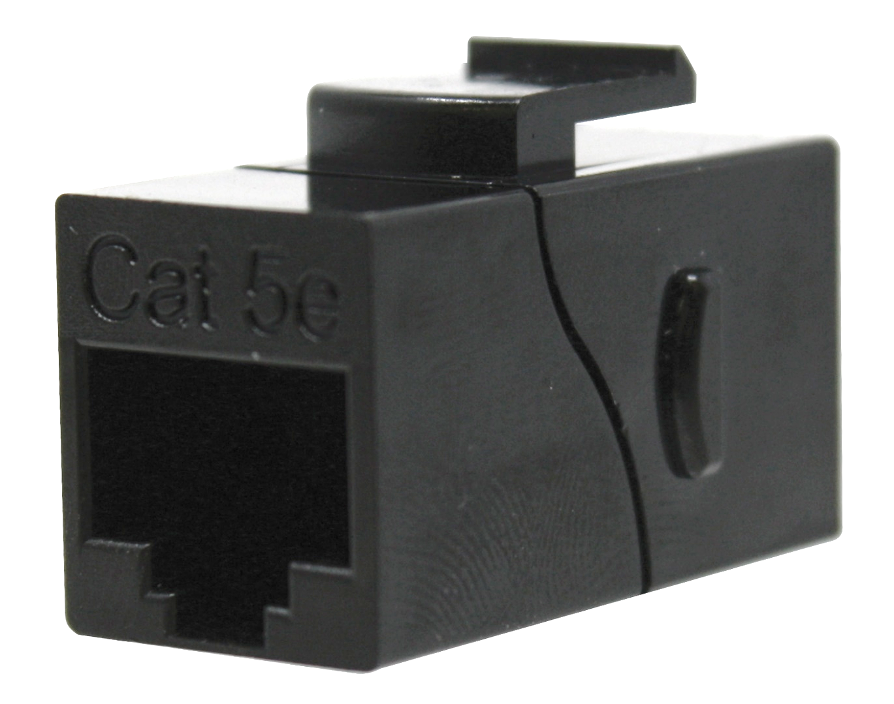
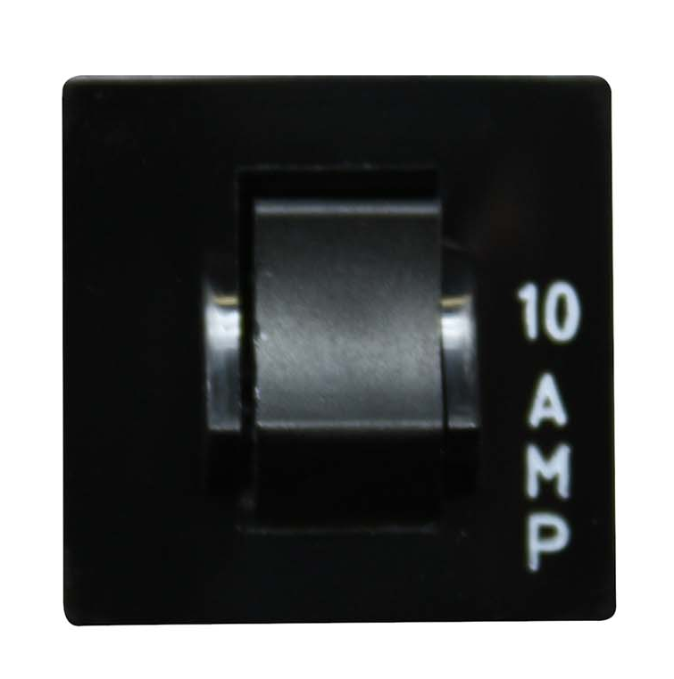
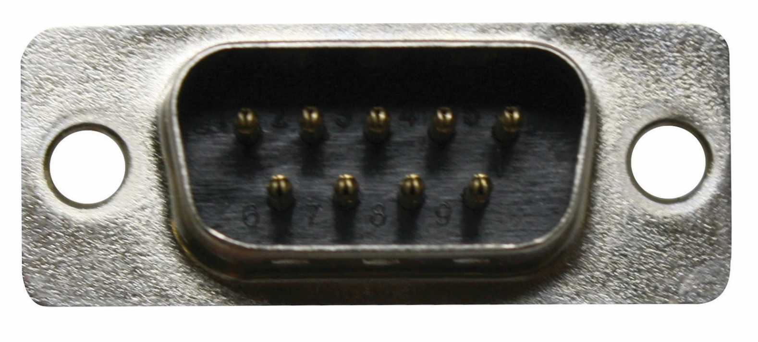
The Possibilities are Endless
Add Your Logo
Choose a Housing from UL Type 1 (no housing), 4, 4X, or 12
Choose your components and power options (both domestic and international options available)
Add special cutouts, cable lengths, text, and logos
We can create a custom-built GracePort, including special text, cut-outs, cable lengths,
and even adding your company logo, all in just 2 - 3 days– created just the way you want it.
Notes:
Enclosure sizes reference / Reference universal outlet RUV - Add USB-C – Add IP Ratings as well
Add an International slide only (CE, CSA, UKCA, etc.)
Add part number structuring.
If you have machines going overseas, we have international components as well.
If you need a logo, send us a JPEG file format and we will create a special U-code associated with your GracePort
Wide variety of GracePorts are available in ePlan. You can pull these from ePlan

Slide 10
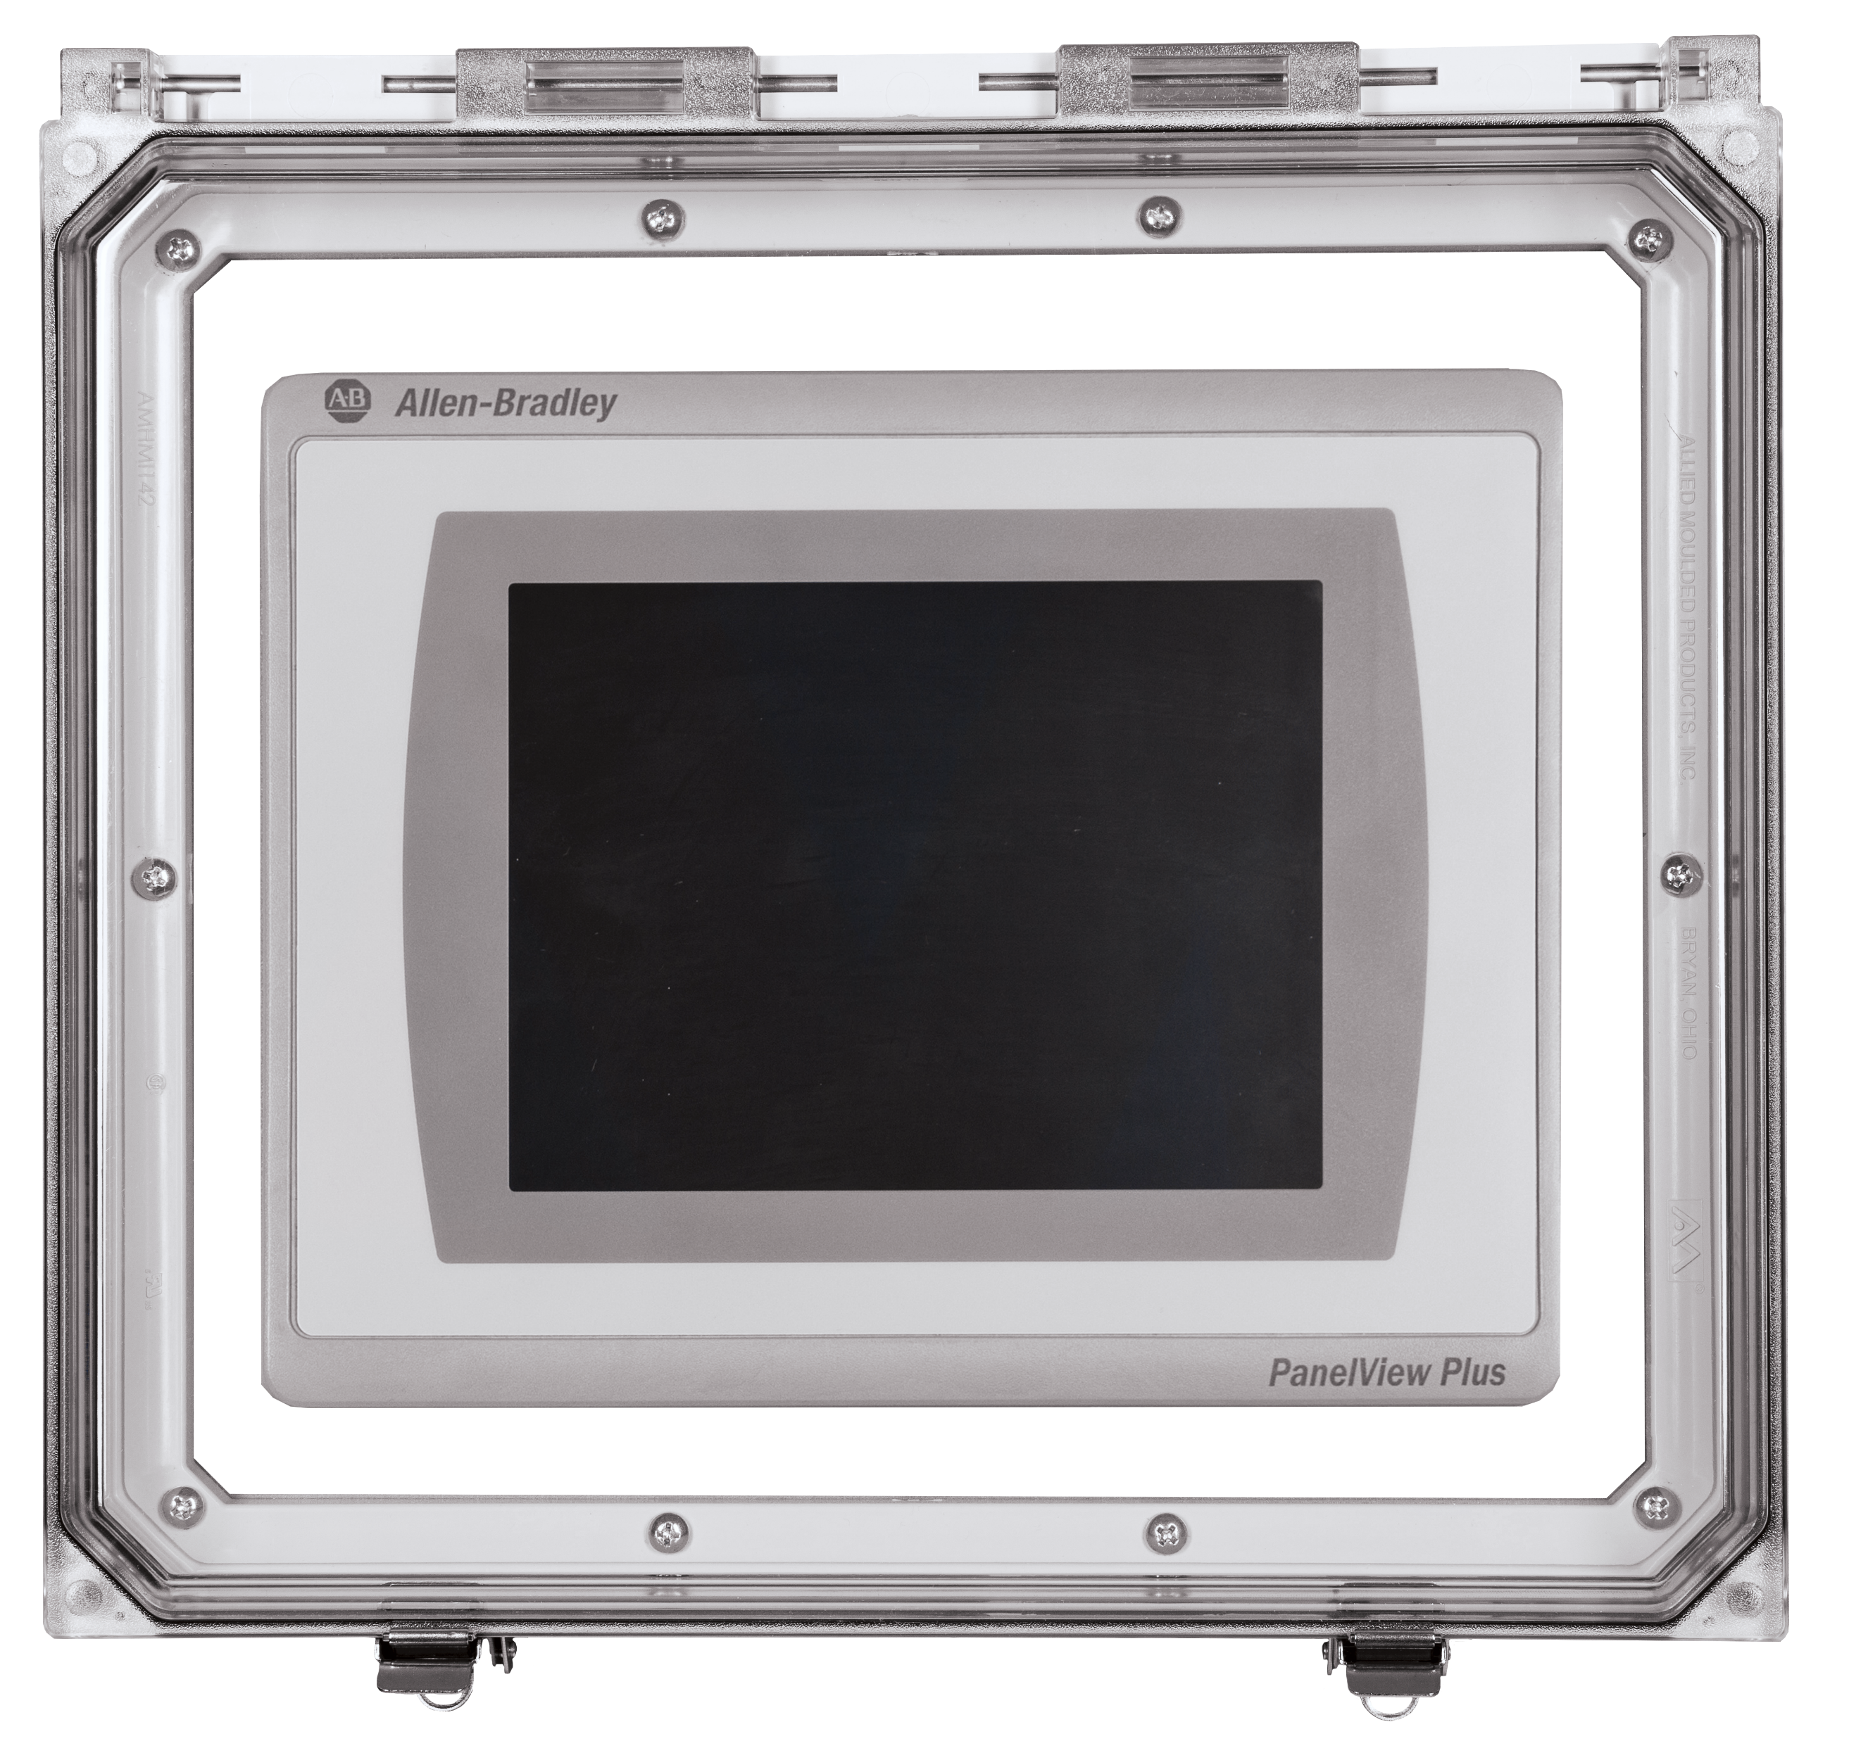
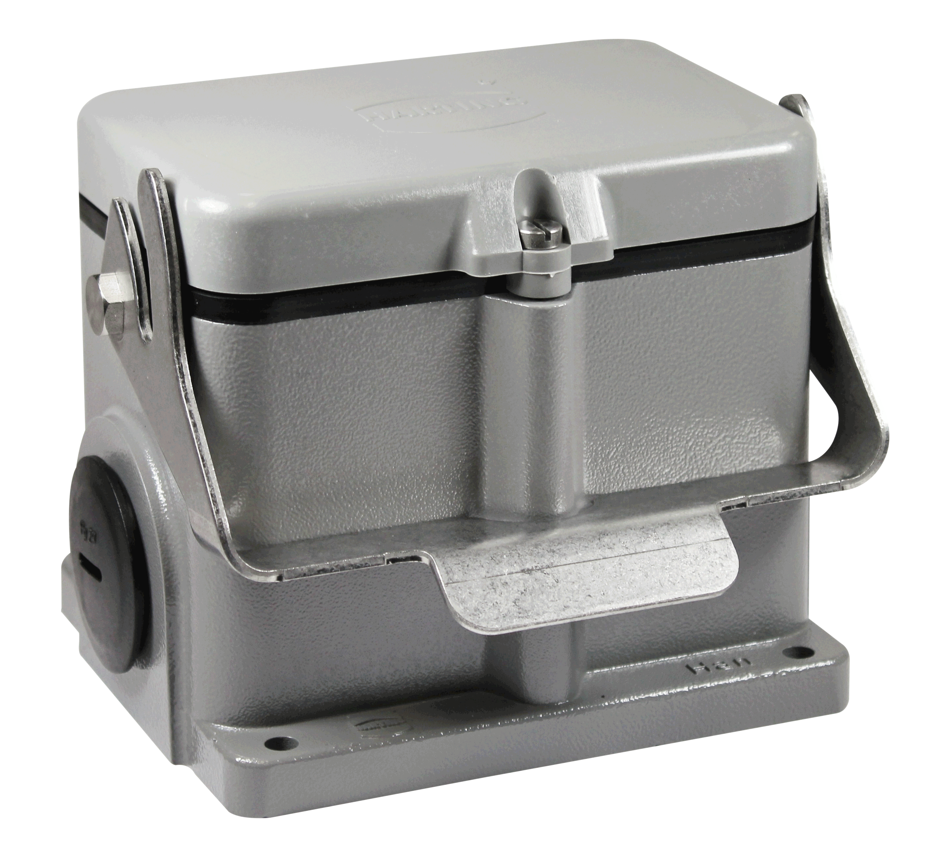
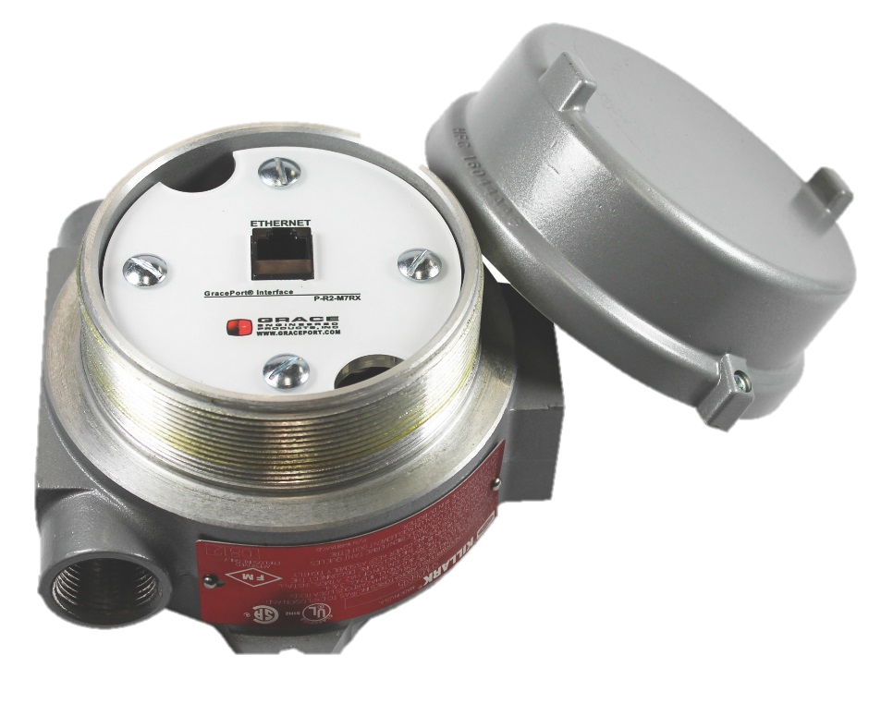
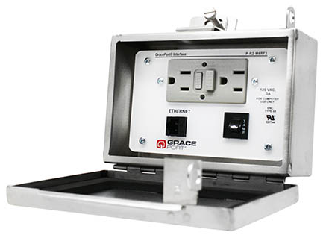
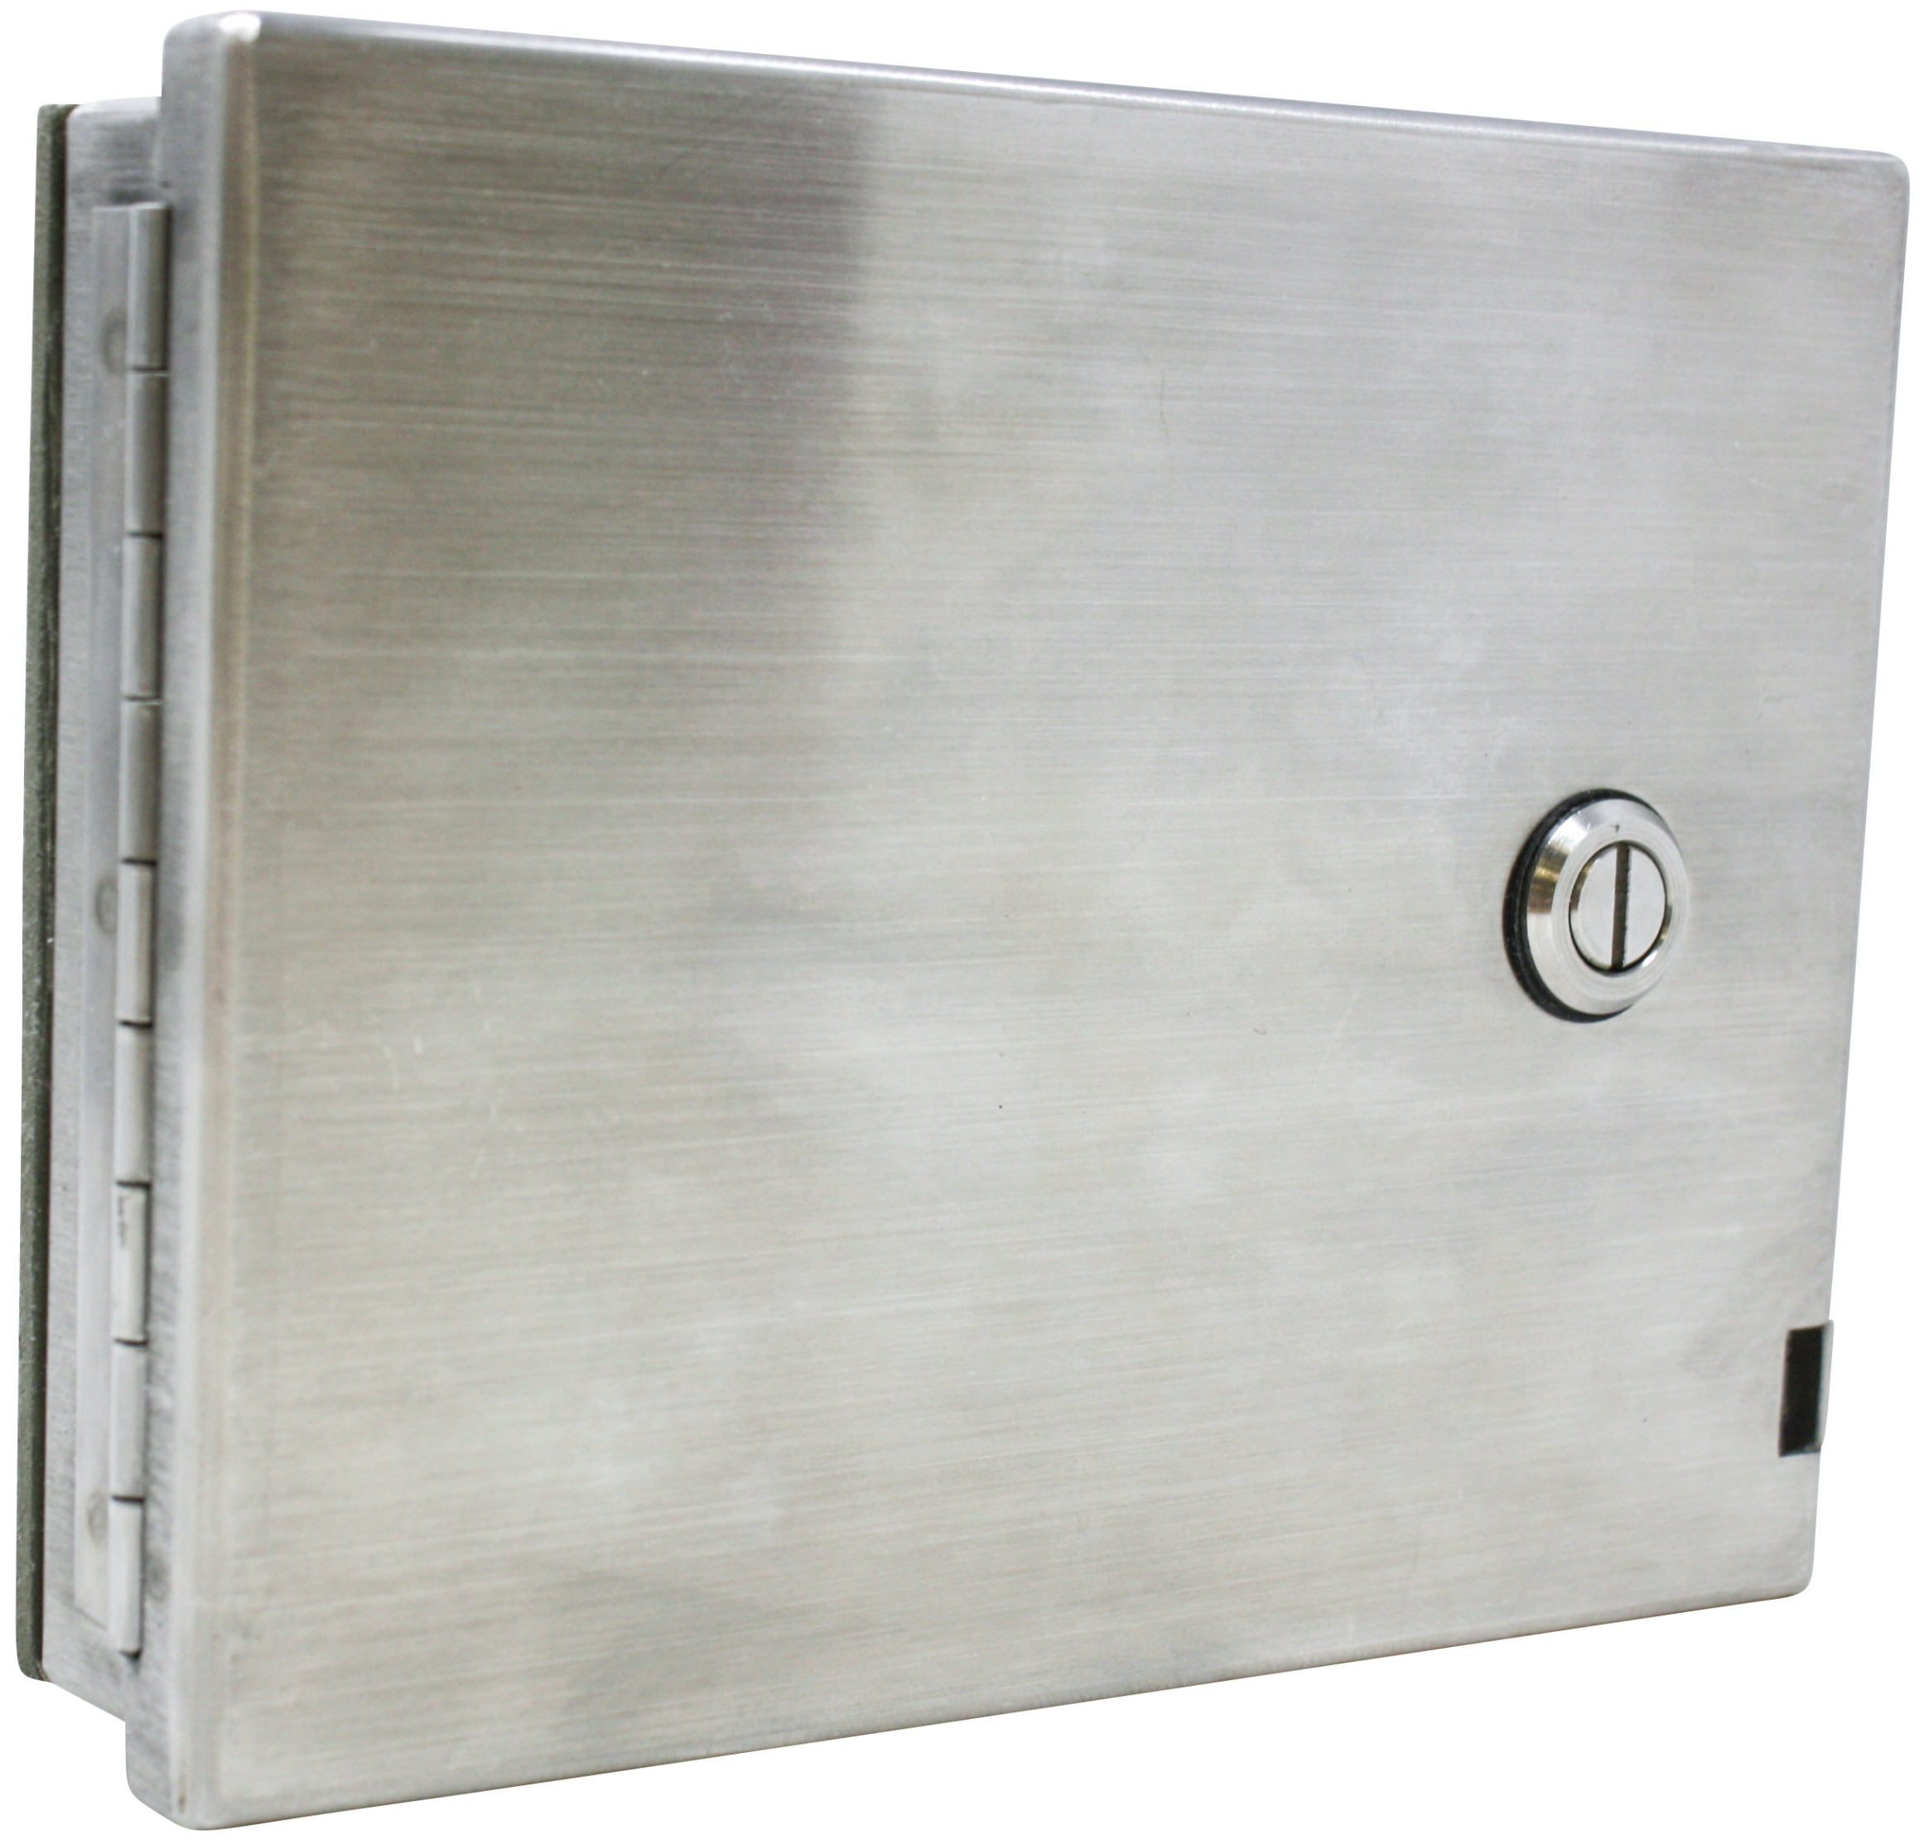
Specialty Housings
GracePort+
A HMI cover kit designed to protect valuable equipment in harsh industrial environments
Stainless Steel
100% stainless steel housing designed to meet rigorous environments. Also available in a low-profile design.
Surface Mount
IP65 and UL Type 4 Rated. Suitable for corrosive environments and/or areas that require frequent washdowns.
Hazardous Location
Intended for environments where the user must perform a “sniff test” and typically obtain a “Hazardous Work Permit” before opening the enclosure.
Notes:
Surface Mount verbiage re-work.
Stainless steel 304/316
Heavy Duty field mount connectors.
GracePort+ is a great way to protect HMIs and prevent interruptions due to damage caused to an HMI. It’s much easier to replace the GracePort+ than to pay for a system integrator or Controls Engineer to fix or repair a damaged HMI.
Working with sequestered panels you can drop the voltage down below 50V’s and still work on your panels.

Slide 11
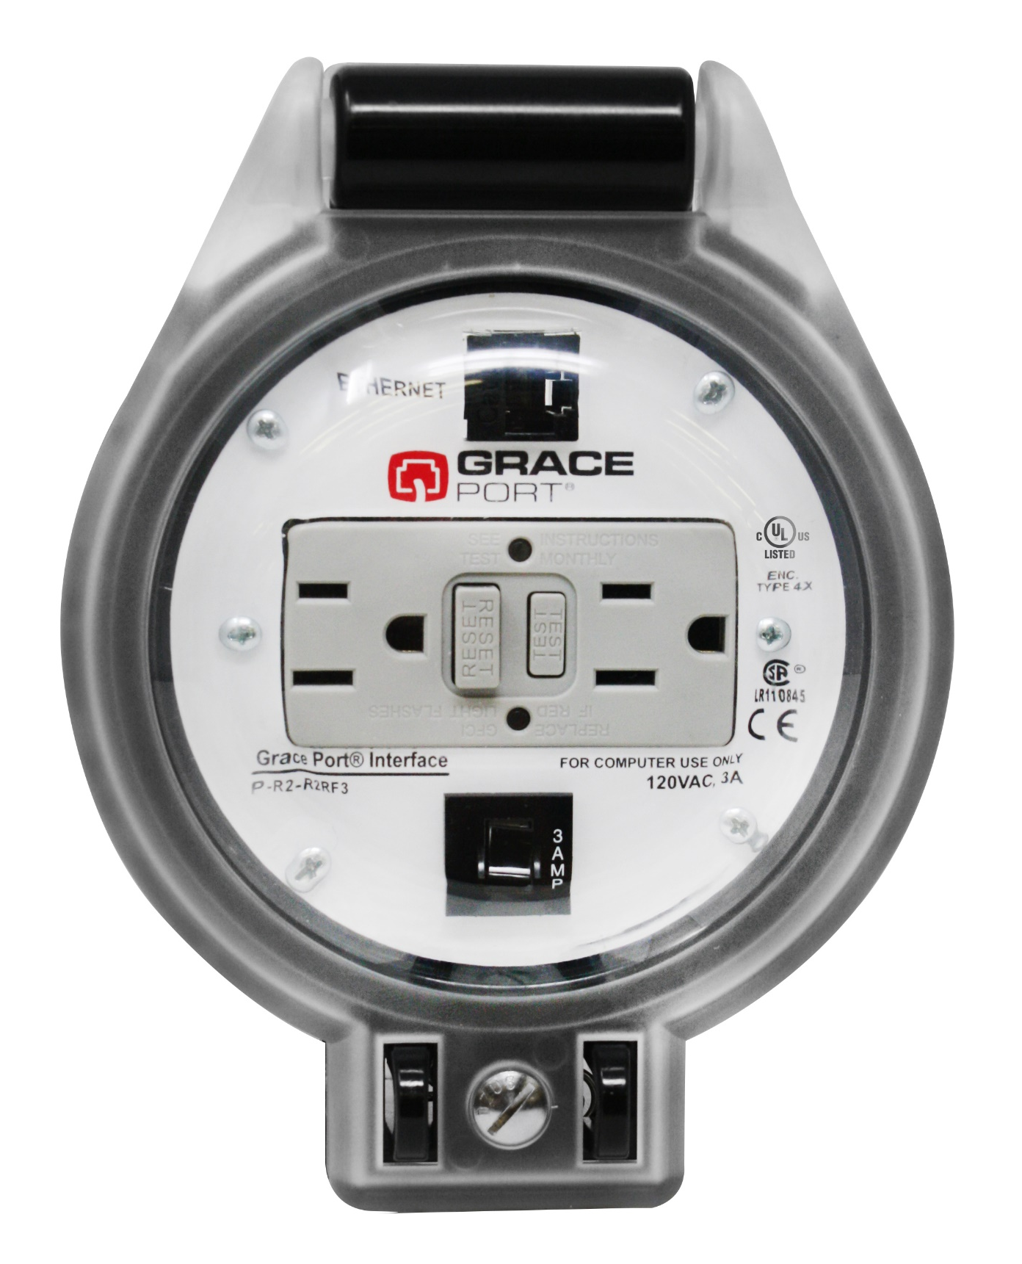
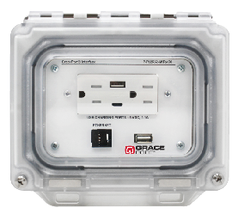
New Innovations
P-R2-R4RF3
P-P22R62-M9RAC0
ThruView™ 360
UL Listed: Seamlessly integrates with existing UL-certified systems, ensuring compliance and reliability in safety standards.
Rapid Punch Installation: Features a circular design that fits a standard knockout punch, enabling quick and easy installation in under 10 minutes.
High-Level Protection: IP66 and IP69* rated, these products offer superior protection against dust, oil, and high-pressure water and are suitable for harsh industrial environments.
*IP69 pending approval
MagView™
UL Listed: Ensures compliance with rigorous safety standards, allowing seamless integration with existing UL-certified equipment.
Patented Magnetic Seal: Features a hands-free magnetic seal that magnetizes to the panel when open, allowing easy access while reducing safety risks.
Robust Environmental Protection: Offers superior shielding against environmental elements with UL Types and IP ratings, including IP66, IP69, and IP69K, ensuring durability in diverse operating conditions.

Slide 12




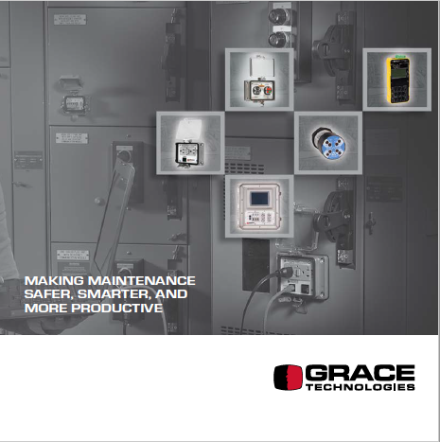
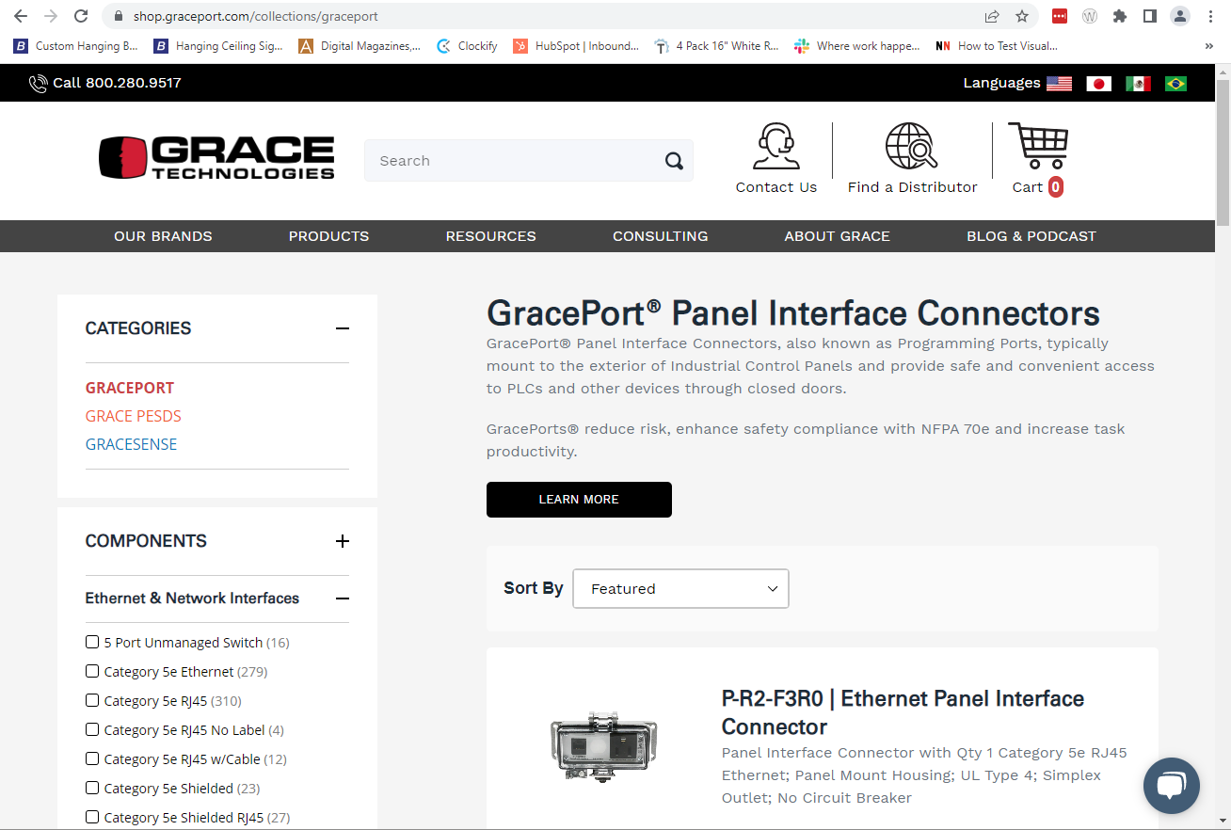

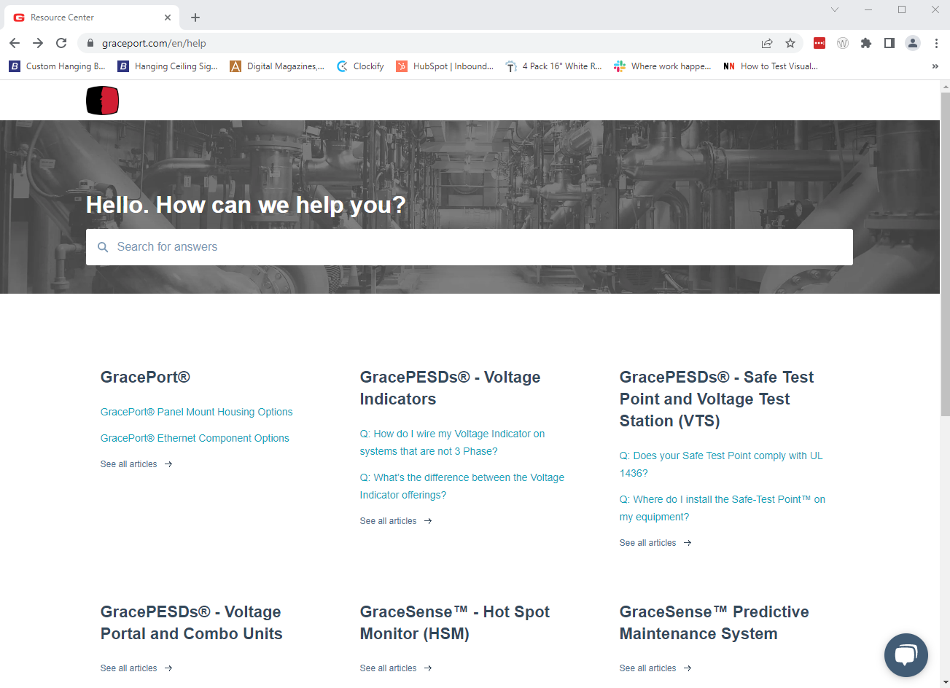




Additional Resources
Visit www.graceport.com to shop and chat with one of our Representatives
180+ GracePorts and all PESD’s now available in ePlan data portal
Grace Technologies Master Catalog
Check out our Knowledge Base Articles with over 250 articles
Notes:
Rockwell configurator section proposal works (add this)
Wide variety of resources available on our eCommerce site. If you need to chat with someone, we can get in-touch with you within a couple of minutes. Available in ePlan and don’t forget to check out our Master Catalog.
Full factory image
GracePort datasheet addition

Slide 13
Permanent Electrical Safety Devices

Slide 14

Did you know….
70%
Of all workplace injuries happen during reactive maintenance
35%
Due to direct contact with wiring, transformers or other electrical components
Occurred on 3-phase low voltage systems
60%
Open Door Testing with Meter is a leading cause of Arc Flash
PPE
The cost of these preventable incidents can cost $50,000 - $10 Million+
Notes:
Open door testing with a meter is a leading cause of arc flash*
70% statistic needs to be proved/application? Change to 3-5X? More likely to touch before you test during reactive maintenance*
Reduce non-compliance to electrical safety standards NFPA 70E. Skilled labor shortage. Compliance = Safety / Productivity Discussion – Reduction in PPE / Closed door verification of voltage.
Maintenance personnel are being pressured and are rushing to
We know electrical safety is an important part of every industry. Electrical injuries are very prevalent during reactive maintenance. 60% of those injuries occurred in low voltage 3-phase systems. You’d think that medium voltage would be more common due to it being higher voltage, but with low voltage corners might be cut more frequently.
Testing with a meter is a high risk action. You’re right there at the live conductor.

Slide 15
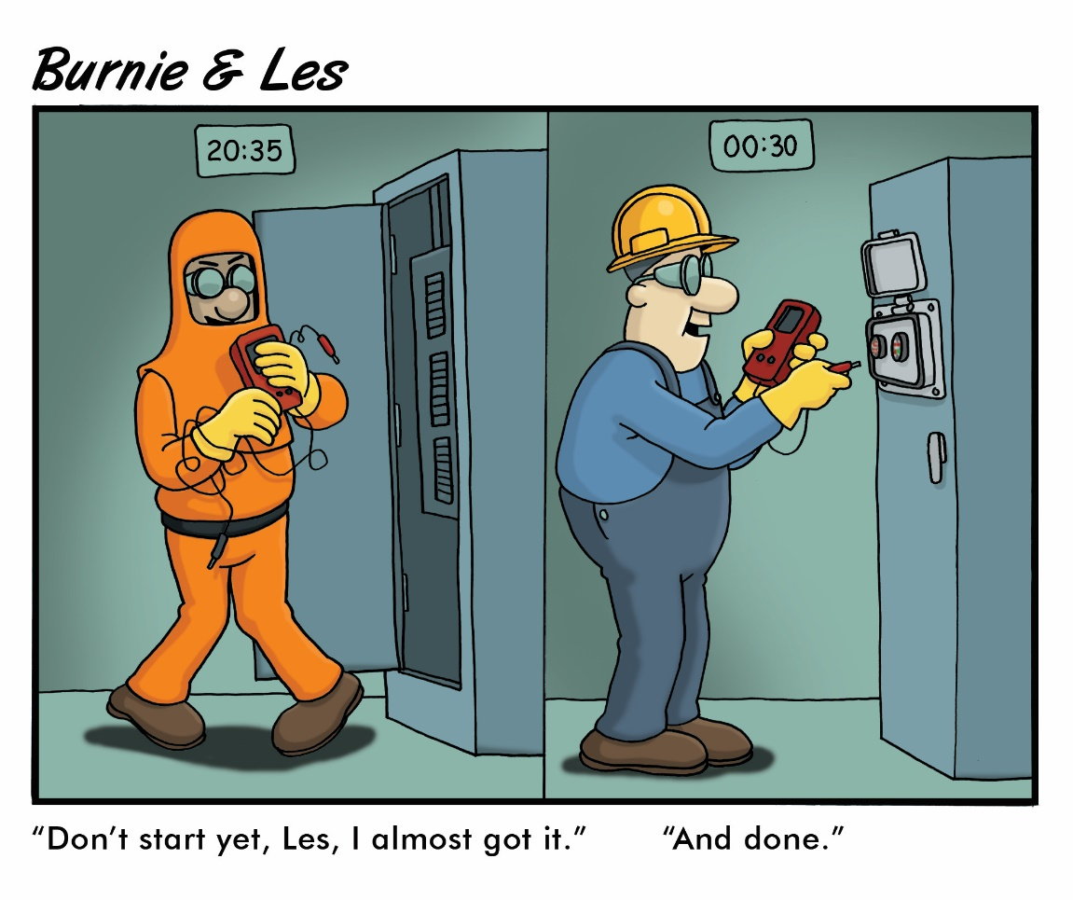
Who Uses PESDs?
Electricians & Electrical Engineers
Power Distribution Engineer
Safety Directors
Health & Safety Engineers
Maintenance Supervisors
Automation Engineers
Machine Operators/technicians
….Anyone with active LOTO programs that prohibit workers from entering panels without verification of de-energized state.
Notes:
End-user presentations should remove this slide.

Slide 16

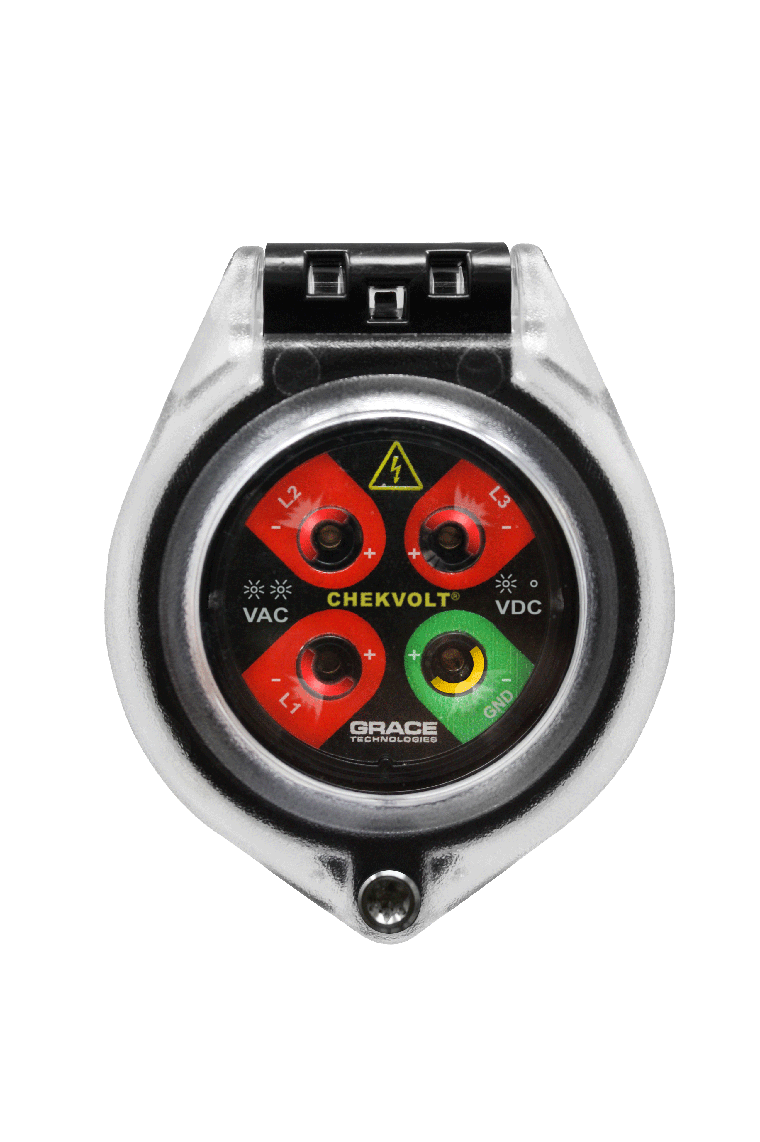

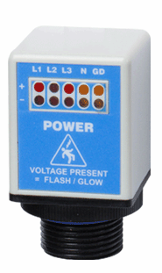
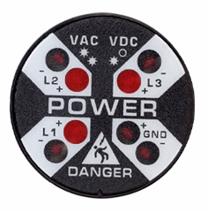
Advantages of PESDs®
Elimination
For electrical and mechanical LOTO, cost effective, high impact risk reduction
Substitution
Engineering Controls
R-3MT-VI
ChekVolt, Safe-Test Point, and Voltage Test Station PESDs
pay for themselves after 2-3 LOTO Procedures
Awareness
Administrative
Controls
R-3D2
R-3W-L-KIT
PPE
Notes:
Hierarchy of Risk Controls (NFPA 70E) Article 120.6 process for establishing an electrically safe working condition
For electrical and mechanical LOTO, we do our best to eliminate risk altogether. These devices are in-expensive, low hanging risk reduction fruit. They pay for themselves within 2-3 LOTO procedures and are installed using a 30mm hole punch

Slide 17
Making Maintenance Safer, Smarter, and More Productive
Safer: PESDs eliminate exposure to energy during mechanical and electrical LOTO by providing external voltage presence indication and absence of voltage testing capabilities.
Smarter: GracePESDs eliminate energy exposure with intelligent design leading to smarter maintenance procedures.
More Productive: PESDs have decreased their LOTO procedures from
45-minute, 2-man job operations down to as low as 5-minute, 1-man job tasks.

Slide 18
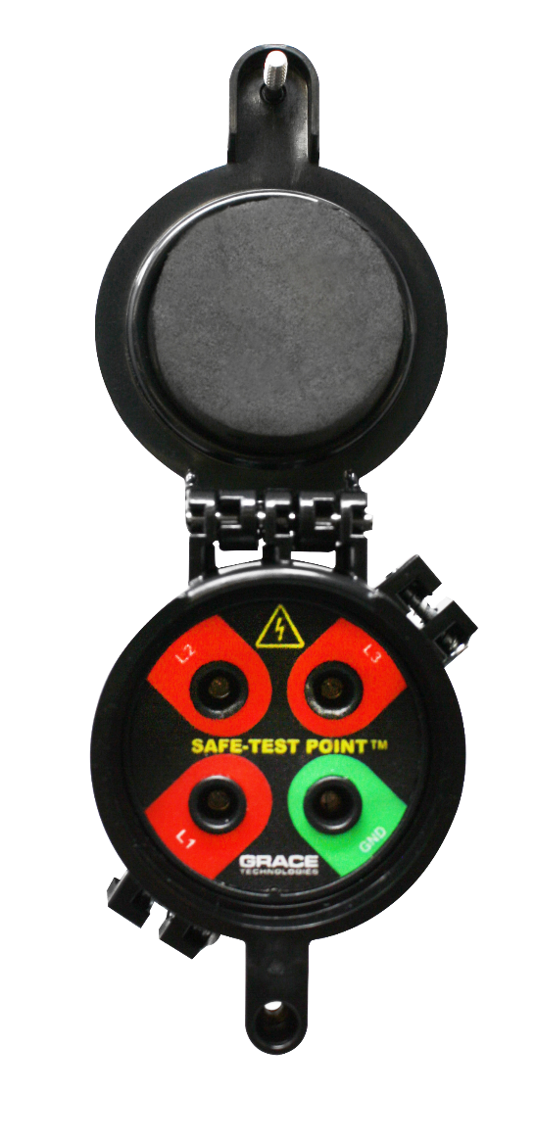
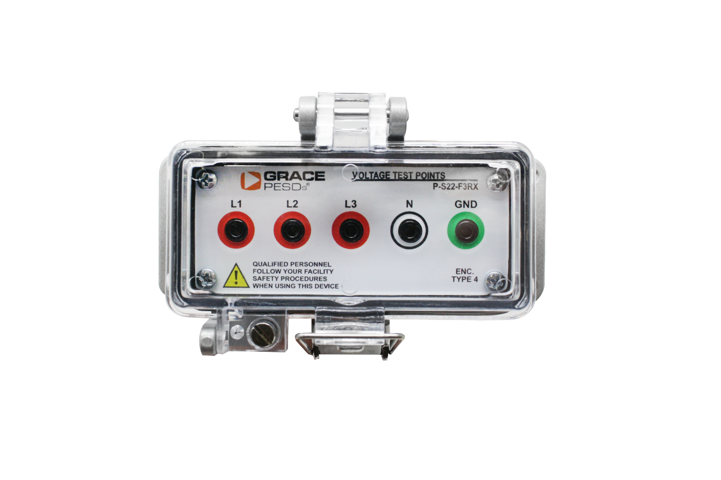
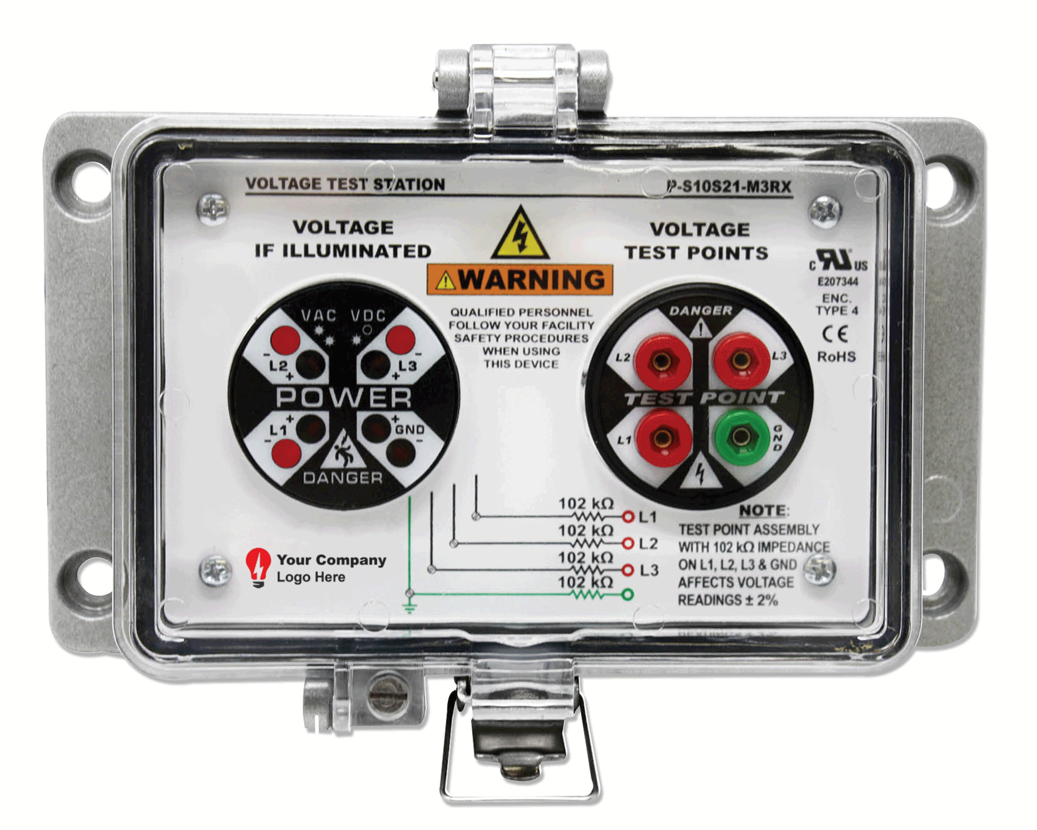
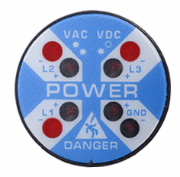
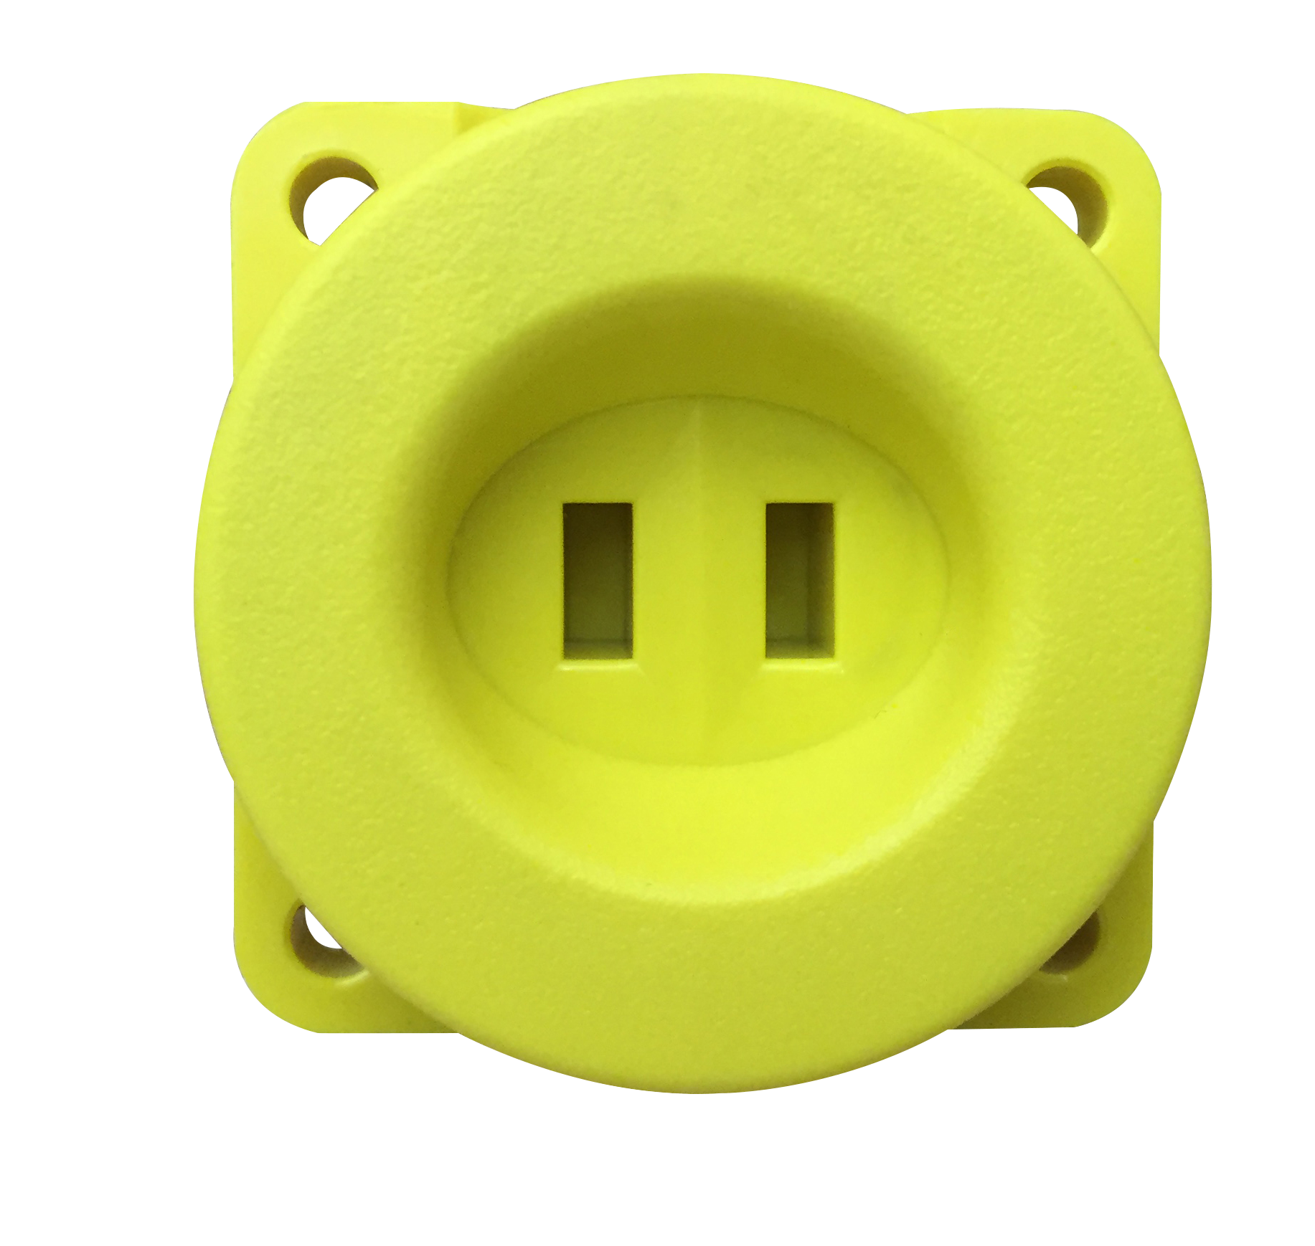
A PESD for Every Application
R-3W2
R-3K
P-S10S21-M3RX
R-3MT-VI
R-5MT
R-3MT-1K
Voltage Indicators
Voltage Portals
Voltage Test Station
ChekVolt
Safe-Test Point
Notes:
Add the trouble shooting capabilities of the R-3W -> I.e. phase loss, stuck blade, etc. Be sure to distinguish between mechanical vs. electrical LOTO and reference a bump/try test when using Voltage Indicators only.
Reducing time spent locking-and-tagging out equipment by 74%.
Voltage Indicators are primarily used in mechanical LOTO and also used in conjunction with the OSHA required try or bump test. This means you try to start the machine after isolation of power using a starter switch. If you are pressing a green button to try to do a “try” test, it isn’t as a sure way to ensure the power is isolated. When adding the Voltage Indicator this is an additional opportunity to verify voltage. It also has other features such as phase loss, stuck blade, etc.
ChekVolt is THE fastest selling new product we offer.

Slide 19
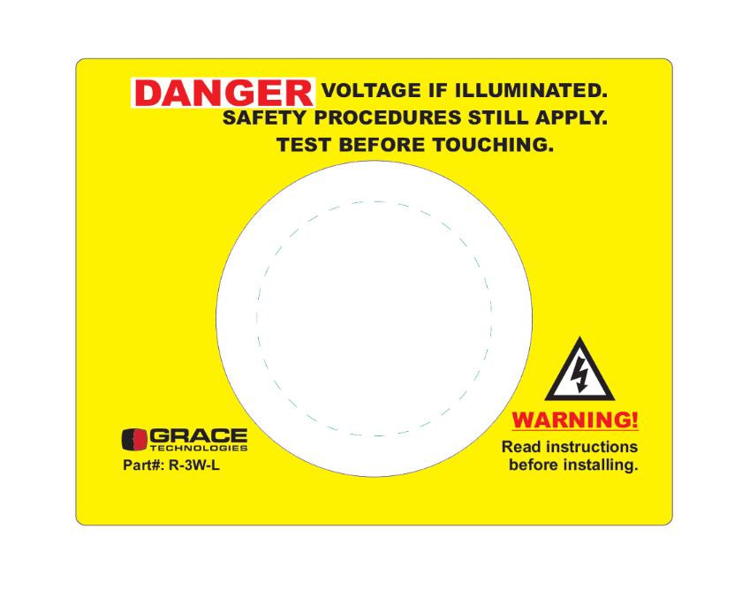

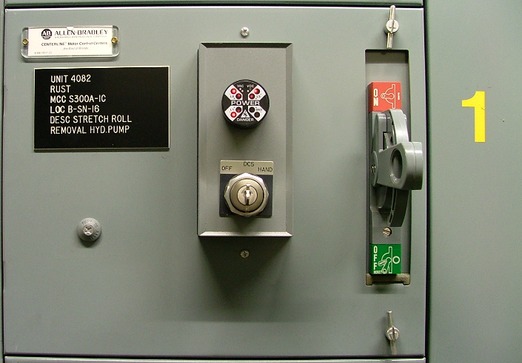
Mechanical LOTO Made Easier & Safer
Fused Disconnect
Voltage Range: 40-750 VAC
30-1000 VDC
Options: Flashing/Solid on/Class 1 Div 2/Fiber Optic
No batteries needed - line voltage powered
High surge immunity CAT III/CAT IV (8kV)
Potted Construction
Various mounting options – 20-minute install
CE, UL Listed (61010), Type 4X, 12, 13
Ex: MCC Bucket
Notes:
Primarily used for mechanical LOTO and required under the OSHA mandated bump or try test process.
1 failure per 50,000,000 hours of operation

Slide 20
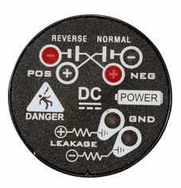
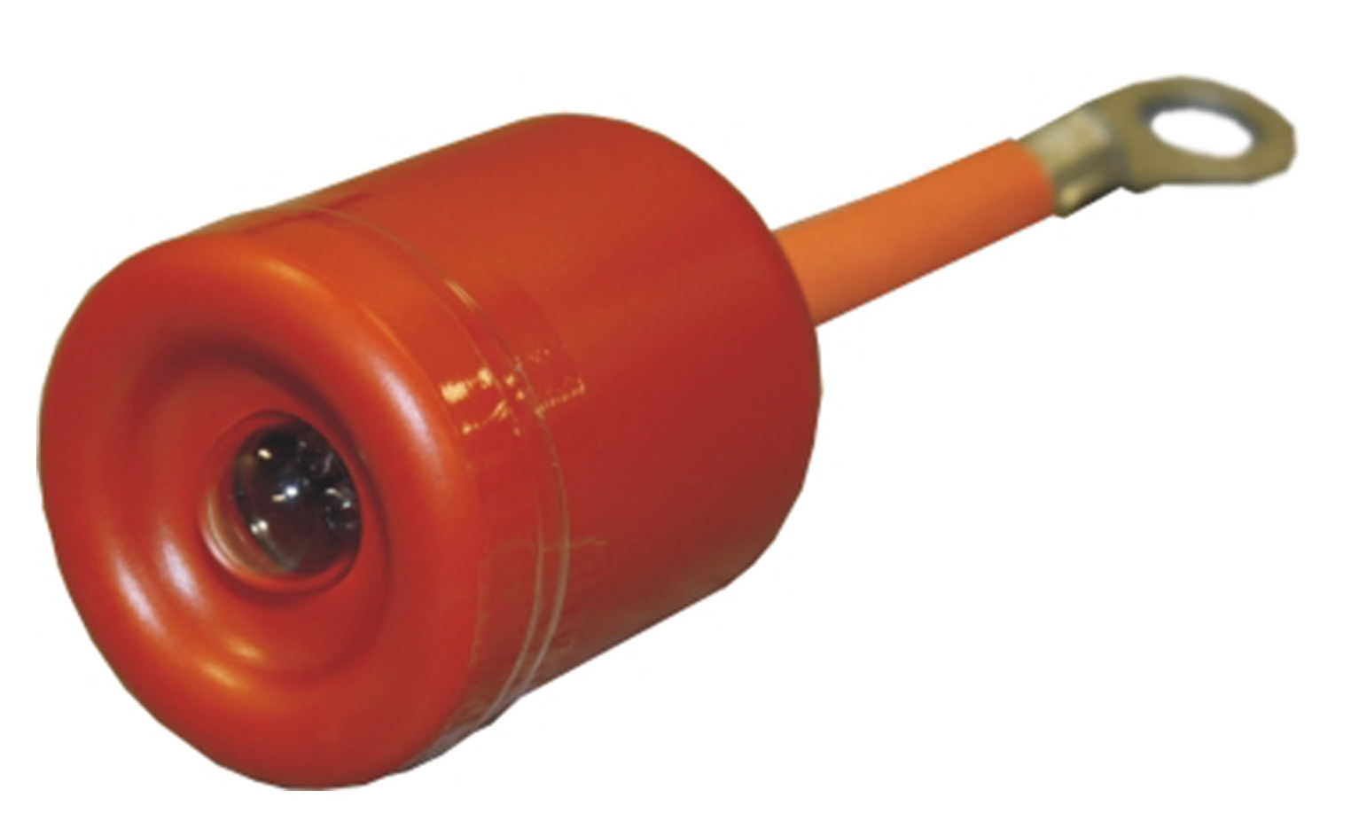
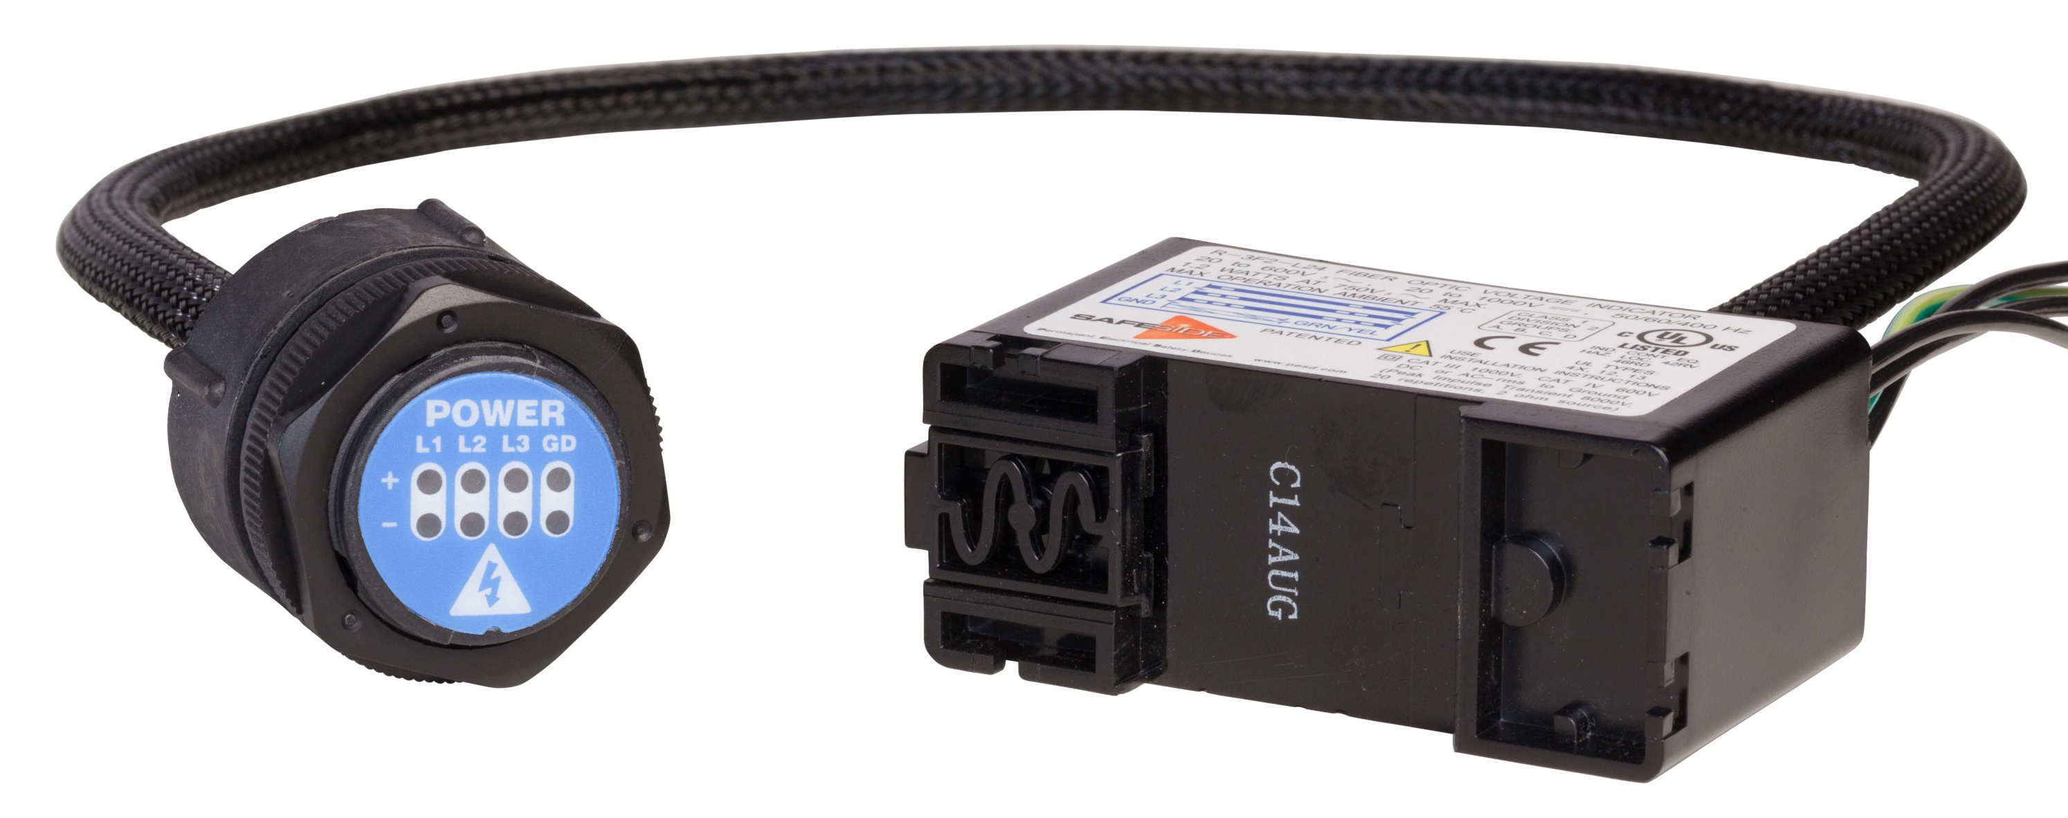
Voltage Indicators & Portals
Different options for Voltage Indicators
  Fiber Optic, Class I Div II, Medium and DC Voltages, etc.
Mechanical LOTO
Visual Indication of Presence of Voltage
Easily troubleshoot stuck blades, phase loss, or stray voltage running to the ground
R-3W
R-3W2
R-3W-DC
R-3D2
R-1VL003 & R-1VH003
R-3K
R-3F2

Slide 21
Safe-Test Point
Electrical LOTO Made Easier & Safer
Voltage Range: 0-600 VAC
0-600 VDC
Frequency: 0-3,000Hz, 50/60/400Hz
High impedance protected test points (102KΩ)
  480V/√3/(102kΩ)= 2.35mA (Phase-to-Phase)
  600V/ √3/(102kΩ)=2.94mA (Phase-to-Phase)
IP2X & UL 600 V Touch Safe
CAT III/IV
Measures full voltage with -2% accuracy
Feature Dust Cap
CE, UL Listed 12, 13, 4, 4X
R-5MT
R-3MT-1K-KIT
R-3MT-KIT
Notes:
Built in impedance on the backside of the device. You will still test full voltage, but shock is derived from current, not voltage. With the built-in impedance of the device, we reduce the max fault current to 2.3 mA.

Slide 22
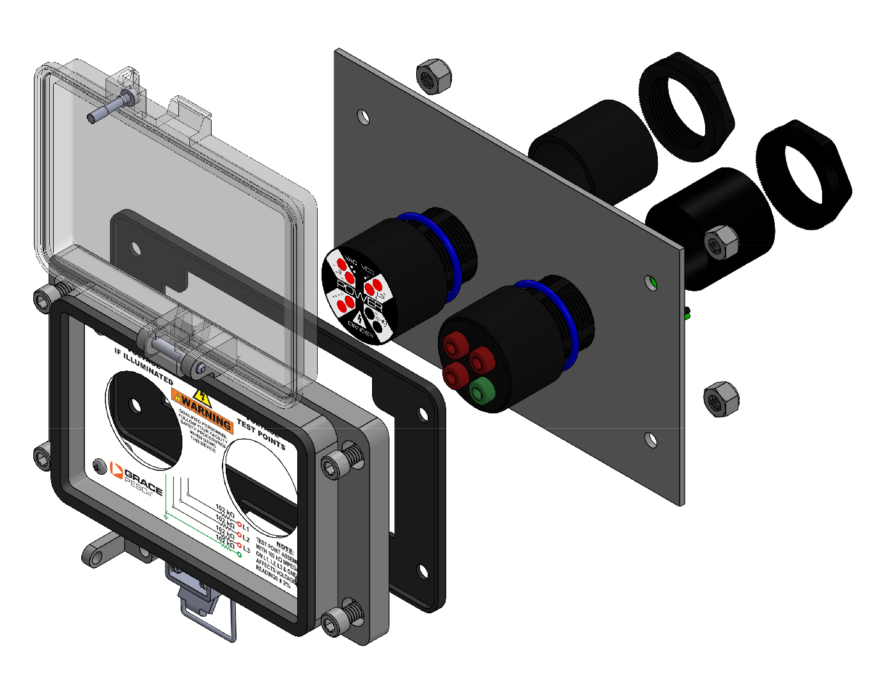
Electrical LOTO - ChekVolt® & Voltage Test Stations
Voltage Range: 0-1,000 VAC
0-1,000 VDC
High impedance protected test points (164KΩ)
  480V/√3/(164k * 2 *.95) = 1.5mA (Phase-to-Phase)
  600V/ √3/(164k * 2 *.95) =1.9mA (Phase-to-Phase)
  1000V/ √3/(164k * 2 *.95) =3.2mA (Phase-to-Phase)
CAT III (to 1000 VAC) & CAT IV (to 600 VAC)
Measures full voltage with -3.3% accuracy
UL/IEC 61010, CE, UKCA & CSA C22.2 No. 94.2/UL 50E
  UL Type 4, 4X, 12, and 13 & IP66, IP69
P-S10S21-M3RX
H-S10S21-M3RX
R-3MT-VI

Slide 23

Our Experts are here to Help
Our Expert Network can work with you to develop and implement an Electrical Safety Program that will save lives, ensure confidence and consistency across your enterprise.
On every order over $10,000 we include
2 hours of free remote consulting with one of our experts

Slide 24
Additional Resources
Visit www.graceport.com to shop and chat with one of our Representatives
180+ GracePorts and all PESD’s now available in ePlan data portal
Grace Technologies Master Catalog
Check out our Knowledge Base Articles with over 250 articles

Slide 25
Intelligent Machine Health Monitoring

Slide 26
Did you know….
The cost of unplanned downtime in process industries per year
70%
of All Workplace Injuries Happen During Reactive Maintenance
$20 Billion
PPE
The compounding effects of these preventable injuries go beyond just the day
of an incident and adversely affect the future of our economies

Slide 27







Challenges Facing Manufacturing Today
Increasing 24/7 Demand
Increasing
Competition
Efficiency
and Scale
Manufacturing requires More Power & complexity
Safety and High Uptime Required
Automation Large CAPEX
Skilled maintenance personnel becoming rare and costly
Profitability

Slide 28
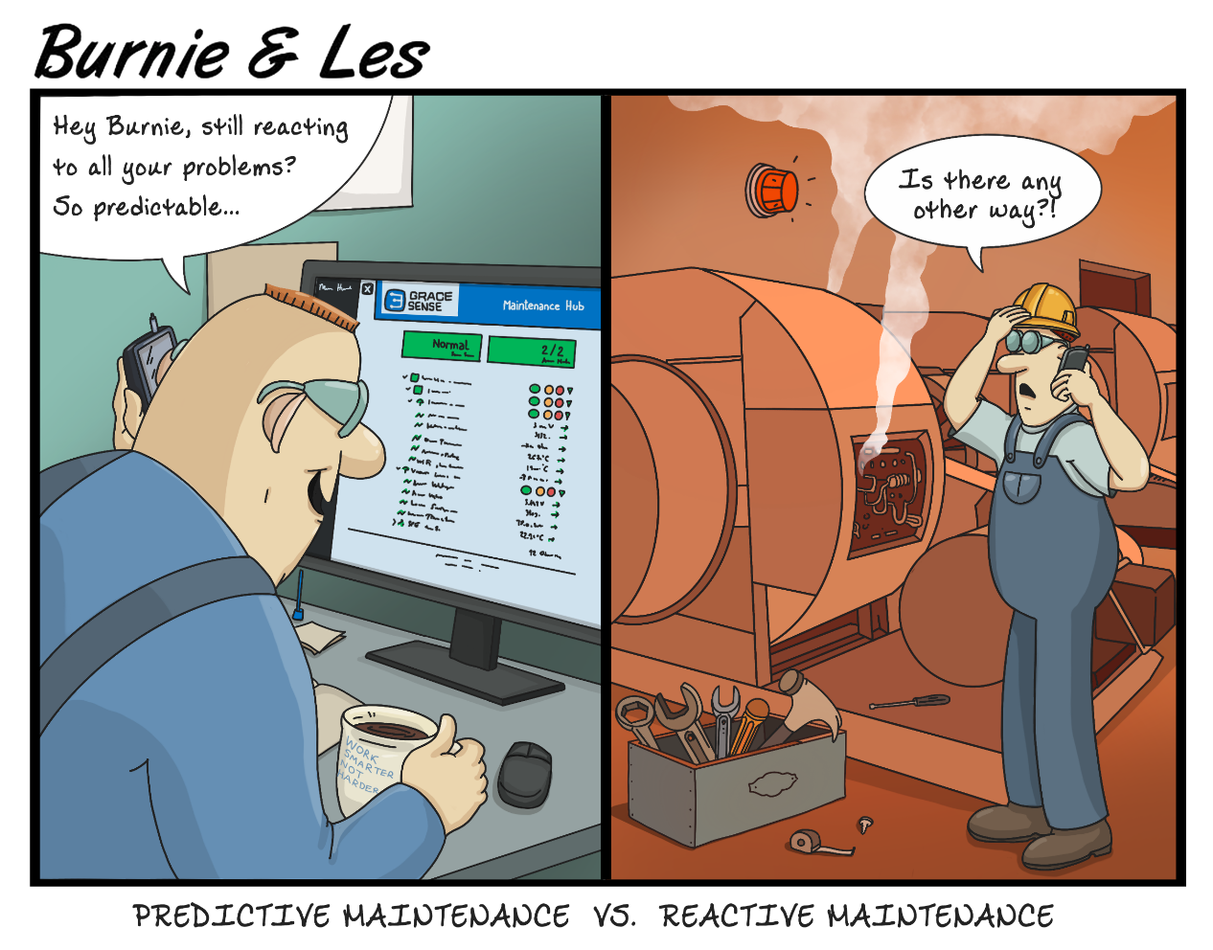
Who Uses GraceSense?
Reliability Engineers
Maintenance Managers
Facility operations personnel
Facility Directors
….Anyone with rotating equipment looking to optimize
their maintenance budget

Slide 29
What’s Your Approach to Maintenance?
Run-to- Failure
Schedule-Based
Risk- Based
Condition-Based
Predictive
Prescriptive
There are many approaches to maintaining equipment
  No one-size-fits-all solution
  Every situation is different
  Criticality assessment is the start of smarter maintenance
However, the goal of any maintenance program is: Optimal Maintenance Budget Allocation

Slide 30
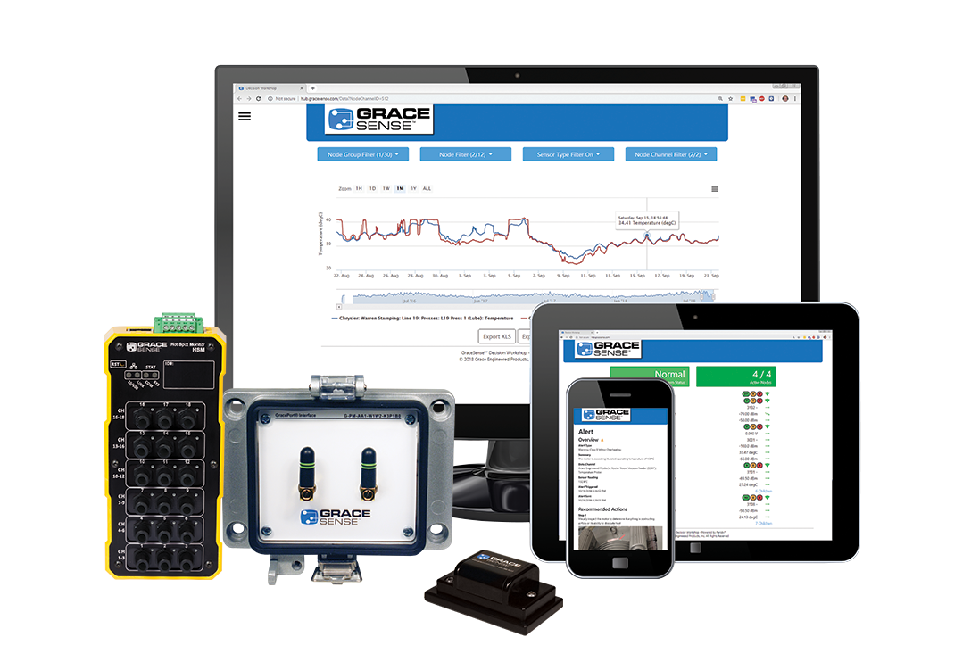
Advantages of the GraceSense®
Predictive Maintenance System
Robust wireless sensor hardware handles nearly all industrial applications
and assets
Ability to integrate existing 3rd Party Sensors
Cloud-based data storage, analysis, and visualization
Real-time alerts contain customizable remediation instructions
  Comprehensive single-platform data collection capabilities
  Meaningful alarms and alerts via SMS, e-mail, CMMS, etc.
  Seamless integration with existing systems (PLC/SCADA/DCS/etc.)
We save our customers money by minimizing unplanned downtime and enabling optimal maintenance budget allocation
Notes:
Each asset requires a different sensing approach
Electrical systems: voltage, frequency, current, power quality
Rotating equipment: vibration, current, temperature
Structural systems (cranes/etc): strain, vibration
Air handlers: temperature, differential pressure, air flow
Conveyors, presses, robots, etc: sensors vary by application

Slide 31
Making Maintenance Safer, Smarter, and More Productive
Safer: Predictive Maintenance solutions provide a safer method of scheduling out downtime. The entire system is designed to empower maintenance personnel to prepare for a surprising and risky situation.
Smarter: Delivers actionable data in real time. Because of this, our customers have experienced a swift return on their investment in the Predictive Maintenance System.
More Productive: Provides customers with continuous data to drive actionable decisions. This allows for faster and more efficient response times than ever.

Slide 32
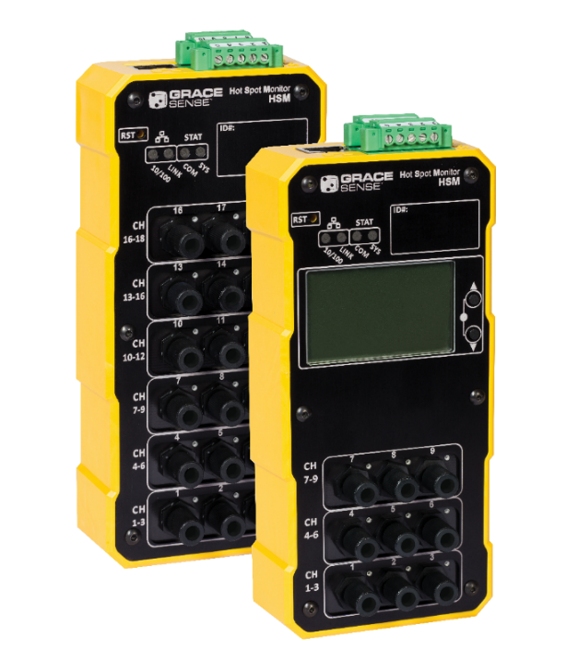
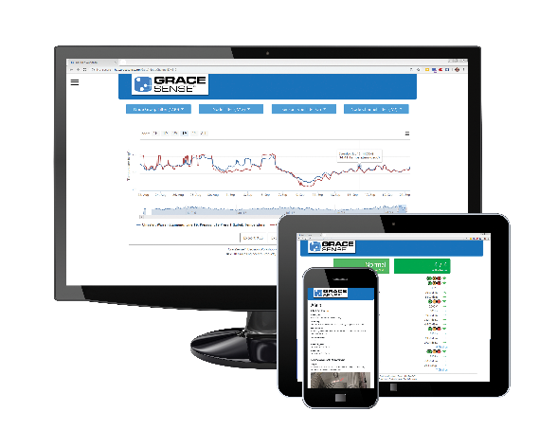
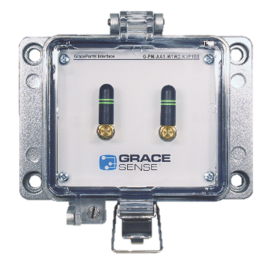
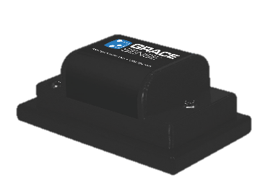
Maximize Production and
Profits with IIoT
Field Mount
Vibration & Temperature
Panel Mount
Customizable Node and Gateways
Hot Spot Monitor
Non-conductive temperature
Maintenance Hub
Data visualization, analysis, and alerting

Slide 33

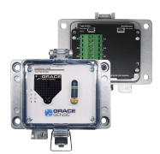


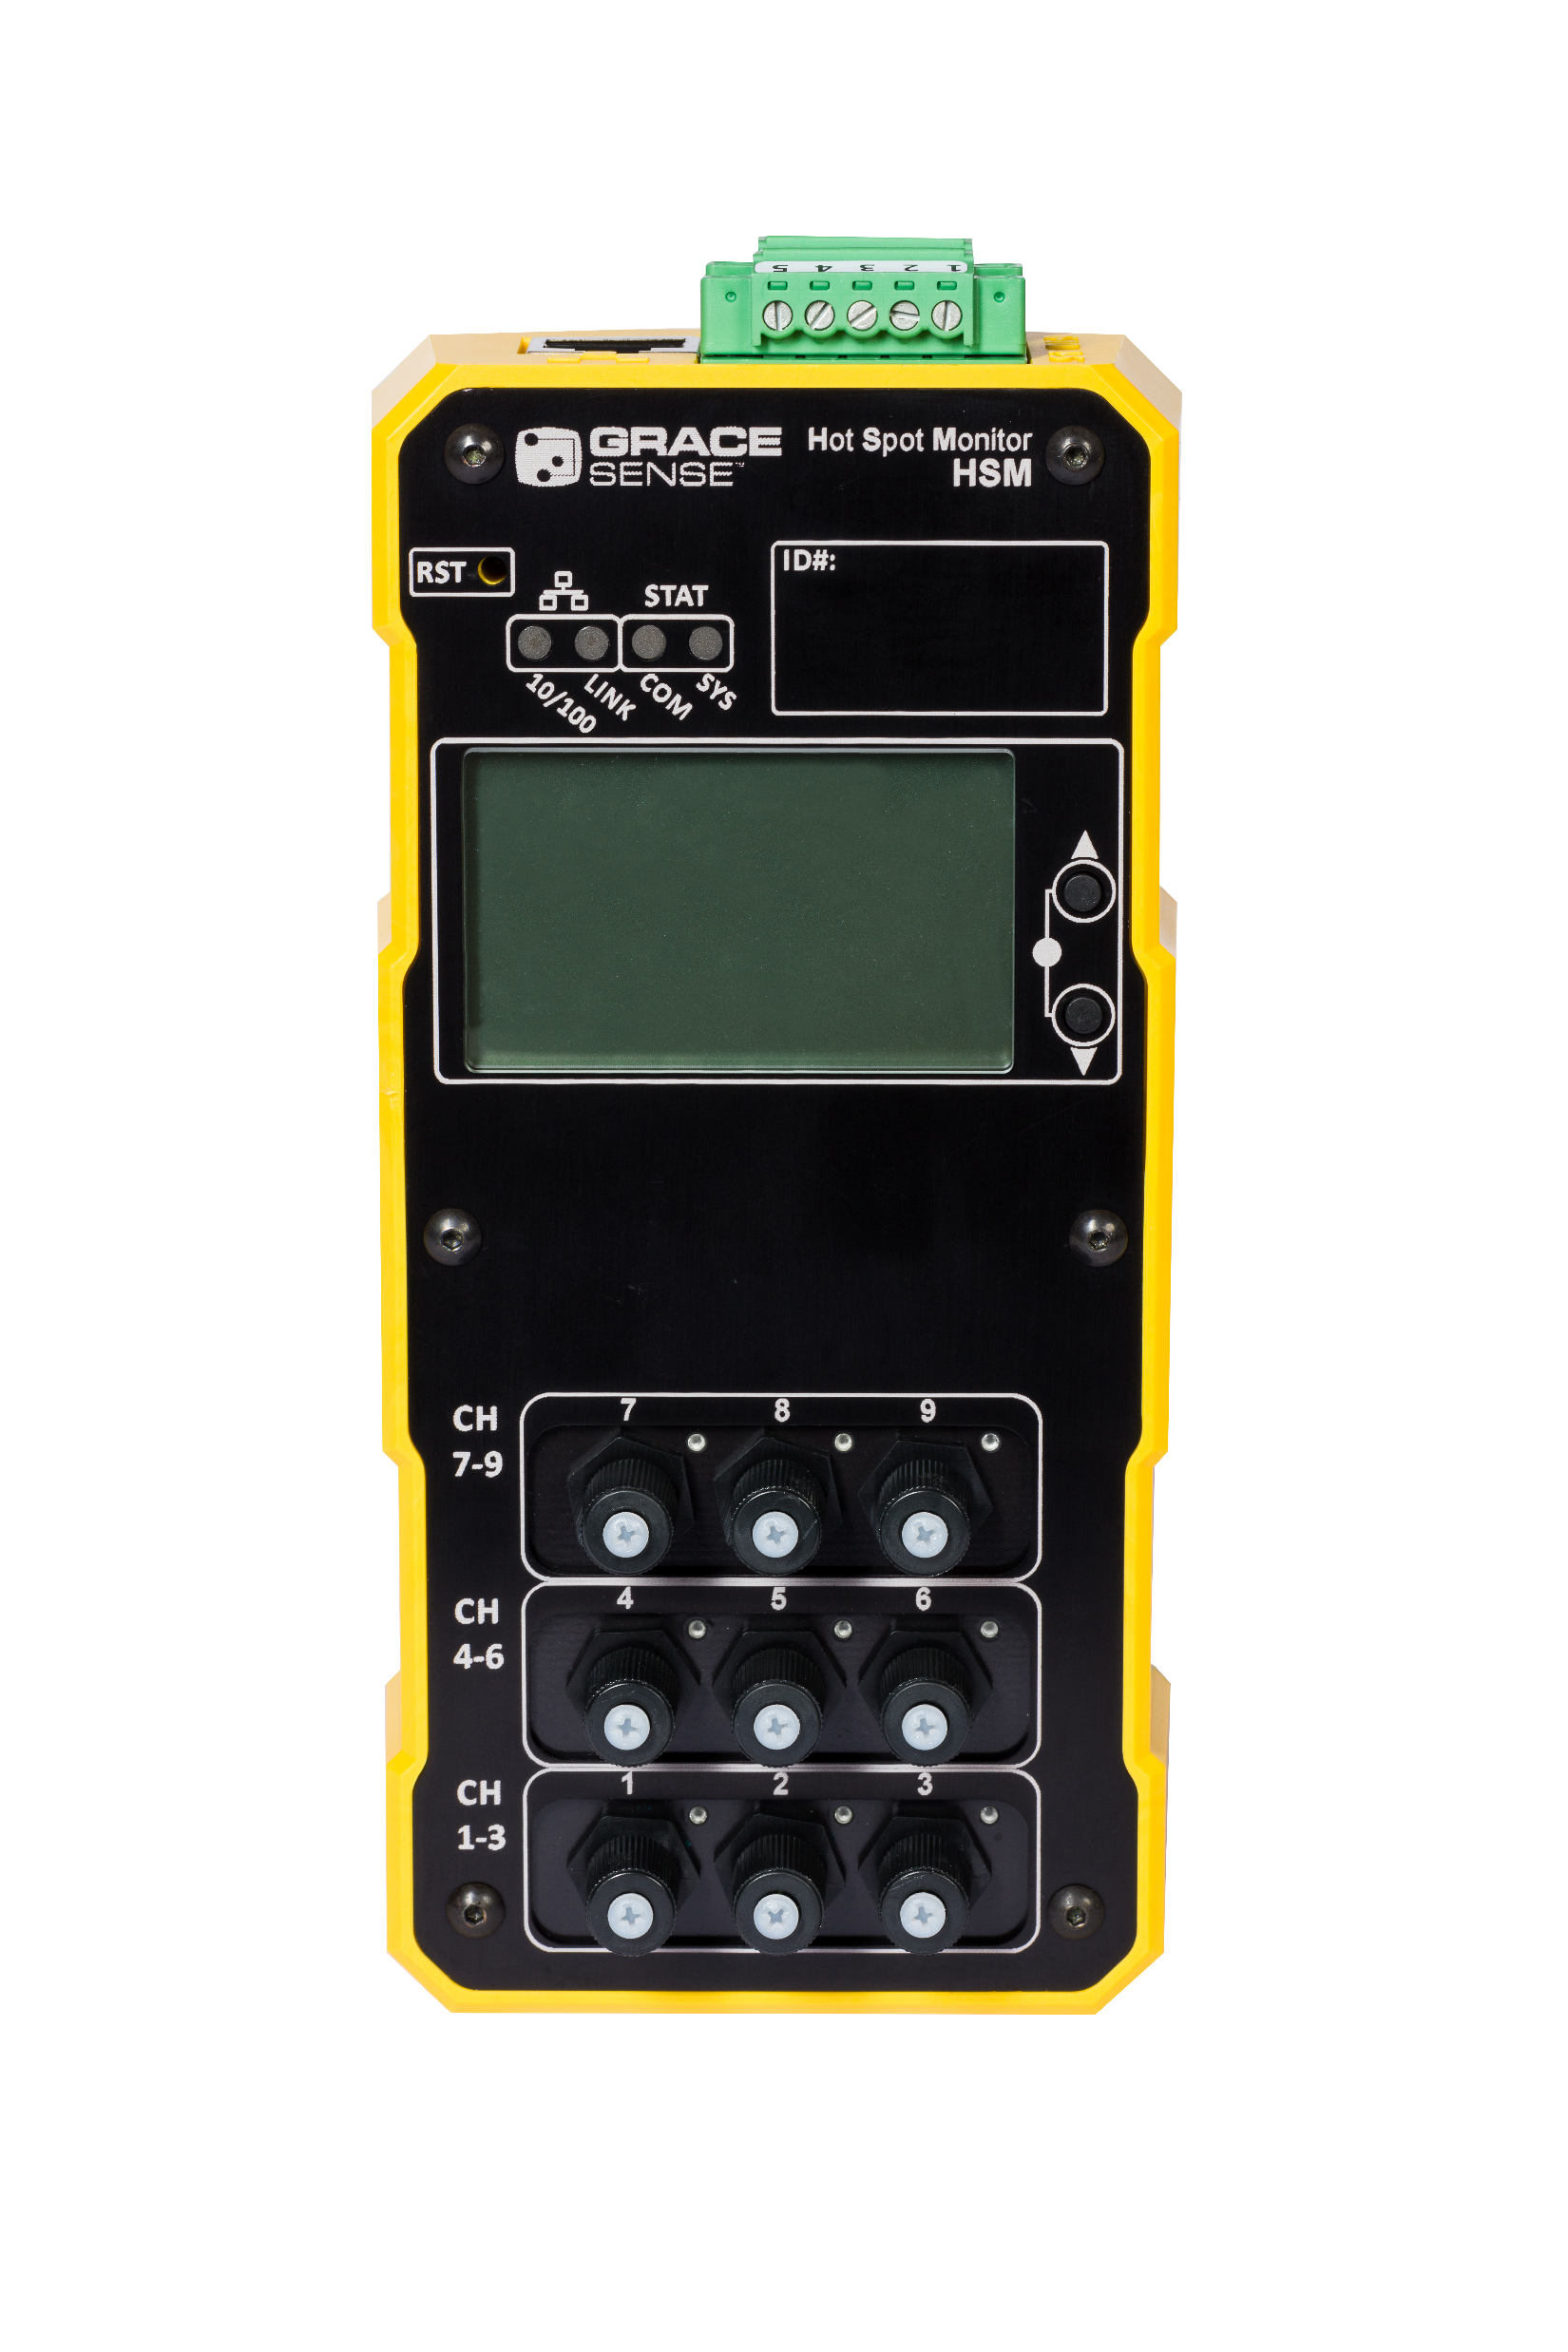
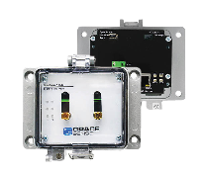




Data Freedom and Actionable Insights
Wireless Vibration
Sensors
Cloud Gateway
Cloud
Maintenance Hub
Hot Spot Monitor
Combo Gateway
Public API
Wireless Panel Mount Sensors
Control Gateway
CMMS/SCADA or PLC
Notes:
Here I would develop what you will say about each product (goal: to transducer options, communication communication

Slide 34


Wireless Vibration & Temperature Node (VBT)
  3 axis acceleration and/or temperature
    800Hz bandwidth
    Sampling rate: up-to 1600Hz
    VBT2 - 4600 Hz (XY), 2200 Hz (Z) up-to 25.6kHz
  Edge Processing = Longer battery life, lower bandwidth
  Replaceable long-life battery (5+ year life)
  ZigBee-compatible wireless connectivity
  IP66
  Stud, epoxy, fin and magnetic mounts
  Wireless range - 30m LOS
  Over-the-Air Updates

Slide 35


Panel Mount Nodes & Gateways
Panel Mount Nodes
Easy-to-install GP Housing
Replaceable long-life battery (5+ year life), 24VDC
Completely customizable transducer options (via rear terminal block)
  Accelerometers, RTD, CT, Rogowski Coils , Flow,
  Pressure, Strain, Humidity, Fluid Level
IP65, UL Type 4, 4X, 12 & 13
Special analytics for GraceSense™ Hot Spot Monitor
Gateways
  Can add Zigbee, LTE and WiFi wireless to all PM Nodes
  Bidirectional Modbus and EtherNet/IP™ interfaces

Slide 36
Hot Spot Monitor (HSM)
Non-conducting polymer fiber. (Can be run with power or comm wires)
Easily Trimmable
Repeatable sensor performance
In the market since 2010 with thousands in the market today
-4° F to 248 °F (-20° C to 120° C)
  Resolution: 1° F (1°C)
  Accuracy: ±3° F (±2° C)
Din Rail Mount
Power: 24 VDC / 0.2 A / 3W
Internal N/O Relay for Hardwiring to Remote Devices
Internal Memory for Data Logging – 16MB (350,000 logs)
Communication: Modbus RTU, Modbus TCP/IP, EtherNet/IP™
cUL Recognized, CSA, CE, FCC

Slide 37


Potential Failure Points
Visibility barriers
Infrared imaging has limitations with Field of View (FOV)
All Potential Failure Points (PFP’s) should be known for optimal predictability

Slide 38

  Why Hot Spot Monitor?
  Overheating can be caused by:
  Thermal expansions and contractions
  Loose or deteriorated connections on conductors
  Unbalanced loads (high switching activities)
  Overloaded circuits
  Mechanical wear & stress
  Harmonics caused by non-linear loads
Industry Average Cost of Downtime
  Average facility infrastructure failure - $2,000 per minute
  Critical facility applications (data centers, hospitals, water facilities) - $9,000 per minute
  Automotive Manufacturers - $22,000 per minute
Thermal Expansion and Contraction
Loose Connection
Resistance Increases
Thermal Avalanche

Slide 39




Non-Conductive Contact Sensing
80kV withstand
150kV BIL
LED tunnels through polymer fiber, reflects off probe tip compound and the light wave attenuation is calculated by the algorithms within the HSM module (Phosphorescence )

Slide 40

Maintenance Hub
  Network Configuration
  Data Visualization
  Alerting/Alarming
  Secure Transmission
  Scalable Architecture
  Custom Dashboards
  Open API
  On-Premise Options Available
Statistical Oversampling
  Converts high-rate data
  (up to 100Hz) into a simple statistical representation
  Converts noisy signals into clear trends

Slide 41


Failure Resistance for Any Application

Slide 42
White Glove Delivery
Included in Your Order
  Account Set Up
  Data structure, assign nodes to assets before they arrive
  Nodes come fully labeled per asset location
On-boarding consulting (On Orders > $7,500 USD)
  Up to 12 weeks of 1 hour of remote technical consulting ($1500 Value)
  Define journey and schedule
  Training
  Alarm/Alert Set Up assistance
  Account configuration
6 month and 12-month check-ins
  Additional consulting or on-site options are available

Slide 43
Additional Resources
Visit www.gracesense.com to shop and chat with one of our Representatives
180+ GracePorts and all PESD’s now available in ePlan data portal
Grace Technologies Master Catalog
Check out our Knowledge Base Articles with over 250 articles

Slide 44
Long-Life Power for Wireless Transmitters

Slide 45

Advantages of Power Puck
Eliminates need for costly wireless battery replacements.
Converts heat from sources between -45 °C to 450 °C into continuous electrical power.
Quick and straightforward installation
Offers a consistent power source, ensuring stable data transmission and integrity for uninterrupted operations.
Beneficial for powering devices in remote or hard-to-reach or hazardous areas.
Less maintenance intervention translates to fewer potential safety incidents.

Slide 46








Power Puck Can Help
Wherever There is A “Warm-To-The-Touch" Temperature Difference
Long-Life Power for Wireless Transmitters
Pumps & Motors
Compressors
Machine Casings
Holding Tanks
Steam Lines
Warm Process Fluids
Oil Production Lines
Boilers

Slide 47
Making Maintenance Safer, Smarter, and More Productive
Long-Life Power for Wireless Transmitters
Safer: The Perpetua Power Puck significantly lowers the risk of injuries associated with maintenance activities by reducing the need for battery replacements, particularly in hazardous or hard-to-reach areas.
Smarter: The Power Puck’s self-sustaining design and compatibility with a wide range of heat sources represent a leap in power management. It powers continuous monitoring and data collection, crucial for informed decision-making.
More Productive: The Power Puck enhances productivity by minimizing maintenance downtime and operational disruptions. Its ability to harness waste heat for power generation maximizes energy efficiency.

Slide 48



Reliable Thermoelectric Energy for Wireless Sensors
Long-Life Power for Wireless Transmitters
Power Puck & IPM
Heat Source Mounting Options

Slide 49


Power Puck
An advanced thermoelectric energy harvester designed specifically to power wireless sensors. By converting ambient heat into electrical power, the Power Puck ensures that wireless transmitters and sensors function continuously, eliminating the frequent need for battery replacements.
-45 °C to 105 °C
Up to 20 years or more of continuous power
Intrinsically Safe (Class 1, Division 1, Groups A-D), IP67 Certified
ATEX Intrinsic Safety Certificate: DEMKO 14 ATEX 1303X
IECEx UL 14.0083X
Long-Life Power for Wireless Transmitters

Slide 50
Additional Resources
Long-Life Power for Wireless Transmitters
Visit www.graceport.com to shop and chat with one of our Representatives
180+ GracePorts and all PESD’s now available in ePlan data portal
Grace Technologies Master Catalog
Check out our Knowledge Base Articles with over 250 articles

