Slide 1
Making Maintenance Safer, Smarter, and More Productive

Slide 2














We develop intuitive solutions for a wide variety of application challenges that industries face today. From GracePort panel interface connectors and GracePESDs voltage indicators/portals to
GraceSense asset health monitoring. Grace is contributing
each day to safer, more productive, and brighter future.
DAVENPORT, IOWA
Sales presence in
60+ countries around the world

Slide 3

Human Error
is the
#3
Cause of
Workplace Death
95%
Of near misses are unreported
Over 80%
Of workers confirmed that they had been shocked on the job
These preventable incidents can cost
^{$50,000 - $10 Million+}

Slide 4
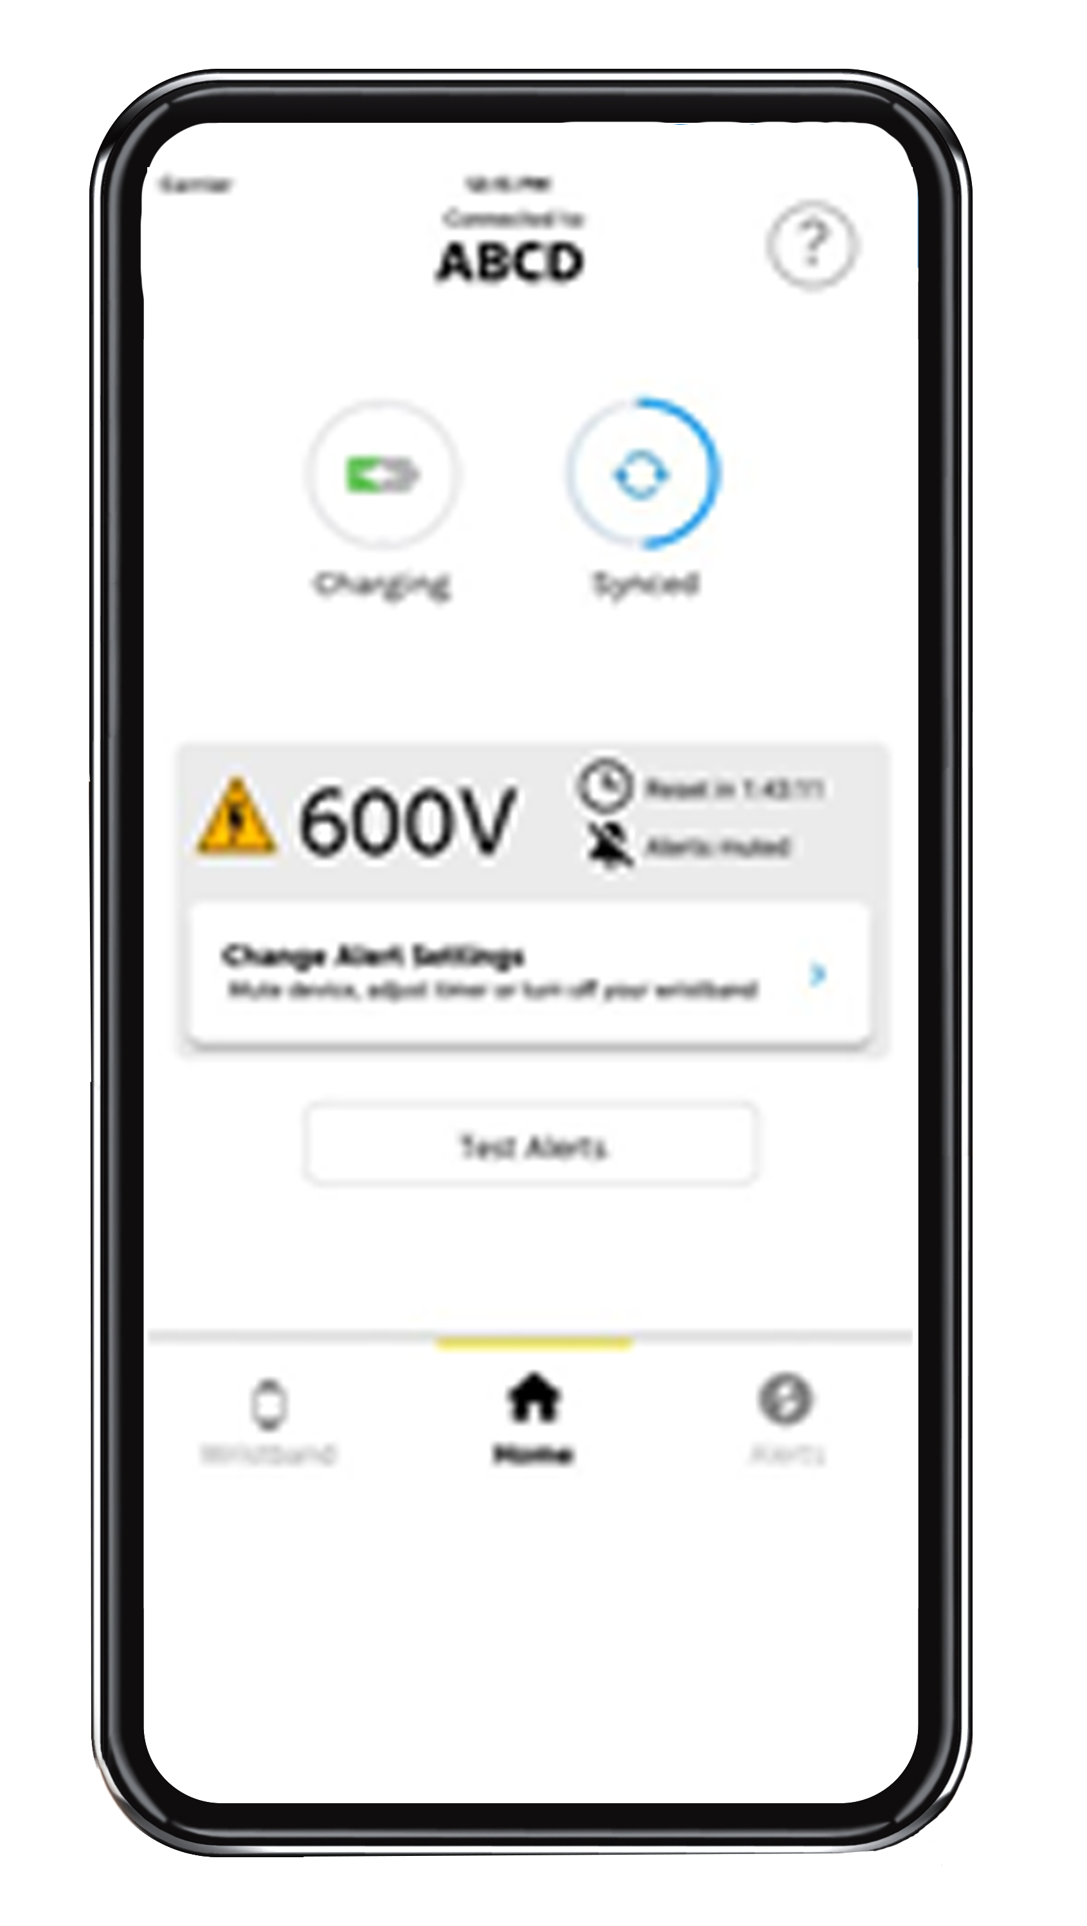

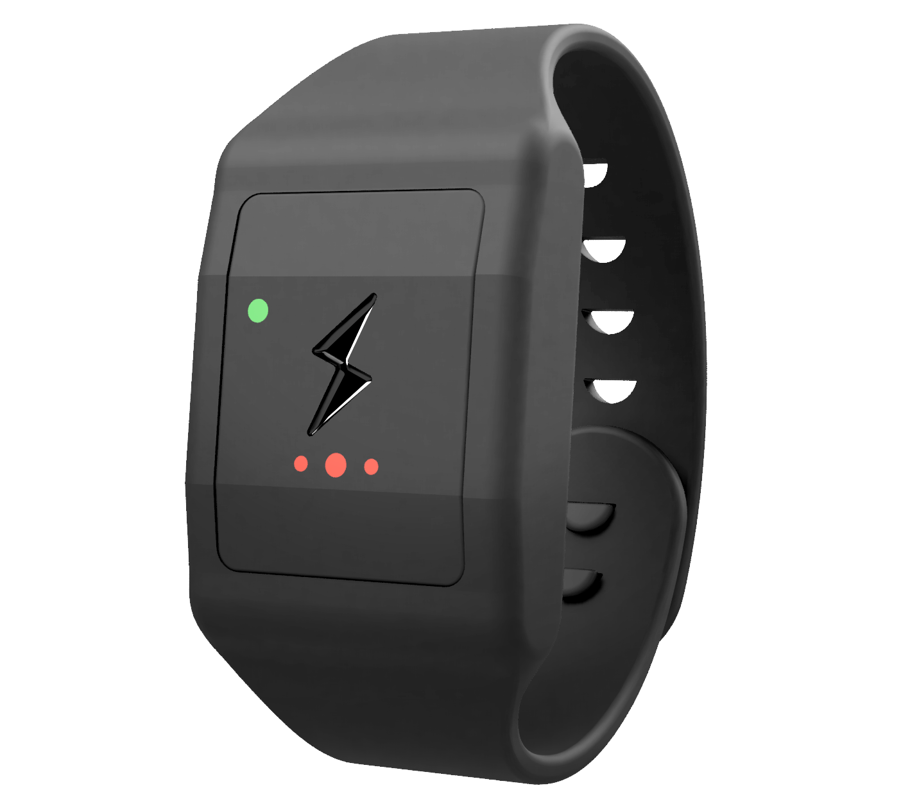

The Solution to Human Error
Multi-Voltage: Enable users to calibrate warnings on the fly from 480V – 500kV
Non-Conductive Material
Mute: Silence alarms when workers acknowledge they are working energized
Compatibility:
iOS & Android Capable

Slide 5
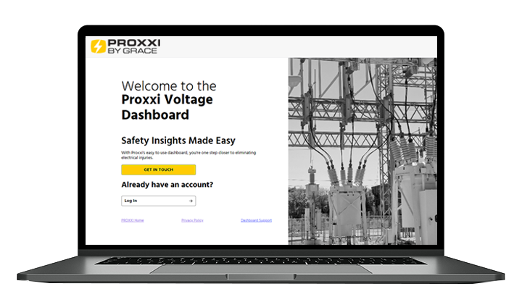
Dashboard: Data Analytics & Insights
Identify precursor incidents
Tack usage and drive compliance
See interactions with energized equipment

Slide 6
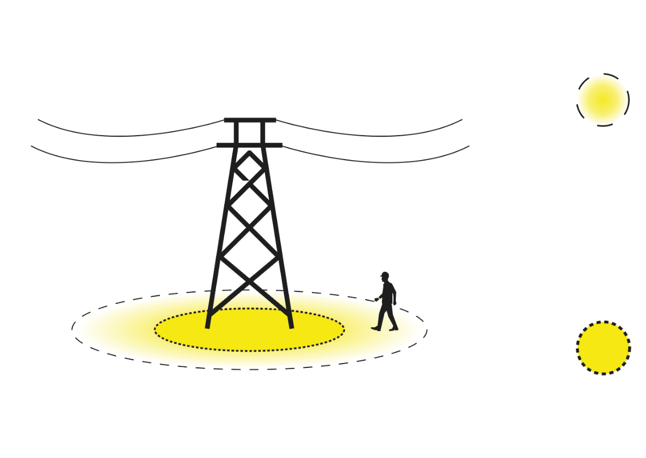
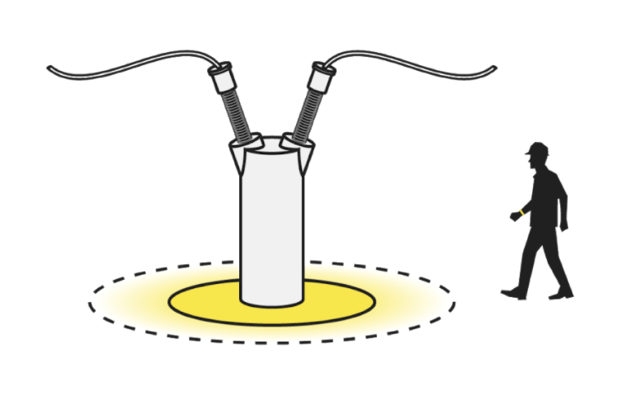

Proxxi Voltage - How it Works
Initial Alert: Voltage will alert as you enter the initial alert zone.
The alert consists of haptic feedback (vibrations) well as audible and visual alerts.
These alerts increase in frequency as you near the limits of approach
High Alert: Once the limit of approach has been breached, the alert becomes persistent, indicating a potential near miss.

Slide 7
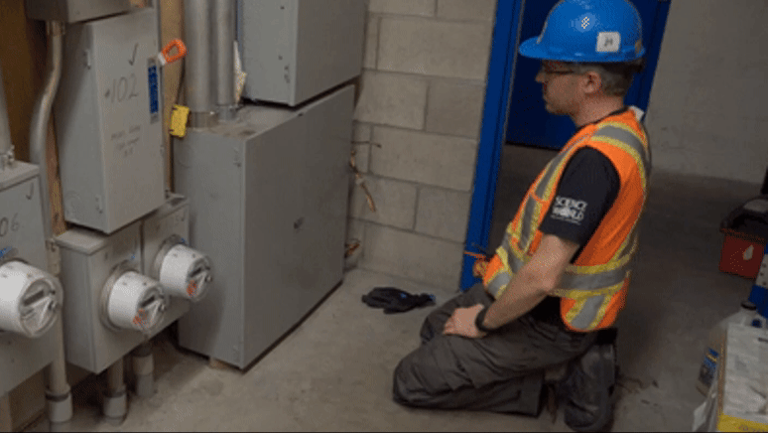

Slide 8

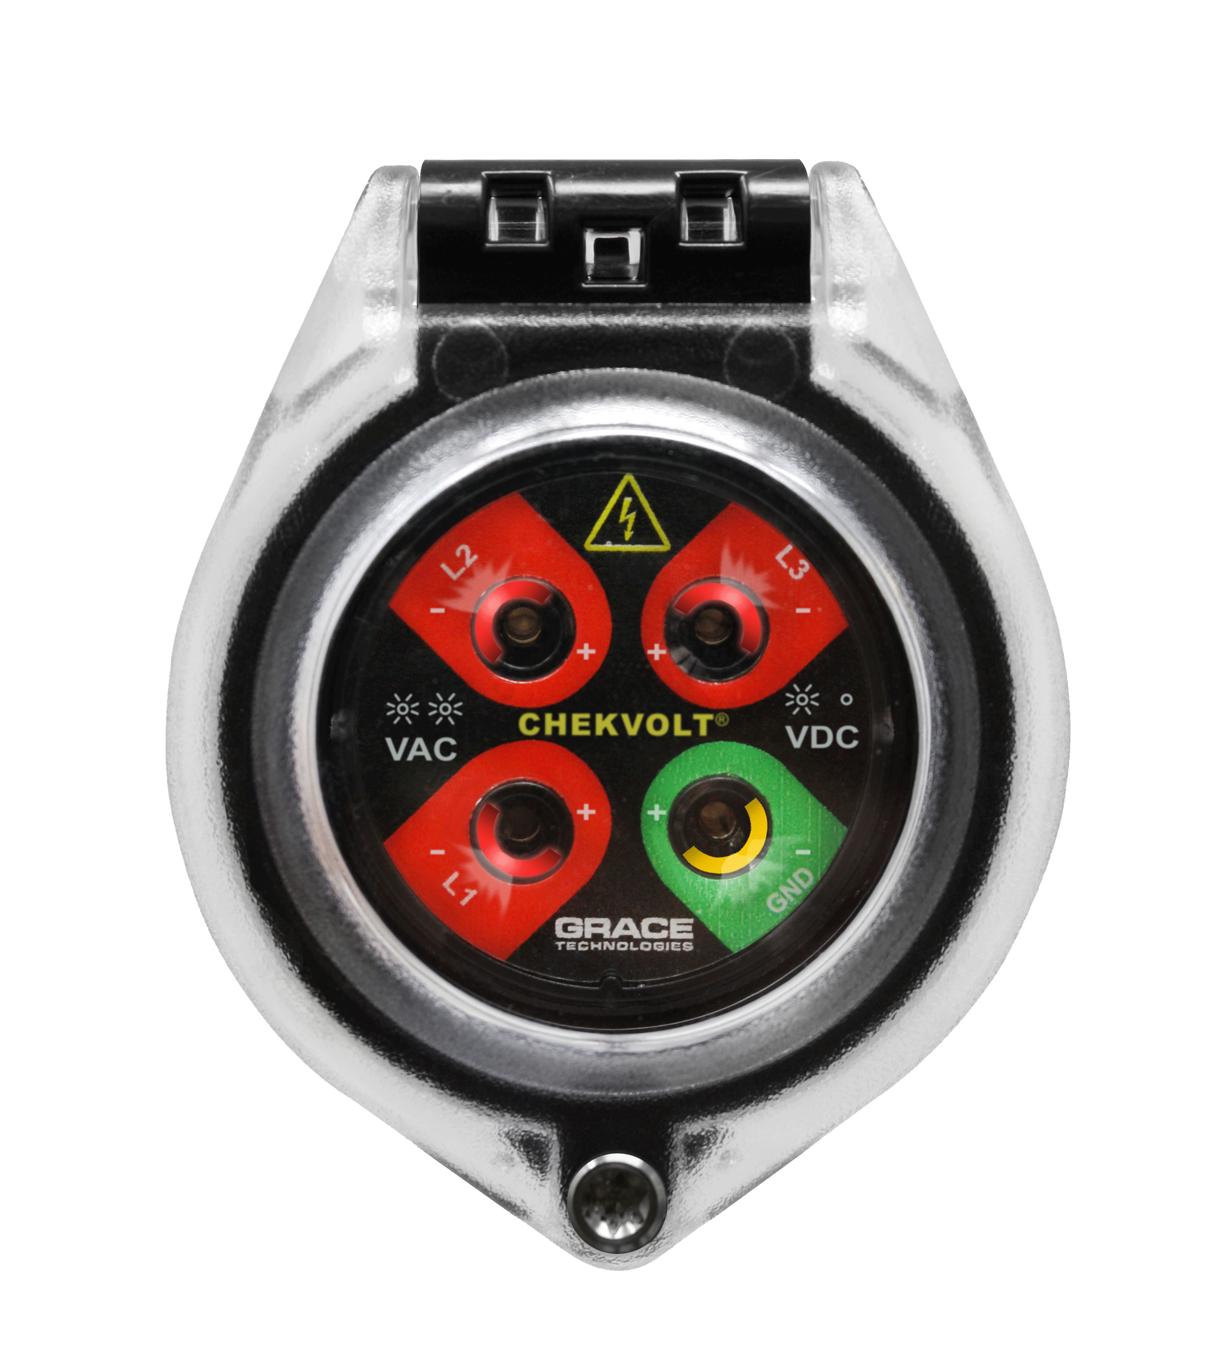
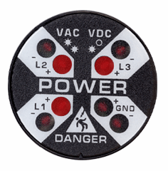
What Are Workers
Saying About Risk?
Elimination
Lack of confidence in the electrical diagrams provided
Lack of confidence in those performing LOTO
Previous experience with mistakes made by themselves or others
Substitution
ChekVolt
Engineering Controls
Voltage Indicator
Awareness
Grace realizes PESDs can’t be in every location, although we wish they could.
Proxxi Band adds an extra layer of protection when the unexpected happens
Administrative
Controls
PPE
Proxxi Band

Slide 9
Synergy of LOTO, PESDs, and Proxxi Band
Enhance LOTO procedures by verifying voltage absence with PESDs and monitoring voltage presence with the Proxxi Band.
Isolate:
LOTO
Enhanced Verification: PESDs
Enhanced Monitoring:
Proxxi Band
Purpose: Physically isolate energy sources to prevent accidental energization.
Purpose: Verify absence of voltage using PESDs at the point of work.
Purpose: Provide real-time alerts if energized equipment is approached or unexpected voltage is detected.
Benefit: Ensures equipment remains de-energized during maintenance and repair
Benefit: Safely verify de-energization without exposure to live parts.
Benefit: Continuous monitoring for unforeseen electrical hazards during work activities.
Integrating these three steps creates a layered safety protocol that enhances worker protection and compliance with OSHA, NFPA 70E, and CSA Z462 safety standards.

Slide 10
Wristband - Use Cases
Recommended Use:
Use the wristband on the default or other environment setting for:
Any environment where the equipment should be de-energized, or is presumed to be electrically safe
When intending to stay outside of the restricted approach boundary of live equipment
Non-Recommended Use:
Mute, power down, put on charge, or do not wear the wristband for:
Live work and Live testing
DC equipment
“Noisy” electrically environments
When not performing work (home, office, breaks, commuting)
Notes:
This was true both when they LOTO themselves and when it was performed by someone else
When they have seen mistakes made, the causes have been:
Network modification (22%)
Human error (22%)
Electrical diagram error (22%)
Identification error (33%)

Slide 11
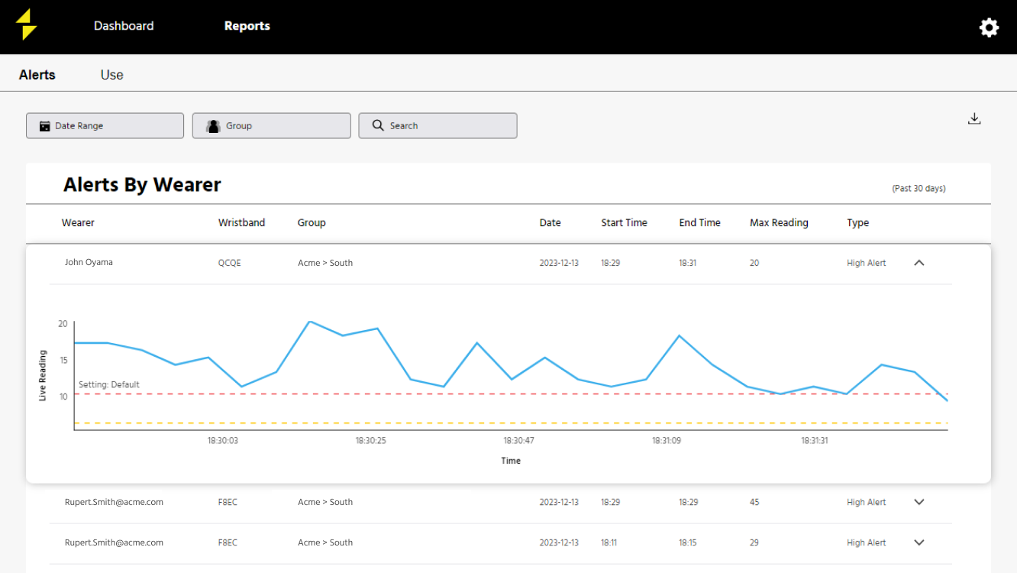


Slide 12
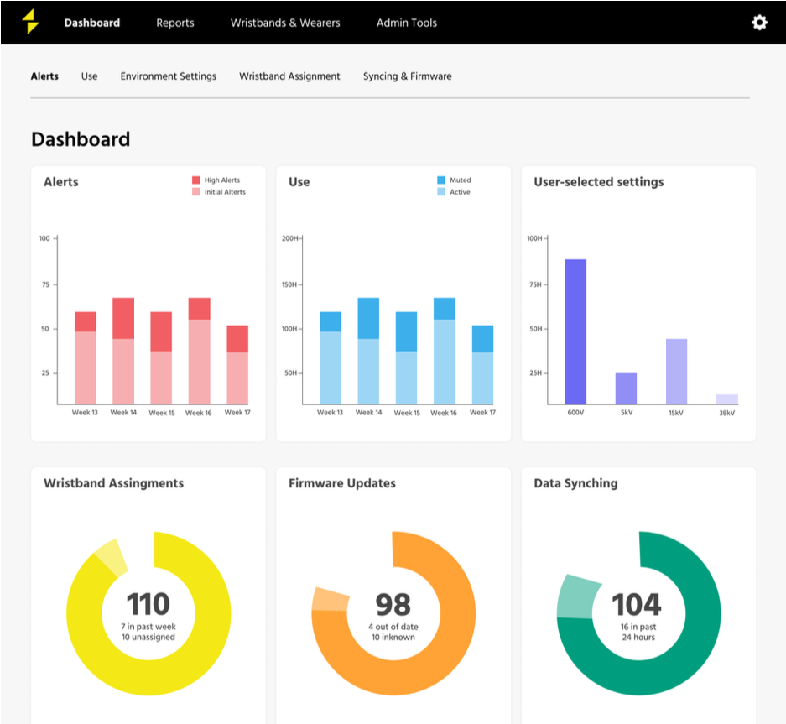

Slide 13
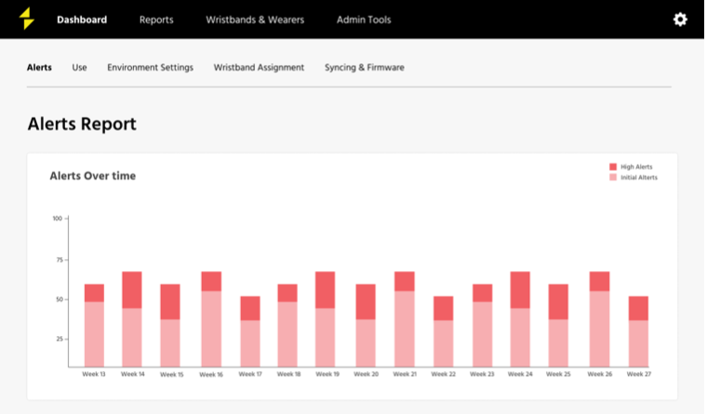

Slide 14
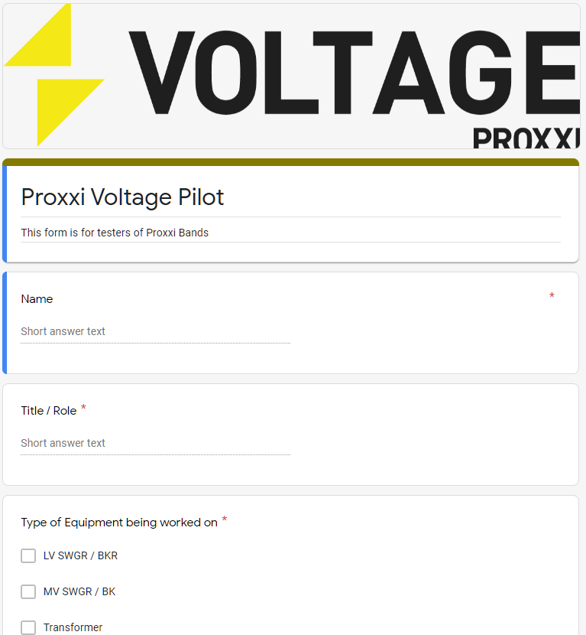
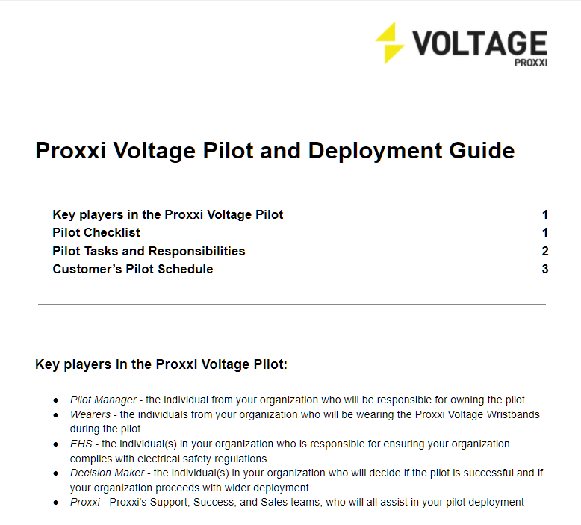
Deployment Process

Slide 15





Trusted By:

Slide 16

Making Maintenance Safer, Smarter, and More Productive
sales@gracetechnologies.com

